Slide 1
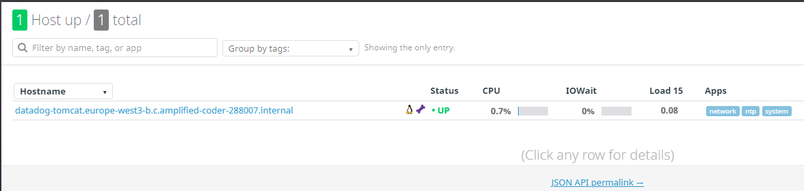
Agent

Slide 2
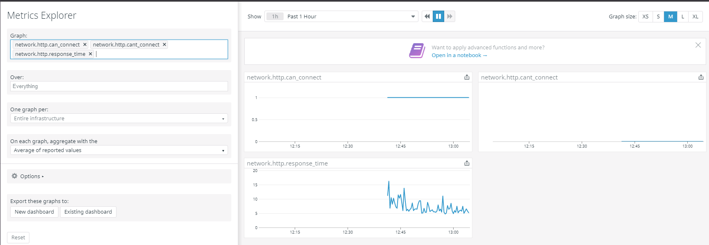
WEB metrics

Slide 3
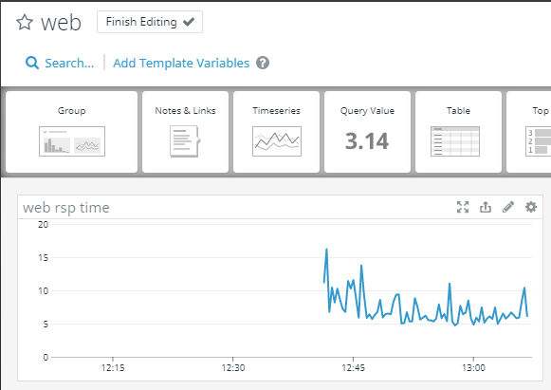
WEB dashboard
Example with response time

Slide 4
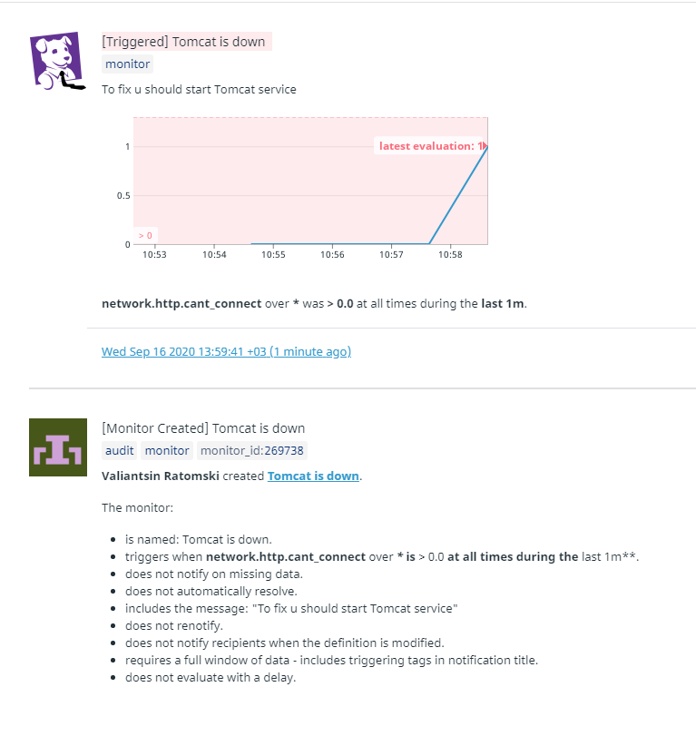
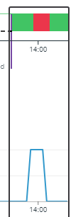


Monitor with alerts
As an example, I set an alert to be triggered if the service was unavailable for a minute (the average value for the previous minute is greater than zero)

Slide 5
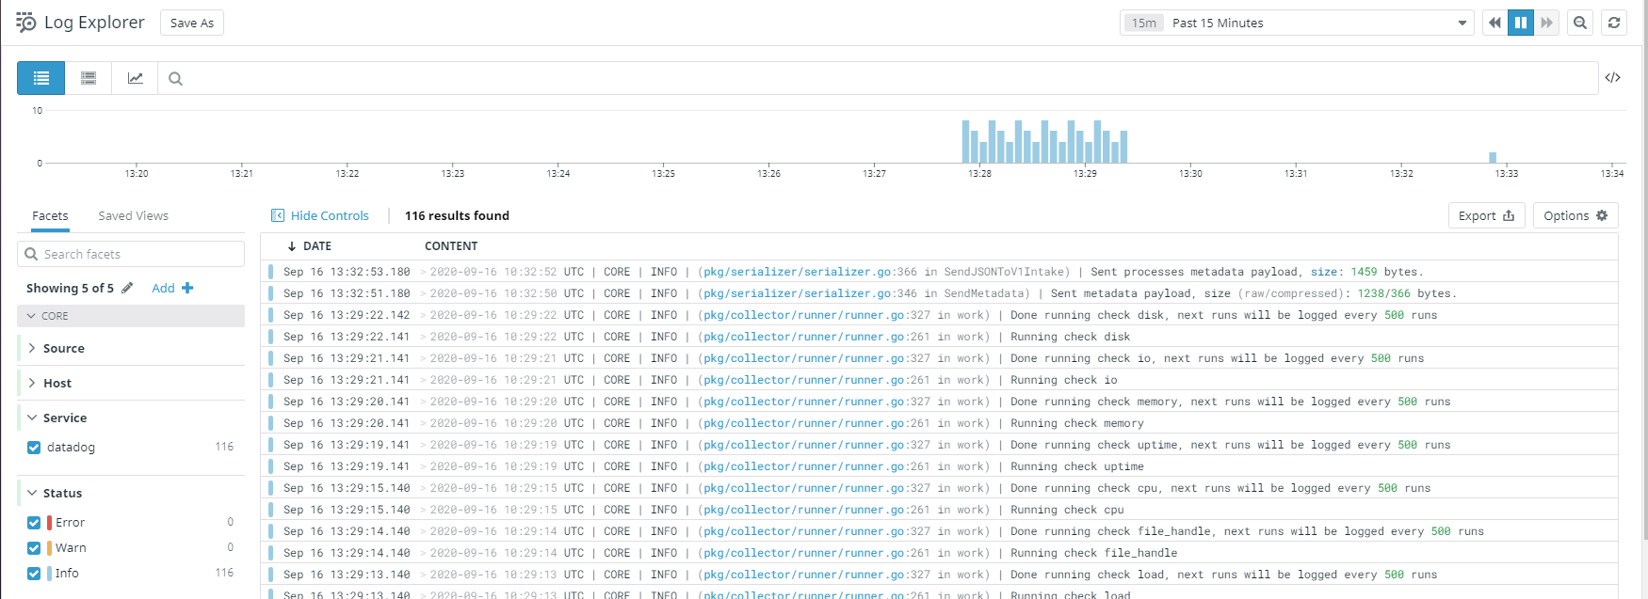
Logs from datadog agent

Slide 6
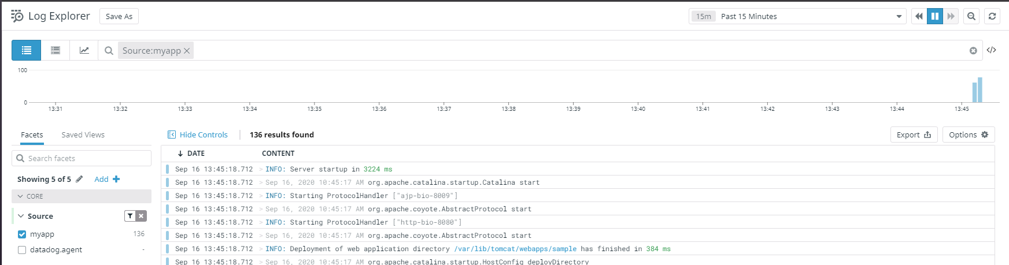
Logs from Tomcat

Slide 7
Monitors (automation)
Monitors was created with terraform. Commands for apply and destroy .tf. Substitute your key values for «x» and «y» (or enter them after terraform apply).
terraform apply -var 'api_key=x' -var 'app_key=y'
terraform destroy -var 'api_key=x' -var 'app_key=y'

