Slide 1
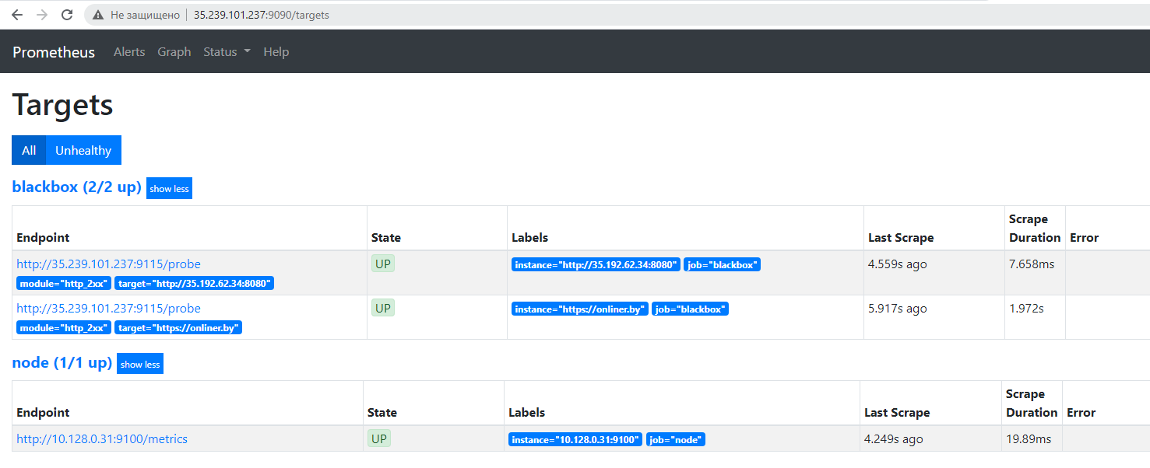
Prometheus with blackbox

Slide 2
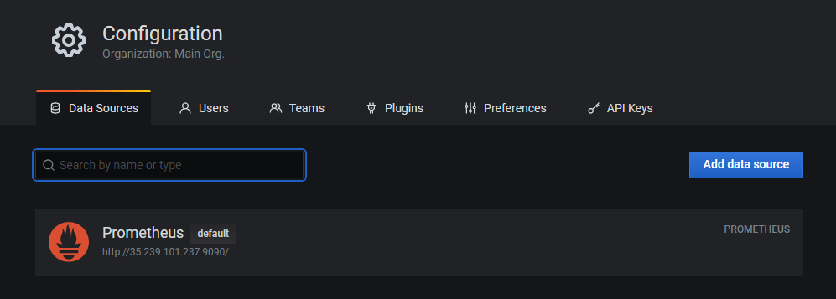
Data source for dashboards

Slide 3

Linux system dashboards

Slide 4
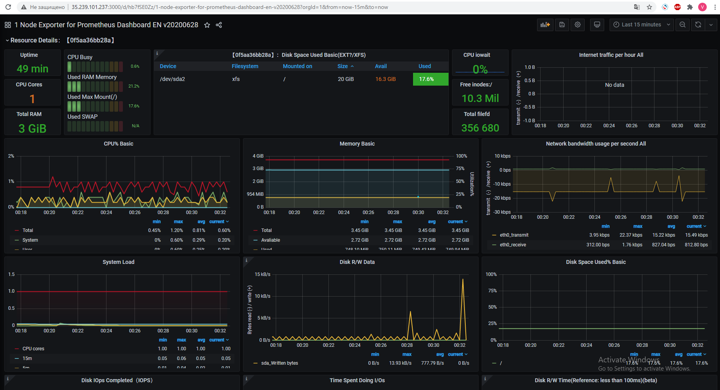

Slide 5
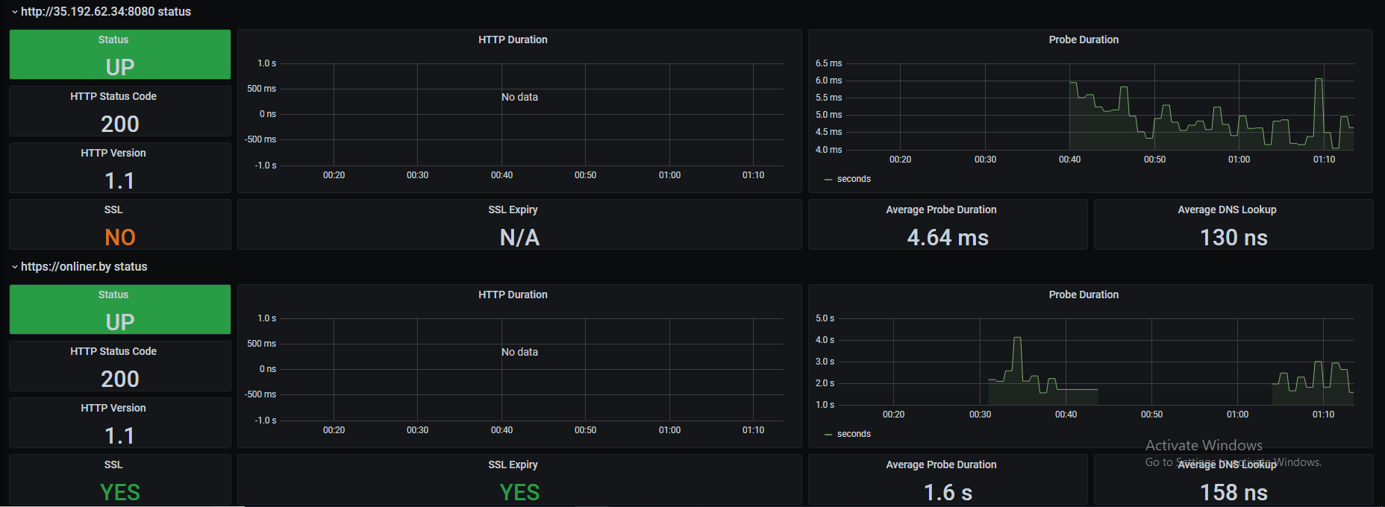
WEB dashboards

