Slide 1
WEB

Slide 2
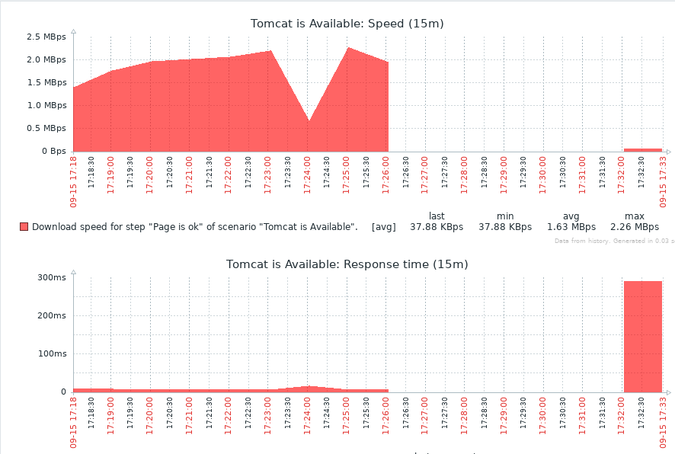
Tomcat was stopped for several minutes

Slide 3
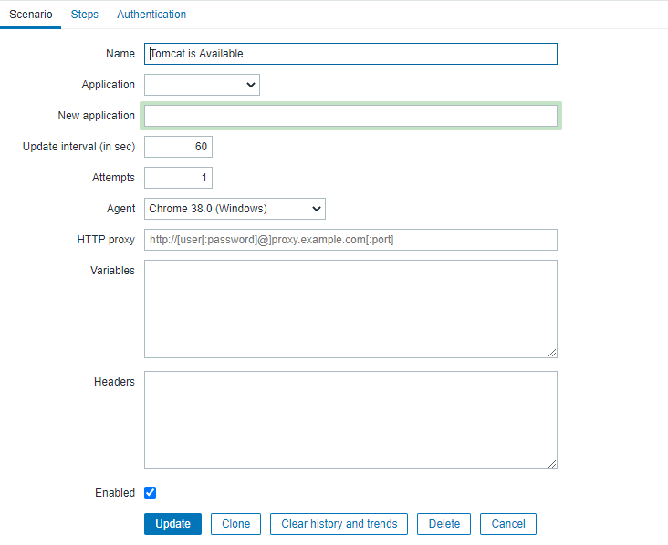
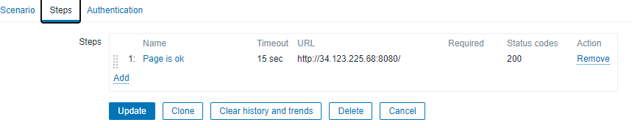
Web scenario with Chrome agent

Slide 4
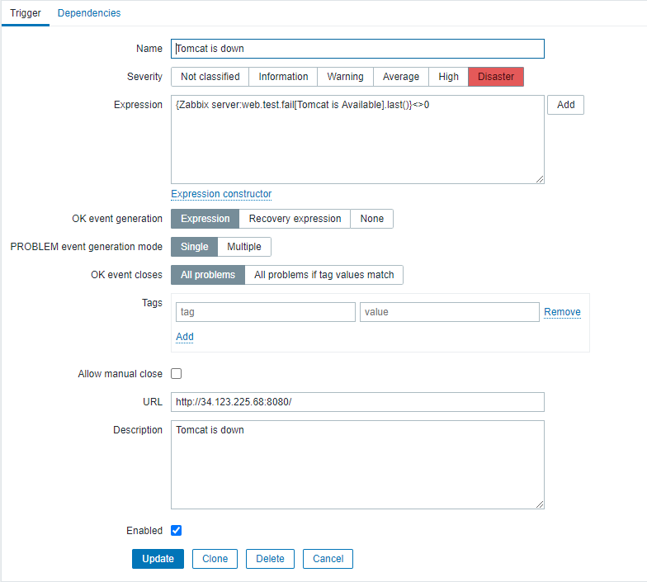
Trigger for web

Slide 5
WEB. Custom scenario

Slide 6
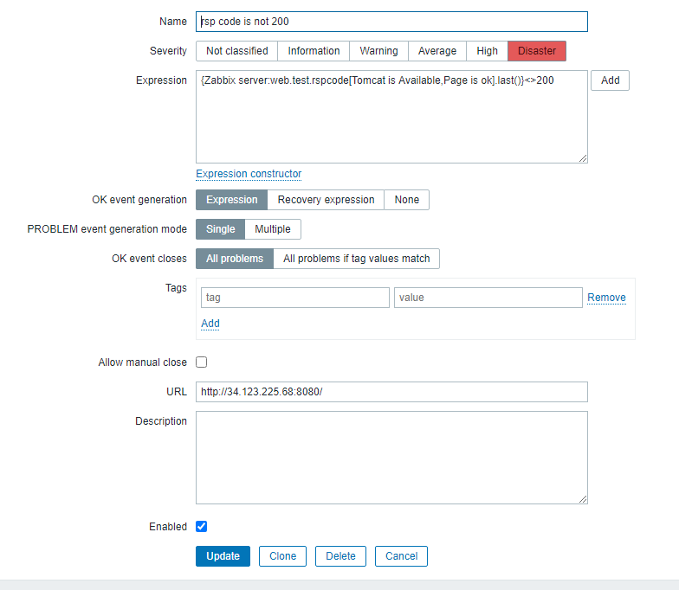
Trigger for response code (!=200)

Slide 7

I caught this message after starting Tomcat:
And the next message under the opposite expression:

Slide 8
Unfortunately I didn't screen the trigger for response time… But expression was like this:
{Zabbix server:web.test.rsptime … .avg(1s)}>0.001ms

Slide 9
LOG

Slide 10
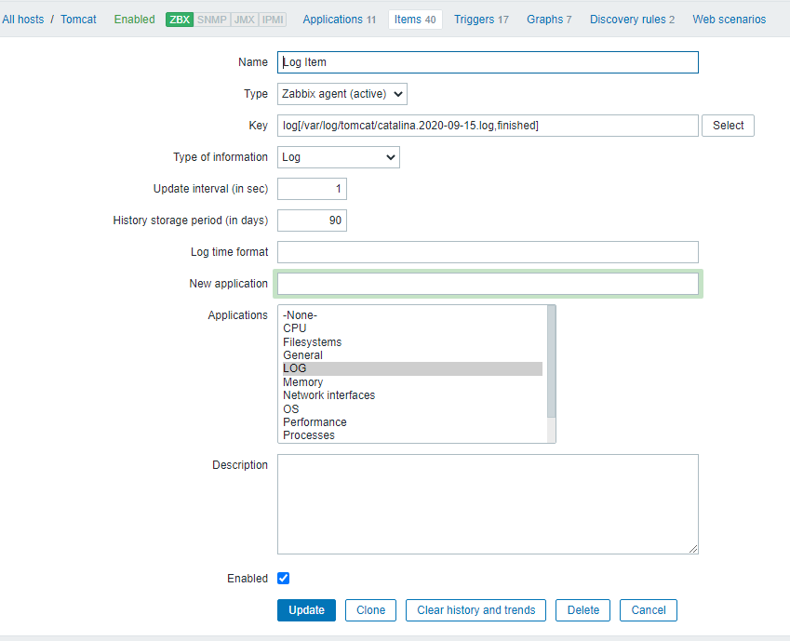
Item for logs

Slide 11
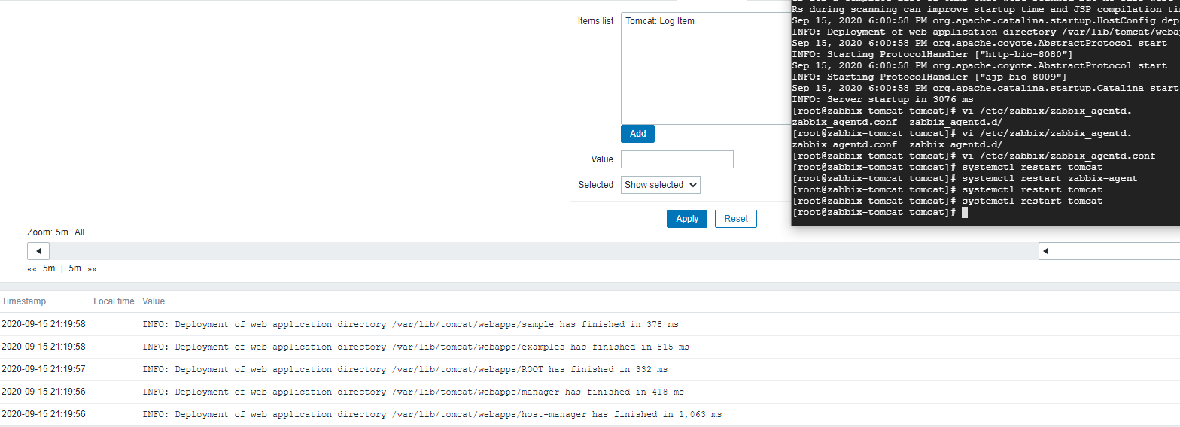

Slide 12
LOG. Custom scenario

Slide 13
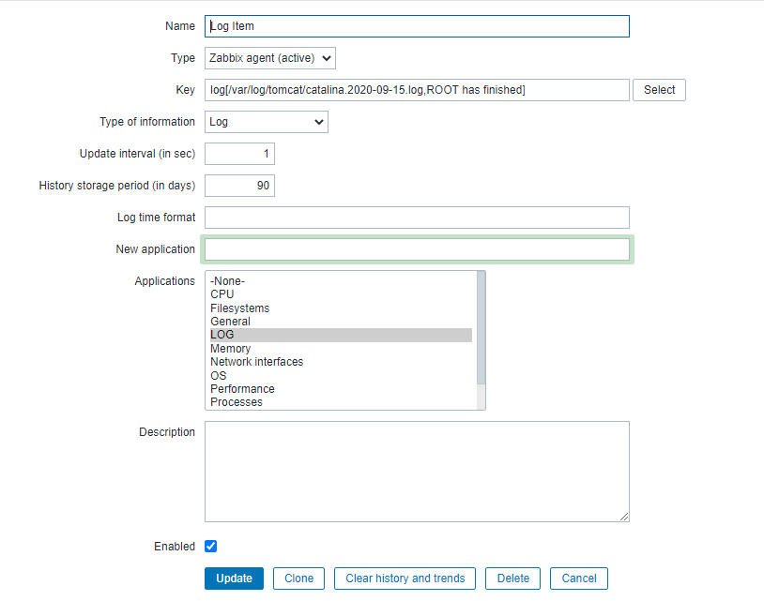

Slide 14
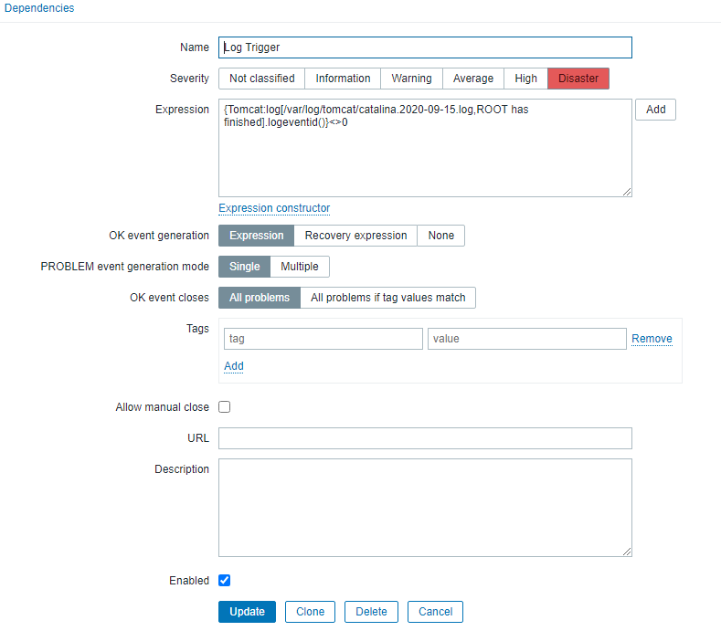

Slide 15
I received a message and a corresponding alert every time I stopped Tomcat

