Slide 1
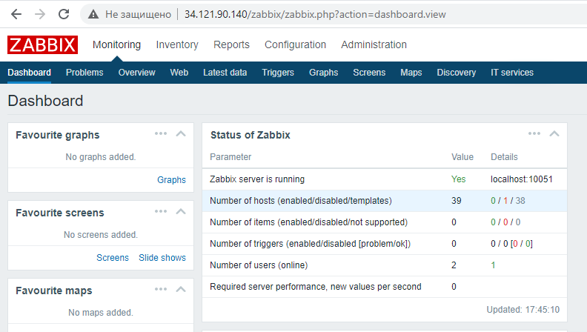

Slide 2

Agent connected

Slide 3
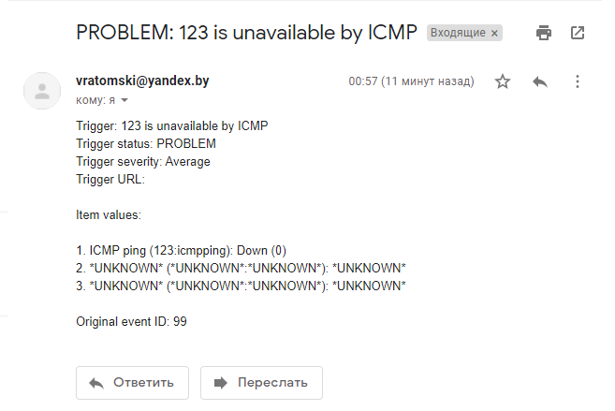
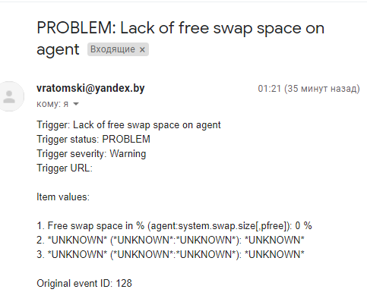
gmail alerts

Slide 4
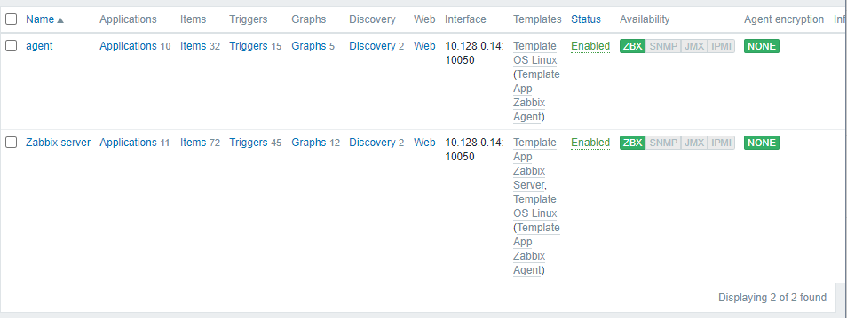
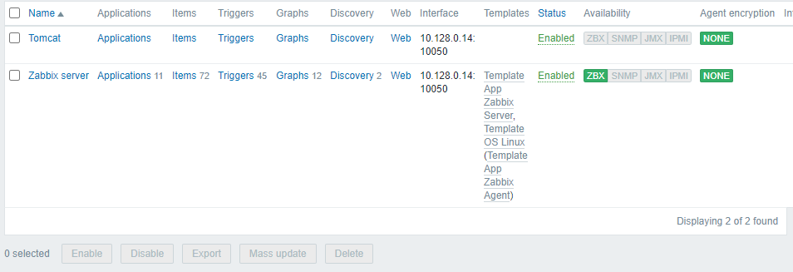
- before
Agent was deleted, and after the restart (with changes in the config) of the agent, a new host appeared.

Slide 5

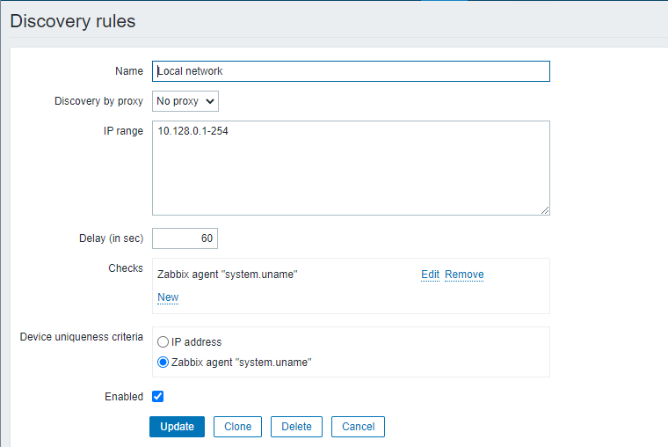
Rules for automated agent registration. Config changes in the script: agent.sh (commented)

