Slide 1
MLOps
Migrate to kubernetes and integrate to kubeflow
(Cloud)

Slide 2
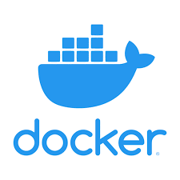
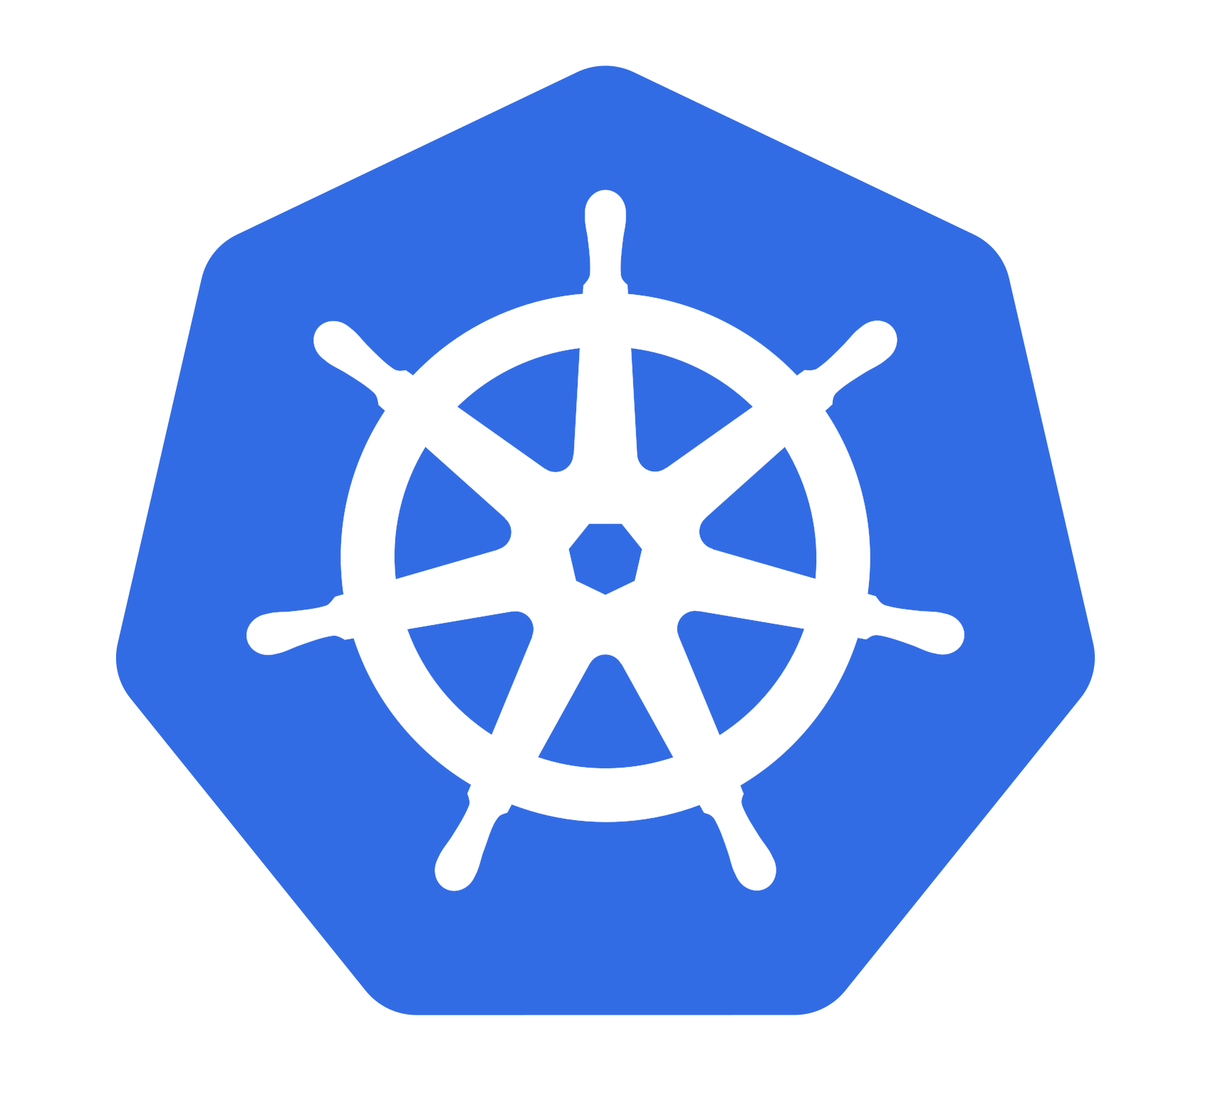


Workflow
Docker images
Kubernetes pod
Kubeflow pipeline
Model deployment

Slide 3
Google Kubernetes Engine (GKE)

Slide 4
Service Required
Google Kubernetes Engine (GKE)
Google Container Registry (GCR)/Artifact Registry
Google Cloud Storage
Google Secret Manager
Google Cloud Logging and Monitoring
Google Cloud IAM

Slide 5
Estimation Cost
Google Kubernetes Engine (GKE)
GKE Control Plane
Biaya: Free untuk zonal cluster (single zone), $0.10 per cluster per jam untuk regional clusters.
Estimasi: Menggunakan zonal cluster (gratis).
Worker Nodes dengan GPU
Contoh Konfigurasi: n1-standard-8 (8 vCPUs, 30 GB RAM) dengan Tesla T4 GPU
Biaya VM: $0.379998 per node per jam
Biaya GPU: $0.35 per GPU per jam
Total per Node: $0.379998 + $0.35 = $0.729998 per node per jam
Total: 3 nodes * $0.729998/hour * 730 hours/month ≈ $1,597.80 per bulan

Slide 6
Estimation Cost
Google Container Registry (GCR)
Biaya: $0.026 per GB per bulan untuk penyimpanan
Estimasi Penggunaan: 10 GB
Total: 10 GB * $0.026/GB ≈ $0.26 per bulan
Google Cloud Storage (GCS)
Tier: Standard
Biaya: $0.020 per GB per bulan untuk penyimpanan
Estimasi Penggunaan: 100 GB
Total: 100 GB * $0.020/GB ≈ $2 per bulan

Slide 7
Estimation Cost
Google Secret Manager
Biaya: $0.06 per secret per version per month + $0.03 per 10,000 API calls
Estimasi Penggunaan: 5 secrets, 100,000 API calls
Total: (5 * $0.06) + ((100,000 / 10,000) * $0.03) ≈ $0.63 per bulan
Google Cloud Logging and Monitoring (Stackdriver)
Log Data Ingestion: $0.50 per GB ingested
Log Data Storage: $0.01 per GB stored per month
Estimasi Penggunaan: 5 GB data ingested, 5 GB data stored
Total: (5 GB * $0.50) + (5 GB * $0.01) ≈ $2.55 per bulan
Google Cloud IAM
Biaya: Gratis

Slide 8
Estimation Cost
Estimasi Total Biaya per Bulan
GKE Control Plane: Gratis (zonal cluster)
GKE Worker Nodes dengan GPU: $1,597.80
Google Container Registry: $0.26
Google Cloud Storage: $2
Google Secret Manager: $0.63
Google Cloud Logging and Monitoring: $2.55
Estimasi Total Biaya:
$1,597.80 (GKE Worker Nodes dengan GPU) + $0.26 (GCR) + $2 (GCS) + $0.63 (Secret Manager) + $2.55 (Logging and Monitoring) ≈ $1,603.24 per bulan

Slide 9
Azure Kubernetes Service (AKS)

Slide 10
Service Required
Azure Kubernetes Service
Azure Container Registry (ACR)
Azure Storage
Azure Key Vault
Azure Monitor
Azure Active Directory (AAD)
Azure Machine Learning (AML)

Slide 11
Estimation Cost
Azure Kubernetes Service (AKS) dengan GPU
Worker Nodes dengan GPU:
Contoh Konfigurasi: VM Standard_NC6 (1 GPU, 6 vCPUs, 56 GB RAM)
Biaya: Sekitar $0.90 per node per jam (harga dapat bervariasi berdasarkan wilayah)
Total: 3 nodes * $0.90/hour * 730 hours/month ≈ $1,971 per bulan
Azure Container Registry (ACR)
Tier: Basic
Biaya: $0.167 per GB per bulan untuk penyimpanan
Estimasi Penggunaan: 10 GB
Total: 10 GB * $0.167/GB ≈ $1.67 per bulan

Slide 12
Estimation Cost
Azure Storage (Blob Storage)
Tier: Standard
Biaya: $0.0184 per GB per bulan untuk penyimpanan
Estimasi Penggunaan: 100 GB
Total: 100 GB * $0.0184/GB ≈ $1.84 per bulan
Azure Key Vault
Tier: Standard
Biaya: $0.03 per 10,000 operasi
Estimasi Operasi: 100,000 operasi per bulan
Total: (100,000 / 10,000) * $0.03 ≈ $0.30 per bulan

Slide 13
Estimation Cost
Azure Monitor
Log Analytics and Monitoring:
Biaya: $2.3 per GB data ingested
Estimasi Penggunaan: 5 GB data ingested per bulan
Total: 5 GB * $2.3/GB ≈ $11.50 per bulan
Azure Active Directory (AAD)
Tier: Free (basic otentikasi dan otorisasi), Premium P1 untuk fitur tambahan

Slide 14
Estimation Cost
Azure Machine Learning
Compute Instances:
Contoh Konfigurasi: Standard_NC6 (1 GPU, 6 vCPUs, 56 GB RAM)
Biaya: $0.90 per instance per jam
Estimasi Penggunaan: 100 jam per bulan
Total: 1 instance * $0.90/hour * 100 hours ≈ $90 per bulan
Storage:
Tier: Standard
Biaya: $0.0184 per GB per bulan
Estimasi Penggunaan: 50 GB
Total: 50 GB * $0.0184/GB ≈ $0.92 per bulan

Slide 15
Estimation Cost
Estimasi Total Biaya per Bulan
AKS Worker Nodes dengan GPU: $1,971
Azure Container Registry: $1.67
Azure Storage: $1.84
Azure Key Vault: $0.30
Azure Monitor: $13.80
Azure Active Directory (AAD): $30
Azure Machine Learning (Compute Instances + Storage): $90.92
Estimasi Total Biaya:
$1,971 (AKS dengan GPU) + $1.67 (ACR) + $1.84 (Storage) + $0.30 (Key Vault) + $11.50 (Monitor) + $90.92 (AML) ≈ $2,077.23 per bulan

Slide 16
Amazon Elastic Kubernetes Service (EKS)

Slide 17
Service Required
Amazon Elastic Kubernetes Service (EKS)
Amazon EC2
Amazon Elastic Container Registry (ECR)
Amazon S3
Amazon CloudWatch
Identify and Access Management (IAM)

Slide 18
Estimation Cost
Amazon Elastic Kubernetes Service (EKS)
EKS Control Plane
Biaya: $0.10 per jam
Total: 730 hours/month * $0.10 ≈ $73 per bulan
Worker Nodes dengan GPU
Contoh Konfigurasi: P3.2xlarge (1 GPU, 8 vCPUs, 61 GB RAM)
Biaya: Sekitar $3.06 per node per jam
Total: 3 nodes * $3.06/hour * 730 hours/month ≈ $6,699.60 per bulan
Amazon Elastic Container Registry (ECR) *beyond free tier limits
Biaya: $0.10 per GB per bulan untuk penyimpanan
Estimasi Penggunaan: 10 GB
Total: 10 GB * $0.10/GB ≈ $1 per bulan

Slide 19
Estimation Cost
Amazon S3 (Storage)
Tier: Standard
Biaya: $0.023 per GB per bulan untuk penyimpanan
Estimasi Penggunaan: 100 GB
Total: 100 GB * $0.023/GB ≈ $2.30 per bulan
AWS Secrets Manager
Biaya: $0.40 per secret per month + $0.05 per 10,000 API calls
Estimasi Penggunaan: 5 secrets, 100,000 API calls
Total: (5 * $0.40) + ((100,000 / 10,000) * $0.05) ≈ $2.25 per bulan

Slide 20
Estimation Cost
Amazon CloudWatch
Log Data Ingestion: $0.50 per GB data ingested
Log Data Storage: $0.03 per GB stored per month
Estimasi Penggunaan: 5 GB data ingested, 5 GB data stored
Total: (5 GB * $0.50) + (5 GB * $0.03) ≈ $2.65 per bulan
AWS Identity and Access Management (IAM)
Biaya: Free

Slide 21
Estimation Cost
Estimasi Total Biaya per Bulan
EKS Control Plane: $73
EKS Worker Nodes dengan GPU: $6,699.60
Amazon ECR: $1
Amazon S3: $2.30
AWS Secrets Manager: $2.25
Amazon CloudWatch: $2.65
Estimasi Total Biaya:
$73 (EKS Control Plane) + $6,699.60 (Worker Nodes dengan GPU) + $1 (ECR) + $2.30 (S3) + $2.25 (Secrets Manager) + $2.65 (CloudWatch) + $131 (SageMaker) ≈ $6,780.80 per bulan

