Slide 1

Validicity System
Secure chain of custody using block chain technology

Slide 2
Properties
Sample handling using NFC scanning of RFID tag
Fully immutable Sample data trail in block chains
Independently provable data correctness with timestamps
Easy to deploy, manage and integrate with other systems
Easy for external parties to query and verify data trails

Slide 3


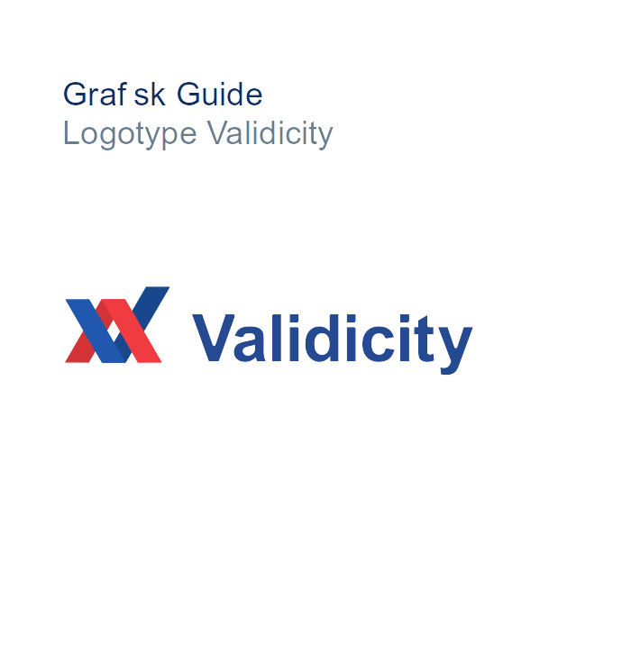








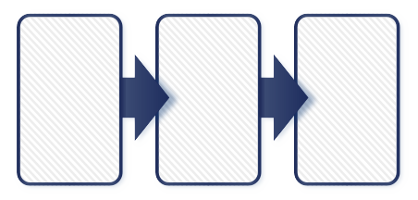


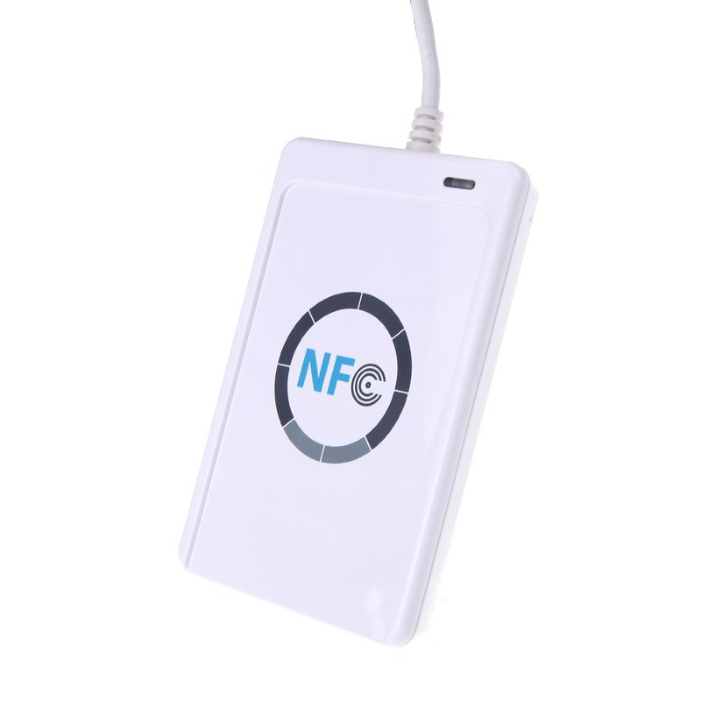

Architecture
Anchor data
in Bitcoin
External
party
Query system for verification
Validicity App
A
Scan event 1
Query system for verification
Scan event 2
Scan event 3
A₁
A₂
A₃
External
party
One block chain per Sample
Each block
signed by creator
Validicity
Scan Box

Slide 4


Validicity System Components
Validicity Server
Validicity Tool
Validicity Client
Validicity Scan Box
Validicity App
Validicity Chainlink
Validicity Query

Slide 5
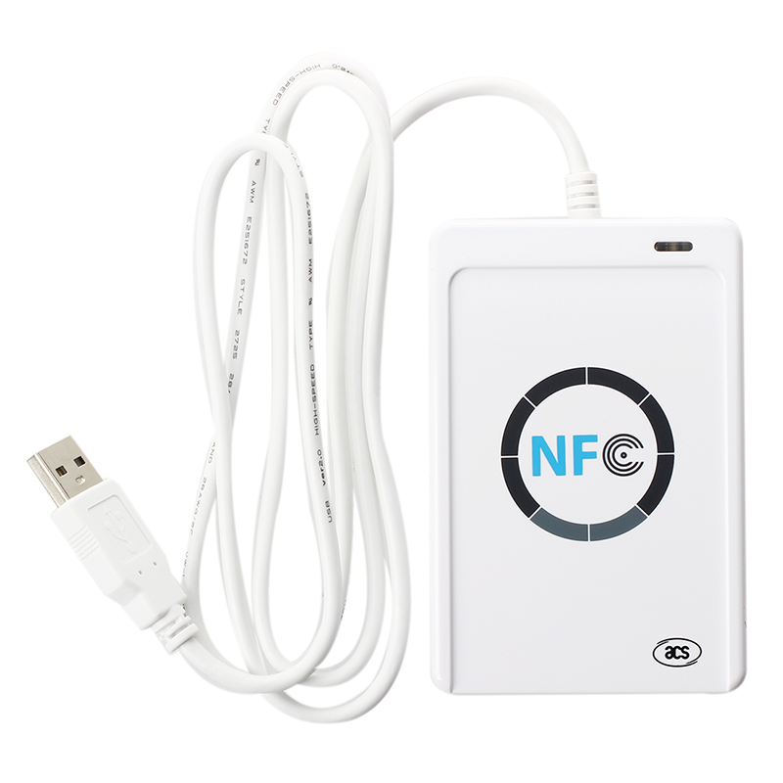
Creating the Sample trail
Samples are scanned using NFC with the Validicity App or Scan Box
The scan event creates a new Sample block of data
Each Sample has its own block chain representing the custody log
The Validicity Server stores the block chain for the Sample

Slide 6
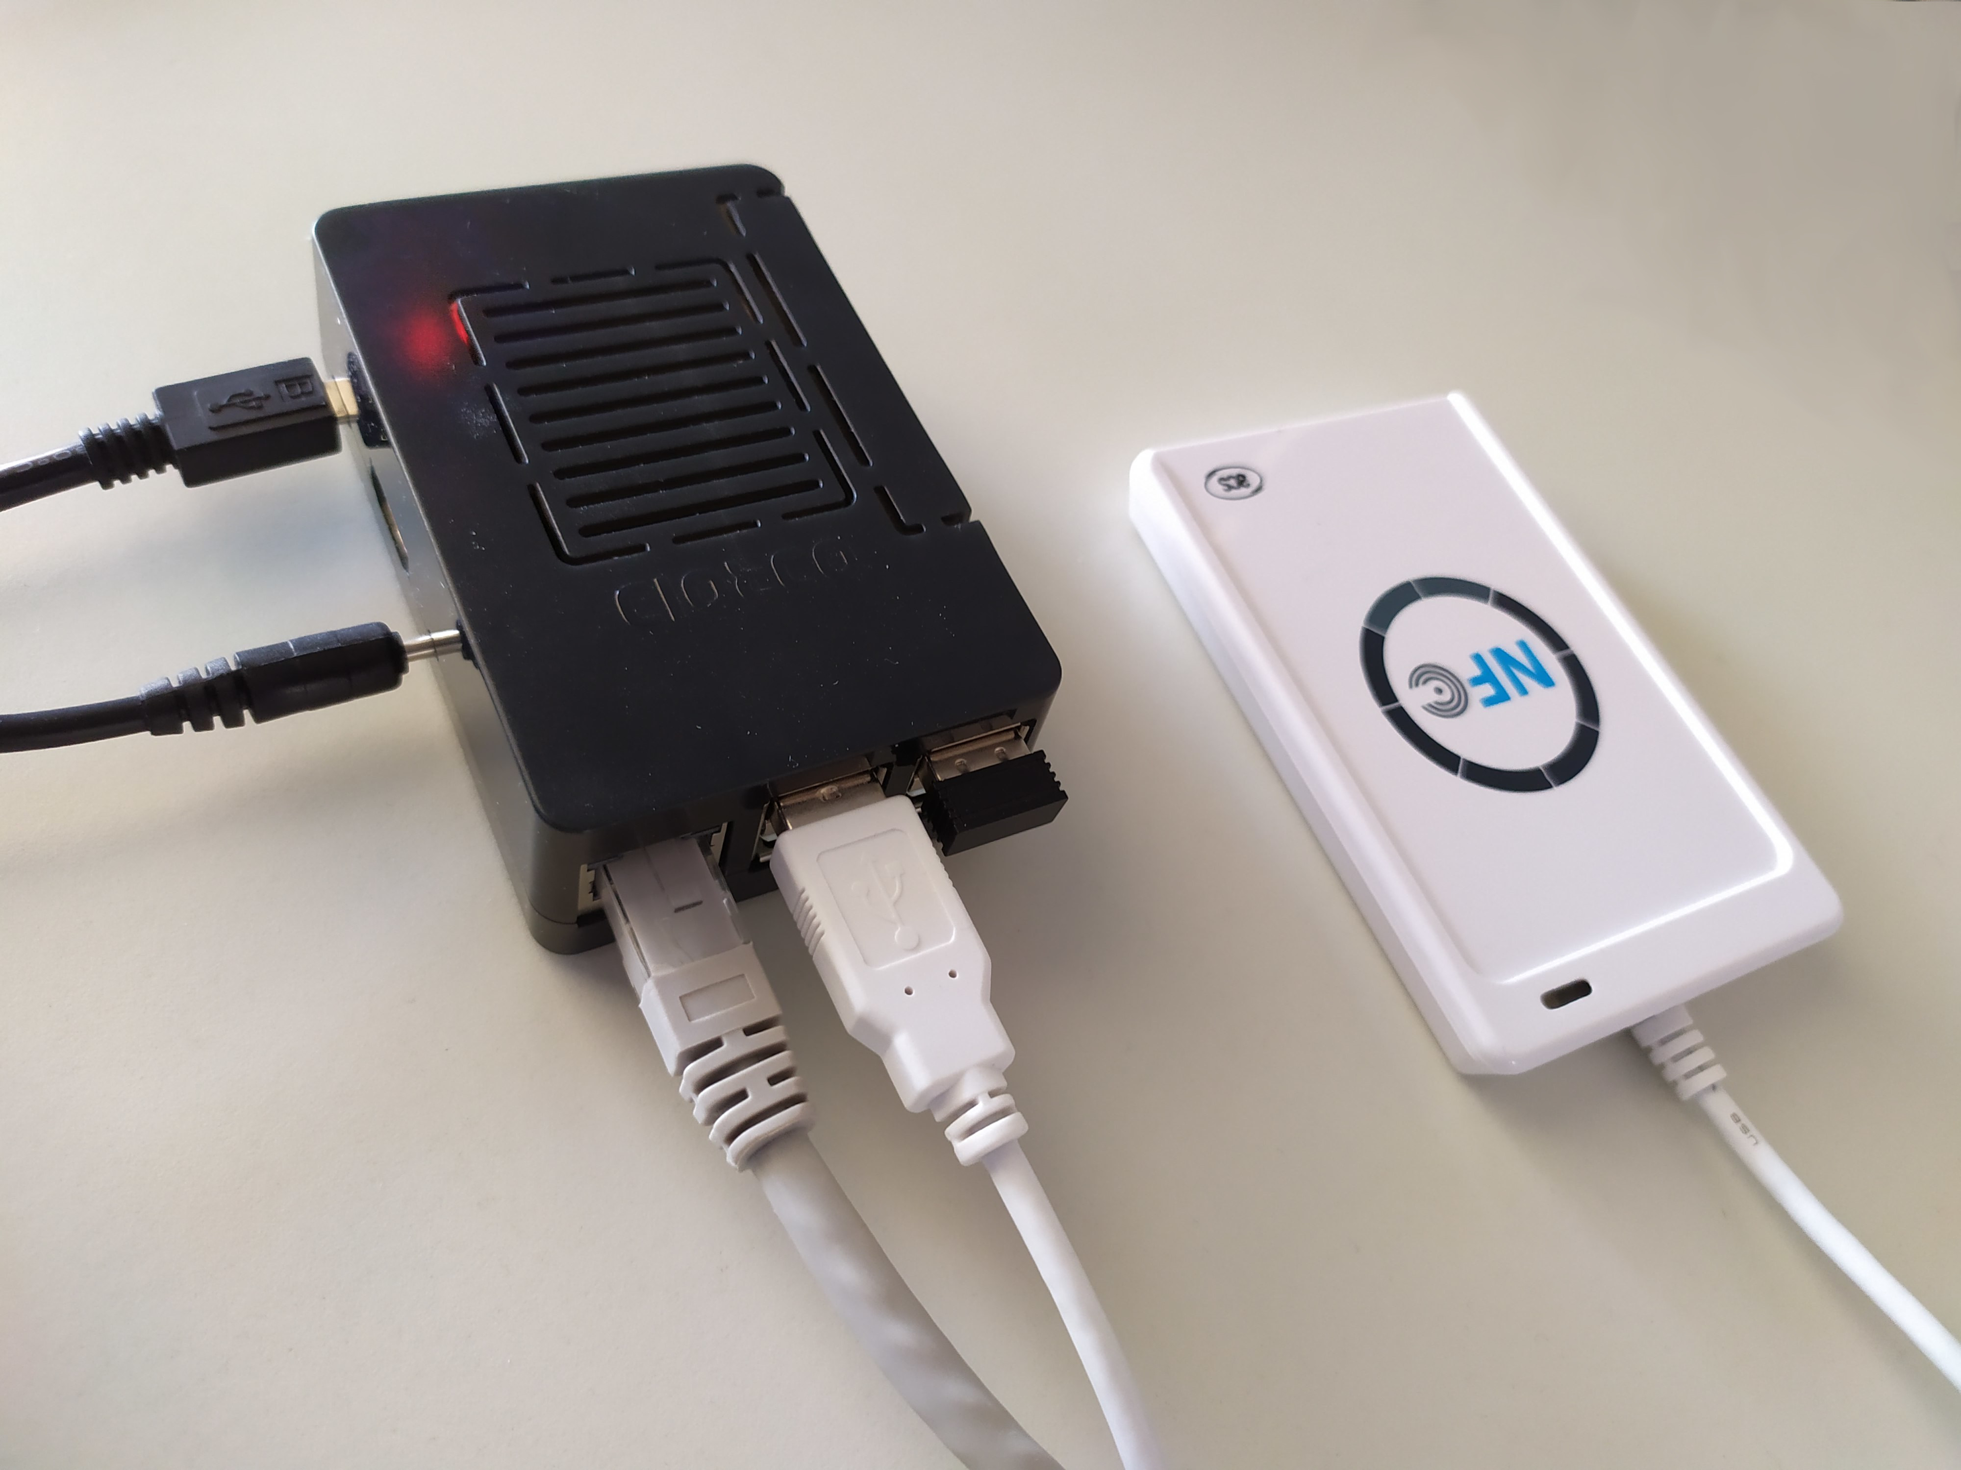
Validicity Scan Box
The scan box is an ODROID C2 embedded Linux device with an attached ACR122U NFC reader
The scan box emulates a keyboard and is attached using a USB cable to a lab computer
USB to lab computer
Power cable
NFC reader USB
Ethernet

Slide 7
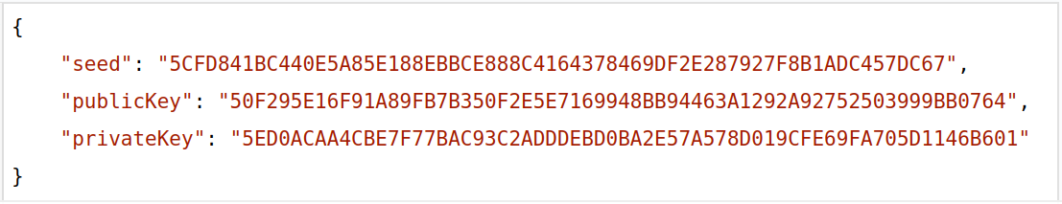
Validicity Client
The client software for the Scan Box is written in Dart
The service scans continuously for RFID tags
When a new Client is added to a system we need to:
  On server: Create an account in with OAuth2 credentials
  On box: Enter credentials in the validicity.yaml config file
  On box: Create keys using the createkeys command
  On box: Register public key in server using the register command

Slide 8
Scanning a Sample
When the scan box scans an RFID tag it has not scanned in the last 5 seconds it performs the following in a fraction of a second:
  Queries the Validicity Server API for the last block for this ID
  Creates a new block including hash of the last block
  Computes a hash of all pertinent fields in the block
  Creates a signature for this hash using the private key
  Submits this new block to the Validicity Server API
  If all goes well, “types” the ID on the lab computer

Slide 9
Anchoring the Sample trail
The blocks of data constitutes an immutable chain
  … but could still be artificially constructed “in retrospect”!
This is why the data is also, at regular intervals, “anchored” to a publically secured block chain – the Bitcoin network
Anchoring is performed using Chainpoint, an open standard
An anchor creates a “timestamp proof” of data

Slide 10
External Party Verification
An external party can verify correctness using the Validicity API
This is done using an Open Source query tool that can easily be installed and used by any party given access to the API
The fact that the source code of the query tool is Open Source guarantees that it does indeed work as claimed

Slide 11
Technology
Server runs on Linux easily deployable in any server or cloud
System is written in Dart and uses industry standard PostgreSQL
The API is a standard REST/JSON API with OAuth2 authentication
Scan Box runs embedded Linux with software in Dart

Slide 12

Block chain technology
All cryptographical code and algorithms in Validicity is the same as used by the Nano crypto currency
Nano has to date 50 million blocks in its public ledger and zero incidents while being in operation in 5 years
Nano is the fastest crypto currency to date
Using the same algorithms and code is a deliberate choice to ensure safety and reliability

Slide 13
Links
https://nano.org
https://chainpoint.org
https://www.postgresql.org
https://dart.dev

