Slide 1
Introduction to J2EE and EJBs
Harpreet Singh
Harpreet.singh@johnabbott.qc.ca

Slide 2
Java 2 Enterprise Edition
The Java™ 2 Platform, Enterprise Edition (J2EE) provides a standard for developing multitier, enterprise applications.
J2EE platform consists of J2EE components, services, Application Programming Interfaces (APIs) and protocols that provide the functionality for developing multi-tiered and distributed Web based applications.

Slide 3
J2EE: 3-tier architecture
Client tier: In the client tier, Web components, such as Servlets and Java Server Pages (JSPs), or standalone Java applications provide a dynamic interface to the middle tier.
Middle tier: In the server tier, or middle tier, enterprise beans and Web Services encapsulate reusable, distributable business logic for the application. These server-tier components are contained on a J2EE Application Server, which provides the platform for these components to perform actions and store data.
Enterprise data tier: In the data tier, the enterprise's data is stored and persisted, typically in a relational database.

Slide 4
J2EE: 3-tier architecture

Slide 5
Type of files
JAR:
is java archive file.
It contain all class file, image, sound and other files which will needed in whole application.
Computer users can create or extract JAR files using the jar command that comes with the JDK. They can also use zip tools.
The JAR file format enables you to bundle multiple files into a single archive file with .jar extension was designed mainly to facilitate the packaging of java applets or applications into a single archive.
Similar class files are packaged together

Slide 6
Type of files
WAR:
Web Archive (WAR) file is a Java archive file used to store jsp, servlets, classes, meta data information, libraries etc.
WAR files are used to package Web modules. A WAR file is for a Web application deployed to a servlet/jsp engine.
Loaded into web container
EAR:
An Enterprise Archive file represents a J2EE application that can be deployed in an application server.
EAR files are standard Java archive files and have the file extension .ear. EAR file contain EJBs, web or application client module. EAR file is complete j2ee application file that contain all(jar +war)

Slide 7
POJOs
Plain Old Java Objects
POJOs basically defines an entity.
It is not a JavaBean or EntityBean

Slide 8
Example
// Employee POJO class for entity Employee public class Employee { String name; //field //arg-constructor to initialize fields public Employee(String name) { this.name = name; } //Getter for name public String getName() { return name; } }

Slide 9
Example
//POJO class for entity Employee public class Employee { //fields String name; public String id; private double salary; //arg-constructor to initialize fields public Employee(String name, String id, double salary) { this.name = name; this.id = id; this.salary = salary; }
//getter method for name public String getName() { return name; } //getter method for id public String getId() { return id; } //getter method for salary public Double getSalary() { return salary; } }

Slide 10
JavaBeans
What is a Bean?
“A Java Bean is a reusable software component that can be
manipulated visually in a builder tool.”
Beans are special type of POJOs with some conventions
They should implement java.io.Serializable interface
Fields should be private
Fields should have getters or setters or both.
No argument public constructor should be included
All JavaBeans are POJOs but not all POJOs are JavaBeans.

Slide 11
Example
//JavaBean Employee public class Employee implements java.io.Serializable { //fields private String name; private String id; private double salary; //public no-arg constructor public Employee() { } //doesn’t matter public Employee(String id, double salary) { this.id = id; this.salary = salary; }
//getter method for name public String getName() { return name; } //setter method for name public void setName(String name) { this.name=name; } //getter method for id public String getId() { return id; } //getter method for salary public Double getSalary() { return salary; } }

Slide 12
Enterprise JavaBeans
Enterprise JavaBeans (EJB) is one of several Java APIs for modular construction of enterprise software.
EJB is used to develop scalable, robust and secured enterprise applications in java.

Slide 13
Enterprise JavaBeans
Unlike RMI(Remote Method Invocation), middleware services such as security, transaction management etc. are provided by EJB Container to all EJB applications.
The current version of EJB is EJB 3.2. The development of EJB 3 is faster than EJB 2 because of simplicity and annotations

Slide 14
JavaBeans vs EJBs
General purpose use
There are no types
It can be inherited
Local use
Can be visible/invisible to the user
Easy to develop
Enterprise purpose use
It has types like session, entity..
No inheritance facility
Server side use
Always invisible
Hard to develop

Slide 15
When to use EJBs
Application needs Remote Access. In other words, it is distributed.
Application needs to be scalable. EJB applications supports load balancing, clustering and fail-over.
Application needs encapsulated business logic. EJB application is separated from presentation and persistent layer.

Slide 16
Why EJBs
EJB lets you focus on the business logic for your business, and leave the underlying services (transactions, networking, security, etc.) to the EJB server vendor.
EJB let’s you customize and configure reusable components at deploy-time, without touching the source code!

Slide 17
Why EJBs
Component-based development
For example: you might create a Customer bean (bean is another word for component) that represents a customer in a database. You can use that Customer bean in an accounting program, an e-commerce shopping cart system, a tech support application, or virtually any other application that might need to represent a customer.

Slide 18
Why EJBs
EJB servers give you a bunch of services, so that you don’t have to write them yourself:
Transaction management and Security
Concurrency
Networking
Resource management
Persistence
Messaging
Deploy-time customization

Slide 19
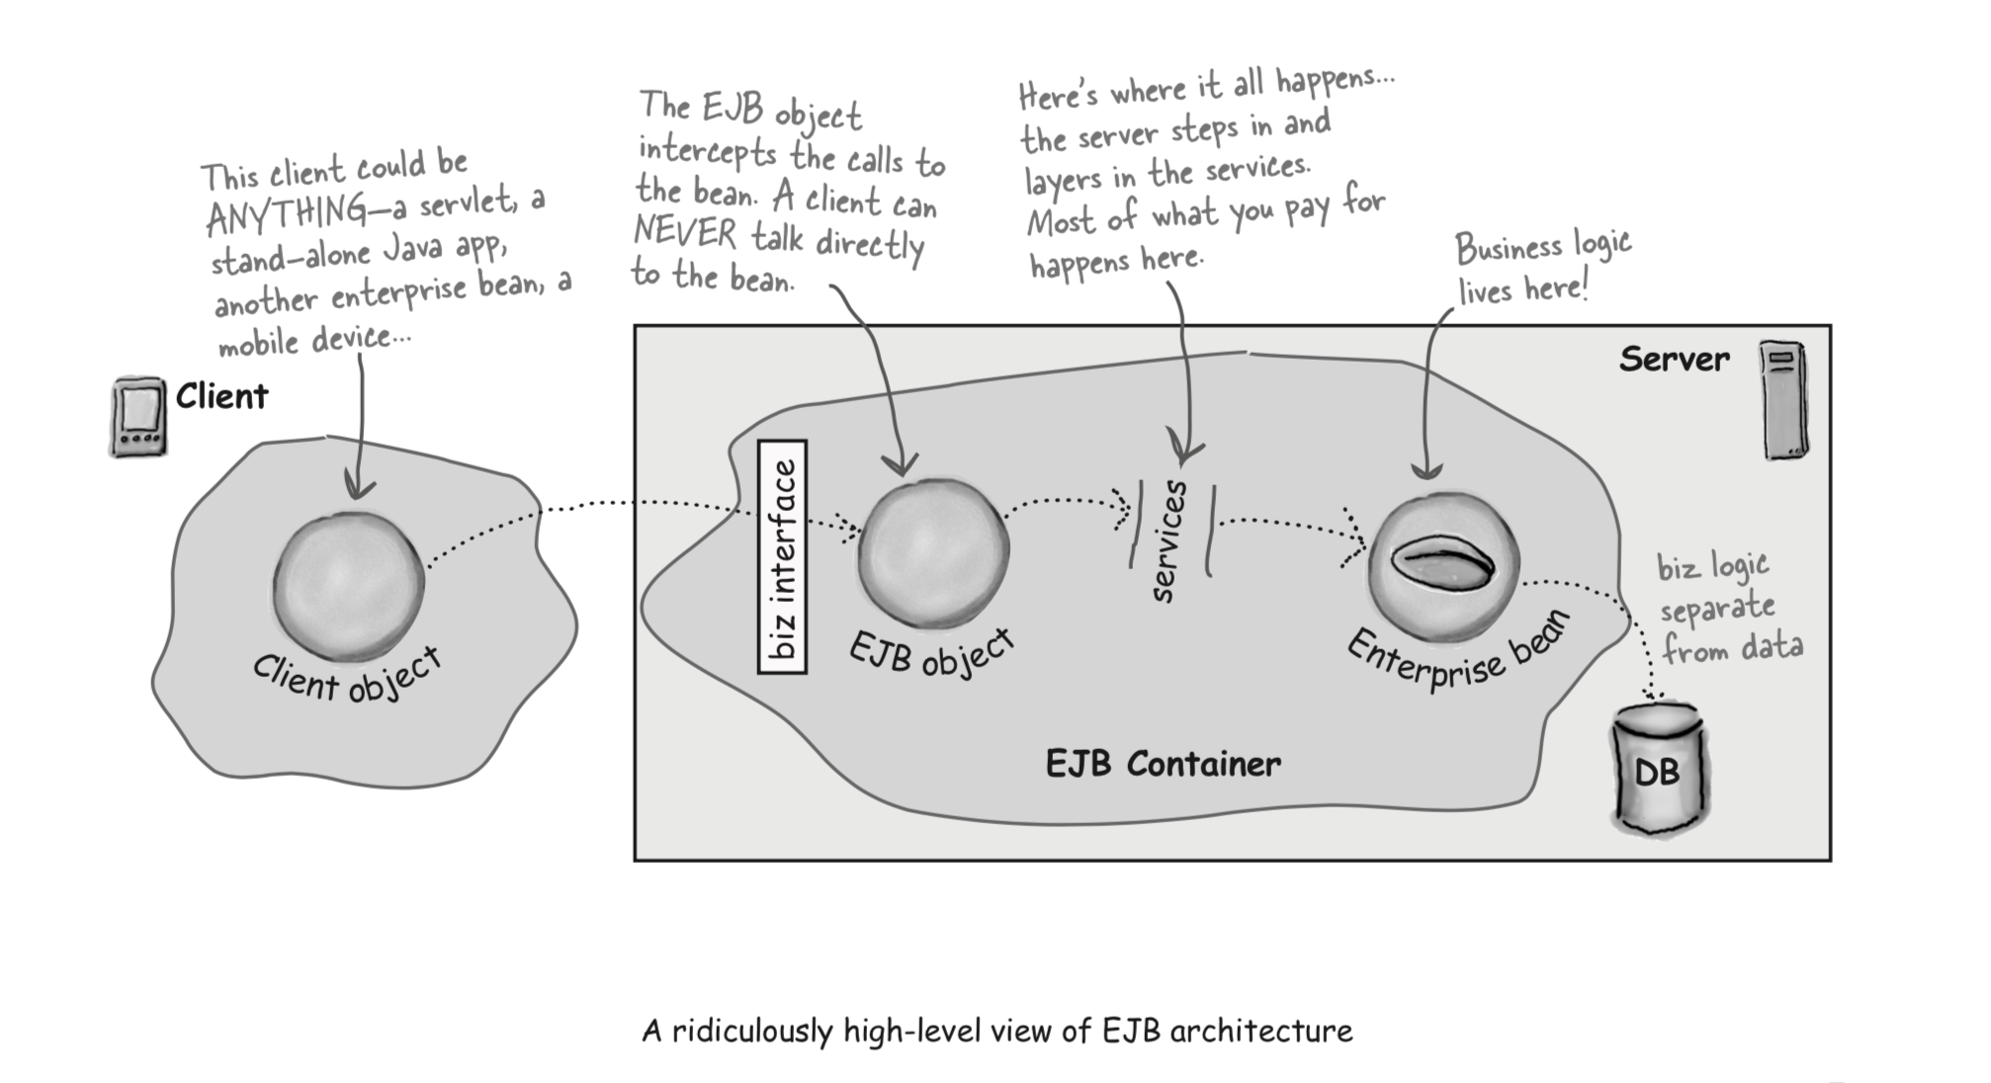
How does it all work?

Slide 20
Types of EJBs
There are 3 types of enterprise bean in java.
Entity Bean: It encapsulates the state that can be persisted in the database. It is deprecated. Now, it is replaced with JPA (Java Persistent API).
Session Bean: Session bean contains business logic that can be invoked by local or remote client.
Message Driven Bean: like Session Bean, it contains the business logic but it is invoked by passing message.

Slide 21
Entity Beans
Represent real world entities (customers, orders, etc.)
The container loads and stores the entity beans in the database
Persistent Objects typically stored in a relational database

Slide 22
Session Beans
When you think for noun it is EntityBean but verb is SessionBean
For example: CardVerifierBean, CartBean
An entity bean represents a thing, a session bean typically represents a process.
Are an extension of the client application
Manage processes or tasks
Are not persistent
Implement business logic

Slide 23
Session Beans
Session Beans come in two types
Stateless session beans: a stateless bean won’t remember anything about the client between method invocations.
no memory between calls
example: Calculator
Stateful session beans: A stateful bean can remember conversational state between method calls
addToCart(item);

Slide 24
Message-Driven Beans
Work in cooperation with Java Messaging System (JMS)
JMS is an abstraction API on top of Message-Oriented Middleware (MOM) – like JDBC is an abstraction API on top of SQL databases
Each MOM vendor implements things differently
is a stateless bean and is used to do task asynchronously.

Slide 25
Servlets Example
Download Eclipse
Download Apache Tomcat and verify
Download servlet-api.jar file
Create Dynamic-Web Project with name ServletEx
In project build path add jar file

Slide 26
Servlets Example
Right click on ServletEx and Create Class “HelloWorld.java”
Create method doGet as
public void doGet(HttpServletRequest request, HttpServletResponse response)
throws Exception {
// Set response content type
response.setContentType("text/html");
// Actual logic goes here.
PrintWriter out = response.getWriter();
out.println("<h1>Hello World</h1>");
}

Slide 27
Servlets Example
Create web.xml file under folder WebContent/WEB-INF and Copy paste this
<?xml version="1.0" encoding="UTF-8"?>
<web-app version="3.0"
xmlns="http://java.sun.com/xml/ns/javaee"
xmlns:xsi="http://www.w3.org/2001/XMLSchema-instance"
xsi:schemaLocation="http://java.sun.com/xml/ns/javaee
http://java.sun.com/xml/ns/javaee/web-app_3_0.xsd">
<servlet>
<servlet-name>HelloWorldServlet</servlet-name>
<servlet-class>HelloWorld</servlet-class>
</servlet>
<servlet-mapping>
<servlet-name>HelloWorldServlet</servlet-name>
<url-pattern>/</url-pattern>
</servlet-mapping>
</web-app>

Slide 28
Servlets Example
Right Click and click Run on Server
Click finish
Lets understand the working now

Slide 29
web.xml
<web-app> represents the whole application.
<servlet> is sub element of <web-app> and represents the servlet.
<servlet-name> is sub element of <servlet> represents the name of the servlet.
<servlet-class> is sub element of <servlet> represents the class of the servlet.
<servlet-mapping> is sub element of <web-app>. It is used to map the servlet.
<url-pattern> is sub element of <servlet-mapping>. This pattern is used at client side to invoke the servlet.

Slide 30
What is a Servlet?
Sun describes a servlet in this way:
“A servlet is a Java programming language class used to extend the capabilities of servers that host applications access via a request-response programming model.
The javax.servlet and javax.servlet.http packages provide interfaces and classes for writing servlets. All servlets must implement the Servlet interface, which defines life-cycle methods.

Slide 31
HttpServlet Class
When implementing a generic service, you can use or extend the GenericServlet class provided with the Java Servlet API.
The HttpServlet class, though, provides methods, such as doGet and doPost, for handling HTTP-specific services.
HttpServlets are best used to generate responses to HTTP requests.
This is the basis for web-based applications.

Slide 32
References
Best book on EJBs, Head First EJB by Kathy Sierra & Bert Bates
http://download.oracle.com/otn-pub/jcp/7224-javabeans-1.01-fr-spec-oth-JSpec/beans.101.pdf?AuthParam=1527471400_d99cd50a332d90b7716b67400a868b9b
https://www.slideshare.net/jitenderlodhi/enterprise-java-bean?from_action=save
https://examples.javacodegeeks.com/enterprise-java/ejb3/ejb-tutorial-beginners/
https://www.slideshare.net/snykmcajob/j2ee-connector-architecture

