Slide 1

Weather Map
Web Services Website
Created by Suim Park & Valini Rangasamy

Slide 2
Overview of the WeatherMap webpage
WeatherMap
Allows user to access to the map of Canada and see directly on the map the current weather conditions in each major cities from coast to coast
Allows user to click a city on the map to get the details of the current weather conditions
Allows user to click mouse right button on the map and get the details of the current weather condition of the location clicked
Allows user to select a city from the selection box in order to get the details of the current weather conditions in the selected city in a table format
Uses two Web API to access map and weather JSON data
Bing Map Web API
Open Weather Map Web API

Slide 3
Bing Maps APIs
Bing Map API provides service that we can use to add Bing Maps or geospatial services to our application.
Bing Maps V8 Web Control is the latest Bing Maps JavaScript API. Combine the AJAX map control with the Bing Maps REST Services and the Bing Spatial Data Services to create powerful Web sites and mobile applications with the latest imagery and location functionality.
Bing Maps REST Services uses REST URLs to perform tasks such as creating a map with pushpins, geocoding an address, retrieving imagery metadata or calculating a route.

Slide 4
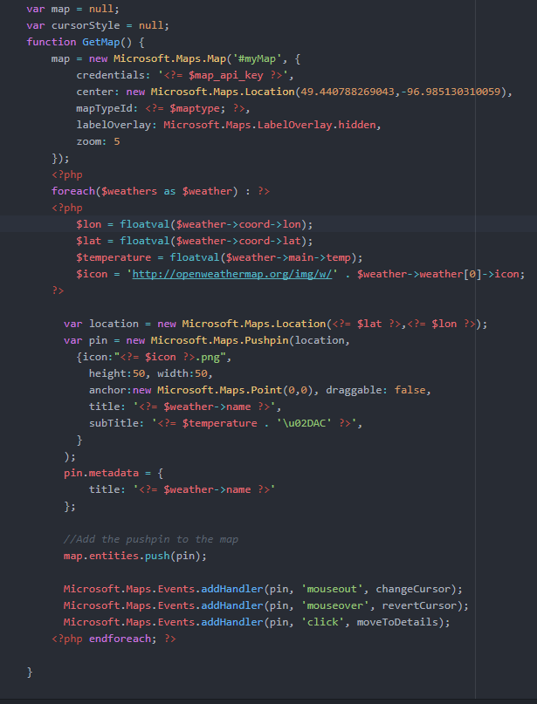
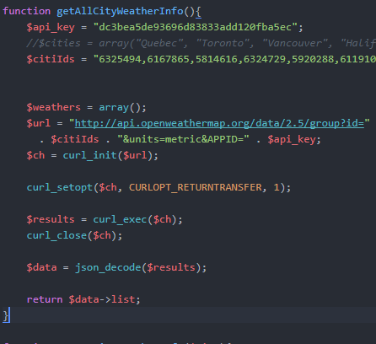

Slide 5
Open Weather Map API
Access current weather data for any location including over 200,000 cities
Current weather is frequently updated based on global models and data from more than 40,000 weather stations
Data is available in JSON, XML, or HTML format
$url = "http://api.openweathermap.org/data/2.5/weather?q="
. $city . "&units=metric&"
. "APPID=" . $api_key;
Used metric units to get temperature in Celsius
Converted Unix timestamps to human readable time in PHP
$epoch = 1483228800;
$dt = new DateTime("@$epoch"); // convert UNIX timestamp to PHP DateTime
echo $dt->format('Y-m-d H:i:s'); // output = 2017-01-01 00:00:00

Slide 6
{"coord":{"lon":139,"lat":35},
"sys":{"country":"JP","sunrise":1369769524,"sunset":1369821049},
"weather":[{"id":804,"main":"clouds","description":"overcast clouds","icon":"04n"}],
"main":{"temp":289.5,"humidity":89,"pressure":1013,"temp_min":287.04,"temp_max":292.04},
"wind":{"speed":7.31,"deg":187.002},
"rain":{"3h":0},
"clouds":{"all":92},
"dt":1369824698, "id":1851632,
"name":"Shuzenji", "cod":200}

