Slide 1
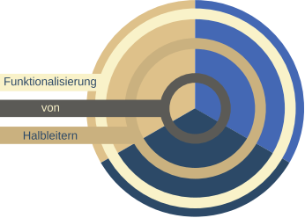


Peculiarities of the photoluminescence line shape in Ga(N,As,P)/GaP: Experiment and Monte Carlo simulations
V. Valkovskii
Prof. S. D. Baranovskii
vitalii.valkovskii@physik.uni-marburg.de
GRK Seminar, Kunze-Hof, Stadland, 2017

Slide 2
Monte Carlo studies
Computer simulations of disordered materials properties:
Charge Transport properties
Optical properties
Ga(N,As,P)/GaP PL
GRK Seminar, Kunze-Hof, Stadland, 2017

Slide 3
Outline
Intro
Baranovskii – Eichmann – Thomas(BET) model
Modified BET – model : Two scales of disorder
Alternative approach : Complex DOS and T-dependent non-radiative recombination
Conclusions
GRK Seminar, Kunze-Hof, Stadland, 2017

Slide 4

Disorder-induced localized states
Tale of localized states (LS) due to disorder:
DOS
GRK Seminar, Kunze-Hof, Stadland, 2017

Slide 5
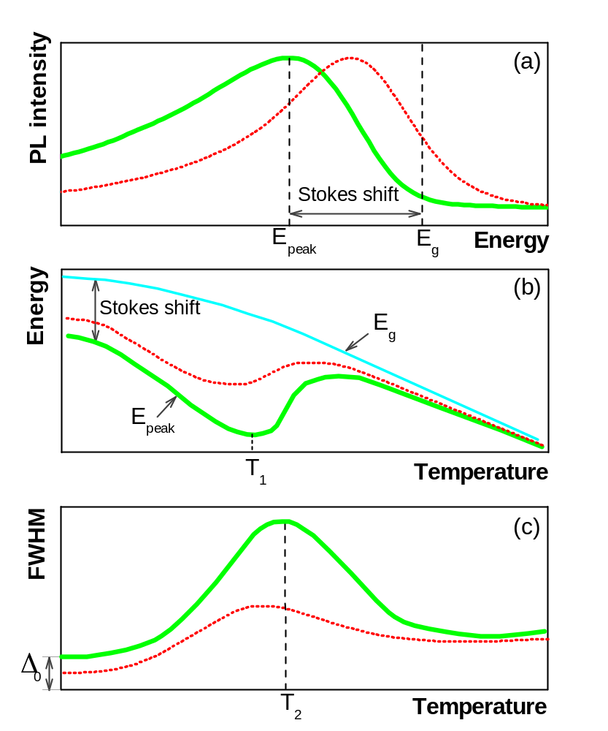
Peculiarities of PL in disordered material
(a) Schematic shapes of the PL spectra;
(b) temperature-dependent PL peak position;
(c) PL linewidth;
Green solid line – low excitation
Red doted line – high excitation
GRK Seminar, Kunze-Hof, Stadland, 2017

Slide 6
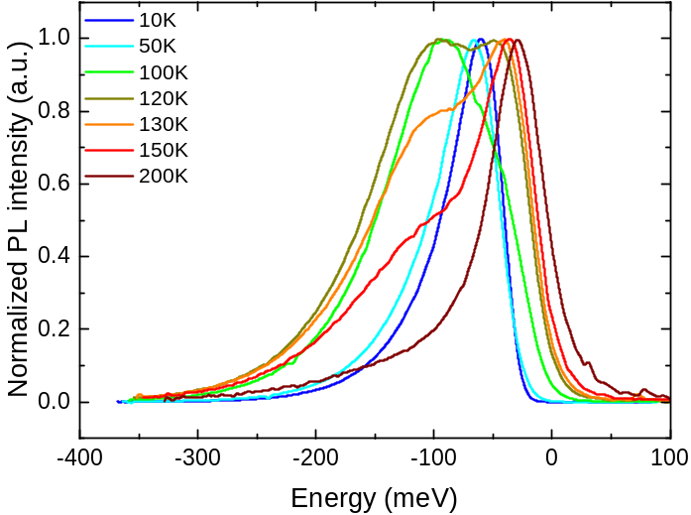
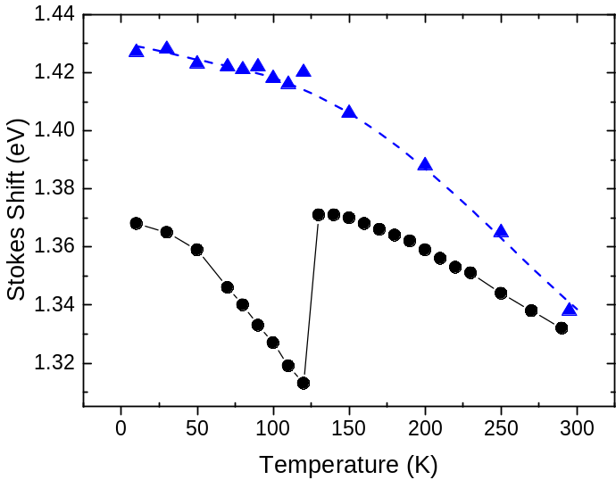
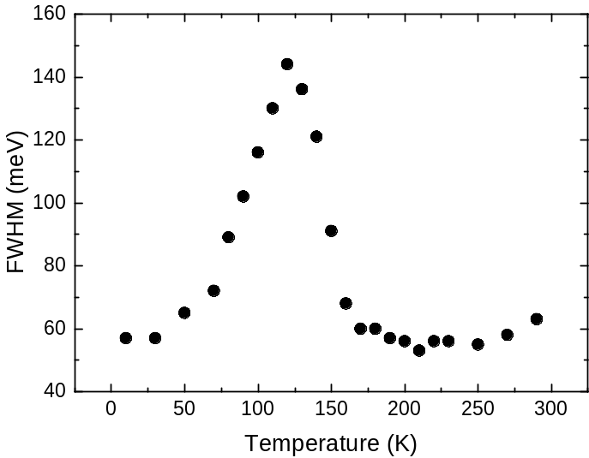
Experimental measurements
PL Spectra:
PL Features:
Karcher C, Jandieri K, Kunert B, Fritz R, Zimprich M,Volz K, Stolz W, Gebhard F, Baranovskii S D and Heimbrodt W 2010 Phys. Rev. B 82 245309
GRK Seminar, Kunze-Hof, Stadland, 2017

Slide 7
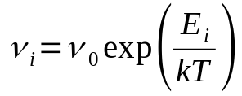
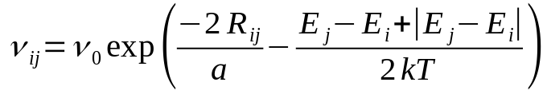



BET - model
Assumptions:
Traps distributed randomly in energy and coordinates;
No correlations between energy and spatial positions of traps are assumed;
Electrons and holes are coupled in form of excitons.
Processes:
Capture to localized states (LS);
Activation to extended states;
Hopping transitions between LS;
Recombination;
Dimensionless parameters:
Baranovskii S D, Eichmann R and Thomas P 1998 Phys.Rev. B 5813081
GRK Seminar, Kunze-Hof, Stadland, 2017

Slide 8

BET - model
KMC Simulation algorithm:
Step 1: Generate LS’s ;
Step 2: Set particle to random site;
Step 3: Throw random number to select next event;
Step 4: Throw random number to generate event’s time;
Repeat Steps 3-4 until recombination.
Recombi-
nation
Activation
Hopping
0
. . .
1
GRK Seminar, Kunze-Hof, Stadland, 2017

Slide 9
BET - model
Successfully applied to:
Quantum wells:
  GaInNAs/GaNAs, InGaN/GaN
Quantum dost:
  InAs/GaAs
Bulk materials:
  GaP(N)
Key feature:
Relations between energy scale of disorder(E) and temperature maximums (T1 and T2)of PL Stokes Shift / FWHM.
Feature | Relation to E/k
T1 (Stokes Shift max) | ~ (0.7 – 0.8)
T2 (FWHM max) | ~ (1.1 – 1.2)
FWHM (at low T) | ~ 2.5
Rubel O, Galluppi M, Baranovskii S D, Volz K, Geelhaar, L, Riechert H, Thomas P and Stolz W 2005 J. Appl. Phys.98 063518
Dawson P, Rubel O, Baranovskii S D, Pierz K, Thomas P and Goebel E O 2005 Phys. Rev. B 72 235301
Dawson P, Goebel E O, Pierz K, Rubel O, Baranovskii S D and Thomas P 2007 Phys. Stat. Sol. b 244 2803
GRK Seminar, Kunze-Hof, Stadland, 2017

Slide 10
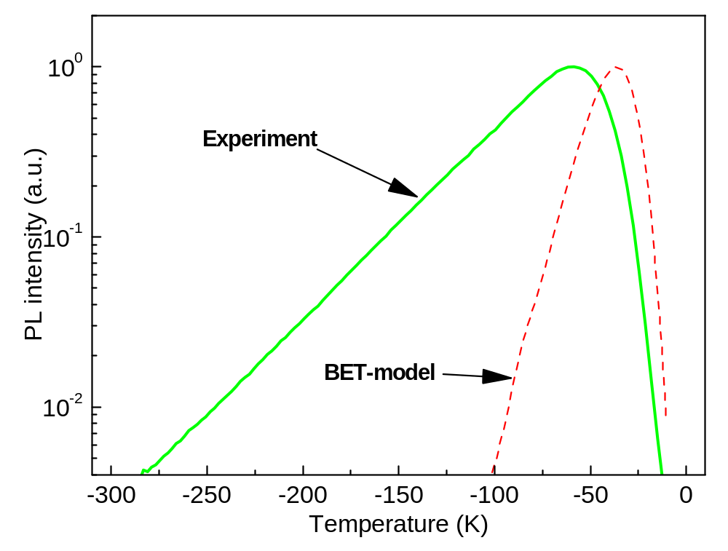
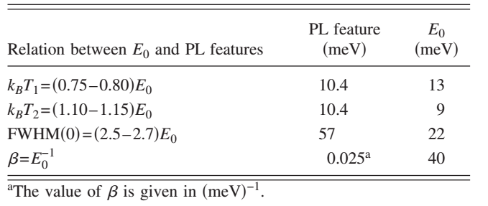
Problems of BET – model for Ga(N,As,P)
Problem:
Relations between PL features
and energy parameter of disorder
doesn’t work!
Karcher C, Jandieri K, Kunert B, Fritz R, Zimprich M,Volz K, Stolz W, Gebhard F, Baranovskii S D and Heimbrodt W 2010 Phys. Rev. B 82 245309
GRK Seminar, Kunze-Hof, Stadland, 2017

Slide 11
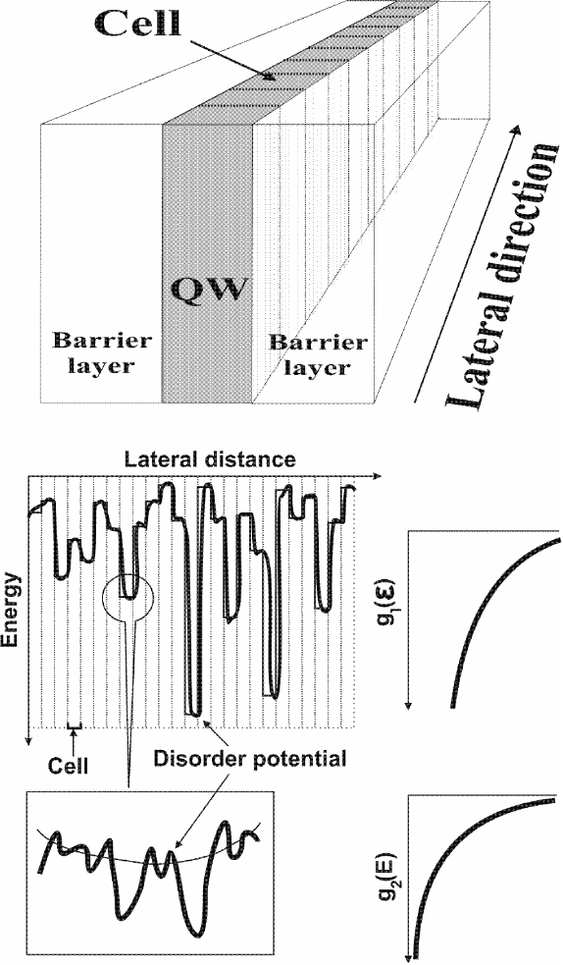
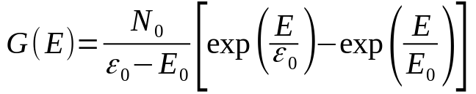
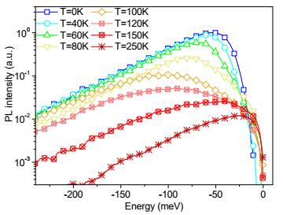
Modified BET – model: Two scales of disorder
DOS for double-scale of disorder:
Simulated spectrum:
Karcher C, Jandieri K, Kunert B, Fritz R, Zimprich M,Volz K, Stolz W, Gebhard F, Baranovskii S D and Heimbrodt W 2010 Phys. Rev. B 82 245309
GRK Seminar, Kunze-Hof, Stadland, 2017

Slide 12
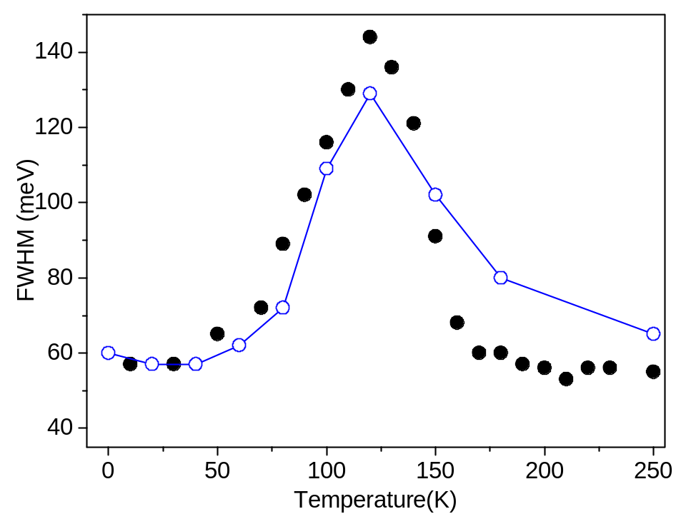
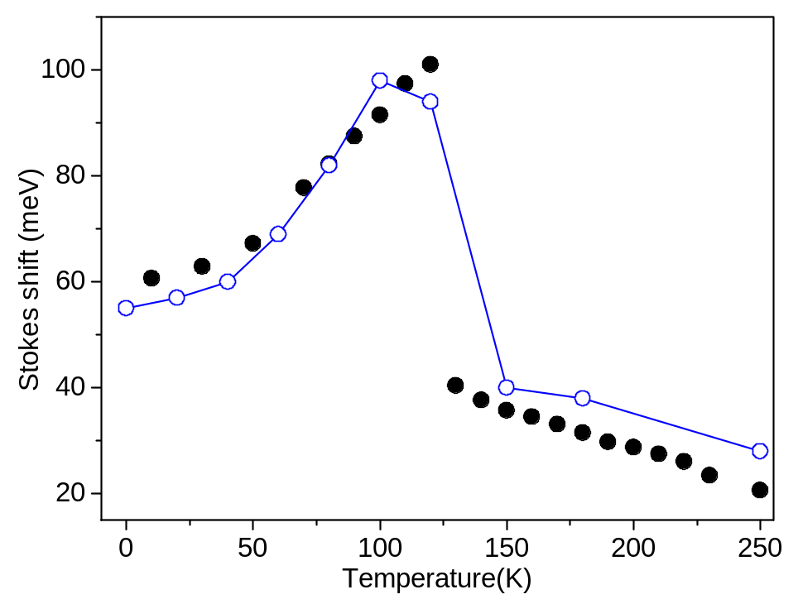
Modified BET – model. Two scales of disorder
Experimental results and simulation:
Karcher C, Jandieri K, Kunert B, Fritz R, Zimprich M,Volz K, Stolz W, Gebhard F, Baranovskii S D and Heimbrodt W 2010 Phys. Rev. B 82 245309
GRK Seminar, Kunze-Hof, Stadland, 2017

Slide 13
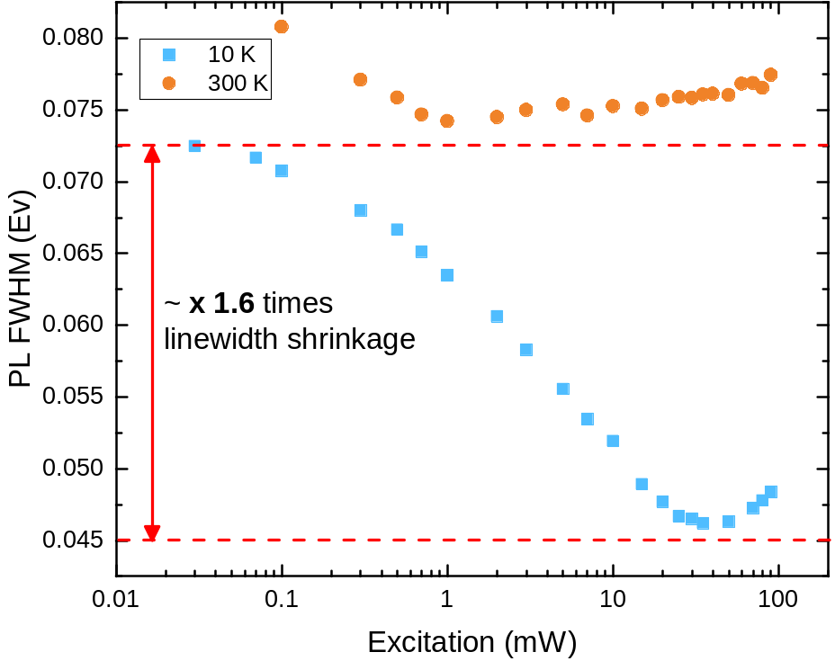
Ga(N,As,P) PL FWHM vs pump
Experimental result: At low temperatures FWHM strongly decreases along with the increase of the Peak Energy, when increasing the excitation power
Similar behavior reported for GaAsBi/GaAS:
Mazur Y I et al 2013 J. Phys. D: Appl. Phys. 46 065306
GRK Seminar, Kunze-Hof, Stadland, 2017

Slide 14
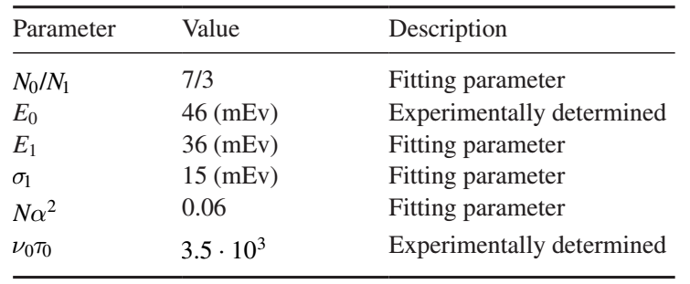
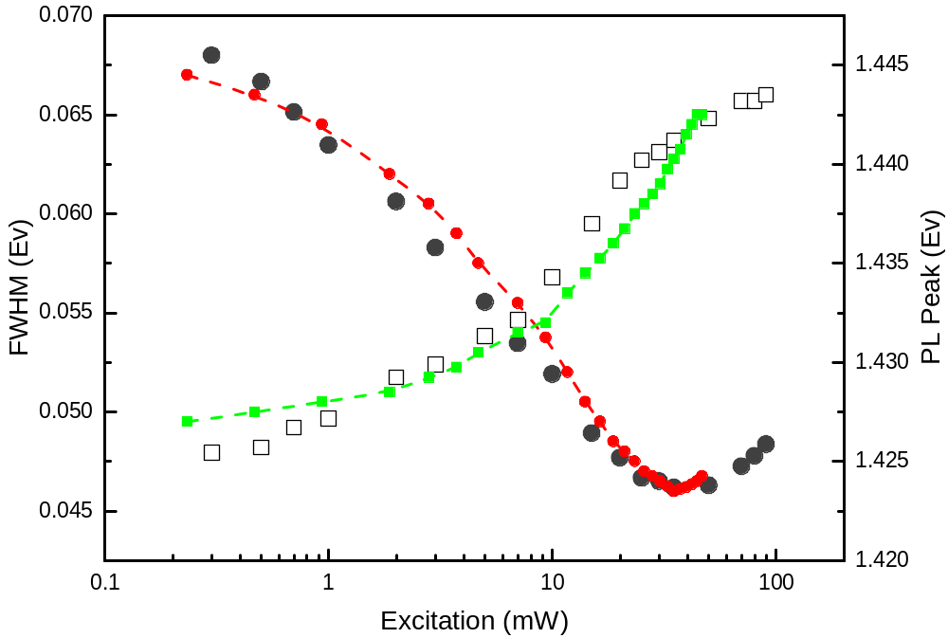
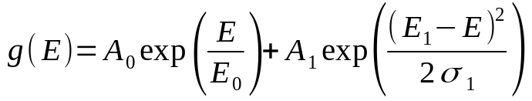
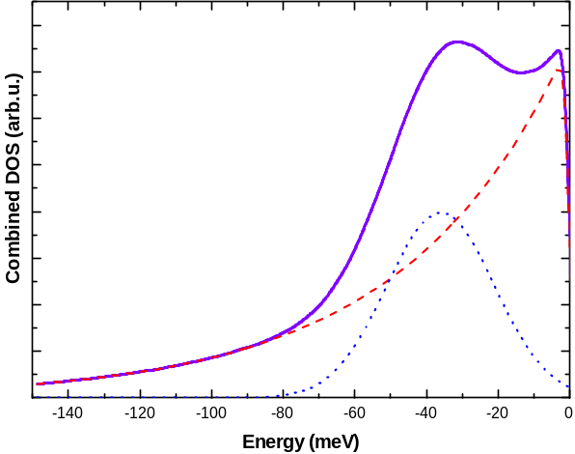
Modified BET – model: Complex DOS
Complex DOS:
Simulation results:
Valkovskii V V, Shakfa M K, Jandieri K, Ludewig P, Volz K, Stolz W, Koch M and Baranovskii S D , 2017 J. Phys. D: Appl. Phys 50 025105
GRK Seminar, Kunze-Hof, Stadland, 2017

Slide 15
Experimental measurements
PL Spectra:
PL Features:
Karcher C, Jandieri K, Kunert B, Fritz R, Zimprich M,Volz K, Stolz W, Gebhard F, Baranovskii S D and Heimbrodt W 2010 Phys. Rev. B 82 245309
GRK Seminar, Kunze-Hof, Stadland, 2017

Slide 16
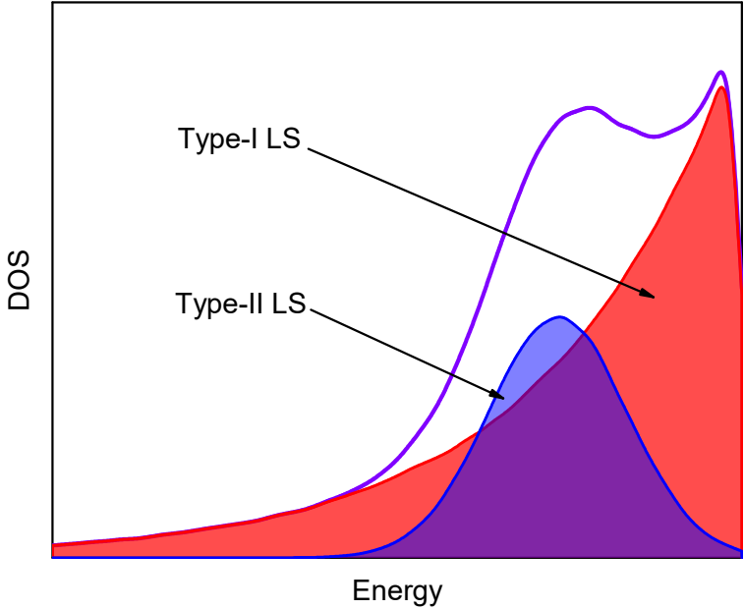

Modified BET – model. Two types of LS
Assumptions:
Many particle system;
Complex DOS given by:
;
Two types of the LS;
Strong temperature dependence of non-radiative recombination;
New parameter – ratio of non-radiative recombination rates .
GRK Seminar, Kunze-Hof, Stadland, 2017

Slide 17
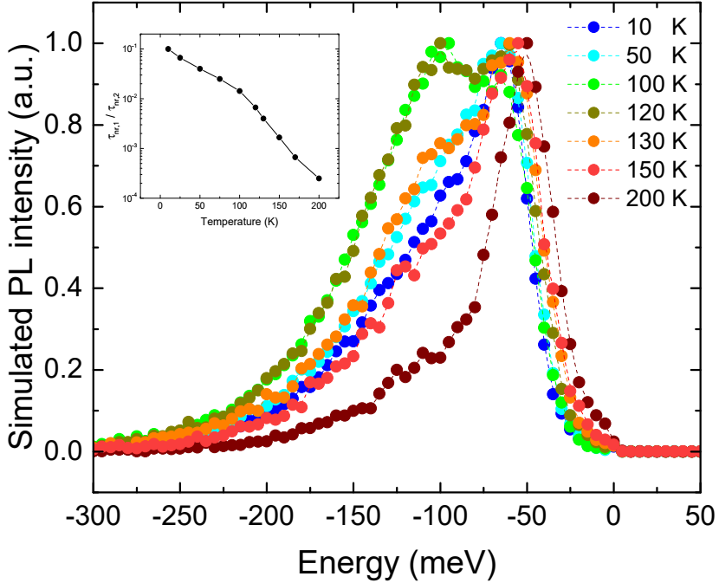
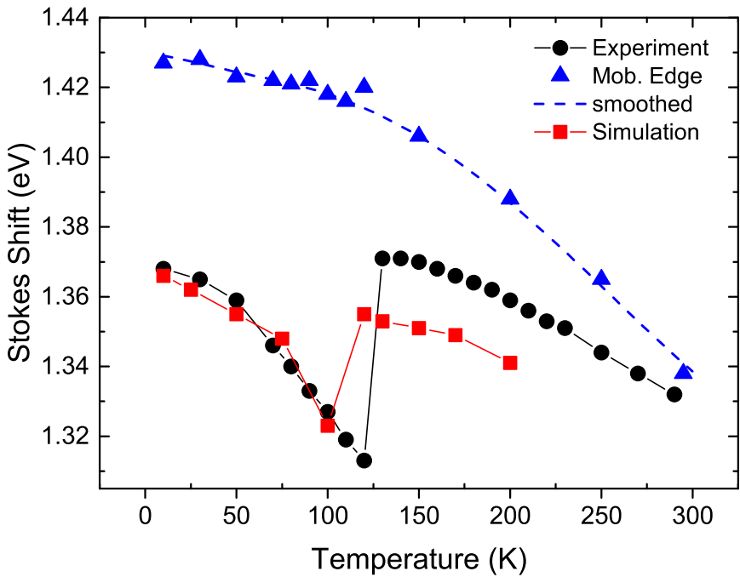
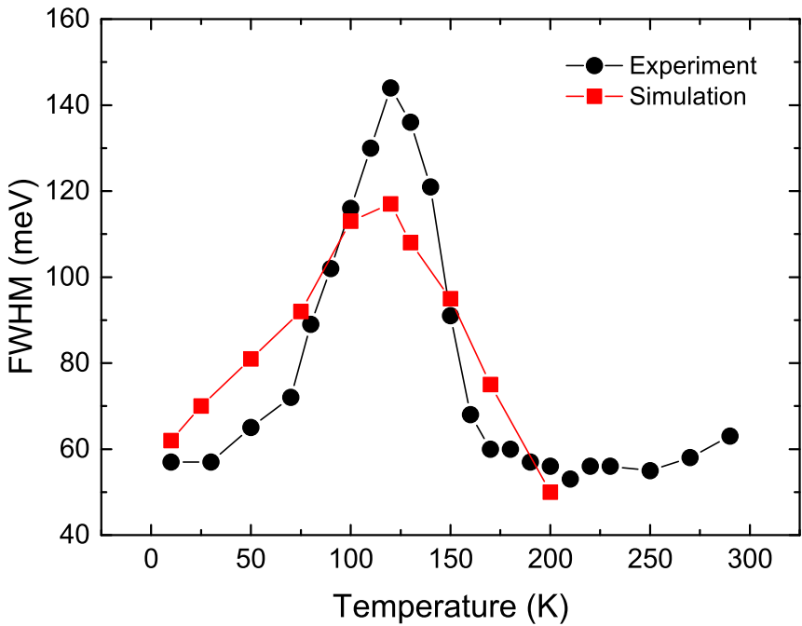
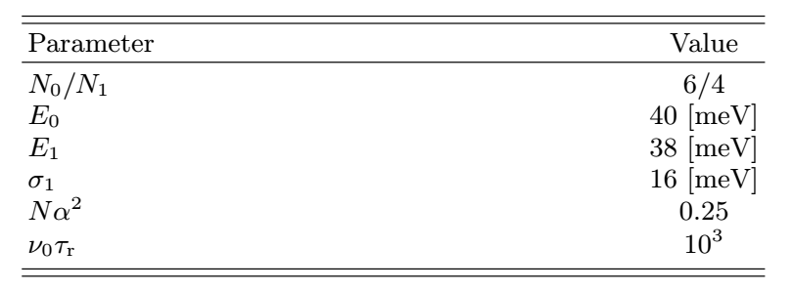
Modified BET – model. Two types of LS
Simulation results :
GRK Seminar, Kunze-Hof, Stadland, 2017

Slide 18
Conclusions
We have studied PL features of Ga(N,As,P) quantum wells using Kinetic Monte Carlo method;
Principal problems of the original BET – model has been revealed;
The original model has been refined, assuming the following:
  Two types of LS with non-monotonous (exponential-plus-Gaussian) DOS;
  Strongly different temperature dependencies of non-radiative recombination rates at LS type-I and LS type-II
GRK Seminar, Kunze-Hof, Stadland, 2017

