Slide 1
Adaptix C2 Operations
Cyber Shield 2026 Red Team

Slide 2

Introductions
whoami /all
Get-LocalUser | Select-Object `
Name `
Unit `
Experience `
Course Goals
Discord: vandey
Chief Beef or Vandey
Certs and stuff

Slide 3
Objectives
Describe the architecture and operational workflow of the Adaptix C2 framework
Create and deploy evasive payloads and assess their interaction with modern endpoint defenses, including antivirus (AV) and endpoint detection and response (EDR) solutions
Analyze Windows hosts and Active Directory environments to identify privilege escalation and lateral movement opportunities
Implement persistence and privilege escalation techniques appropriate to Windows enterprise environments
Acquire and use credentials to perform authorized identity impersonation during simulated engagements
Configure SOCKS proxies and peer-to-peer (P2P) agents to pivot through segmented networks
Evaluate and execute a complete Active Directory discretionary access control list (DACL) abuse path from a low-privilege user account to full domain compromise within a controlled lab environment

Slide 4
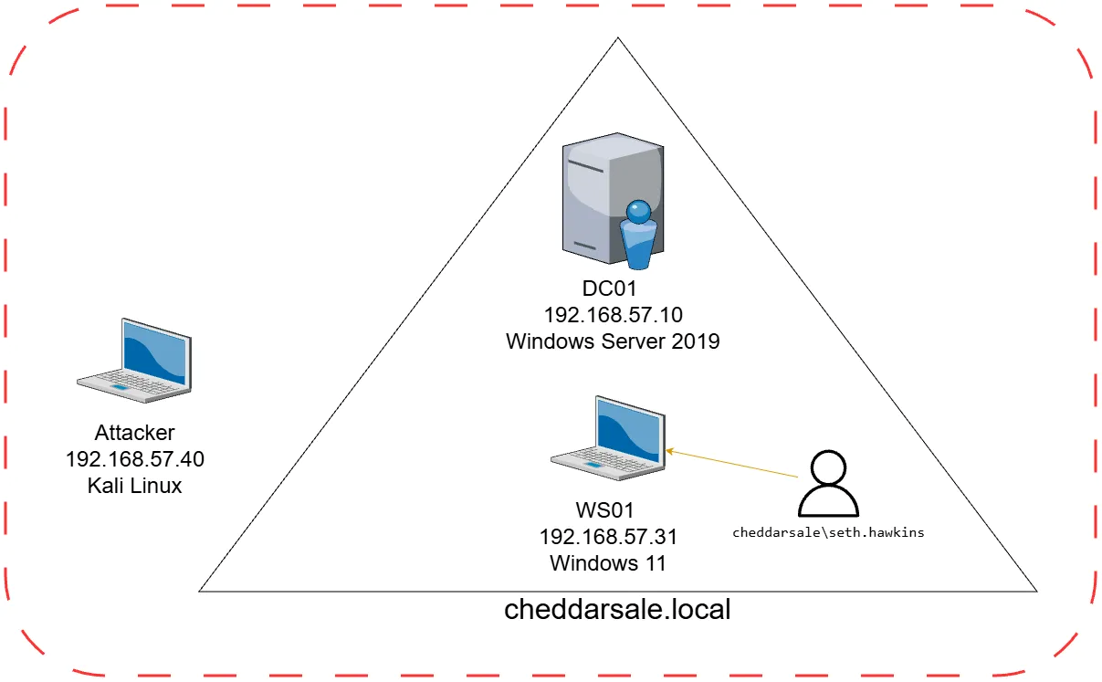
Lab
Windows hosts are running Sysmon and Windows Defender
C:\DevTools on WS01 excluded from Windows Defender
WS01 will also be used for some “offensive development” to reduce system requirements
/opt on Kali is the location of most tools including .NET (SharpCollection)

Slide 5

Adaptix C2
Open-source C2 framework by RalfHacker
Server – written in Go, configured with profile.yaml
Extenders – Go modules that extend server functionality adding listeners and agent types
Client – written in C++ Qt, supports Linux, Windows, and MacOS
AxScript – scripting language built into AdaptixC2, inspired by Cobalt Strike’s Agressor Script

Slide 6

Listeners
Two types of listeners
External listeners
Internal (P2P) listeners
External listeners
HTTP/HTTPs
GopherTCP (mTLS)
DNS
Internal listeners
TCP (bind)
SMB (named pipe)

Slide 7
Crystal Palace/The Garden
Written by Raphael Mudge, original creator of Cobalt Strike
Crystal Palace is a linker, linker script language, and Aspect-Oriented Programming toolset for building and transforming position-independent code
The Garden is a collection of modular, reusable evasion techniques packaged as load-time and runtime tradecraft components
This course will use two projects from k1ngOfnOth1ng, both projects are user-Defined Reflective Loader (UDRL) built on top of Crystal Palace
CrystalForge – custom AdaptixC2 agent that modifies the default beacon agent to support a Crystal Palace based UDRL pipeline
Reflectra – modular UDRL architecture that can be integrated across multiple C2 frameworks
Notes:
https://tradecraftgarden.org/index.html
https://github.com/k1ng0fn0th1ng/reflectra
https://github.com/k1ng0fn0th1ng/CrystalForge

Slide 8
DEMO
Notes:
Show profile.yaml
Show starting server
Show connecting to server from the client
Go over UI

Slide 9
LAB 1

Slide 10
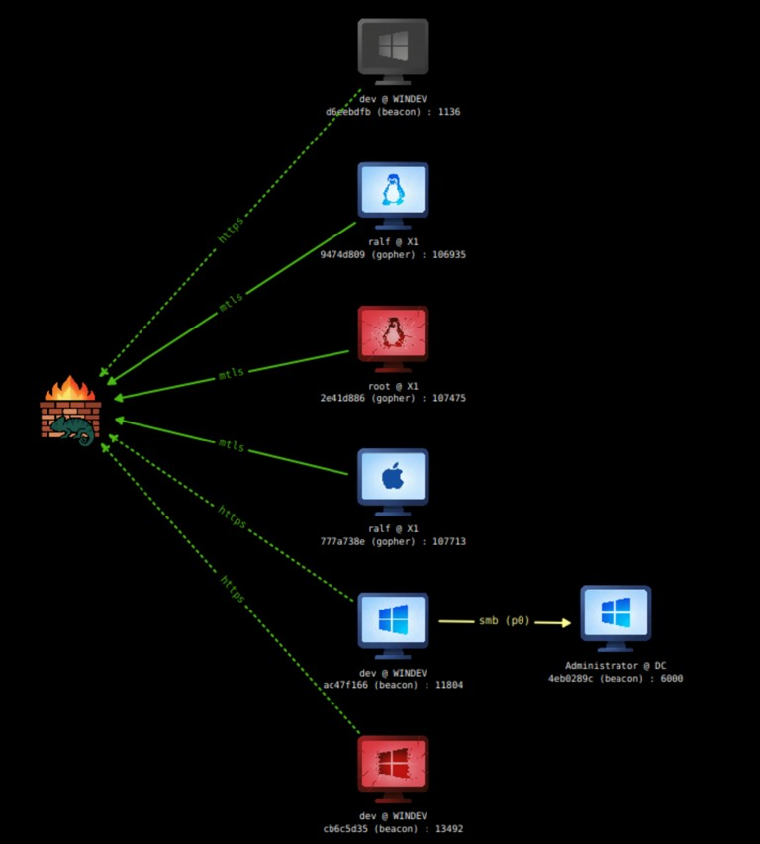
Agents
Beacon – Windows
Gopher – Windows, Linux, MacOS
CrystalForge – Windows
Kharon – Windows
Position-Independent Code (PIC) agent
Malleable Profile using json files
Notes:
Note: Kharon was archived on 2026 05 17, the agent is kept in the class for demonstration purposes

Slide 11
AV/EDR Evasion Tools
Beatrice – modifies a binary's assembly instructions to evade YARA rules and antivirus signatures.
Lucky Spark – loader featuring JIT shellcode decryption, fiber-based execution, dynamic API resolution, string obfuscation, CPU instruction patching, and disguised as FileZilla to evade detection
RedTeamGrimoire Charon – standalone, self-compiling artifact builder designed for Red Team operations. It creates a specialized executable for your shellcode that utilizes advanced evasion techniques to bypass EDR hooks, memory scanners, and static analysis
reflectra

Slide 12
DEMO
Notes:
Show generating an agent
Show selecting Agent and creating a profile
Show the save and load profile buttons

Slide 13
LAB 2

Slide 14
LAB 3

Slide 15
Host/Domain Enumeration
Understand the target network hosts, subnets, domain structure, and trust relationships
Enumerate users, groups, and their memberships to map access and privileges
Identify vulnerabilities and misconfigurations for privilege escalation Locate high-value targets: domain controllers, file servers, administrators
Identify active sessions and logged-in users to find lateral movement opportunities
Identify defenses: EDR, AV, logging, and monitoring in place

Slide 16
Host Enumeration
Three BOF groups
SAL-BOF (privcheck *)
PostEx-BOF (screenshot_bof, sauroneye)
TrustedSec-SA-BOFs (combination of host and domain tools)
Seatbelt comprehensive host triage (credentials, configs, installed software, AV, etc.)
SharpUp focused privesc checks: unquoted paths, weak service perms, autoruns

Slide 17

Domain Enumeration
LDAP queries
Group - LDAP-BOF (ldap *)
TrustedSec-SA-BOFs (ldapsearch)
AD Certificates (certi *, Certify)
BloodHound/SharpHound

Slide 18
LAB 4

Slide 19
Persistence
Persistence ensures access survives reboots, logoffs, and credential rotations
Mechanisms fall into two categories: machine-triggered (run at boot regardless of user) and user-triggered (run when a specific user logs in)
NTUSER.MAN – Windows loads it as a mandatory hive at logon executing any embedded run keys while discarding changes on logoff
Phantom Persistence – abuses a lesser-monitored Windows execution mechanism to survive reboots and logons
Notes:
NTUSER.MAN is a mandatory profile hive, when present in a user's profile directory, Windows loads it in place of NTUSER.DAT at logon, executing any registry run keys embedded within it. Because the hive is treated as read-only and changes are discarded on logoff, the payload re-executes on every login while leaving no persistent modifications to the live registry.
https://swisskyrepo.github.io/InternalAllTheThings/redteam/persistence/windows-persistence/#registry-hkcu
https://deceptiq.com/blog/ntuser-man-registry-persistence https://www.elastic.co/guide/en/security/8.19/potential-persistence-via-mandatory-user-profile.html
Phantom Persistence embeds shellcode into a compiled payload that abuses a less-monitored Windows execution mechanism, triggering a callback on logon without relying on common artifacts like scheduled tasks or registry run keys. Because it operates outside the typical persistence paths that defenders monitor, it has a lower detection profile while still surviving reboots and logoffs.
https://blog.phantomsec.tools/phantom-persistence https://github.com/Teach2Breach/phantom_persist_rs

Slide 20
LAB 5

Slide 21
Pivoting
SOCKS Proxy – tunnel attacker tools through a compromised host to reach internal segments
Port Forwarding – relay traffic through a compromised host to reach the C2 from hosts that can't talk to the internet directly

Slide 22
LAB 6

Slide 23
Credential Theft
LSASS (Local Security Authority Subsystem Service) is the primary target for credential theft on Windows, it holds plaintext passwords, NTLM hashes, and Kerberos tickets in memory for all authenticated sessions on the host
Dumping LSASS requires SYSTEM-level access
On Windows 11, LSASS runs as a Protected Process Light (PPL) by default, which prevents even SYSTEM-level processes from opening a handle to it, standard dumping techniques fail without first neutralizing PPL
BYOVD (Bring Your Own Vulnerable Driver) is the common PPL bypass: a legitimately signed but vulnerable kernel driver is loaded to gain kernel-level access, which can then strip PPL protection from LSASS before dumping proceeds

Slide 24
Impersonation
Token impersonation allows an operator to act as another user by creating a token from known credentials
Token theft allows an operator to act as another user by stealing a token from an existing process running under that user's context
Credential prompting targets the human rather than the system, using a fake Windows security dialog rendered on the victim's desktop captures credentials directly from the user, bypassing all technical controls

Slide 25
LAB 7

Slide 26
Kerberos Tickets
Kerberos is an authentication protocol based on tickets. It basically works like this (simplified process):
Client asks the KDC for a TGT (Ticket Granting Ticket). One of the requesting user's keys is used for pre-authentication. The TGT is provided by the Authentication Service (AS). The client request is called AS-REQ, the answer is called AS-REP.
Client uses the TGT to ask the KDC for a ST (Service Ticket). That ticket is provided by the Ticket Granting Service (TGS). The client request is called TGS-REQ, the answer is called TGS-REP.
Source: The Hacker Recipes

Slide 27
Kerberos Tickets Continued
Client uses the ST (Service Ticket) to access a service. The client request to the service is called AP-REQ, the service answer is called AP-REP.
Both tickets (TGT and ST) usually contain an encrypted PAC (Privileged Attribute Certificate), a set of information that the target service will read to decide if the authentication user can access the service or not (user ID, group memberships and so on).
Source: The Hacker Recipes

Slide 28
Pass-The-Ticket
Pass-the-Ticket (PtT) extracts a valid Kerberos ticket from one session and injects it into another, allowing an operator to authenticate to services as the ticket's owner without knowing their password or hash
A stolen TGT can be used to request service tickets for any resource the user has access to, while a stolen TGS only provides access to the single service it was issued for
Source: The Hacker Recipes
Notes:
Same LUID (your own session) no elevated privileges required if the ticket belongs to your own account
Injecting into another user's LUID requires SYSTEM or SeDebugPrivilege to open a handle to another process's logon session
Creating a sacrificial logon session (NetOnly/runas /netonly style) requires local admin in most tooling implementations (e.g., Rubeus), but some C2 frameworks can do this without admin by managing the process interaction through named pipes
Injecting a ticket into an active SYSTEM session risks overwriting the machine account's existing Kerberos ticket unlike user accounts, SYSTEM will not automatically obtain a new ticket, meaning the host loses its ability to authenticate to domain resources until it is rebooted

Slide 29
LAB 8

Slide 30
LAB 9

