Slide 1
Sales Data Analysis Using Excel and Power BI
Submitted by: Vallabh Trivedi
Date: June 19, 2025

Slide 2
Introduction
This project involves analyzing sales data using Microsoft Excel. The analysis focuses on regional performance, product trends, and salesperson productivity. Power BI visuals are optionally used for enhanced presentation.

Slide 3
Objectives
- Analyze regional and product-wise sales
- Identify sales trends over time
- Evaluate individual salesperson performance
- Visualize data using Excel and Power BI

Slide 4
Dataset Overview (Sample)
Date Region Product Sales_Amount Units_Sold Salesperson Month
2024-01-01 East Product C 4627 25 David 2024-01
2024-01-02 West Product B 6450 35 Alice 2024-01
2024-01-03 North Product B 2663 25 David 2024-01
2024-01-04 East Product B 6592 29 Bob 2024-01
2024-01-05 East Product B 8392 18 Charlie 2024-01

Slide 5
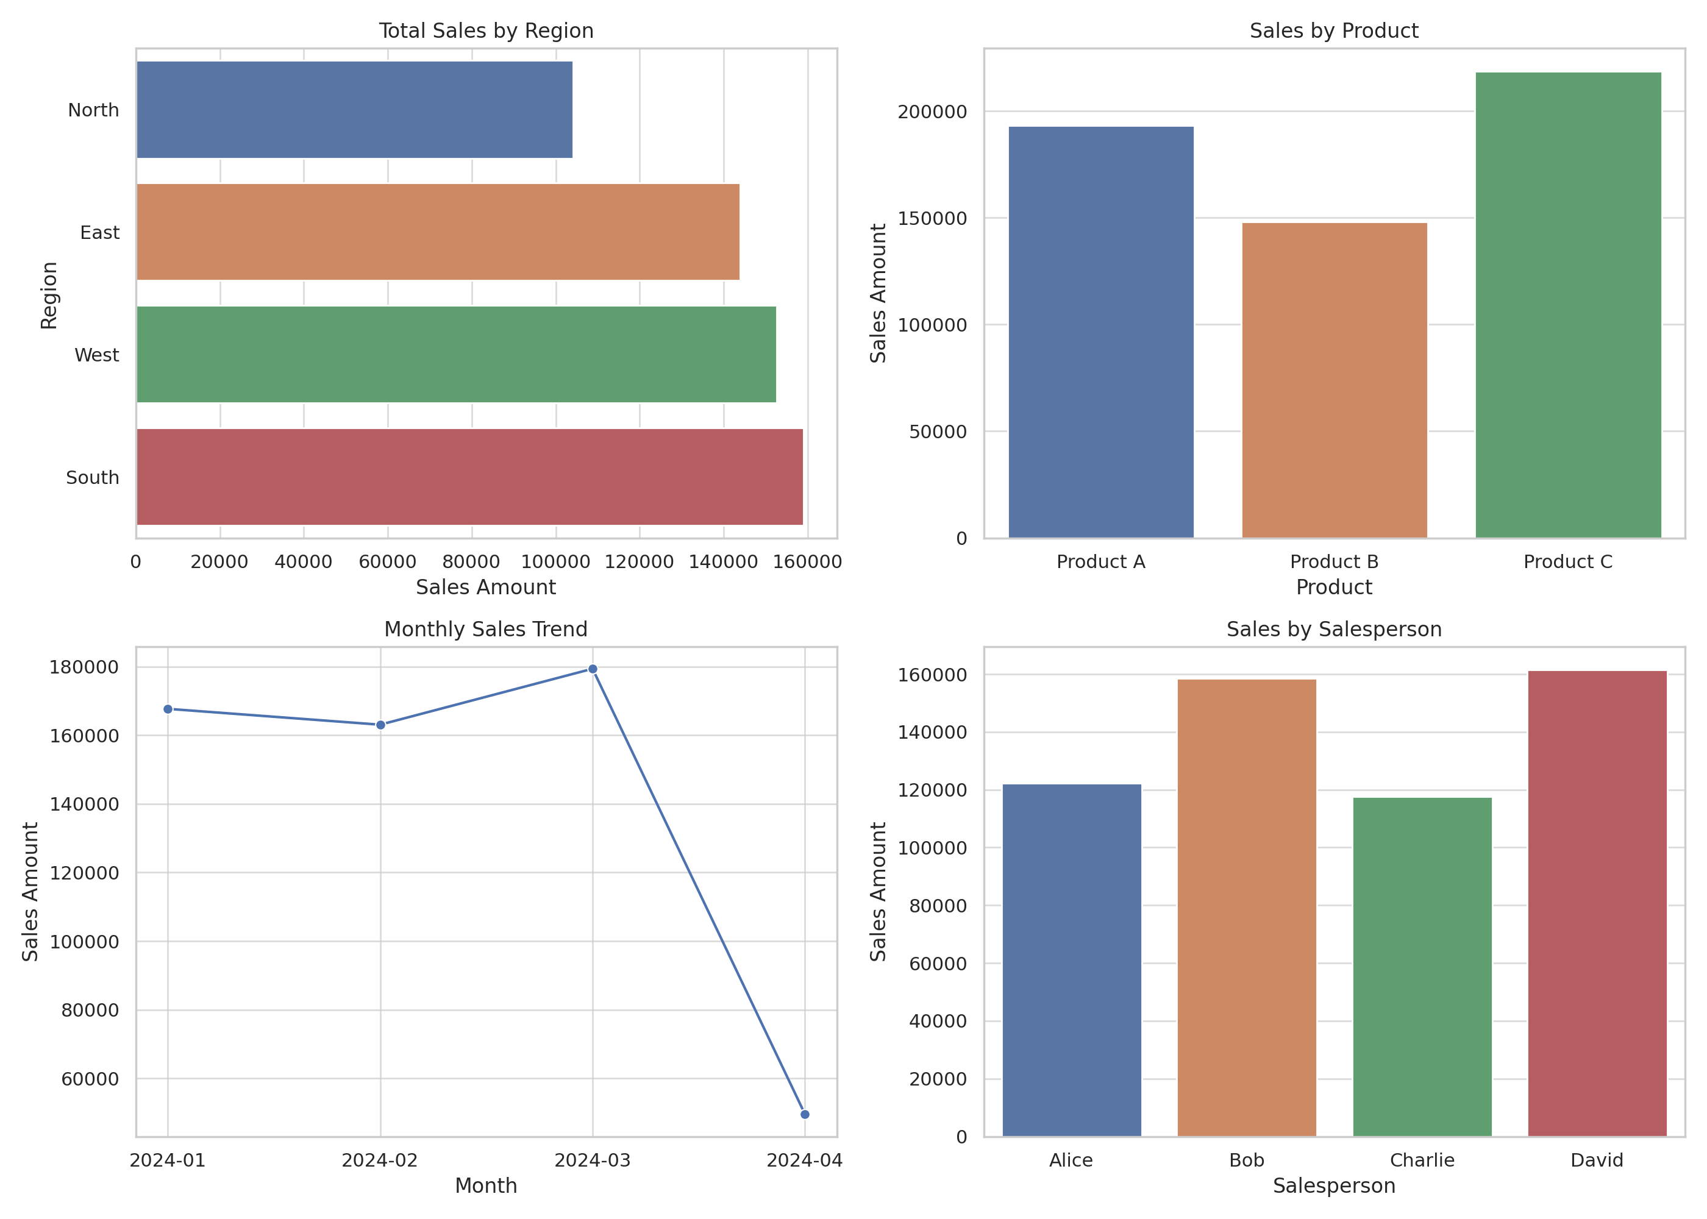
Visualizations from Excel

Slide 6
Insights & Observations
- East and West regions had the highest sales
- Product B was the top-performing item
- Monthly sales remained steady with a slight increase in later months
- Alice and Charlie performed consistently well as salespeople

Slide 7
Conclusion
Excel and Power BI proved to be powerful tools for understanding sales trends. This analysis helps businesses make informed decisions on product stocking, regional strategies, and sales team performance.

Slide 8
Tools Used
- Microsoft Excel (Pivot Tables, Charts, Filters)
- Power BI (optional visuals)
- Python (for data generation)

