Slide 1



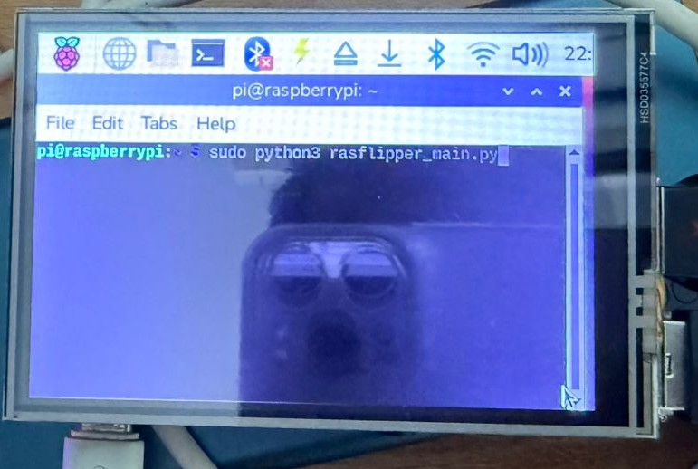
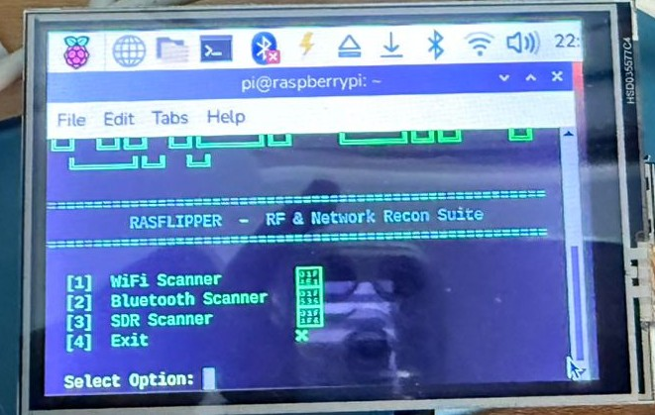
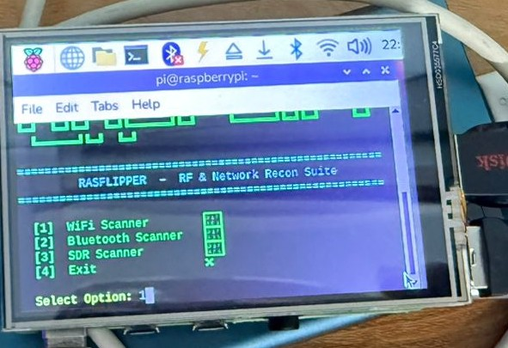
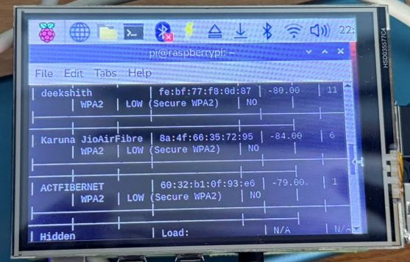
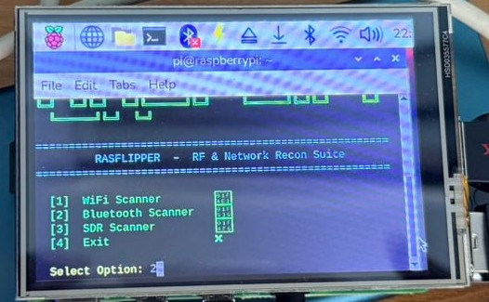
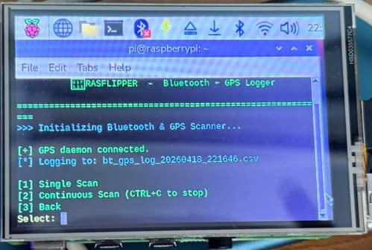
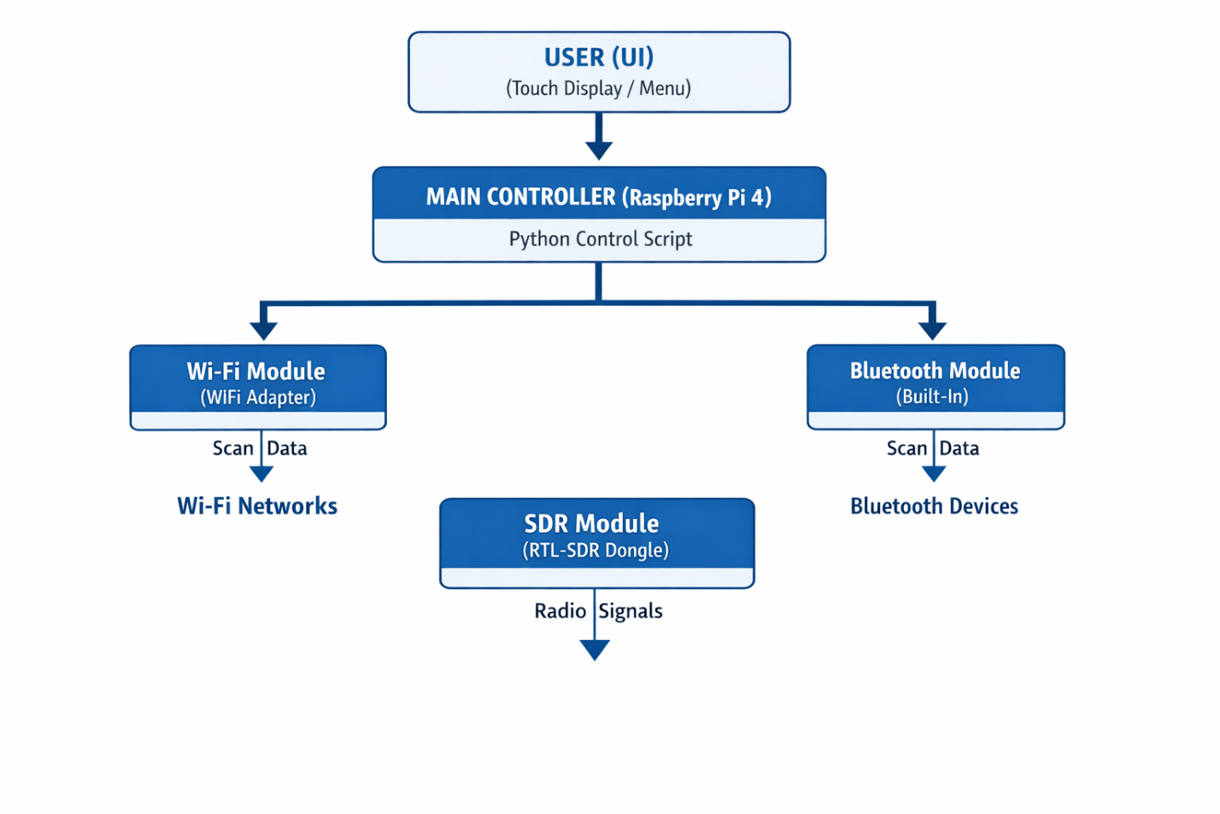
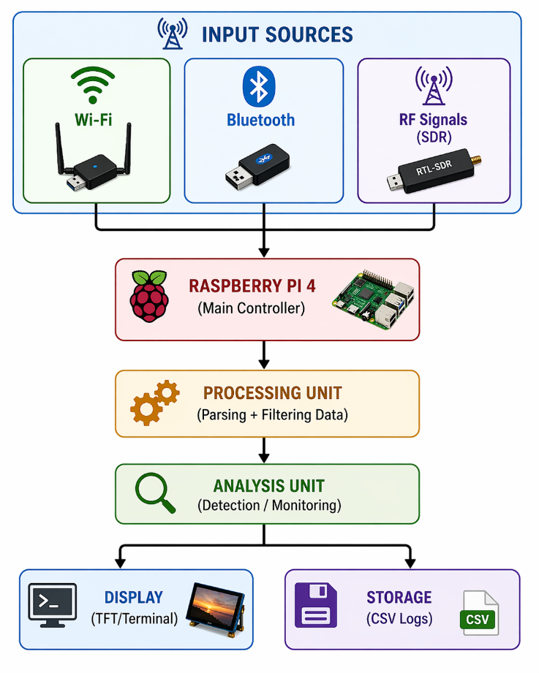
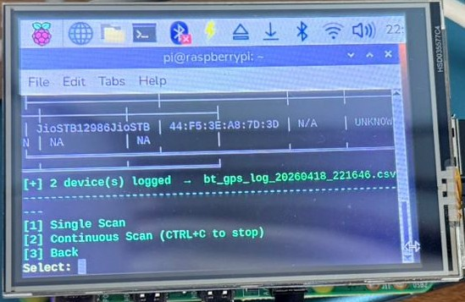
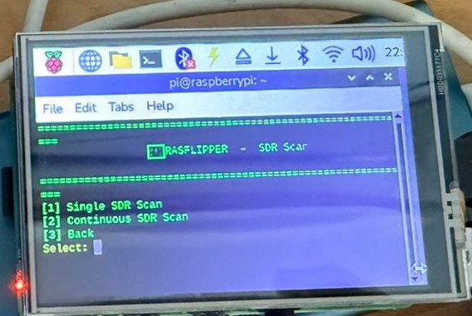
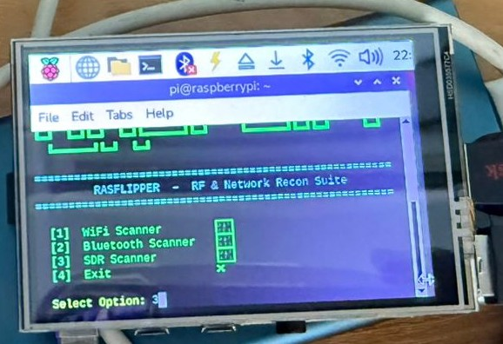
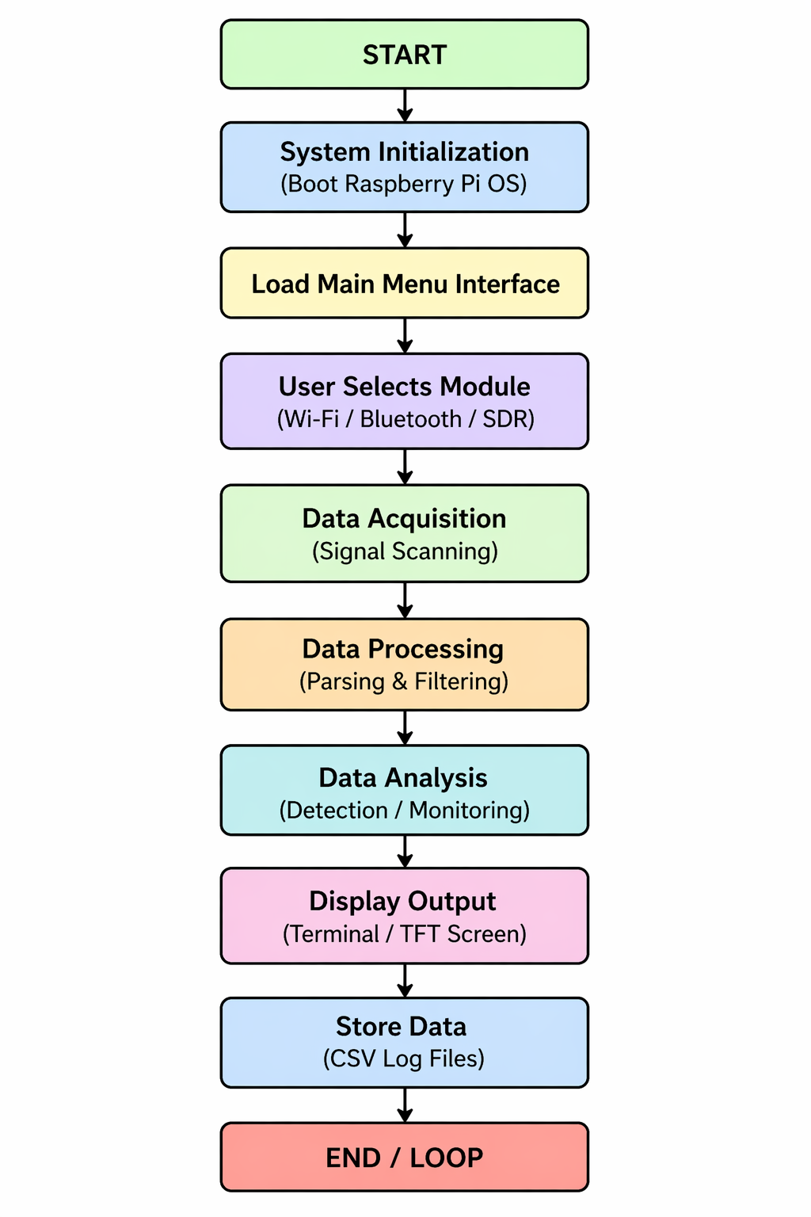
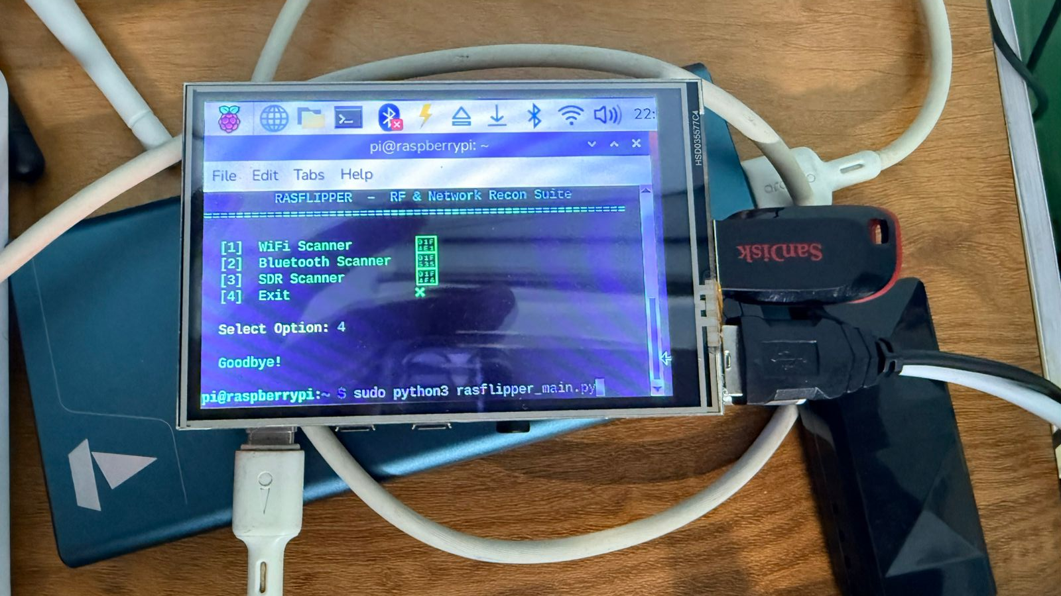
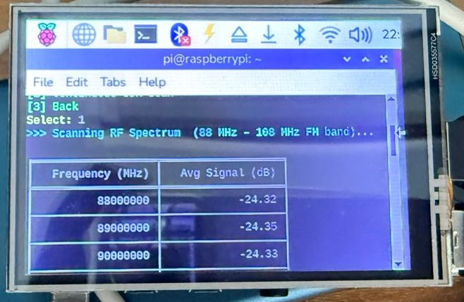
SCHOOL OF COMPUTER SCIENCE AND ENGINEERING (G3)
PROJECT EXPO - 2026
RASFLIPPER-PORTABLE MULTI-PROTOCOL PENTESTING TOOLKIT
M. MOURYA KOUSHIK REDDY C. GNANESWAR REDDY B. GAJAN VAROOD V. DEEKSHITH
mouryareddy113@gmail.com gnaneswarreddy666@gmail.com varoodgajan@gmail.com djdeekshithv14@gmail.com
GUIDE Name: Dr P.V. Bhaskar Reddy
r22ei044@reva.edu.in r22ei032@reva.edu.in r22ei031@reva.edu.in r22ei058@reva.edu.in
Abstract
Objectives
d & Amin, M.(2015). Design and Construction of a Multipurpose Robot. International Journal of Automation, Control and Intelligent Systems. 1. 34-46.
Conclusion
With the rapid advancement of wireless communication technologies, the need for efficient and portable security analysis systems has become increasingly important. The widespread use of Wi-Fi, Bluetooth, and radio-frequency (RF) communication introduces potential vulnerabilities that can be exploited, highlighting the importance of continuous monitoring and analysis. The proposed system, RASFLIPPER, is a portable multi-protocol wireless pentesting and signal analysis toolkit developed using the Raspberry Pi platform.
The system integrates multiple technologies, including Wi-Fi monitoring, Bluetooth device scanning, and Software Defined Radio (RTL-SDR), to enable comprehensive analysis of wireless environments. Wi-Fi analysis is performed using monitor mode for network scanning and signal observation, while Bluetooth scanning enables real-time detection of nearby devices. Additionally, RTL-SDR is used for wideband RF signal monitoring, allowing physical-layer analysis beyond traditional network-level tools.
The system follows a modular and scalable architecture, where each module operates independently and is controlled through a unified interface. Data is processed in real-time and stored in CSV format for further analysis. The compact design, powered by a portable power source, enables easy deployment in different environments.
The proposed system provides a low-cost, user-friendly, and efficient platform for cybersecurity education, ethical hacking practice, and wireless signal analysis. By combining multiple protocols into a single device, RASFLIPPER bridges the gap between theoretical knowledge and practical implementation, offering hands-on experience in modern wireless security techniques.
Results
.
The primary objective of the RASFLIPPER project is to develop a portable and low-cost wireless pentesting toolkit for practical use. The system aims to integrate multiple wireless protocols into a single platform for efficient analysis. It provides Wi-Fi network scanning capabilities to observe wireless environments and supports Bluetooth device detection for monitoring nearby devices. The project also includes RF signal analysis using Software Defined Radio to extend functionality to physical-layer communication.
Additionally, the system is designed with a simple and user-friendly interface to ensure easy interaction. A modular architecture is adopted to support scalability and future enhancements. The project focuses on delivering real-time analysis and data logging. Overall, it promotes hands-on learning in cybersecurity and wireless communication.
.
The RASFLIPPER system presents a low-cost and portable pentesting toolkit that integrates Wi-Fi, Bluetooth, and SDR into a single platform. It enables real-time monitoring and analysis of wireless environments, helping users detect vulnerabilities and understand communication protocols. The use of Raspberry Pi OS ensures flexibility and ease of development, while the Python-based implementation allows customisation and scalability. The modular design supports independent operation of each component and allows future enhancements. CSV-based data logging improves usability and supports further analysis. The project also addresses practical challenges such as hardware limitations and integration constraints. Optimisation decisions helped improve system stability and performance. It bridges the gap between theoretical knowledge and practical implementation. Overall, the project successfully demonstrates a reliable and efficient wireless security analysis solution.
Proposed Solution
Fig.3(a). RasFlipper Initialisation Command Execution
Fig.3(b).Main Interface – RF & Network Recon Suit Menu
Fig.3(c). Menu Selection – Wi-Fi Scanner Module
The proposed system, RASFLIPPER, is a portable and low-cost wireless analysis toolkit developed using a Raspberry Pi. It integrates Wi-Fi monitoring, Bluetooth scanning, and RF signal analysis using Software Defined Radio into a single platform. The system performs real-time scanning and analysis of wireless environments.
It follows a modular architecture where each module operates independently and is controlled through a common interface. Data is displayed on the screen and stored in CSV format for further analysis. The compact and portable design makes it suitable for practical wireless security applications.
Advantages:
Mobile Application Interface Develop an Android/iOS app for controlling the device, viewing live scans, and receiving instant alerts.
AI-Based Threat Detection: Integrate machine learning models to automatically identify suspicious patterns, unknown devices, and anomalous wireless behaviour in real time.
Introduction
Future scope
Wireless communication technologies such as Wi-Fi, Bluetooth, and radio-frequency (RF) systems have become an integral part of modern digital infrastructure. These technologies are widely used in smartphones, IoT devices, smart homes, industrial automation, and communication systems, enabling seamless connectivity and efficient data exchange. However, the rapid expansion of wireless systems has significantly increased exposure to security vulnerabilities.
In recent years, cyber threats targeting wireless networks have grown considerably. Issues such as unauthorised access, device tracking, signal interception, and exploitation of communication protocols pose serious challenges in cybersecurity. Many of these vulnerabilities arise due to weak configurations, outdated security mechanisms, a lack of continuous monitoring, and limited awareness among users.
Traditional cybersecurity education often focuses more on theoretical concepts, with limited emphasis on practical implementation. Although advanced penetration testing and signal analysis tools are available, they are often expensive, complex, and difficult to access for students and educational institutions. This creates a gap between academic learning and real-world application.
To overcome these challenges, the project RASFLIPPER – Portable Multi-Protocol Wireless Pentesting Toolkit is proposed as a low-cost, portable, and efficient solution. The system is developed using the Raspberry Pi platform, leveraging its compact design, flexibility, and compatibility with multiple hardware modules.
The system integrates multiple wireless analysis technologies into a single unified platform. It includes Wi-Fi monitoring using a monitor mode adapter, Bluetooth device scanning using a USB dongle, and RF signal analysis using Software Defined Radio (RTL-SDR). This enables comprehensive multi-protocol analysis covering both network-layer and physical-layer communication.
The system is designed with a modular architecture, allowing each component to operate independently while maintaining overall integration.
Integration of AI for automated threat detection
Support for additional protocols like Zigbee, LoRa, and RFID
Development of a mobile app for remote control and monitoring
Fig.4(a). Detected Wi-Fi Networks with Security & Signal Details
Fig.4(b). Menu Selection – Bluetooth Scanner Module
Fig.4(c). Bluetooth Logger Initialisation
Fig.1(a). ARCHITECTURE DIAGRAM of RASFLIPPER
Fig.1(b). Block Diagram of Dashboard
[5] Zaman, M. & Ahmed,
Methodology
References
[1] S. Fluhrer, I. Mantin, and A. Shamir, “Weaknesses in the Key
Scheduling Algorithm of RC4,” in Proc. Selected Areas in Cryptography, 2001.
[2] E. Tews, R. Weinmann, and A. Pyshkin, “Breaking 104-bit WEP in less than 60 seconds,” in Proc. WISA, 2007.
[3] R. Messier, Wireless Network Security: A Beginner’s Guide, McGraw-Hill, 2013.
[4] M. Vanhoef and F. Piessens, “Key Reinstallation Attacks: Forcing Nonce Reuse in WPA2,” in Proc. ACM CCS, 2017.
[5] J. Mitola, “The Software Radio Architecture,” IEEE Communications Magazine, vol. 33, no. 5, pp. 26–38, 1995.
[6] M. Reddy et al., “Wireless Penetration Testing using Raspberry Pi Platforms,” International Journal of Cybersecurity, 2021.
[7] N. Delija and M. Petrović, “Wireless Security Analysis using Embedded Linux Systems,” IEEE Access, 2022.
[8] A. Nazir and A. Laghari, “A Survey on Wireless Network Security Challenges,” Journal of Network Security, 2023.
[9] RTL-SDR Project Documentation, “RTL-SDR Tutorial and Applications,” 2024. [Online].
[10] Kali Linux Documentation, “Wireless Penetration Testing Tools,” Offensive Security, 2024.
[11] Bluetooth SIG, “Bluetooth Security Architecture,” 2023.
[12] Raspberry Pi Foundation, “Raspberry Pi 4 Model B Documentation,” 2024.
Fig.5(a). Bluetooth Scan Results Logged (CSV File Generated)
Fig.5(b). SDR Scan Interface – Frequency Range Selection
Fig.5(c). Menu Selection – SDR Scanner Module
Problem statement
Wireless communication systems are widely used across various domains; however, they are often deployed without proper security assessment mechanisms. Many users and organisations rely on wireless technologies without fully understanding the associated risks and vulnerabilities.
Existing penetration testing tools are either expensive, complex, or limited to specific protocols, making them inaccessible for students and small-scale users. Additionally, most available solutions do not provide a unified platform for analysing multiple wireless protocols simultaneously.
The lack of affordable and portable tools for multi-protocol wireless security analysis creates a gap in cybersecurity education. Students are unable to gain hands-on experience in identifying vulnerabilities across different wireless technologies, limiting their ability to understand real-world security challenges.
Fig.6(a). SDR Scan Results
Fig.6(b). Program Exit – RASFLIPPER Session Termination
Fig.2. Flow Chart of the Complete Process of the proposed project

