Slide 1
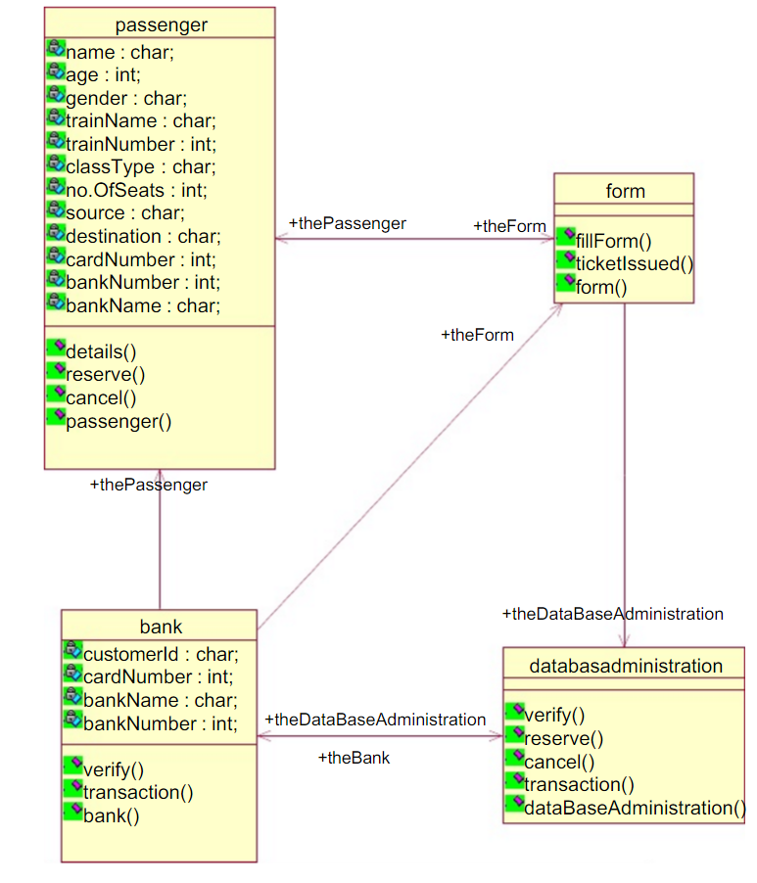
UML DIAGRAM

Slide 2
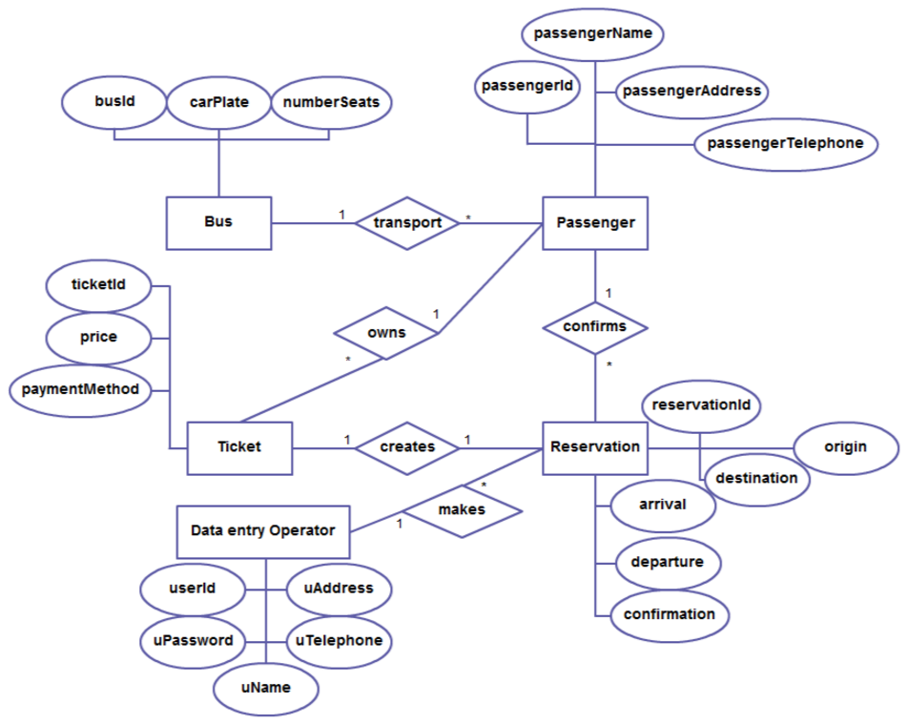
ER-DIAGRAM

Slide 3
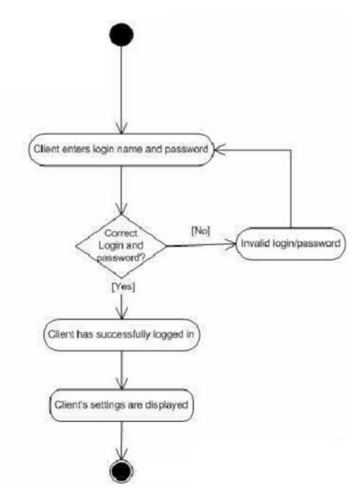
Login Page

Slide 4
USE-CASE DIAGRAM

Slide 5
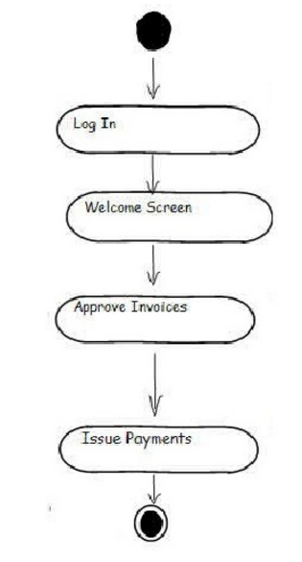
Seat Checking

