Slide 1
NSPMS
National Service Posting Management System

Slide 2
REQUIREMENTS
Posts students to companies and institutions to serve
Schools upload an excel sheet containing a list of her students
The companies request for students of a particular field
Students may be posted with respect to their field of study, location and availability of space in companies.

Slide 3
school
Uploads a CVS file of the students details
Send request for service personnel
Runs algorithm to post students
company
NSS System
nss admin
Sends service personnel
Get total number of student enrolled and company requests
Checks posting and updates service details
Sends posting
student

Slide 4
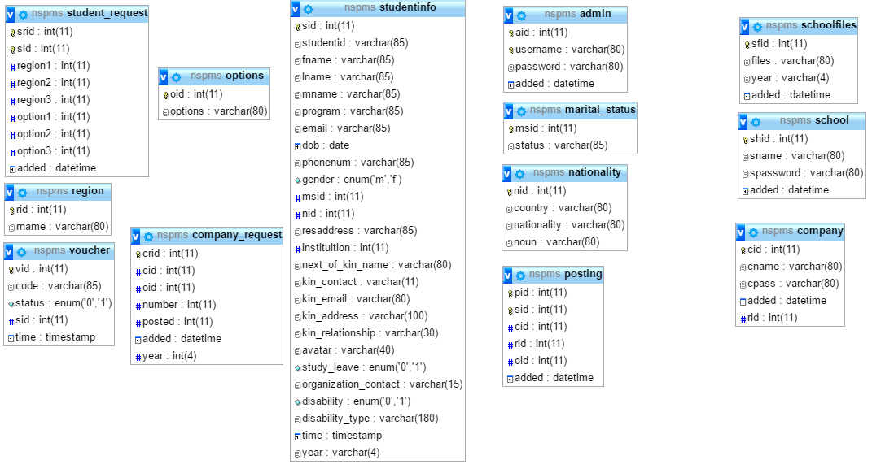

Slide 5
NSPMS
Upload student list
Check Postings
Update Details
Request Personnel
NSS
User

Slide 6
NSPMS
Update Details
View Postings
NSS
Student

Slide 7
NSPMS
Request Personnel
NSS
Company

Slide 8
NSPMS
Upload student list
NSS
School

