Slide 1
Garden Monitor Station
Mike Braaten
Valley Forge Tech Demo
3/26/2014

Slide 2
Agenda
Introduction
What’s the Problem
System Overview
Arduino
What is it
Example Projects
Input/Output Components
Java GUI
System Details
Demo
What’s Next
Questions

Slide 3
Introduction
Mike Braaten
Software Engineer Sr
Lockheed Martin
I have very little electronics knowledge
I did most of this project this past weekend

Slide 4
Problem To Solve
Real-time Data
Send environment data to a PC/Phone
Sun Light
Soil Moisture
Temperature
Humidity
Garden Automation
Water when (and only when) necessary
Control plant’s growing conditions
Sun Light
Soil Moisture
Temperature
Humidity
Indoor Garden vs. Outside Garden

Slide 5
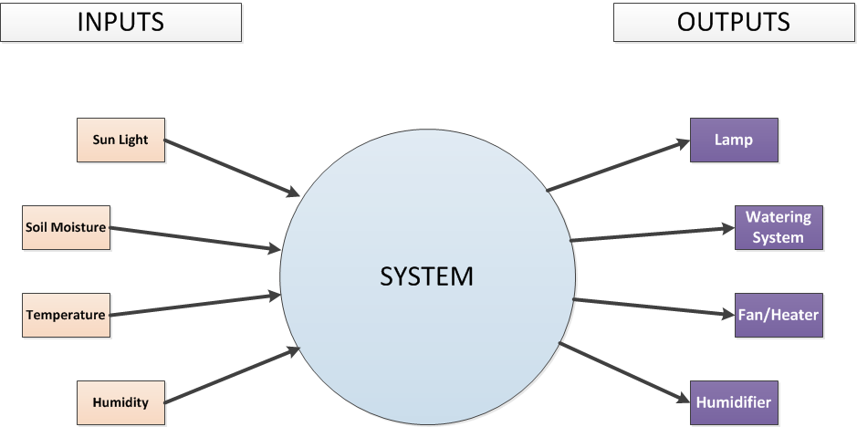
System Overview

Slide 6
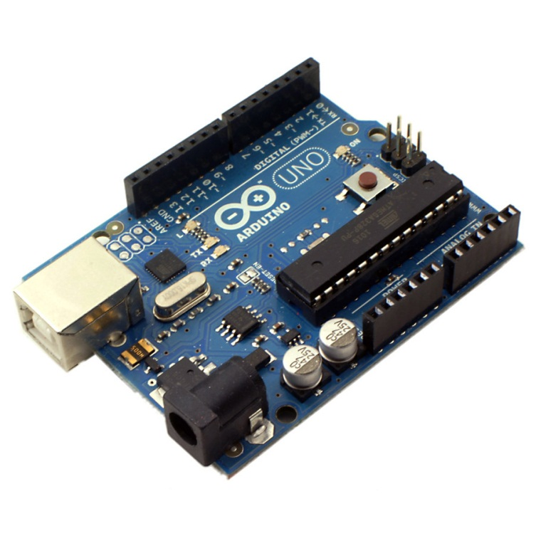
Arduino UNO
open-source electronics prototyping platform
Lets people who don’t know much about electronics (like me) to do a lot of cool things really easily.
‘Sketches” are programmed in a variation of C
Setup and loop functions

Slide 7
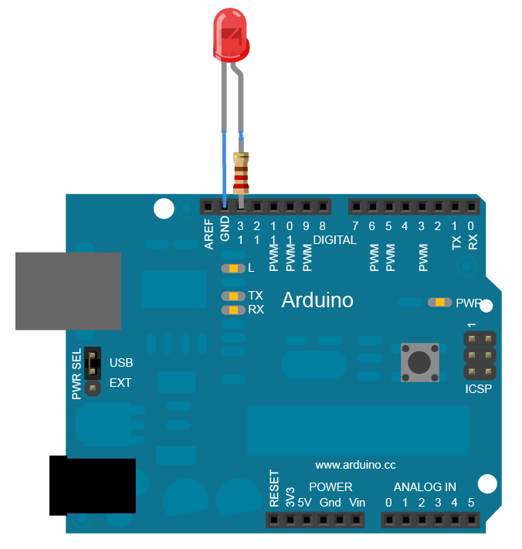
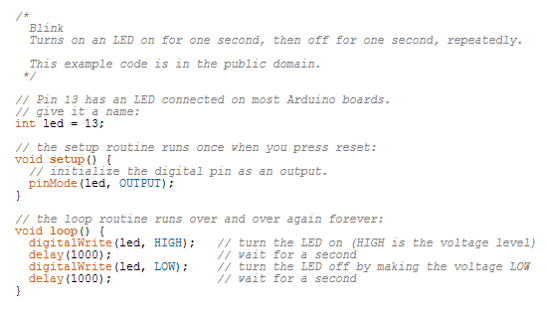
Sample Code

Slide 8
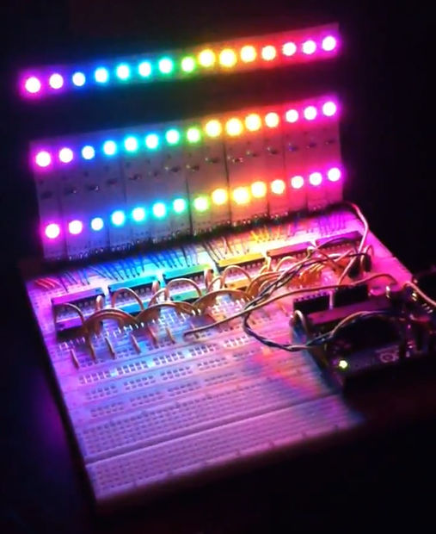
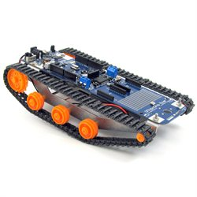
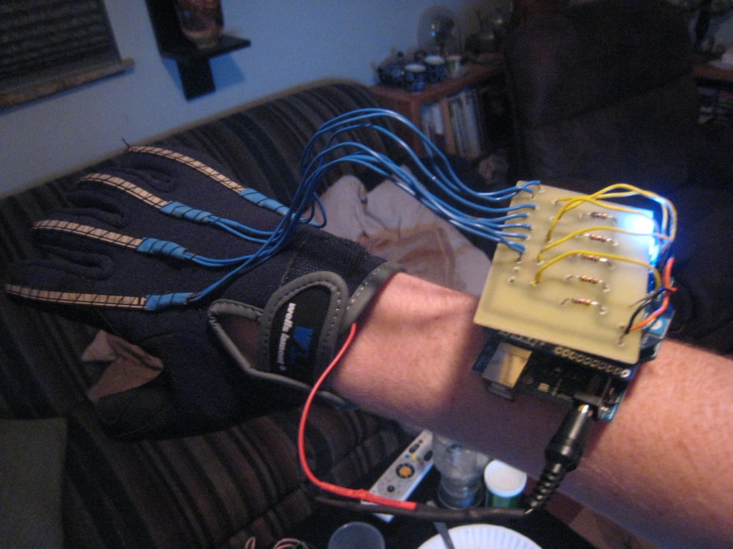
Arduino DIY Projects
Robots!
Wireless Animatronic Hand
Light Show Controller

Slide 9
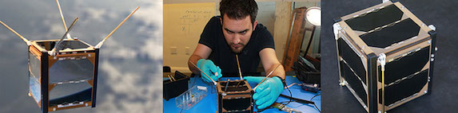
Arduino in Space
Nanosatisfi’s Ardusat Project
The world’s first open-source satellites
“The general public allowed to use on board Arduinos and sensors for their own creative purposes while they are in space”
Nov 2013 – Ardusat-1 and Ardusat-X deployed from IIS
Feb 28, 2014 – Ardusat-2 put into orbit

Slide 10
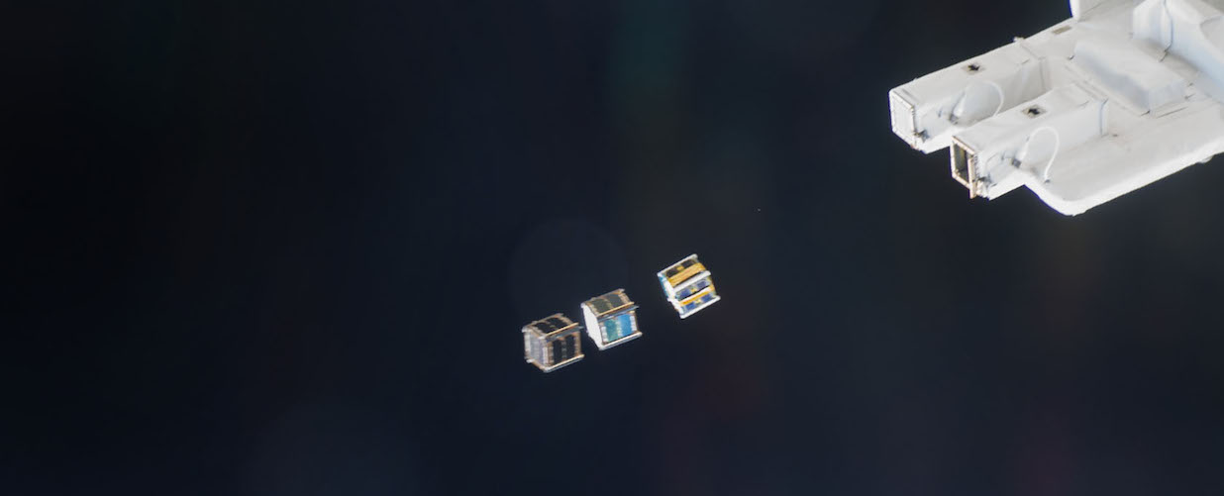
Ardusat-1 and Ardusat-X Nov 2013

Slide 11
Back to Earth…

Slide 12
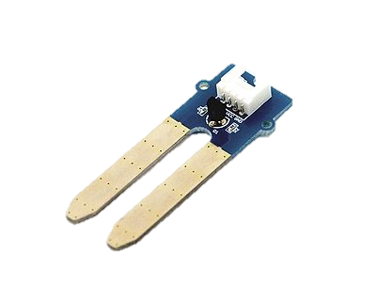
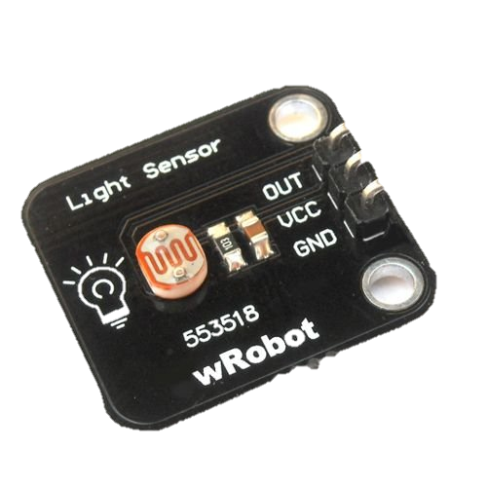
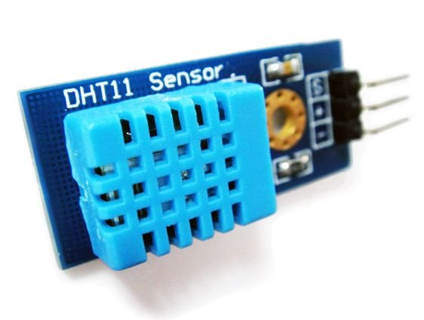
Sensors (Inputs)
Soil Moisture Sensor ($4.99)
Light Sensor ($3.83)
Temperature/Humidity Sensor
($7.99)

Slide 13
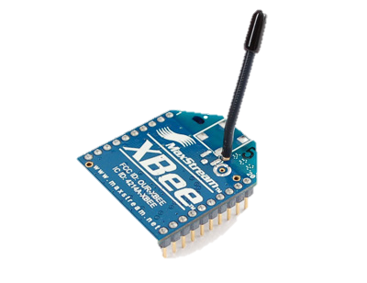
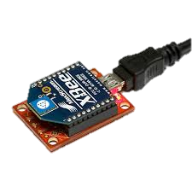
XBEE Wireless Components
Wireless Communication between Arduino hardware and computer (100ft range)
XBEE shield that sit on top of Arduino
XBEE USB dongle connects to PC

Slide 14
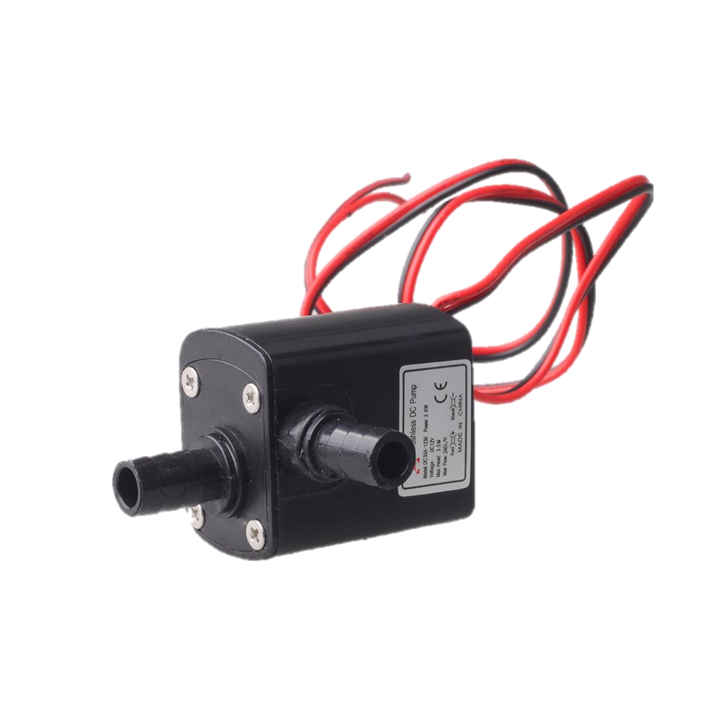
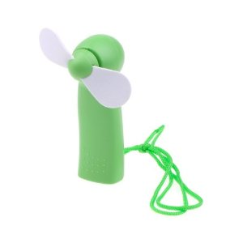
Hardware Components (Outputs)
Mini Hand Fan
($1)
5v Water Pump ($4.99)

Slide 15
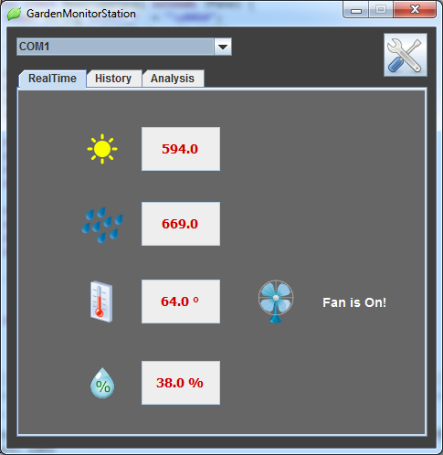
Java GUI Application
Reads the XBEE USB device and updates the GUI
*Compile/Show statistical analysis of data. (ex. Full day of data)

Slide 16
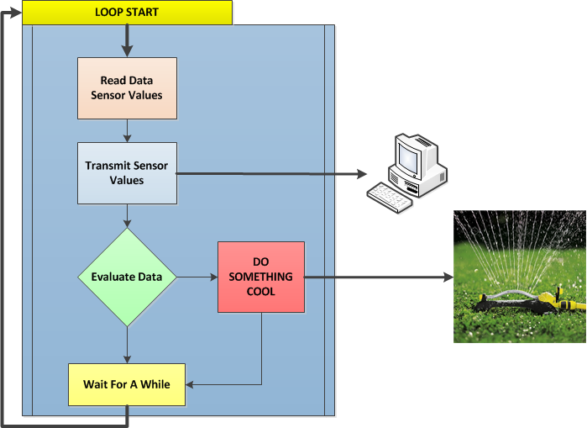
System Flow

Slide 17
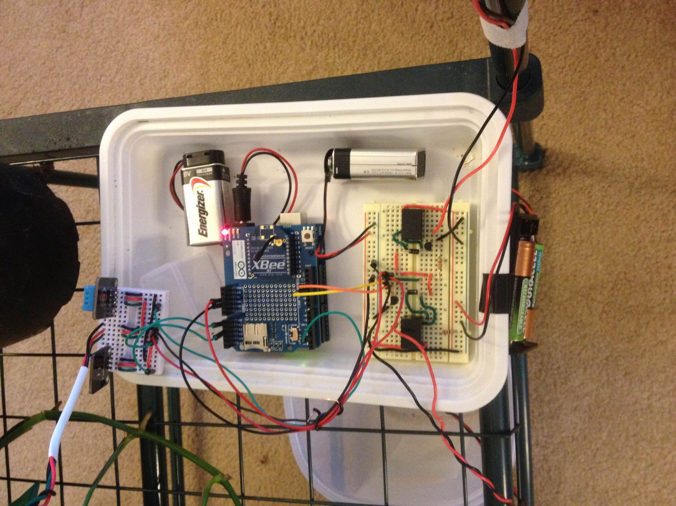
GMS System
Arduino with XBEE
Temp/Humidity Sensor
Fan Cables
Relay Control
Board
Moisture Sensor
Pump Cables
Light Sensor

Slide 18
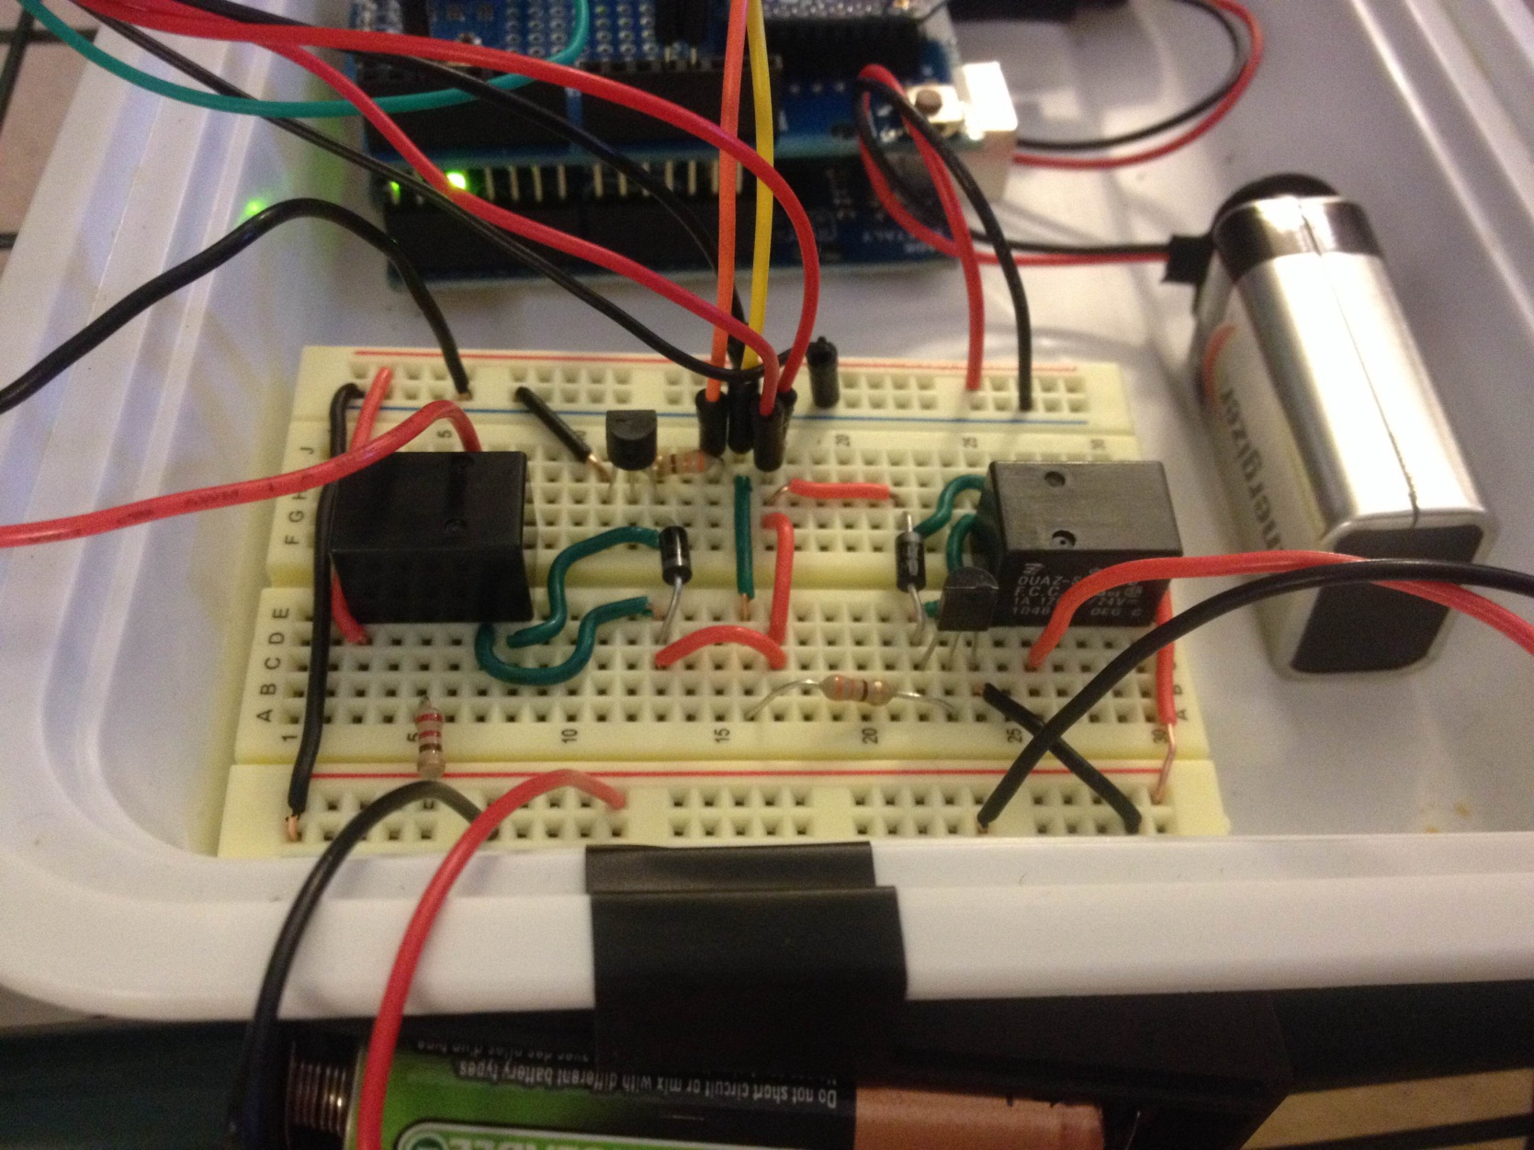
Relay Control Board

Slide 19
Demo

Slide 20
What’s Next
Add additional hardware to control
Lamp
Humidifier
Take it Outside
Electronic water valve controller
Large water pump to pump collected rain water
Additional GUI work
Analysis/graphs
Ability to turn hardware on manually
App/Web Version of GUI

Slide 21
References
Arduino
http://www.arduino.cc/
Arduino Project Ideas
http://www.instructables.com
ArduSat
https://www.kickstarter.com/projects/575960623/ardusat-your-arduino-experiment-in-space

Slide 22
QUESTIONS?

