Slide 1
CAPSTONE PROJECT
Cristiano Ronaldo – All Club Goals
Presented By:
1. Vallinayagam D-Alagappa College of Technology-Chemical Engineering

Slide 2
OUTLINE
Problem Statement
Proposed System/Solution
System Development Approach
Algorithm & Deployment
Result
Conclusion
Future Scope
References

Slide 3
PROBLEM STATEMENT
A players goals depends on many factors like
Teams he is playing for
Teams he is playing against
Position
Etc
The player chosen for analysis is Cristiano Ronaldo, his goal scoring records were used as data

Slide 4
PROPOSED SOLUTION
Using Python, an open source programming platform the dataset in CSV format collected could be cleaned - to get rid of duplicate, incomplete or false data; analysed – to find the relationships between different factors; and visualized - using various charts comparing different attributes. And predict a model that could later help in calculating future possibilities. This could help us estimate the impact of each factor on the performance of students from different backgrounds.

Slide 5
SYSTEM APPROACH
To proceed on to the proposed solution, involves a combination of data processing and data visualization. Here are the key system and library requirements
SYSTEM REQUIREMENTS: Hardware: ▪ A computer with sufficient processing power and adequate RAM to handle the size of the Dataset. Since we only require Python, most of the modernday computers could be used. Software: ▪ Operating system capable of running at least Python 2 (eg.: Windows, Linus, MacOS, etc.)

Slide 6
SYSTEM APPROACH
LIBRARY REQUIREMENTS : Data Processing: NumPy – NumPy can be used to perform a wide variety of mathematical operations on arrays. Pandas – pandas is a fast, powerful, flexible and easy to use open source data analysis and manipulation tool, built on top of the Python programming language. Data Visualisation Matplotlib – Matplotlib is a comprehensive library for creating static, animated, and interactive visualizations in Python Seaborn - Seaborn is a Python data visualization library based on Matplotlib. It provides a high-level interface for drawing attractive and informative statistical graphics.
Data Modelling : Scikit-learn - Scikit-learn is probably the most useful library for machine learning in Python.

Slide 7
ALGORITHM & DEPLOYMENT
DATA PROCESSING:
Procuring Data : The data used was obtained online as a CSV file.
Importing the necessary libraries: The aforementioned libraries are imported into the file.
Loading the Dataset : After inputting the path of the file from the computer, command the programme to read the file.
Displaying the Dataset: The first five rows of the Dataset could be viewed and also the total number of rows and columns of the same are also prompted to be displayed.

Slide 8
ALGORITHM & DEPLOYMENT
DATA PROCESSING:
5. Handling the Dataset: The Dataset is checked for any blank or duplicated value. Thankfully, none of the above problems arose. Next, the type of each header is obtained. Following this, the number and the name of the unique elements in each category is obtained. The described function is to obtain the count, mean, standard deviation, minimum value, maximum value, 25% value, 50% value and 75% value.
6. Data Analysis : The number of students who obtained full marks and below 20 marks is determined in each subject.

Slide 9
ALGORITHM & DEPLOYMENT
DATA VISUALISATION :
Line over Histogram Plot : A line over histogram plot has been plotted for average score vs overall student count and another plot is for average score vs Male and Female students. Three similar plots are generated for different factors, these are: • Average score vs Student • Average score vs Female student • Average score vs Male student
2. Violin Plot : Violin plot is used to determine the following for each subject: • Median

Slide 10
ALGORITHM & DEPLOYMENT
First Quartile • Third Quartile • Maximum Value • Minimum Value
3. Pie Chart: The percentage of students in each category has been given.

Slide 11
ALGORITHM & DEPLOYMENT
DATA MODELLING:
Data preprocessing : The X and y variables are made reading for being used for modelling. Columns are transformed using OneHotEncoder for objects and StandardScalar for numerical values.
2. Separating dataset: The data points are split into train and test data.
3. Linear Regression : The train data fit in the linear regression model.
4. Test model : The model is tested using the test data.

Slide 12
ALGORITHM & DEPLOYMENT
5. Evaluation: The parameters like mean absolute square, mean squared error, root mean squared error and R2 are evaluated.
6. Visualization : The predicted and actual values are plotted to validate our model.

Slide 13
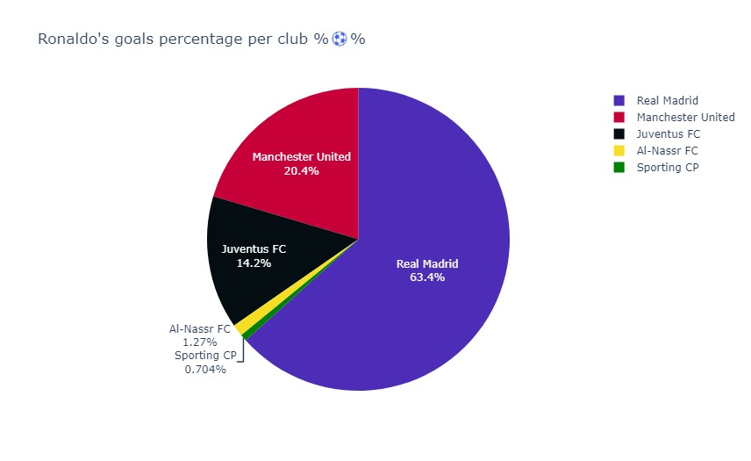
RESULT

Slide 14
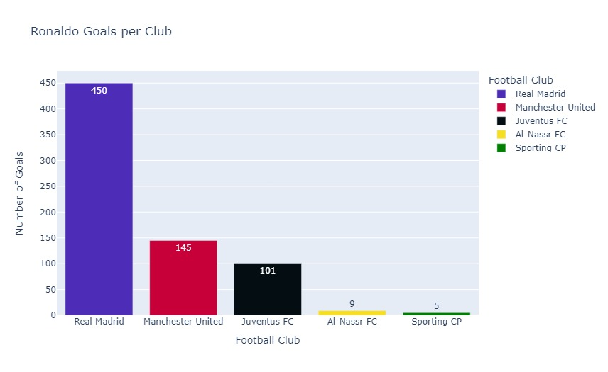
RESULT

Slide 15
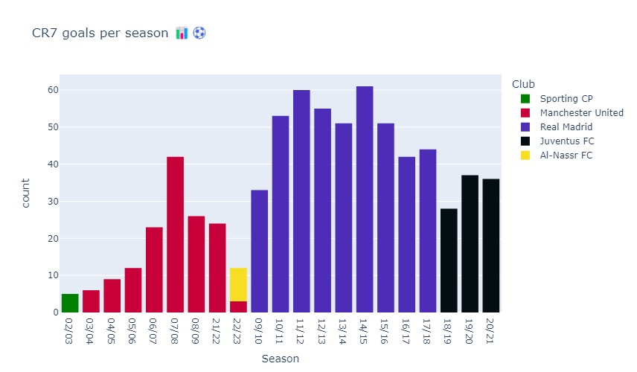
RESULT

Slide 16
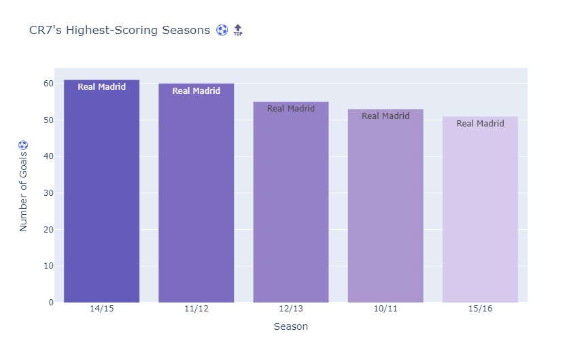
RESULT

Slide 17
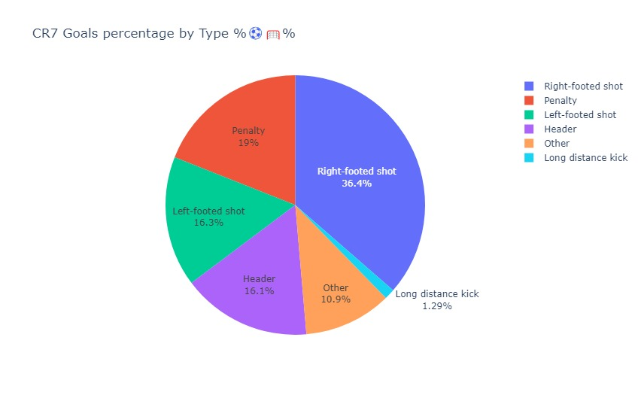
RESULT

Slide 18
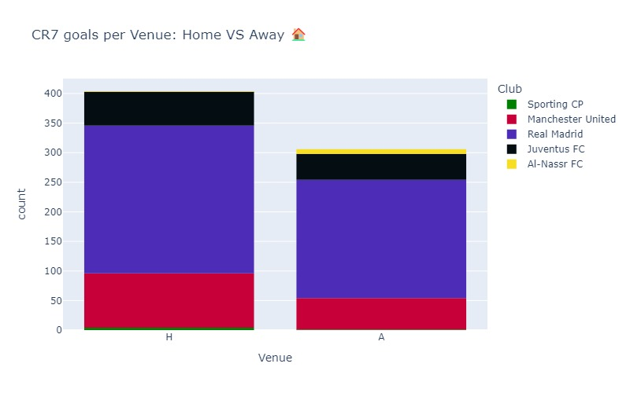
RESULT

Slide 19
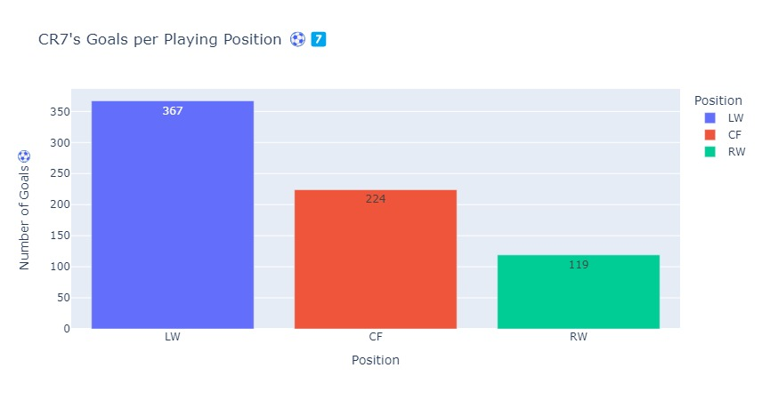
RESULT

Slide 20
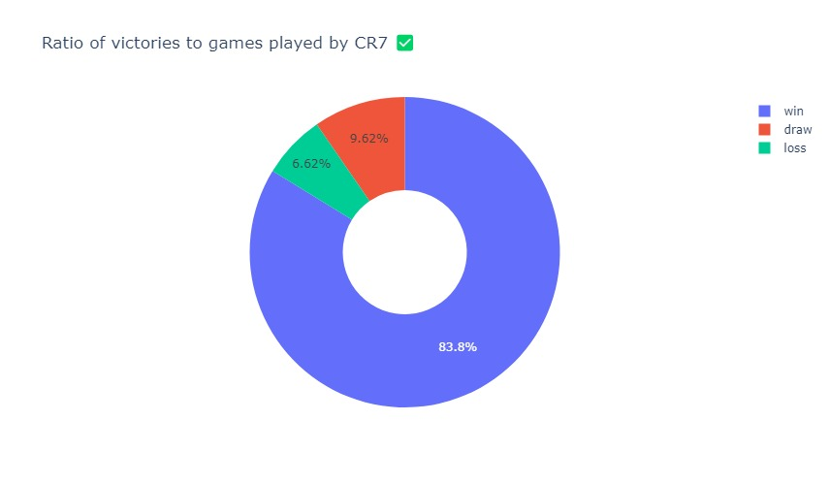
RESULT

Slide 21
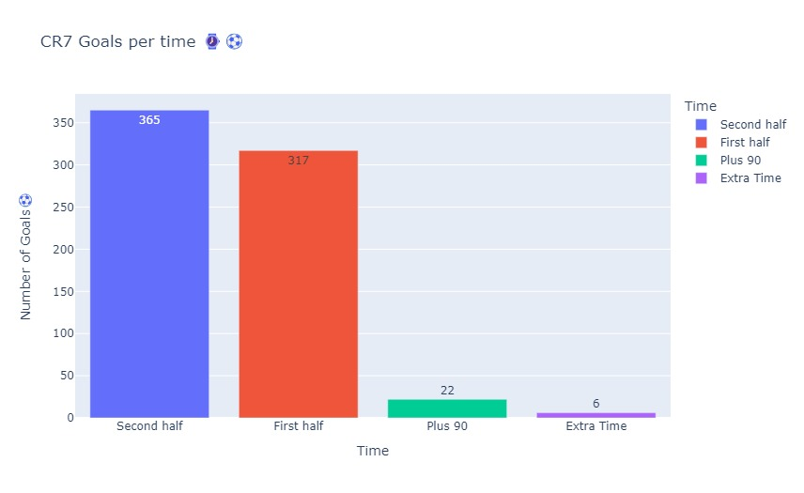
RESULT

Slide 22
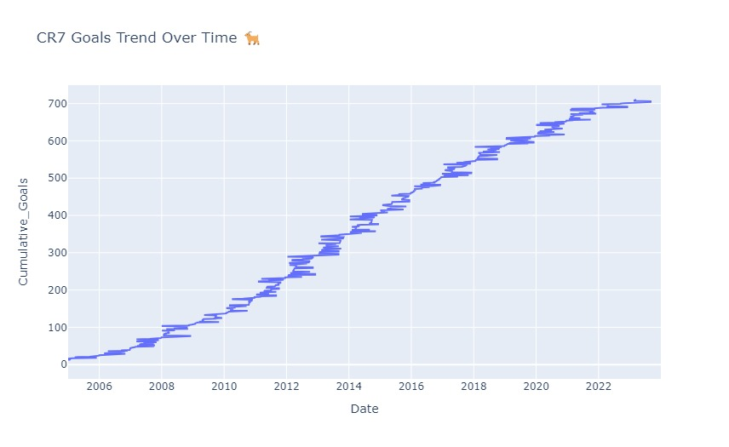
RESULT

Slide 23
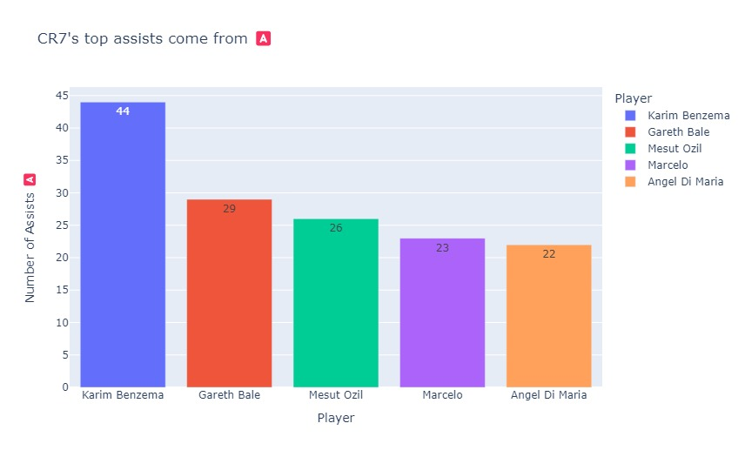
RESULT

Slide 24
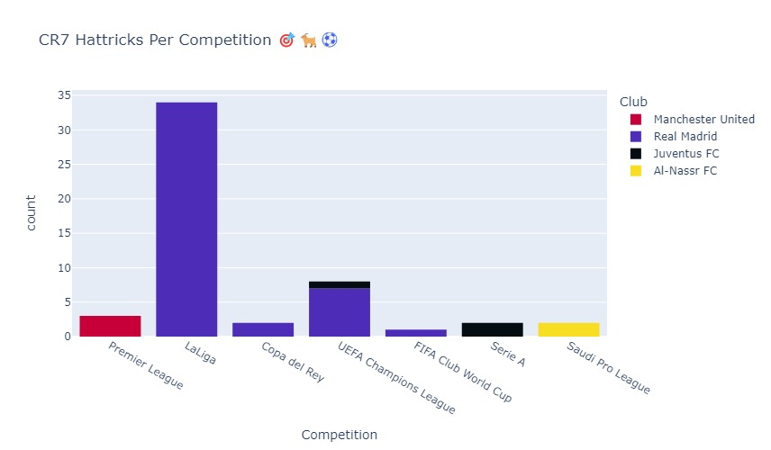
RESULT

Slide 25
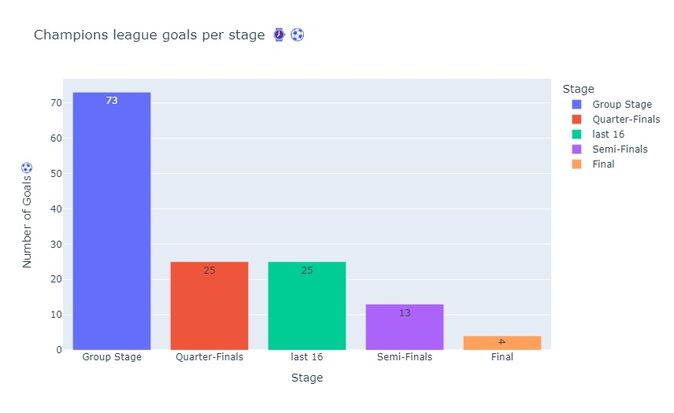
RESULT

Slide 26
CONCLUSION
Based on the data, various plots for comparison of the performance of students based on various factors. A model has been generated to predict the performance by using the data.

Slide 27
FUTURE SCOPE
The model can be used to predict the performance of a student given the necessary information, with this the necessary training could be given to the student to excel.

Slide 28
REFERENCES
• https://www.kaggle.com
• https://pandas.pydata.org
• https://numpy.org
• https://scikit-learn.org/stable
• https://matplotlib.org
• https://seaborn.pydata.org

Slide 29
THANK YOU

