Slide 1


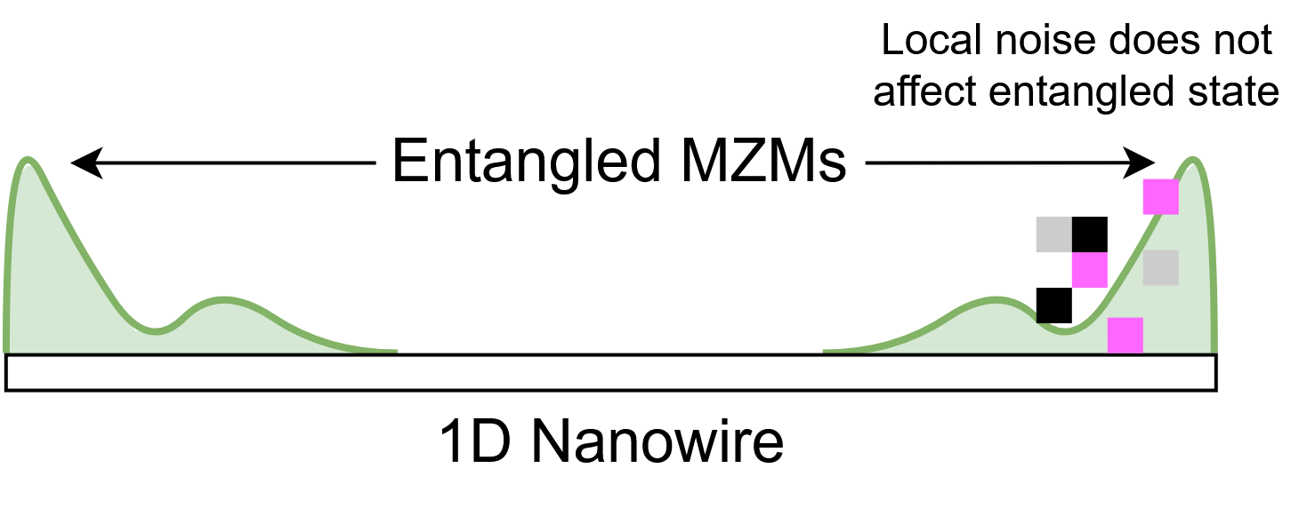
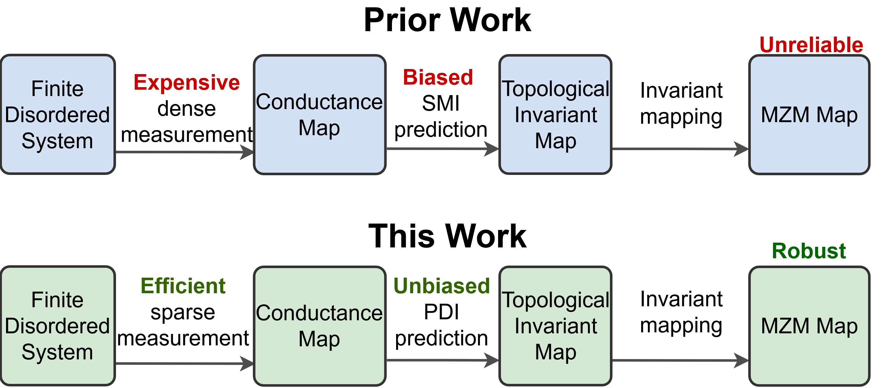
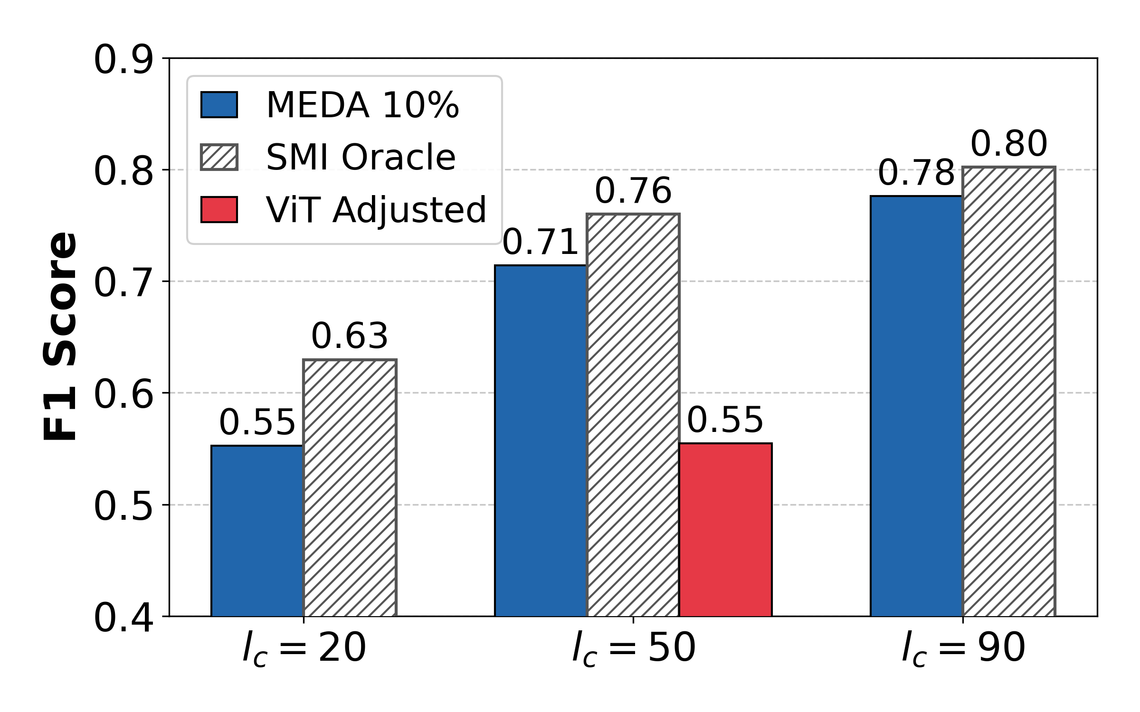
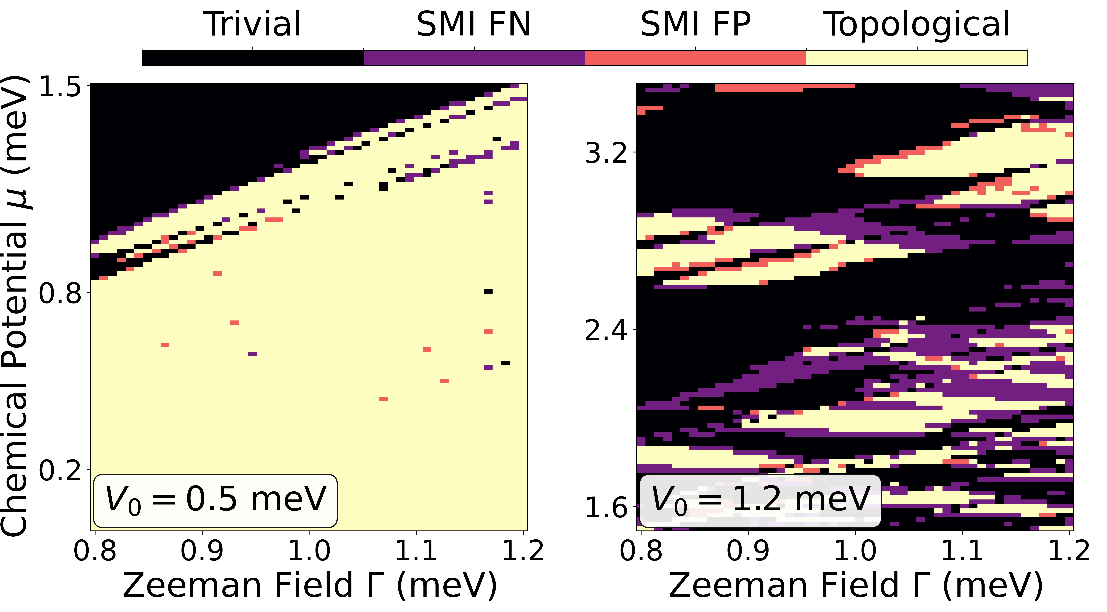
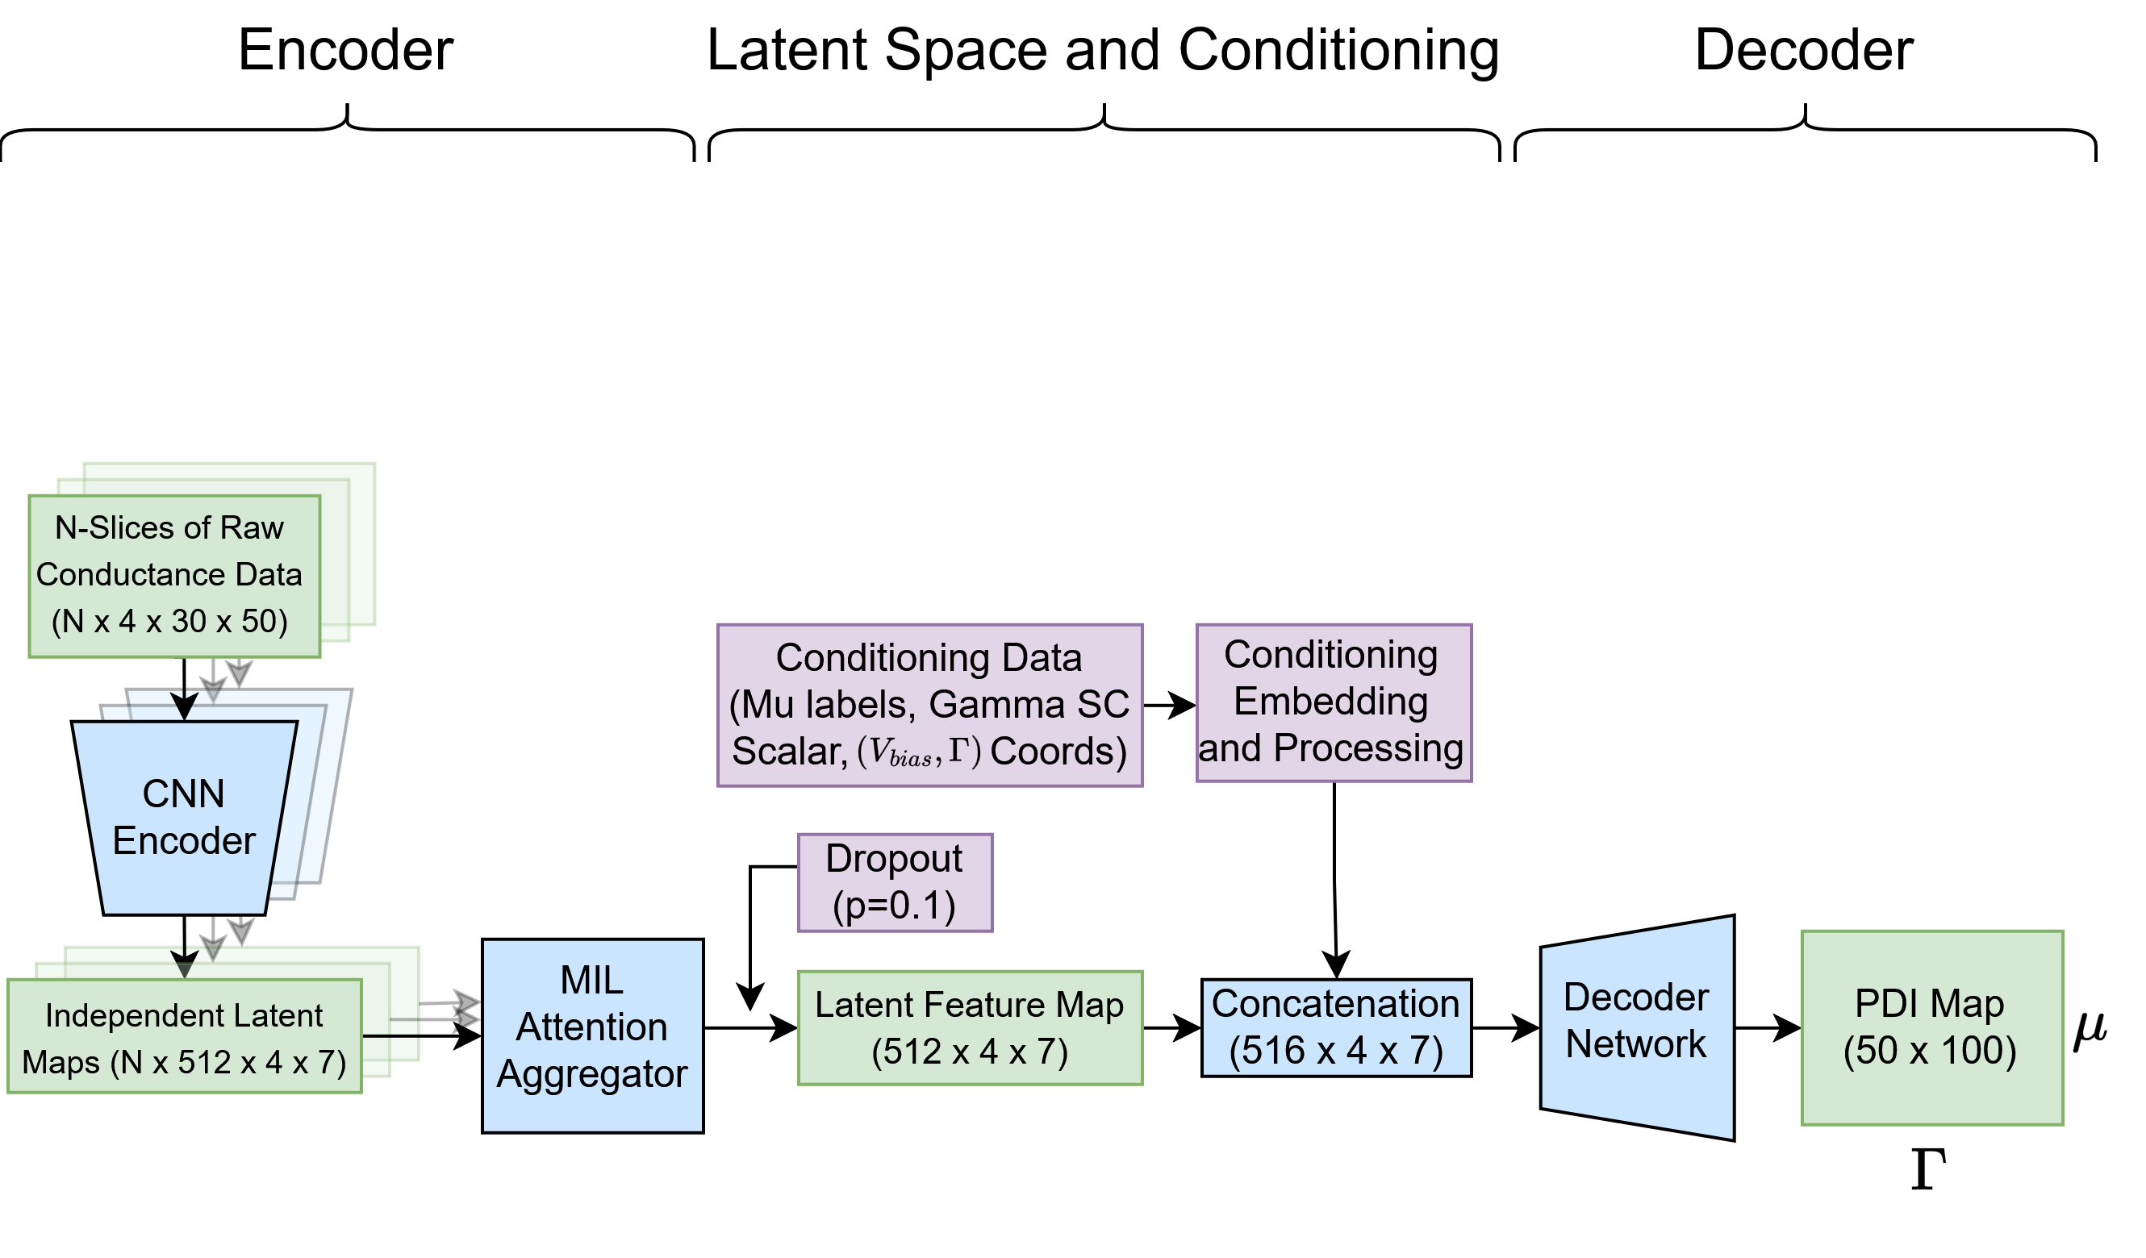
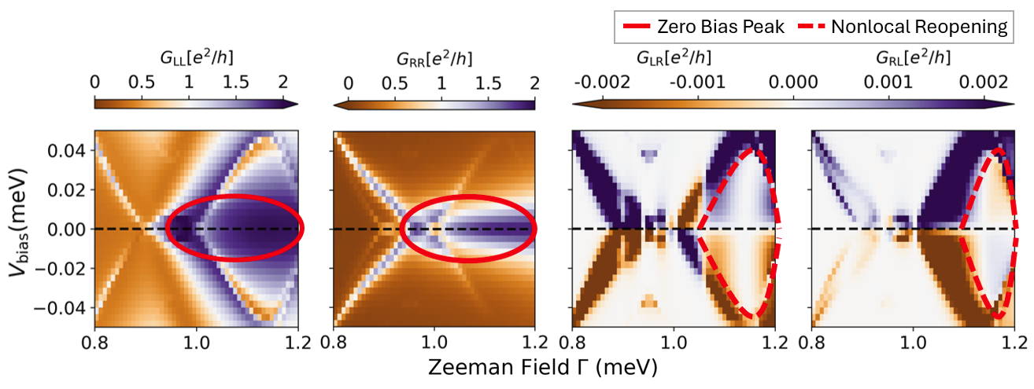
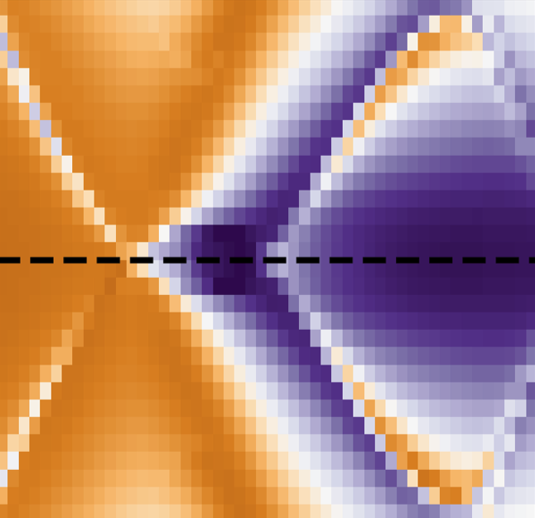



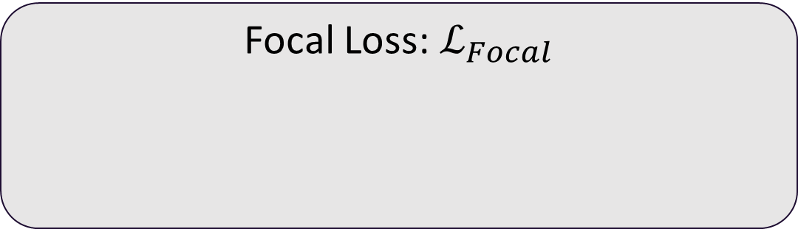
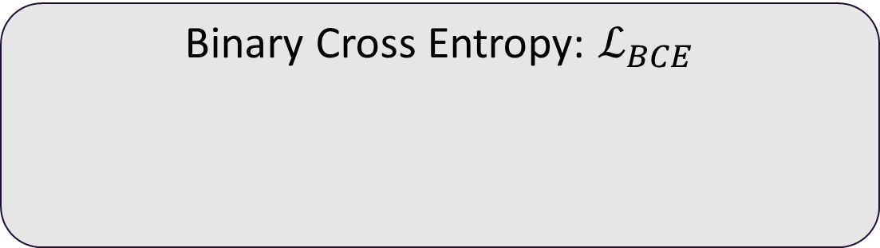
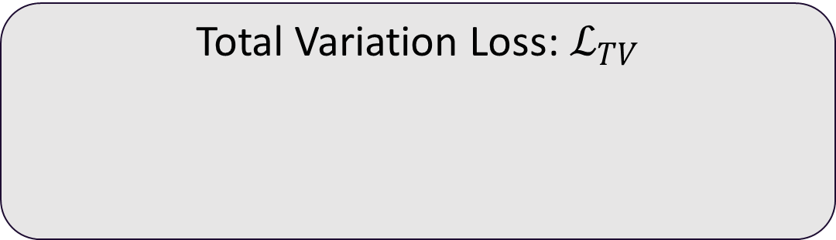
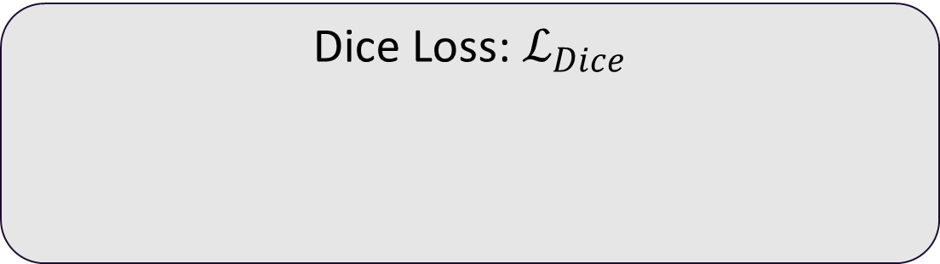
MEDA: Measurement-Efficient Disorder-Aware Majorana Zero Mode Detection in Realistic Devices
Nathan Jones*, Binayyak Roy, Valentine Mohaugen, Ian Lewis, Toby Cox, Sumanta Tewari, Rong Ge | *najones@clemson.edu
Fault Tolerance via MZMs
MEDA Overview
Composite Loss Function
Majorana Zero Modes (MZMs):
non-Abelian quasiparticles
emerge in topological superconductors
Data stored in entanglement: resilient to local noise
MEDA is a Measurement Efficient, Disorder-Aware ML framework for MZM detection in realistic devices.
Measurement Efficient: MEDA uses a sparse parameter regime to decrease measurement requirements by 10x
Disorder-Aware: MEDA maps observables to the PDI, which leverages system awareness to avoid biases
High disorder causes the topological phase space to drastically shrink and shatter, causing challenges for standard optimization strategies. To prevent the model from falling into a trivial-majority local minimum, MEDA utilizes a physically motivated composite loss function:
Problem: How do we know MZMs exist?
Binary Cross Entropy: $ℒ_{BCE}$
Focal Loss: $ℒ_{Focal}$
Provides the foundational pixel-wise classification gradient for the model.
Dynamically down-weights the dominating trivial majority, increasing focus on rare, hard-to-predict pixels near quantum phase transitions.
MZM Detection in Simulation
Dice Loss: $ℒ_{Dice}$
Total Variation Loss: $ℒ_{TV}$
Prior Topological Indicators like the Scattering Matrix Invariant (SMI) attempt to translate rules from infinite, clean systems to realistic systems.
Realistic systems have unique behaviors that bias topological indicators:
Evaluates spatial overlap, heavily penalizing the model if it completely misses small, fragmented MZM islands.
Penalizes overfragmentation to prevent unrealistic noise artifacts common with sparse inputs. Recognized trade-off: limited ability to differentiate highly fragmented phase regions.
Scalar weights are optimized as hyperparameters to tune sensitivity and stability.
Finite size causes unexpected interaction between MZMs
Disorder fuzzes MZM-heralding features
Results
The Periodic Disorder Invariant (PDI) aims to eliminate such biases through disorder aware design. Instead of applying ideal rules to a finite disordered system, PDI considers the limit of replicating a finite disordered system.
MEDA Architecture
Despite using only 10% of observable data, MEDA achieves performance comparable to the SMI Oracle and offers significant improvement over ViT, the state-of-the-art SMI-based prediction pipeline.
MEDA utilizes an attention-driven multiple instance learning (MIL) architecture to identify the most topologically informative regions of the conductance map, enabling MEDA’s sparse-measurement paradigm.
For finite disordered systems, SMI becomes increasingly biased as disorder increases. PDI is designed to solve this problem.
CNN Encoder: Captures state evolution across slices
MIL Attention Aggregator: Weighted aggregation according to information density, resulting in maximally informative latent feature map
Latent Bottleneck: Enforces manifold learning to compress extracted physics into a dense global representation.
Conditioning: Injects inductive spatial priors to re-anchor permutation-invariant latent features to exact parameter-space coordinates.
Upsampling Decoder: Projects spatially-conditioned global features onto a 2D grid, enabling continuous phase boundary interpolation and robust extrapolation into unsampled regimes.
MZM Detection in Real Systems
MEDA's attention weights heavily prioritize conductance maps with clearly visible conductance features that Morteza et al. establish as indicators of high topological phase probability.
Topological indicators, including PDI, rely on unobservable information, making them infeasible for real systems. Machine learning approaches aim to connect observables to topological indicators but face severe measurement bottlenecks.
Each pixel in this conductance plot requires an independent measurement. Full parameter space coverage for one device requires 720,000 such images.
Experimental Efficiency: MEDA's architecture extracts global topological rules from sparse, unanchored conductance slices, interpolating complete and accurate phase diagrams without the need for exhaustive experimental sweeps.
Acknowledgments
This work is supported in part by the South Carolina Quantum Association, U.S. National Science Foundation under Award No. 2017965, the Clemson Palmetto 2 Cluster, and Clemson Creative Inquiry.
How can we integrate PDI with under a feasible measurement budget?
Full Paper

