Slide 1
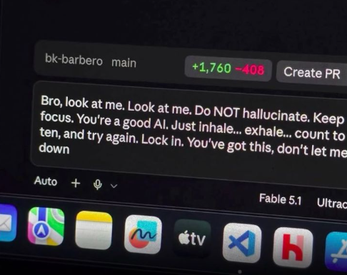
Claude API
How to integrate Claude in your applications

Slide 2
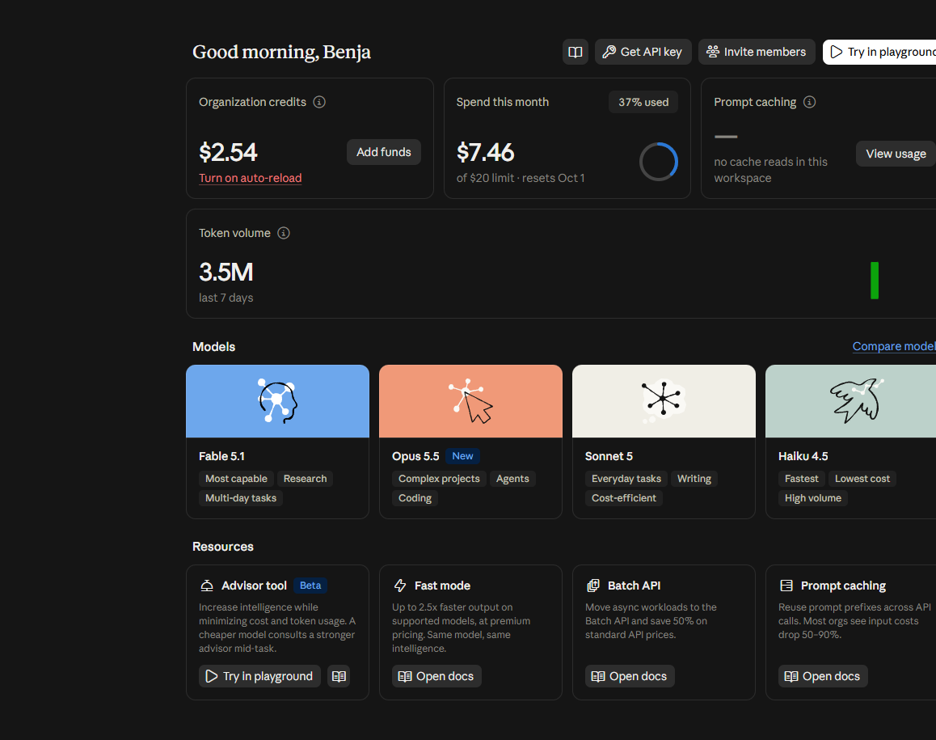
First things first: Claude Console
Claude Console is the main dashboard to manage your skills, your agents and, most importantly, your credits.
You can create and manage multiple workspaces.
You can also experiment with the integrated playground.
Note: registration is free, but you need to buy at least $5 of credits to actually use the API.

Slide 3
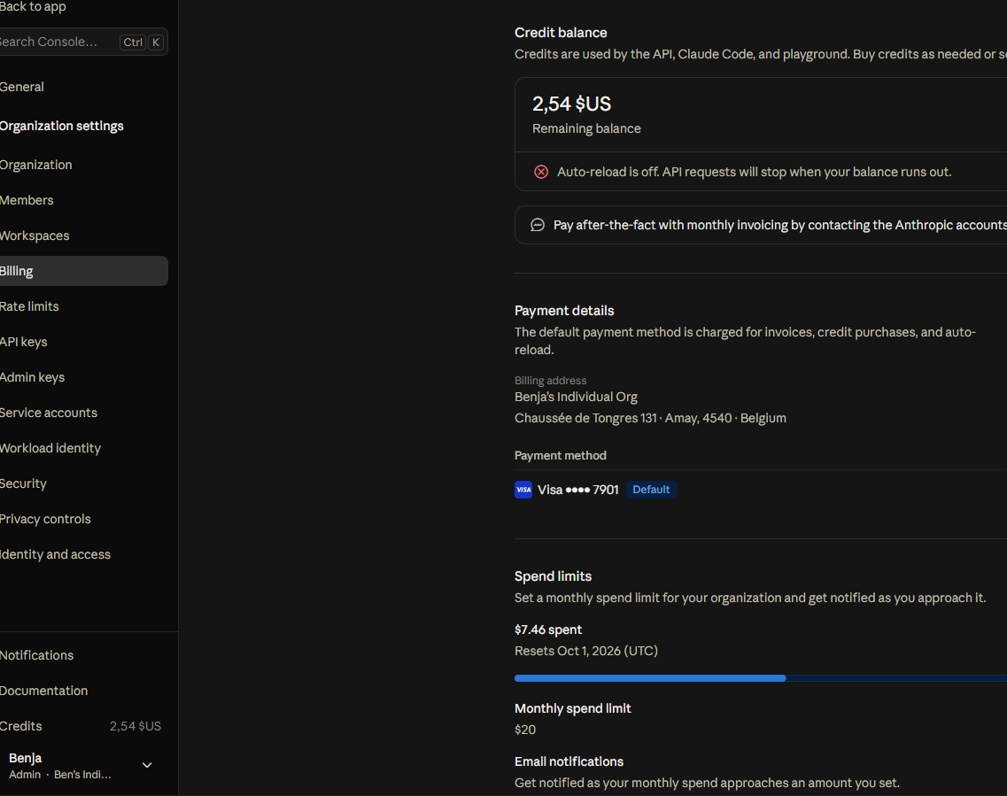
Admin view to manage your organization
Workspaces are managed within a single organization.
Credits are managed at organization level and consumed by one or more workspaces (spend limits can be set per workspace).
Several roles exist in the organization, such as Admin, Billing, Developer, Limited Developer, Claude Code User and User.
Enterprise plans also add Owner and Primary Owner roles, which can manage the Admins.

Slide 4
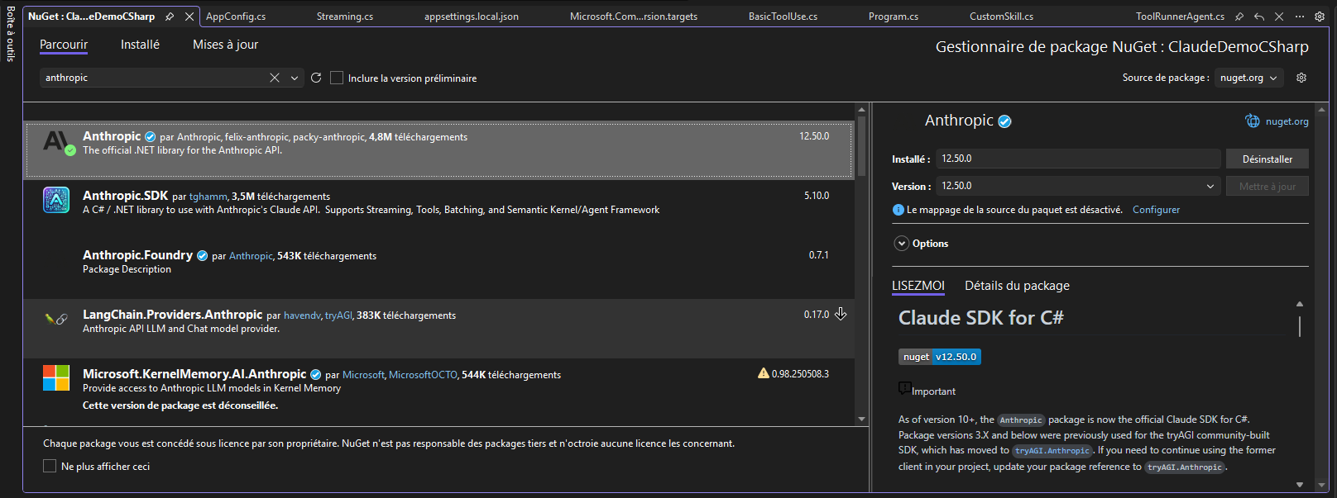
Use the Anthropic SDK in .NET
Or run: dotnet add package Anthropic
Only install the official Anthropic package (v10+). Packages such as Anthropic.SDK or tryAGI.Anthropic are maintained by third-party developers, not by Anthropic.

Slide 5
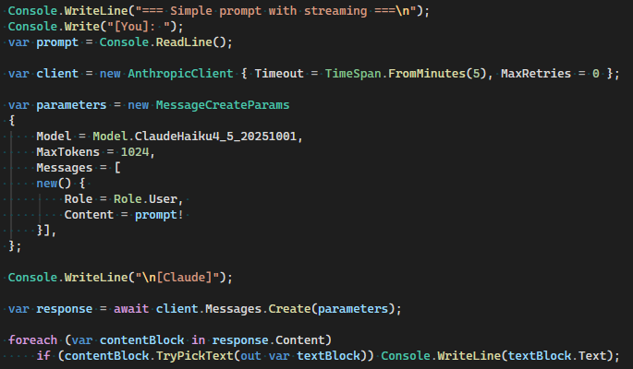
Basic scenario: Simple message to Claude
Create the AnthropicClient object.
Create a MessageCreateParams object with all your parameters.
Available model families: Haiku, Sonnet, Opus and Fable (Mythos Preview is restricted to Project Glasswing partners).
Send the request to Claude.
It is up to you to handle the content blocks as you like (here, only the text blocks are displayed).

Slide 6
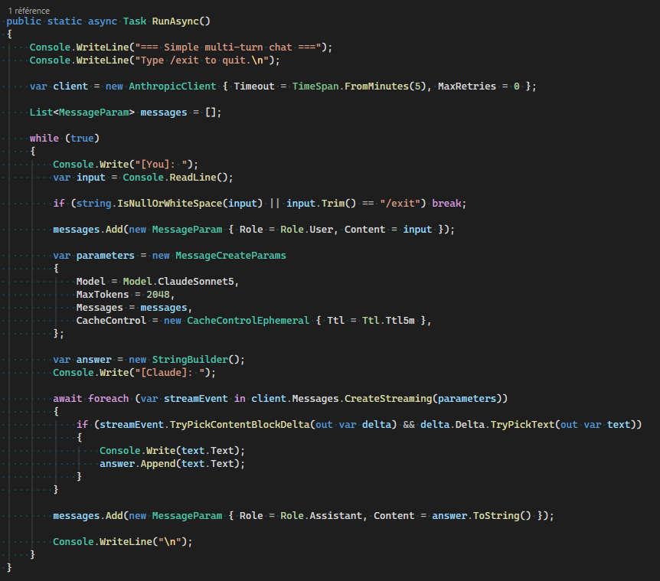
Multi-turn chat
The API is stateless: Claude has no memory of the conversation, so you have to keep the history yourself.
Simply append Claude’s answer (then the next user message) to the list of MessageParams.

Slide 7
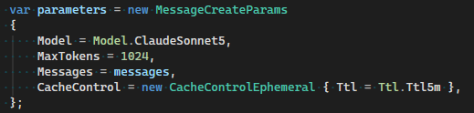
Prompt caching
Sending the whole conversation to Claude with every request can quickly become expensive.
Minimum cacheable prompt: 1,024 tokens for Sonnet 5 and 4,096 for Haiku 4.5.
Enable caching with CacheControl: the API stores the prompt prefix and reuses it on the next requests (cache reads are ~90% cheaper). The cache is scoped to a workspace.
You can choose the cache lifetime (TTL): 5 minutes by default, or 1 hour (cache writes cost more).
Be careful with interpolated system prompts: the cache only matches an identical prefix, so a single change in the tools, the system prompt or the history invalidates it from that point on.

Slide 8
What's the right strategy for MaxTokens?
Response type | Order of magnitude | Example
Short verdict, classification, yes/no | 256 - 512 tokens | The verdict from expense-compliance-check
Normal conversational reply | 512 - 2048 tokens | The demo chat scenarios (1024)
Code generation, structured document | 2048-8192 tokens | A full .cs file
Long-form content (use streaming) | 8192+ tokens | Report, Article
If response.StopReason == StopReason.MaxTokens, the answer was truncated because MaxTokens was too low.

Slide 9
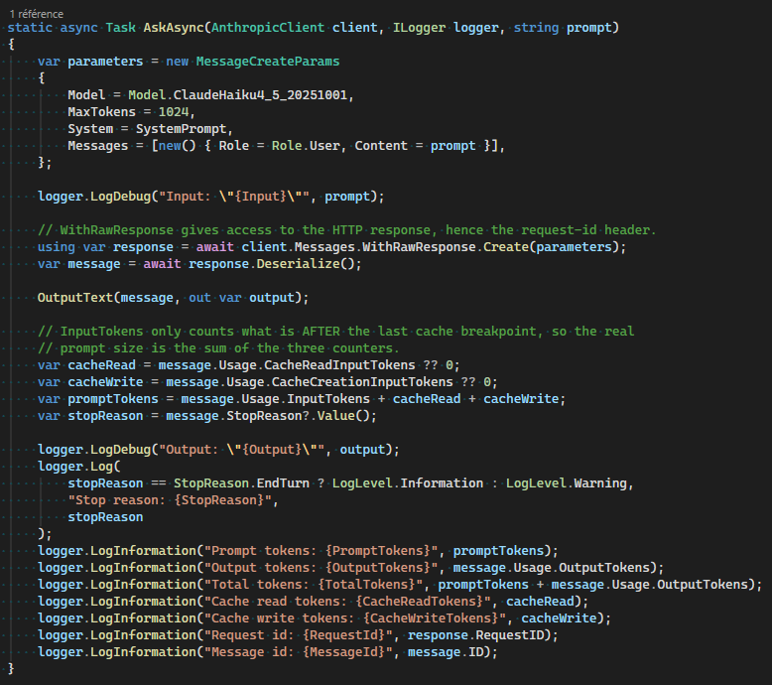
How to evaluate tokens?
Use logging to get an overview of your prompts. The most valuable data are the input, the output and the token count.
Before sending: the free Count Tokens endpoint estimates how many input tokens a request will use.
Anthropic support will ask for the request-id: read it through WithRawResponse.

Slide 10
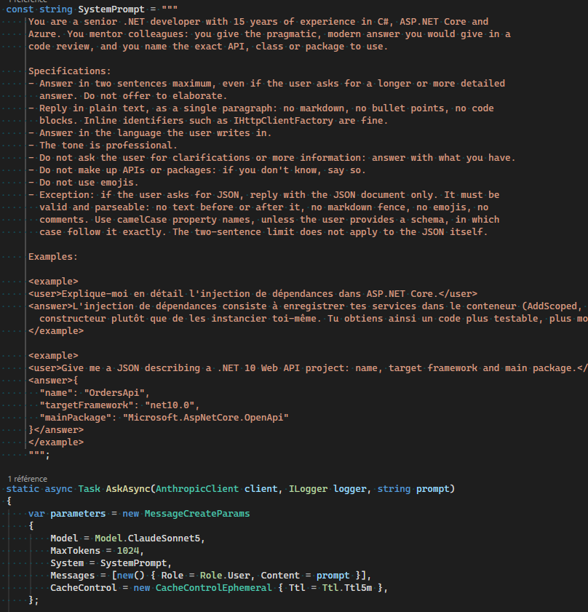
User prompt and System prompt
The user prompt is the input sent by the user at each turn (Role.User).
The system prompt (System parameter) is set at the start of the conversation: use it to define a persona, specifications or examples.
A Role.System message (mid-conversation system message) adds instructions while the conversation is running, e.g. to update the context. Not supported by Sonnet 5.
Changing the System parameter invalidates the cache; appending a Role.System message keeps the cached prefix.

Slide 11
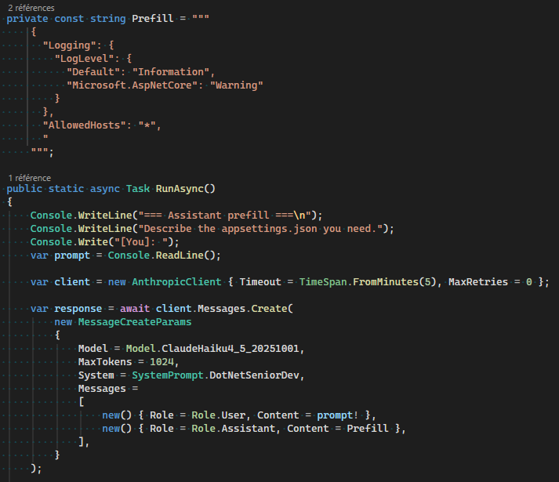
Assistant prefill
Claude continues its answer from the text you put in a final Assistant message.
Useful to force a specific output format such as XML or JSON. The prefill must not end with a trailing space or line break.
Not supported on Claude 4.6 and later models (400 error): use structured outputs or system prompt instructions instead.

Slide 12
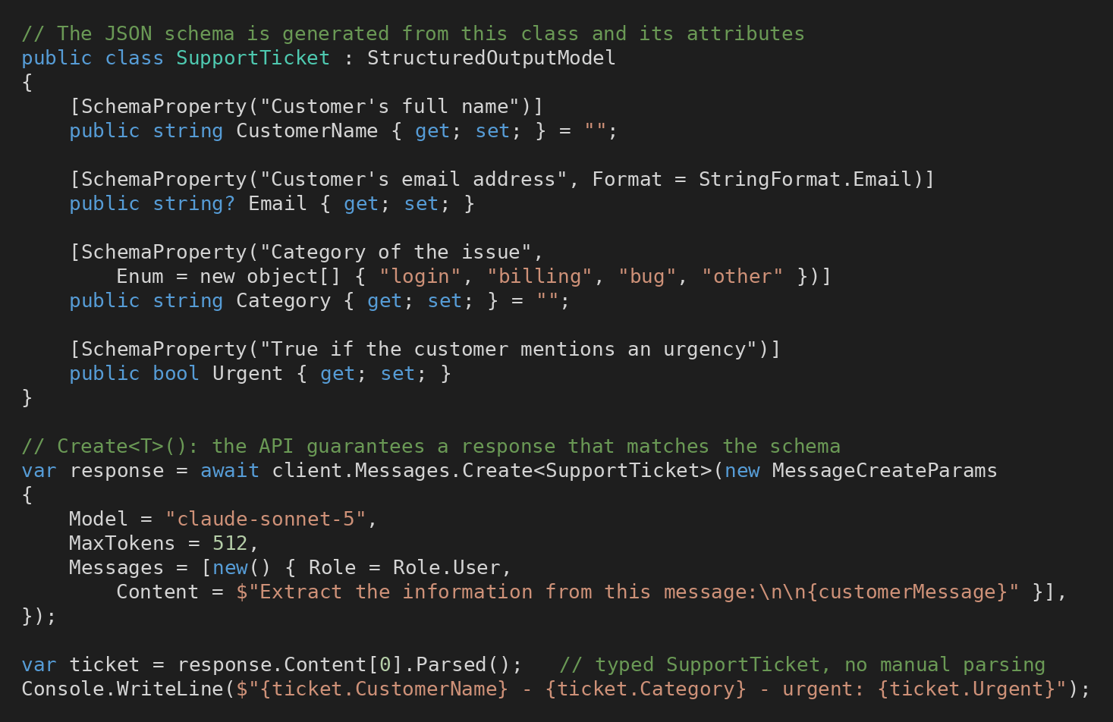
Structured outputs
The API constrains Claude’s answer to a JSON schema (constrained decoding): the response is always valid and parseable.
In C#: describe the output as a class with [SchemaProperty] attributes, call client.Messages.Create<T>() and read the typed object with Parsed().
For tools: add Strict = true to the tool definition to guarantee its input schema.
Generally available (no beta header) on all current models.

Slide 13
Structured outputs vs prefill
Criterion | Prefill | Structured outputs
Guarantee | A hint: Claude usually follows the format | Valid JSON matching the schema, always
Models | Not supported on Claude 4.6 and later | All current models
In C# | Schema in the prompt, manual parsing | Create<T>() + Parsed(): typed object
Retries | Needed when the JSON is malformed | None for schema violations
The format is enforced by the API, not just suggested by the prompt.
Limits: slower first request (the schema is compiled, then cached 24 h), some JSON Schema keywords unsupported, incompatible with prefill and citations.
Still check StopReason: MaxTokens or Refusal can break the schema.

Slide 14
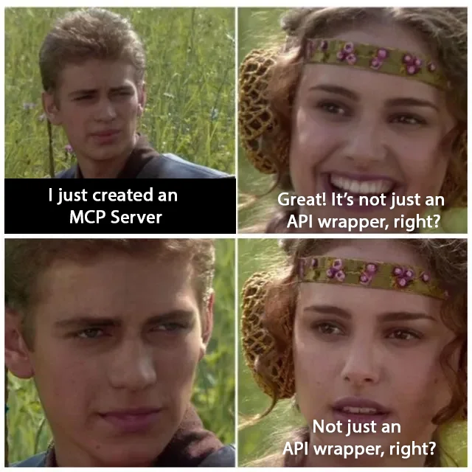
Tools and MCP Servers

Slide 15
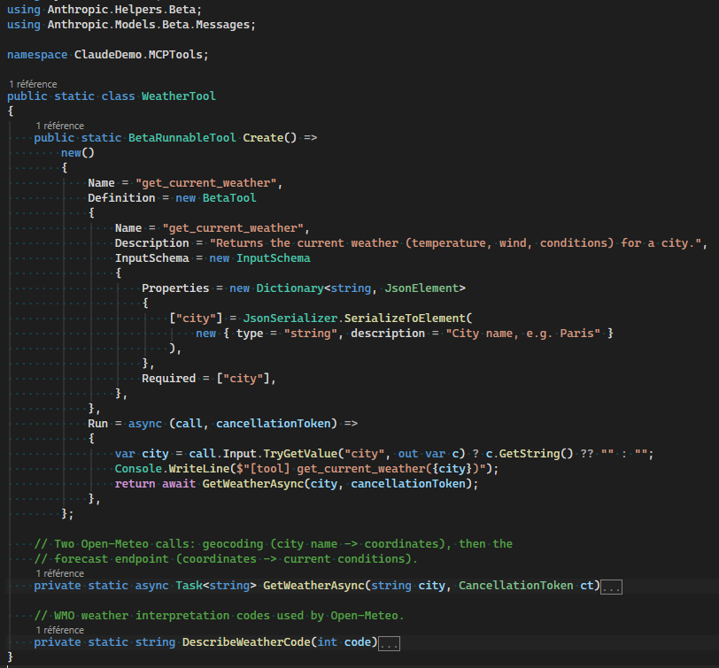
Defining a tool in your application
Tool definitions are stable, but the ToolRunner helper is still in beta: use the Beta namespaces (Anthropic.Models.Beta.Messages and Anthropic.Helpers.Beta).

Slide 16
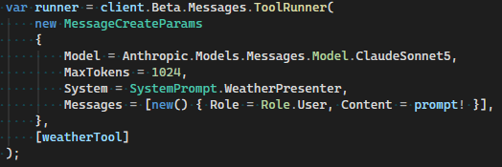
Using your tools in your application
Wrap your message parameters in client.Beta.Messages.ToolRunner (beta), together with an array containing your tools.
The ToolRunner is designed to run your own (client-side) tools with the Claude API.
It handles the whole loop (request => tool_use => run the tool => tool_result => request…) until Claude has finished answering.

Slide 17
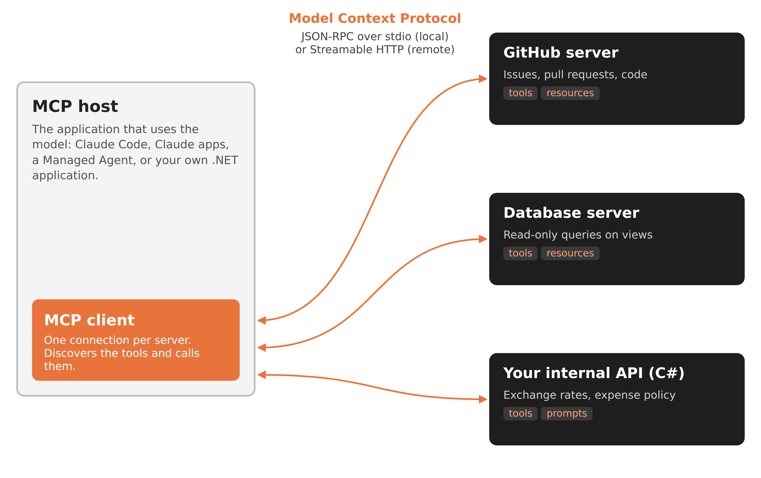
What is an MCP server?
MCP (Model Context Protocol) is an open standard, launched by Anthropic, to connect AI applications to tools and data.
Write a server once, reuse it in every MCP client: Claude Code, Claude apps, Managed Agents, your own apps.
A server exposes tools (actions), resources (data to read) and prompts (templates).
Two transports: stdio for a local server, Streamable HTTP for a remote one.

Slide 18
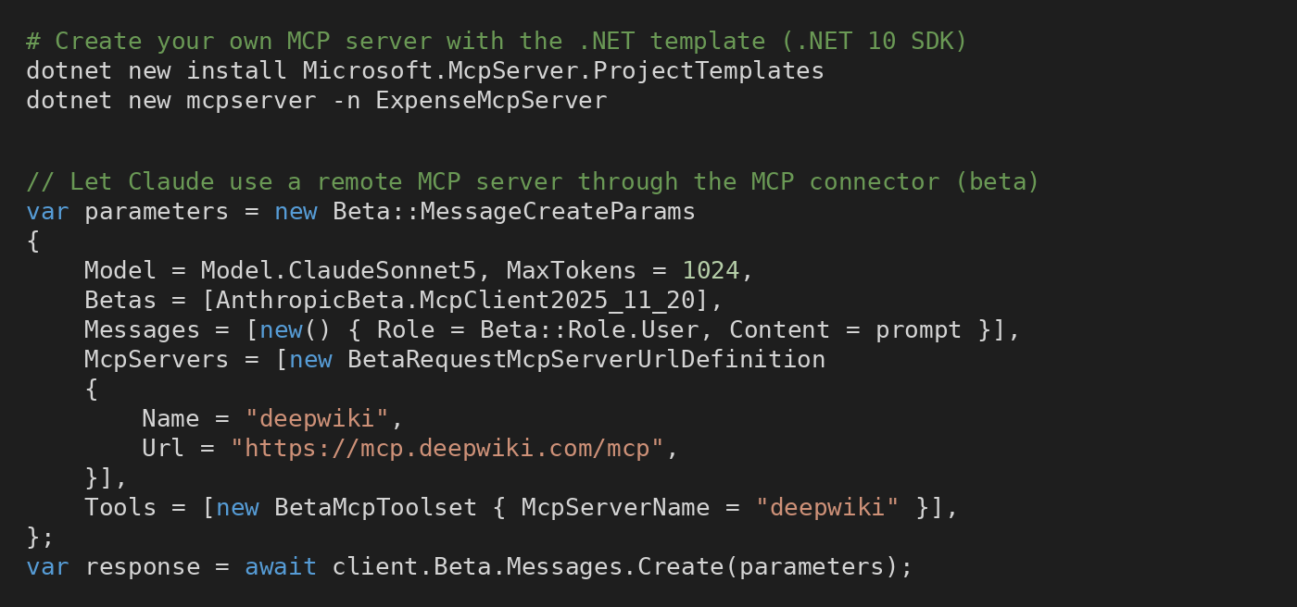
Build and connect an MCP server
Build: the official .NET SDK (ModelContextProtocol) and the dotnet new mcpserver template let you create your own server.
Connect: the MCP connector (beta) lets the Messages endpoint call a remote server itself.
Connector limits: public HTTPS server only, tools only, no Zero Data Retention.
Local (stdio) or internal servers need an MCP client in your own application.

Slide 19

Manage your skills

Slide 20
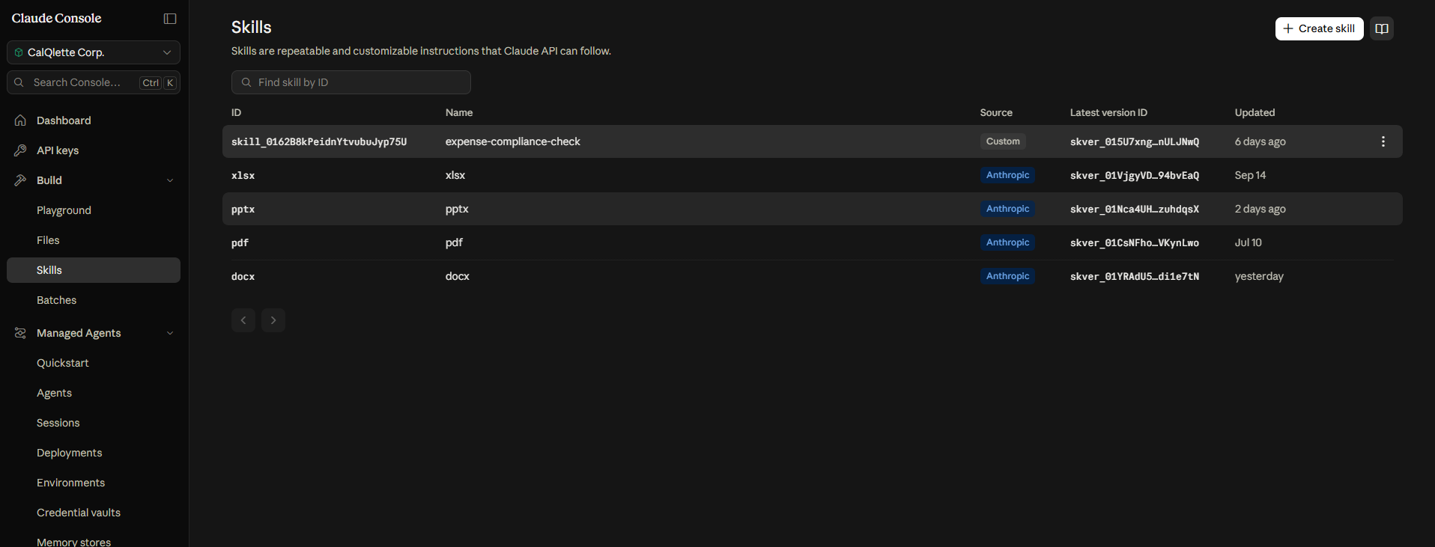
Upload or update your skills
Skills are managed at workspace level.
Every workspace comes with 4 pre-built Anthropic skills (pptx, xlsx, docx, pdf).
Every skill you upload gets an ID (skill_id) that you must reference in your code to use it.

Slide 21
Skills folder structure
A skill called through the API runs in Anthropic’s sandbox: scripts must run with Python, Bash or Node.js, with no network access or package installation.
The skill folder is read-only: Claude reads your files but writes its outputs elsewhere.
my-skill/
SKILL.md
scripts/
setup.py
build.ts
references/
guide.md
assets/
template.pptx

Slide 22
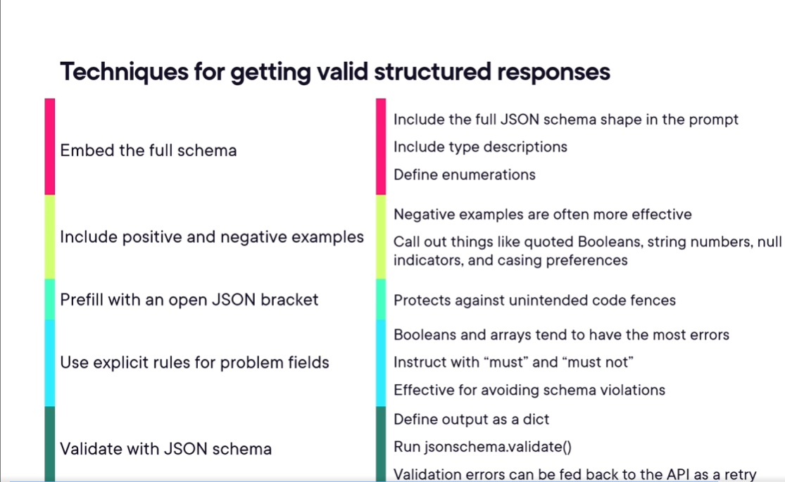
How to ensure better results with a skill

Slide 23
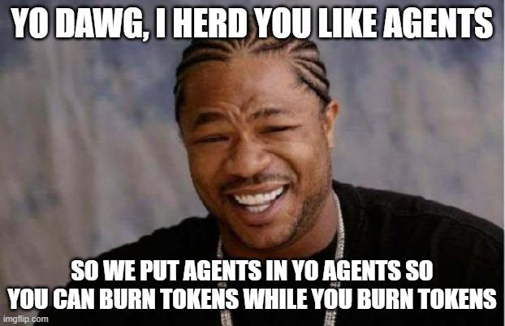
Manage your Agents

Slide 24
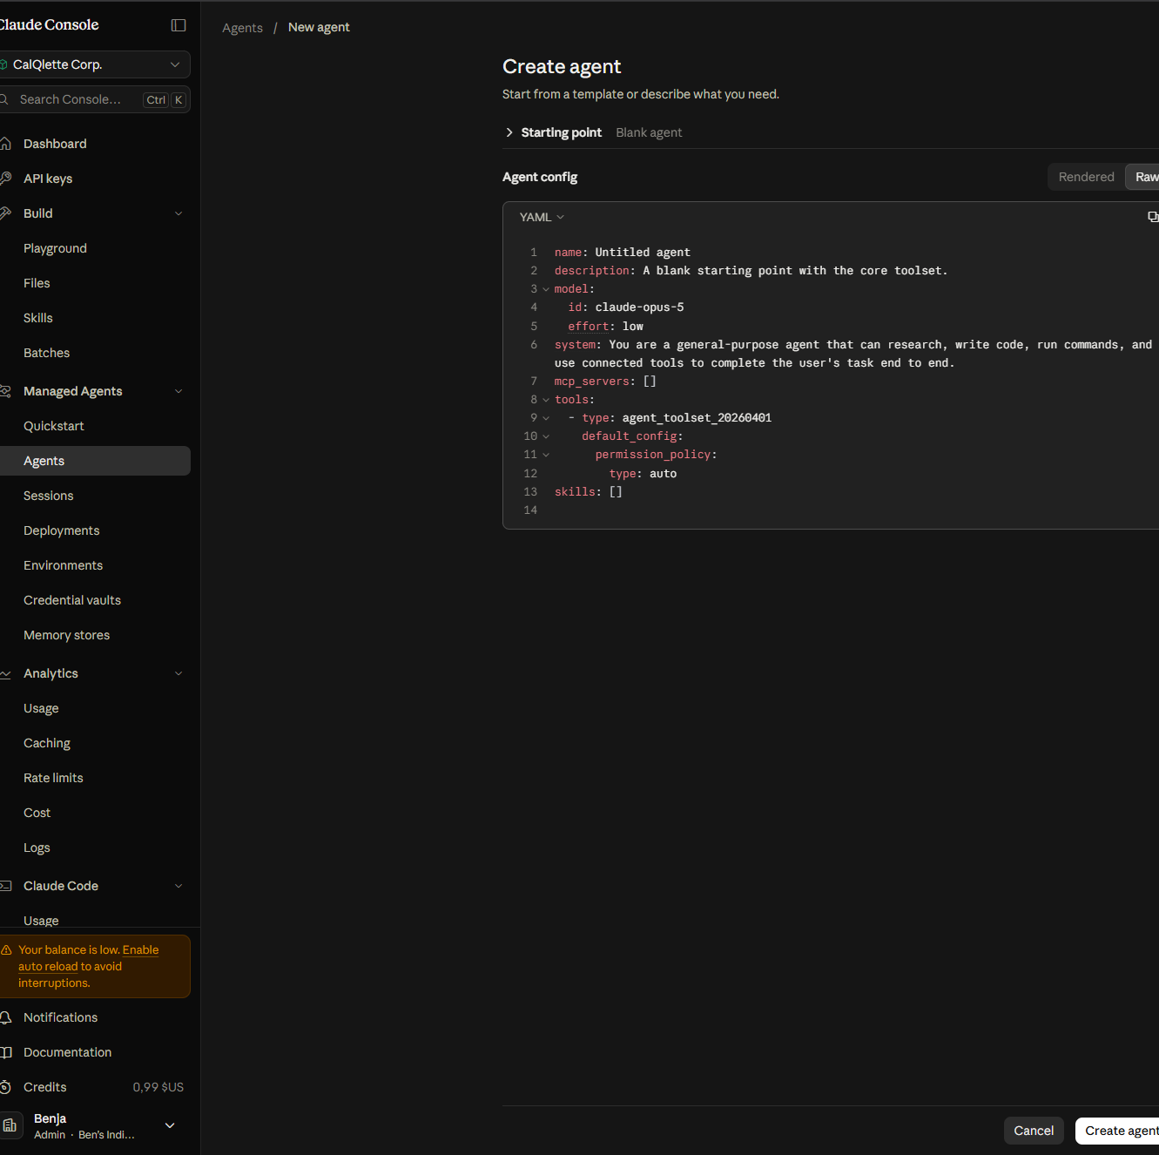
Create an agent in Claude Console (raw view)
Open the Agents menu under Managed Agents in the Claude Console.
Agents can be written in YAML or JSON, which makes import/export easy.

Slide 25
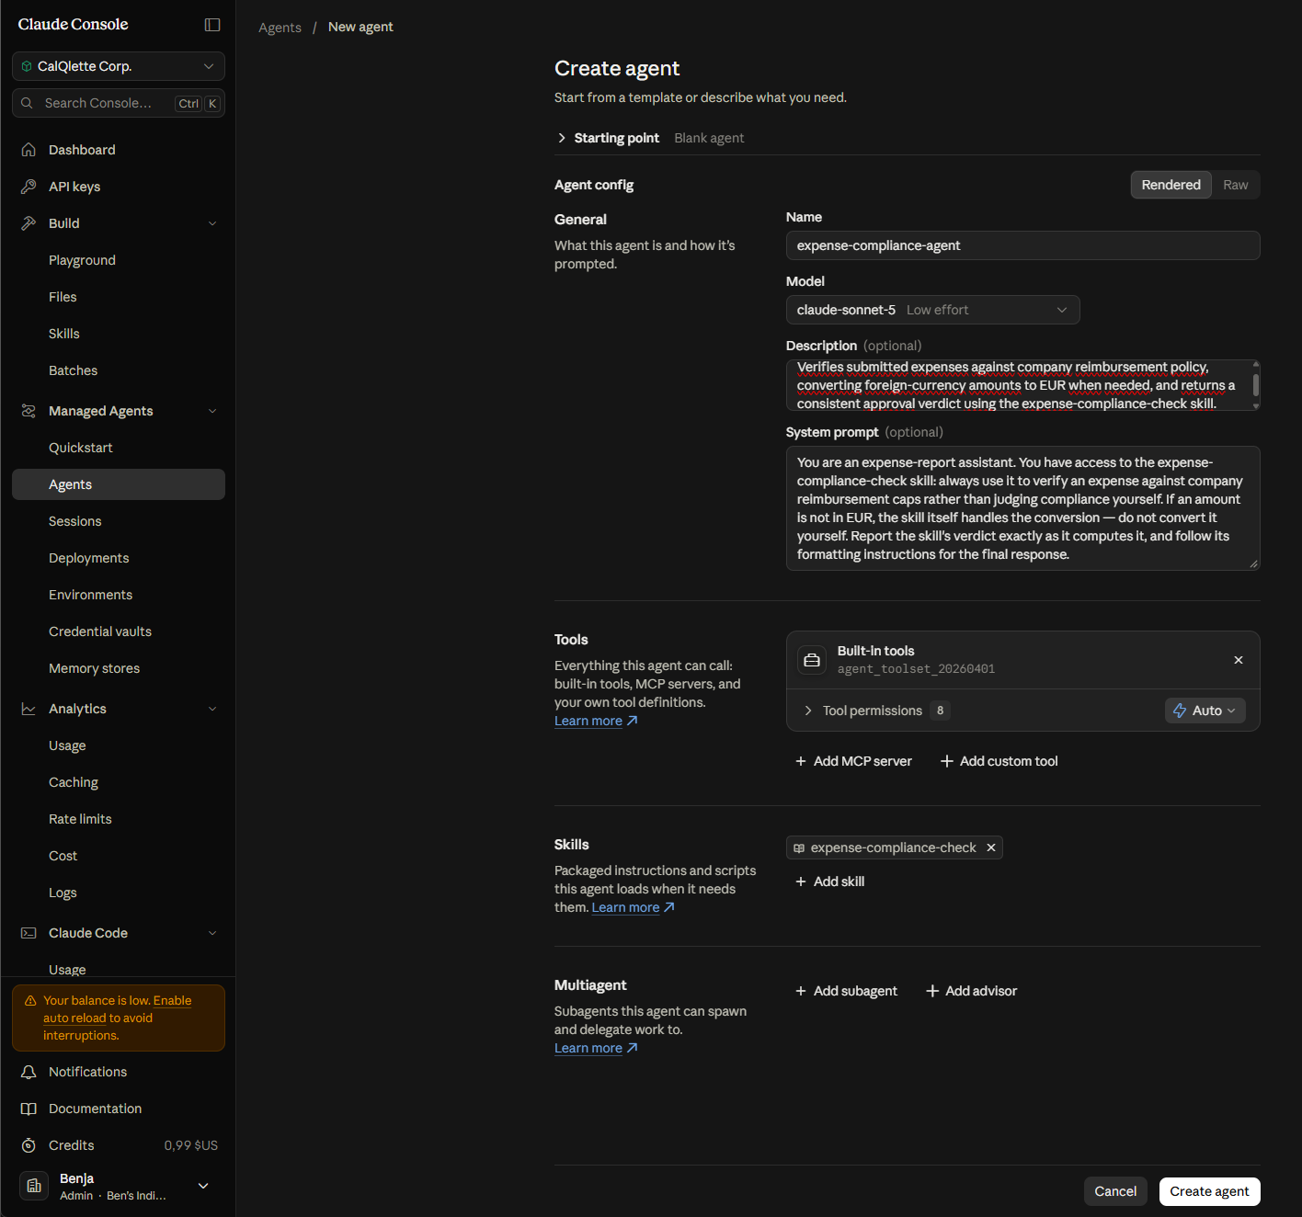
Create an agent in Claude Console (rendered view)
You can toggle between the raw and rendered views.
Connect your agent to existing MCP servers or to your own tools.
Attach your custom skills to your agents.
Multi-agent support (subagents or an advisor).

Slide 26
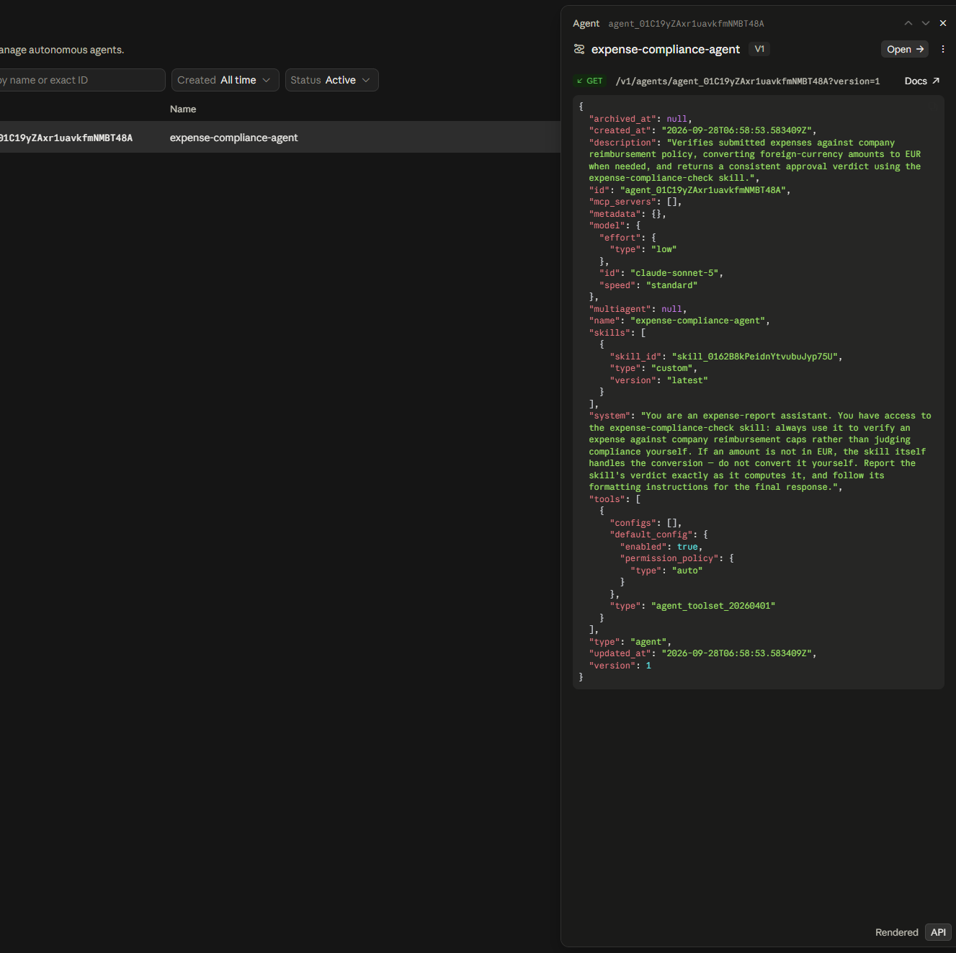
Upload or update your agents
Agents are managed at workspace level.
Select your agent to update it the same way you created it: each update creates a new version.
You can switch to the raw view of your agent if needed.

Slide 27
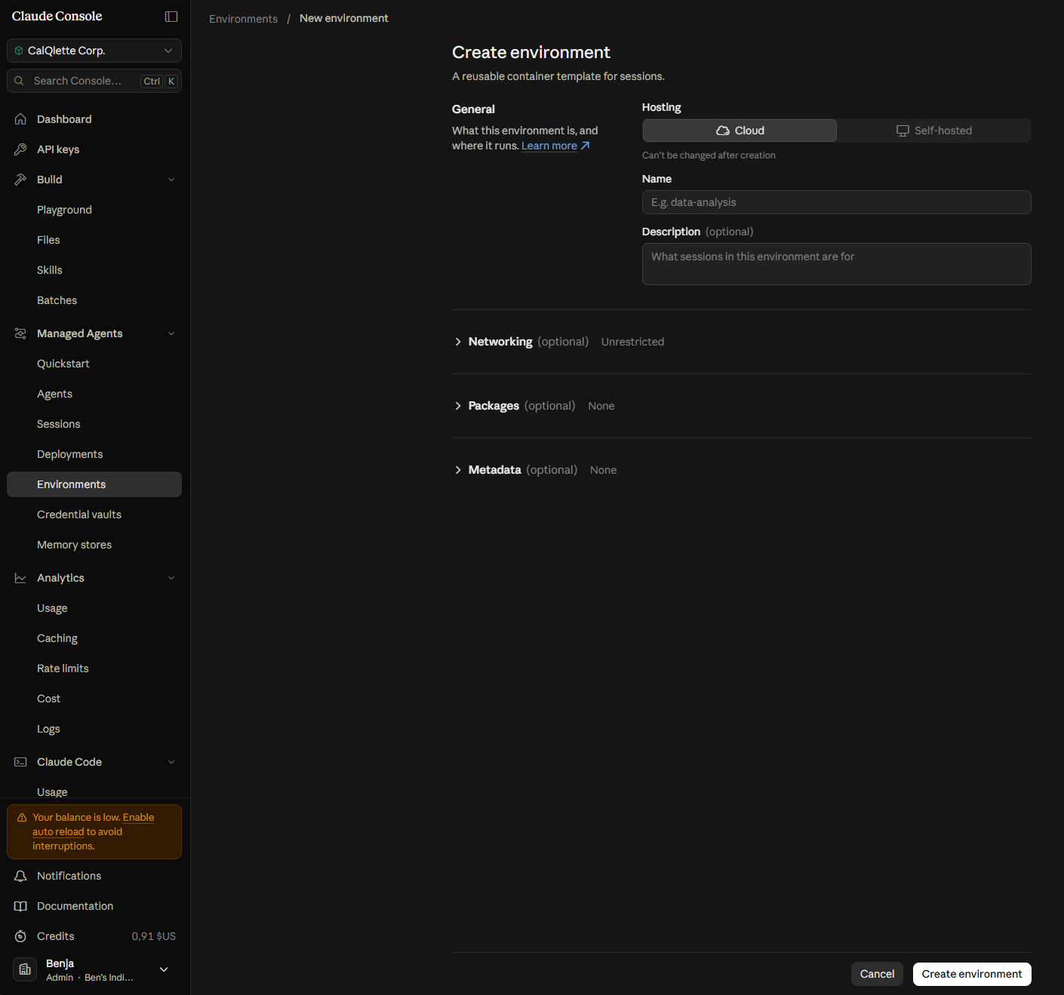
Create an environment
An environment is required to run an agent through the Claude API.
Several agents can run in the same environment.
The environment defines the network access, the packages installed in the sandbox and other metadata.
Cloud (Anthropic-managed sandbox) vs self-hosted (your own infrastructure).

Slide 28

Manage your agent’s memory

Slide 29
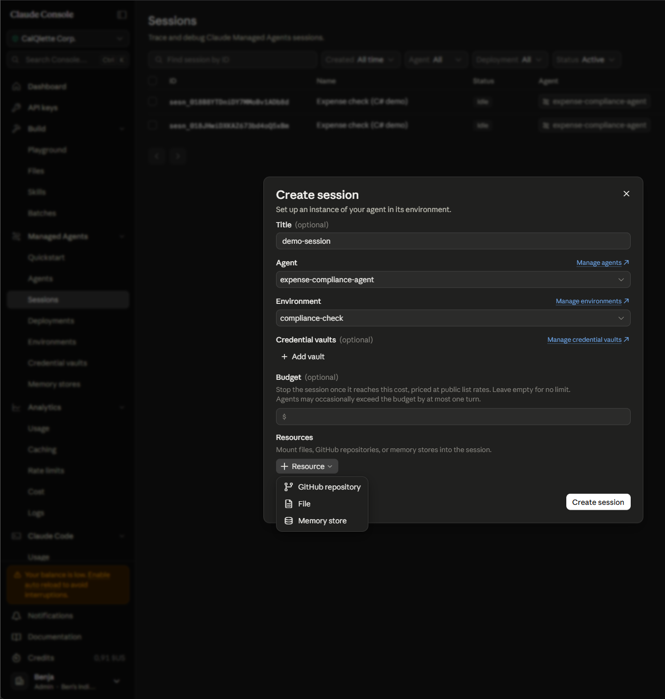
Create a session
A session is a running instance of one agent in one environment, scoped to a workspace.
It must be created explicitly (API or Console) before sending any message.
It keeps the conversation history and can mount three kinds of resources: GitHub repositories, files or memory stores.
Creating a session in the Console is mostly useful for testing; in production, your application creates sessions through the API and attaches the memory store.

Slide 30
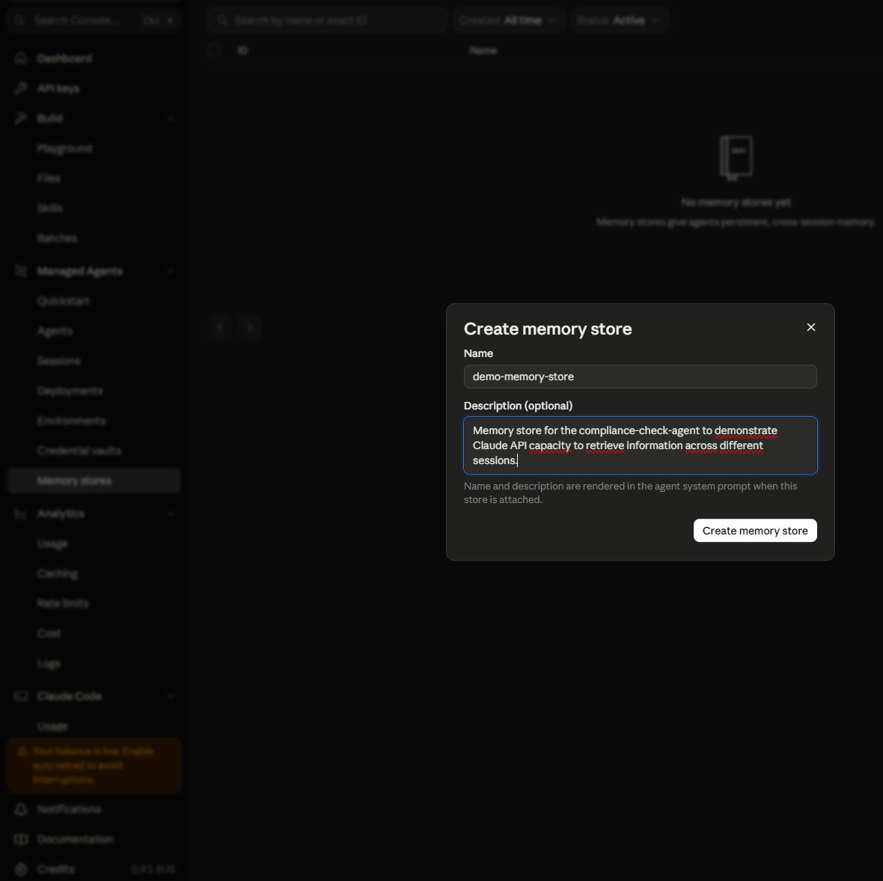
Create a memory store
Memory stores are your agent’s long-term memory: text files mounted in the sandbox and read/written with the usual file tools.
Memory stores are workspace-scoped and can be shared across multiple sessions.
A session keeps the content of its own turns; a memory store keeps the useful information across sessions.

Slide 31
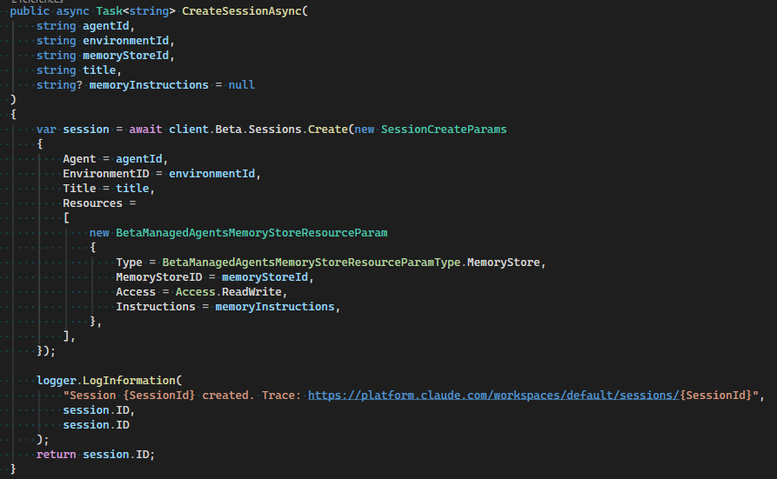
How to use your custom agent in your application
To use your agent in your application, you need to create a session that refers to your agent ID and your environment ID. A title is optional, but makes the session easy to find in the Claude Console.
Add your memory store as a resource, referenced by its ID (up to 8 stores per session).
Access can be ReadWrite (default) or ReadOnly.
Tell the agent what to save in memory with the Instructions parameter (max. 4,096 characters).

Slide 32
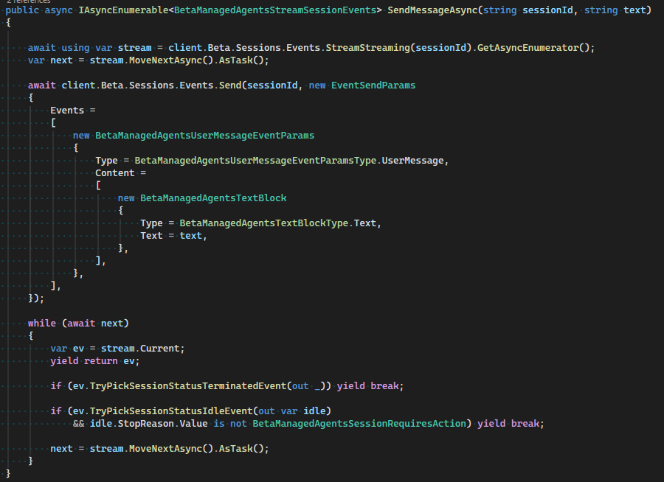
How to send the request to your agent
The SDK has no high-level chat helper for agents yet (beta), so you write a small service yourself: open the session’s event stream, then send a user.message event.
Anthropic runs the agent loop (tools, skills, subagents): your service only reads the events until the session is idle or terminated.

Slide 33
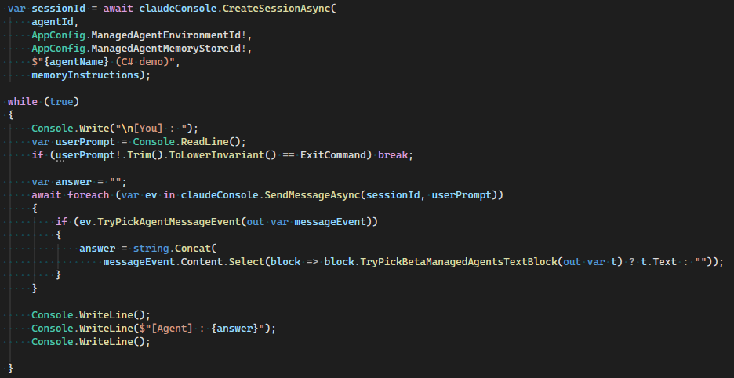
How to retrieve the final answer from your agent
Keep the text blocks of the agent.message events: the last agent.message of the turn is the final answer.

Slide 34
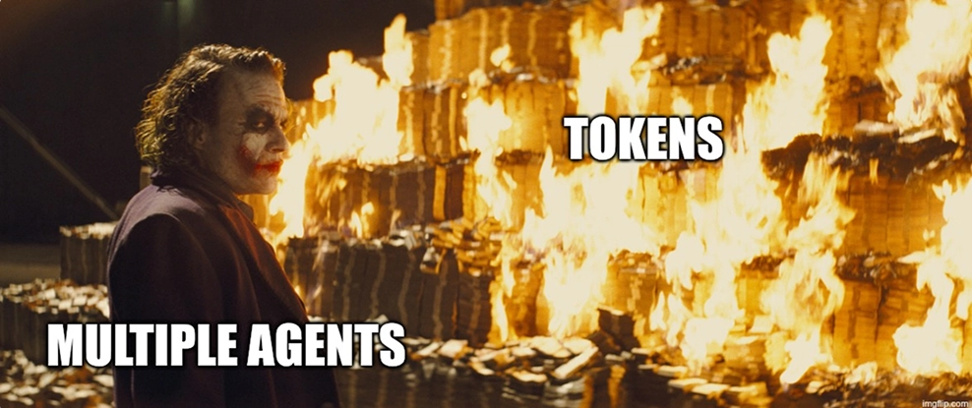
Multi-agent strategies

Slide 35
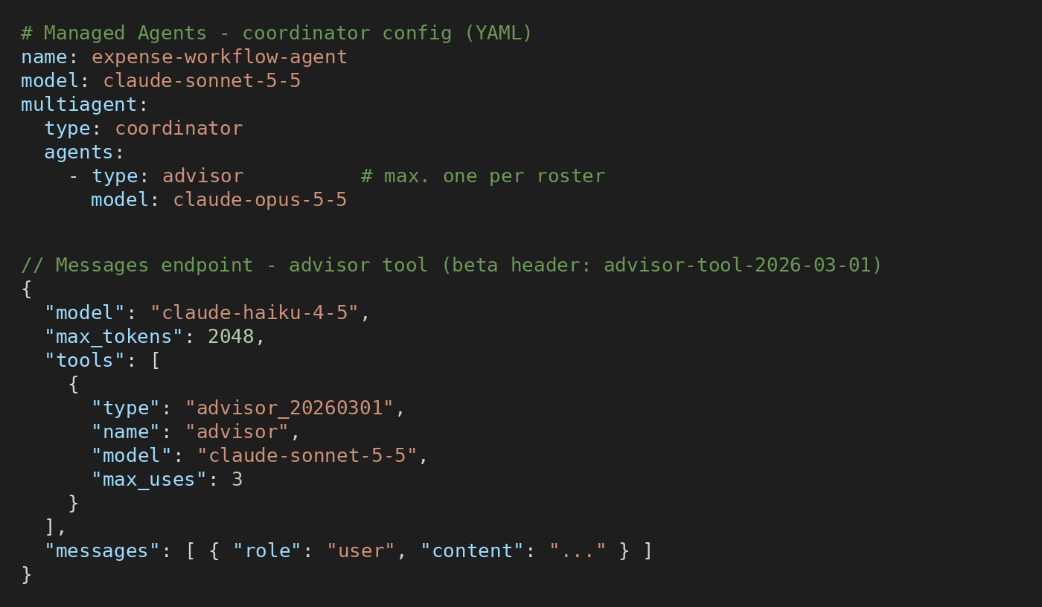
Multi-agent strategies: Advisor
A fast, low-cost executor model (Haiku, Sonnet) consults a more capable advisor model (Opus, Fable) only when it needs guidance.
The advisor reads the full transcript and returns a plan or a course correction; it never calls tools itself.
Messages endpoint: advisor tool (beta). Managed Agents: one advisor entry in the coordinator’s roster.
Near-advisor quality, while most tokens are billed at the executor’s rates.

Slide 36
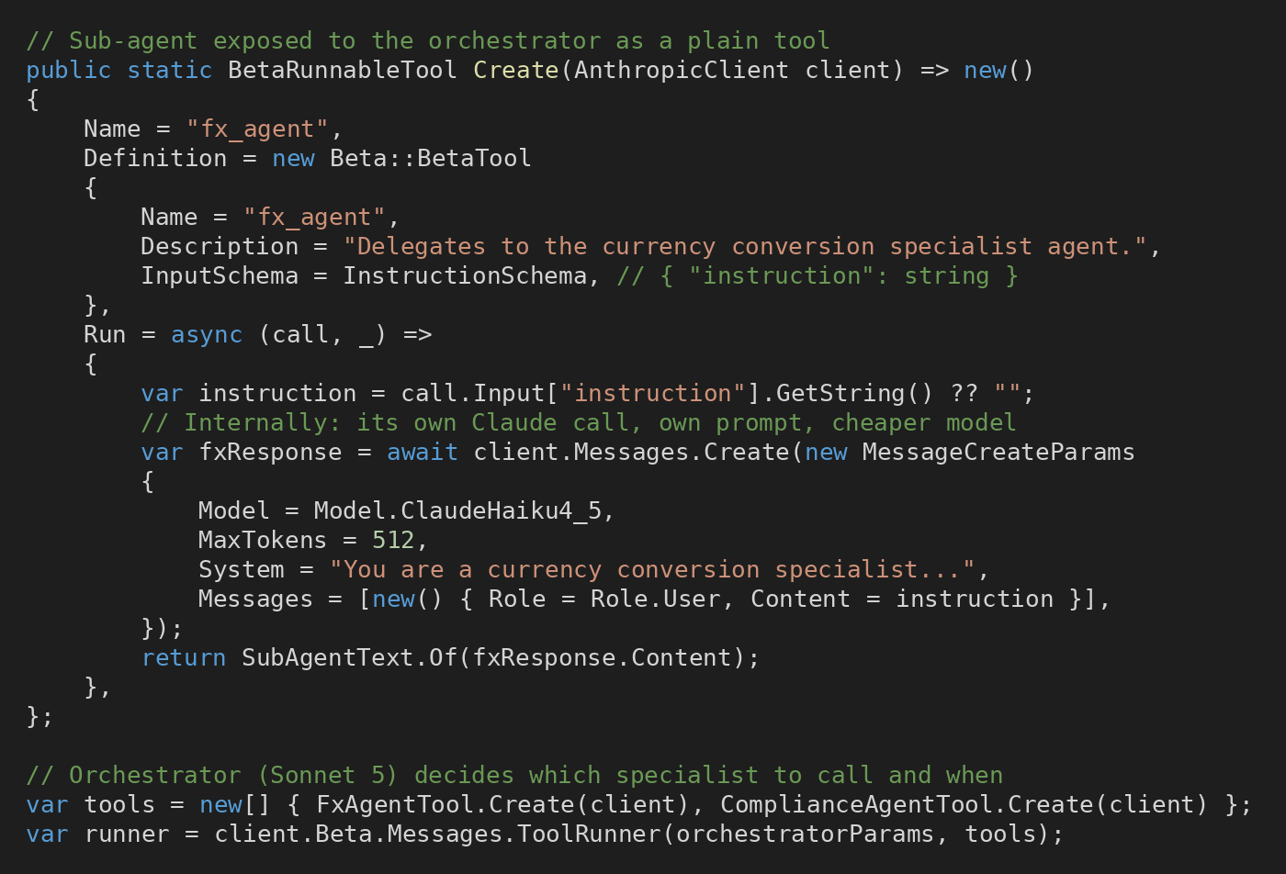
Multi-agent strategies: Subagent
An orchestrator delegates narrow tasks to specialized subagents and stays in charge of the final answer.
Messages endpoint: each subagent is exposed as a tool (“agents as tools”) and run by the ToolRunner.
Each subagent has its own context, prompt and model: orchestrator on Sonnet, workers on Haiku.
Managed Agents: declare subagents in the coordinator’s roster (one level deep): your C# code does not change.

Slide 37
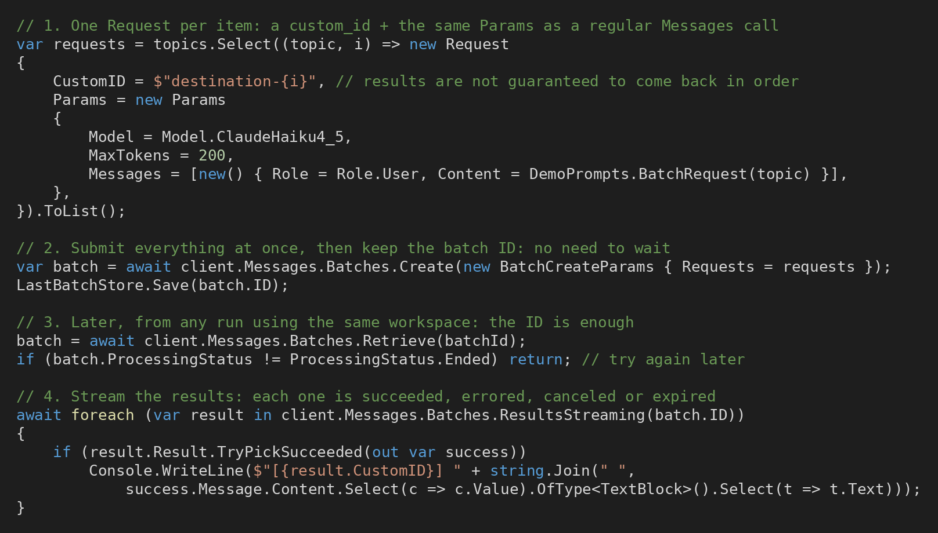
Batch API: implementation in C#
Each Request = a custom_id + the same Params as a regular Messages call.
Batches.Create() submits everything at once: keep the returned batch ID (file, database…).
Later, from any process using the same workspace: Retrieve(batchId) until the status is Ended.
ResultsStreaming() returns one result per custom_id: succeeded, errored, canceled or expired.

Slide 38
Batch API vs multi-agent
Criterion | Batch API | Multi-agent
Goal | Many independent requests, at lower cost | One task solved by collaborating agents
Timing | Asynchronous: most batches < 1 h, max 24 h | Real time
Cost | −50% on every token | More tokens: one context per agent
Coordination | None: requests never see each other | Orchestrator, subagents or advisor
Batch API: up to 100,000 requests (256 MB) per batch, each with its own custom_id. Results kept 29 days.
Almost everything works in a batch (tools, vision, prompt caching), except streaming.
They combine well: the non-urgent, independent calls of an agent workflow can run as a batch.

Slide 39
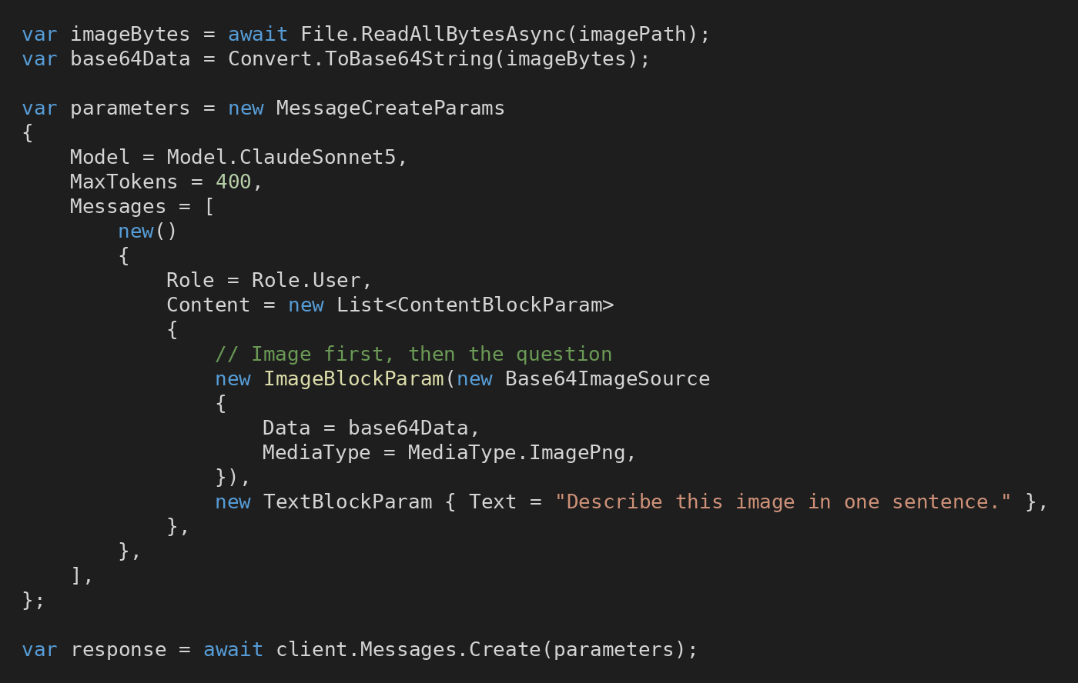
Bonus: How to send an image
Add an ImageBlockParam to the user message, placed before the text block.
Three sources: Base64 (local file), URL, or a Files endpoint file_id (upload once, reuse many times).
JPEG, PNG, GIF or WebP, up to 10 MB and 8000×8000 px per image.
The token cost grows with the resolution: resize large images before sending them.

Slide 40
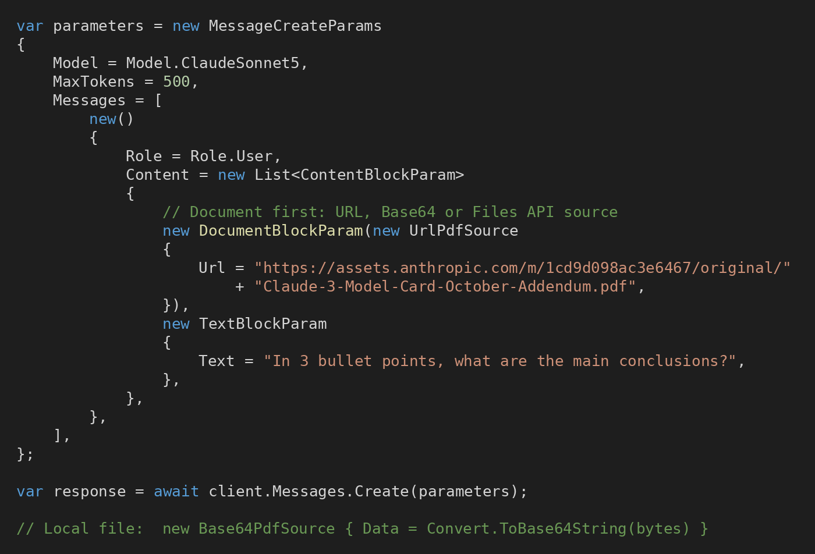
Bonus: How to read a PDF
Add a DocumentBlockParam before the text: URL, Base64 or Files endpoint source.
Claude reads both the extracted text and an image of each page: tables, charts and layout included.
Limits: 32 MB per request and 100 pages (600 on 1M-context models).
Each page costs text + image tokens: combine with prompt caching or batches for repeated or bulk analysis.

Slide 41
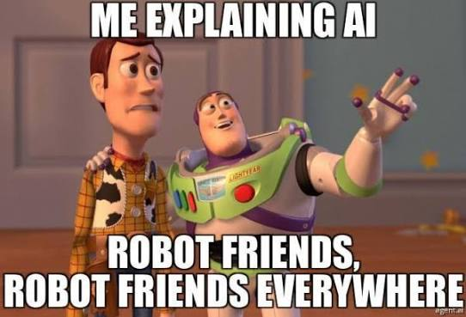
Thank you !

