Slide 1
Syriatel churn analysis
A study by Valentine gacheri, moringa school.

Slide 2
Business understanding
SyriaTel, a leading telecommunications provider in Syria, is experiencing an increase in customer churn. Understanding the factors leading to service discontinuation is crucial for enhancing customer retention strategies. This analysis focuses on identifying predictive features that might indicate potential churn.

Slide 3
objectives
Identify key indicators of customer churn: Determine which customer characteristics, behaviors, or interactions are most strongly associated with discontinuing service.
Develop a predictive model for customer churn: Create a model that can accurately predict which customers are likely to churn in the future.
Formulate proactive customer retention strategies: Use the insights gained from the analysis to design and implement strategies to reduce customer churn, such as targeted promotions, improved customer service, or personalized communication.

Slide 4
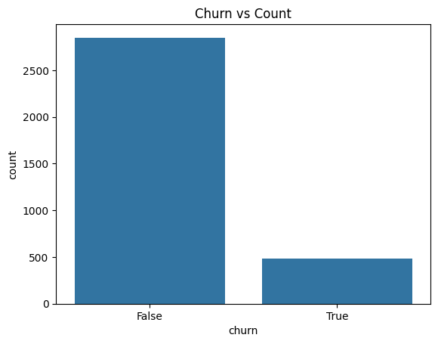
Number of customers under ‘churn’
Of the 3,333 customers in the dataset, 483 have terminated their contract with SyriaTel.
That is 14.5% of customers lost.

Slide 5
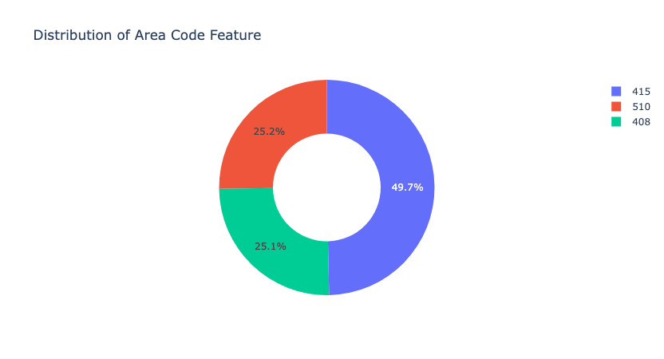
Distribution of Area Code Feature
- Half of the customers have the area code 415.
- One fourth of customers have the area code 510
- Another fourth have the area code 408.

Slide 6
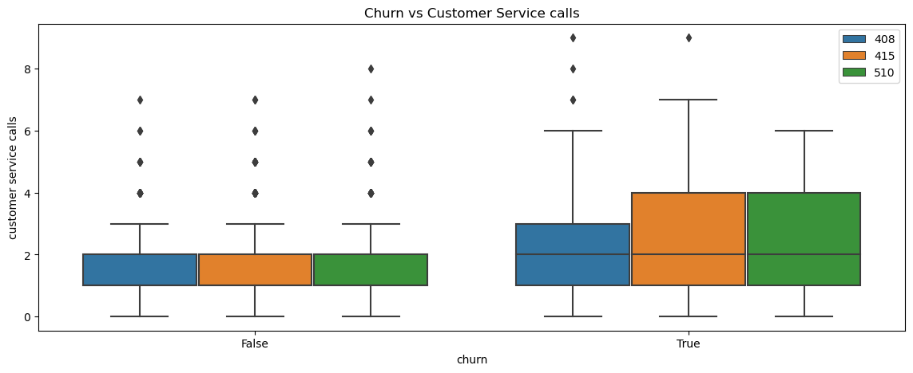
Churn vs Customer Service calls
- There seems to be a evident relationship between customer service calls and true churn values.
- After 4 calls, customers are a lot more likely to discontinue their service.

Slide 7
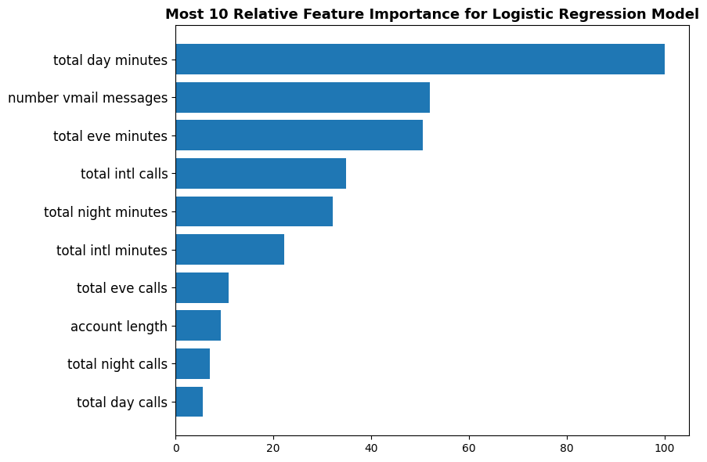
MODEL ANALSIS

Slide 8
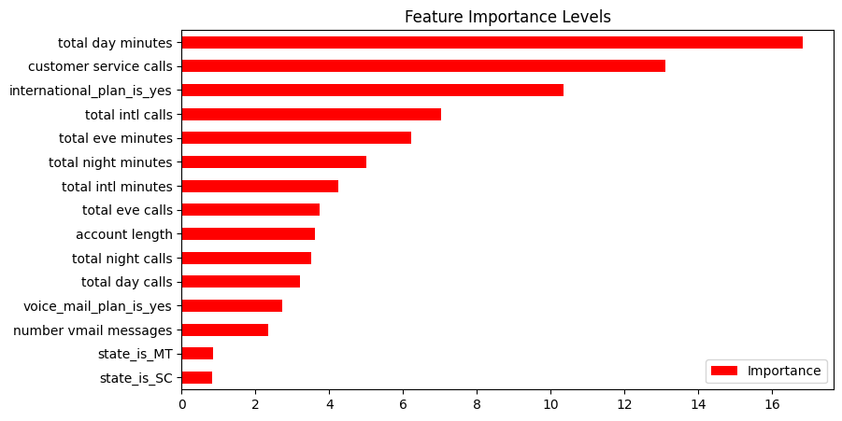

Slide 9
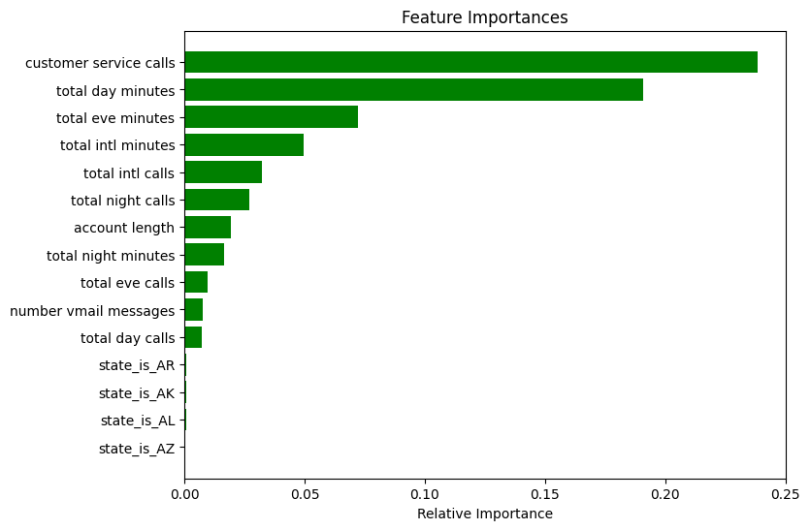

Slide 10
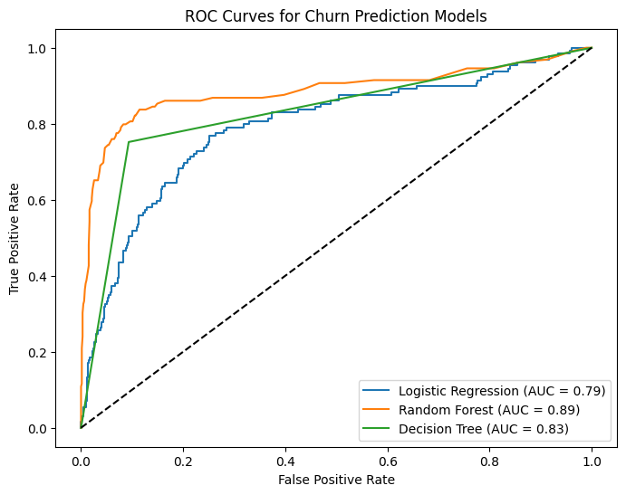
OC Curves for Churn Prediction ModelS

Slide 11
CONCLUSION
- The analysis concludes that the Random Forest model, after hyperparameter tuning, provides the best performance for predicting customer churn.
- While Logistic Regression and Decision Tree models offer decent accuracy, the tuned Random Forest achieves a 93% accuracy and 77% recall, outperforming the others in terms of overall predictive power and identifying customers likely to churn.
Key features influencing churn include;
- Total day charges
- Customer service calls
- The presence of an international plan.

Slide 12
SyriaTel company, in order to combat churn and improve customer service should;
1. Proactive Customer Service:
- Focus on customers with a high number of customer service calls.
- Implement a system to identify customers exceeding a threshold (e.g., 4 calls) and offer proactive support. This could involve personalized outreach, special offers, or early problem resolution.
2. International Plan Review:
- Analyze customer behavior with international plans.
- Identify pain points or dissatisfaction related to international plans. Improve plan offerings or address customer concerns promptly.
3. Optimize Pricing for Daytime Usage:
- Examine total day charges and their relationship to churn.
- Investigate potential adjustments to pricing plans for daytime usage, potentially offering tiered plans or more competitive rates for high-usage customers.

