Slide 1
VCH overview

Slide 2
Project Overview
📘 Lessons Learned:
Structure matters more than ambition
Constraints reveal priorities
Students need working AI-tools, not systems
Students need active support, not just a workshop
Failures teach if documented
Local infra works, but needs support
Collaboration drives progress
🧠 Skills & What’s Working:
Full AI stack deployment (OpenWebUI, Qdrant, n8n)
Reproducible R workflows (RStudio, Docker)
Real-use workshops + mentorship
Proposal writing and stakeholder engagement
Active collaborations gaining traction

Slide 3
Current Workstreams and Collaborations
🔧 Infrastructure:
VCH LLM stack (OpenWebUI, Qdrant, n8n)
DAT Linux for reproducible setups
Nextcloud for shared docs
RStudio workflows in progress
📚 Education & Workshops:
AI workshops based on real failures
Mentoring students with ready-to-use tools
Focus on prompting over building
Toward an AI learning track
🌐 R&D:
Tool testing (Far.AI, AI Scientist)
R-based reproducibility pilots
Mapping AI for research workflows
🤝 Collaborations:
AgUnity (Clearroots) Stefan
Thomas Mazuiri (VCH-Infra),
Torsten Raudssus (Supplylens), Thomas Dik
SCF NICE (grant/pilot) Luka Westergeest

Slide 4
Agenda – VCH Lab Update
🧠 LLM Infrastructure for Students
🛠️ General Tooling & Self-Hosted Stack
🔁 Reproducible Research Environment
🧪 Practical AI Workshops & Use Cases
🚀 AI-Supported Student Projects
🌐 SupplyLens – Supply Chain Mapping Tool
🧬 Experimental AI Tool Testing (Far.AI, AI Scientist)
📲 ClearRoots – Compliance Platform (SCF NICE)
📄 ClearPaper – Template Proposal (SCF NICE)
🤝 Key Collaborations & Workstreams

Slide 5
1. VCH Infrastructure – LLM for Students
🎯 Goal: Enable students to use local LLMs for assignments, feedback, and learning.
🔒 Why: A local LLM stack enables:
Secure research with real data
No reliance on cloud services
Independent student experimentation
✅ Accomplished:
Running OpenWebUI-based LLM environment
Hosted on a local-controlled server
Integrated tools: Qdrant, n8n, pgvector, dashboards
🚀 Next Steps:
Broader student adoption
Classroom integration
Real use case development
🆘 Help Needed:
Budget for TOKENS to run larger models
Personal costs are unsustainable
Need focused hours to maintain and improve
Requesting support and validation of direction

Slide 6
2. VCH Infrastructure – General Tools
🎯 Goal: Provide infrastructure with built-in tools so students can quickly ideate and prototype.
⚙️ Why: A seamless environment helps students move from ideas to experiments without technical barriers. ✅ Accomplished:
AI stack fully deployed
Nextcloud environment live
DAT Linux system in full testing
🚀 Next Steps:
Tighter integration of AI tools with DAT Linux
Enable AI features inside Nextcloud
Launch a documentation server using Nextcloud
🆘 Help Needed:
Hands-on testing of tools and flows
Feedback on missing functionality
Time to improve reliability
Support to validate that this is the right direction

Slide 7
3a. Reproducible Research
🎯 Goal: Enable researchers to build, test, and share repeatable experiments — data, code, and results.
🔍 Why:
Reproduce prior research
Run simulations
Build on each other’s work AI is only useful in research when workflows are reproducible.
✅ Accomplished:
Stack deployable with DAT Linux, Docker, systemd
RStudio Server tested and running
📎 More Info: VCH-Datasharing GitHub

Slide 8
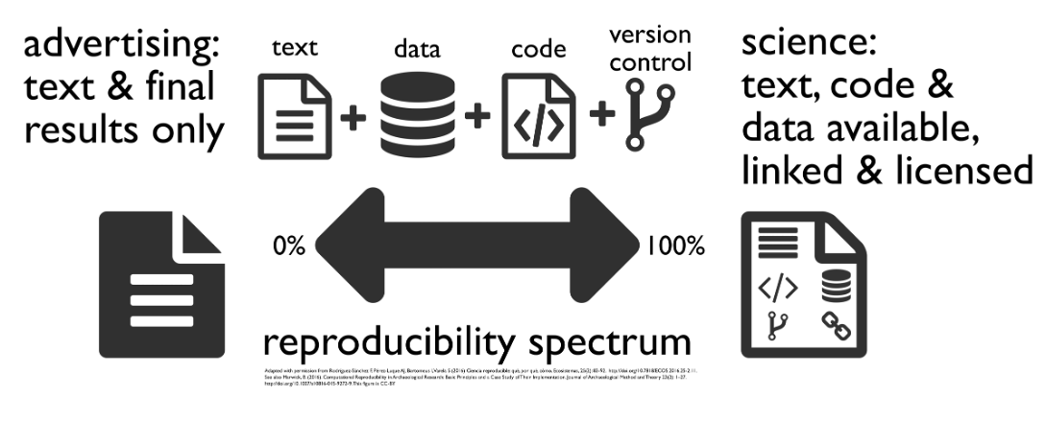
3b. Reproducible Research – What’s Next
🚀 Next Steps:
Build integrated workflows with RStudio
Apply data stewardship practices
🆘 Help Needed:
A real research case to reproduce
Time to document and test
Support and validation to proceed

Slide 9
4a. Practical AI Use Cases & Workshops
🎯 Goal: Teach students how to use AI tools effectively — with a clear view of their limitations.
⚠️ Why: AI is overhyped. In reality:
Makes mistakes
Lacks reasoning & context
Struggles with memory & coherence Students must learn to test and contain AI — not trust it blindly.
✅ Accomplished:
Workshop repo created
First sessions delivered
Failures (Knopenkoning, Inchainge) used as learning cases
📚 Summarizing large volumes of literature
💡 Generating and refining hypotheses from data
🧹 Automating data cleaning and preprocessing
✍️ Drafting sections of reports or papers
🧪 Running simulations or optimizing parameters

Slide 10
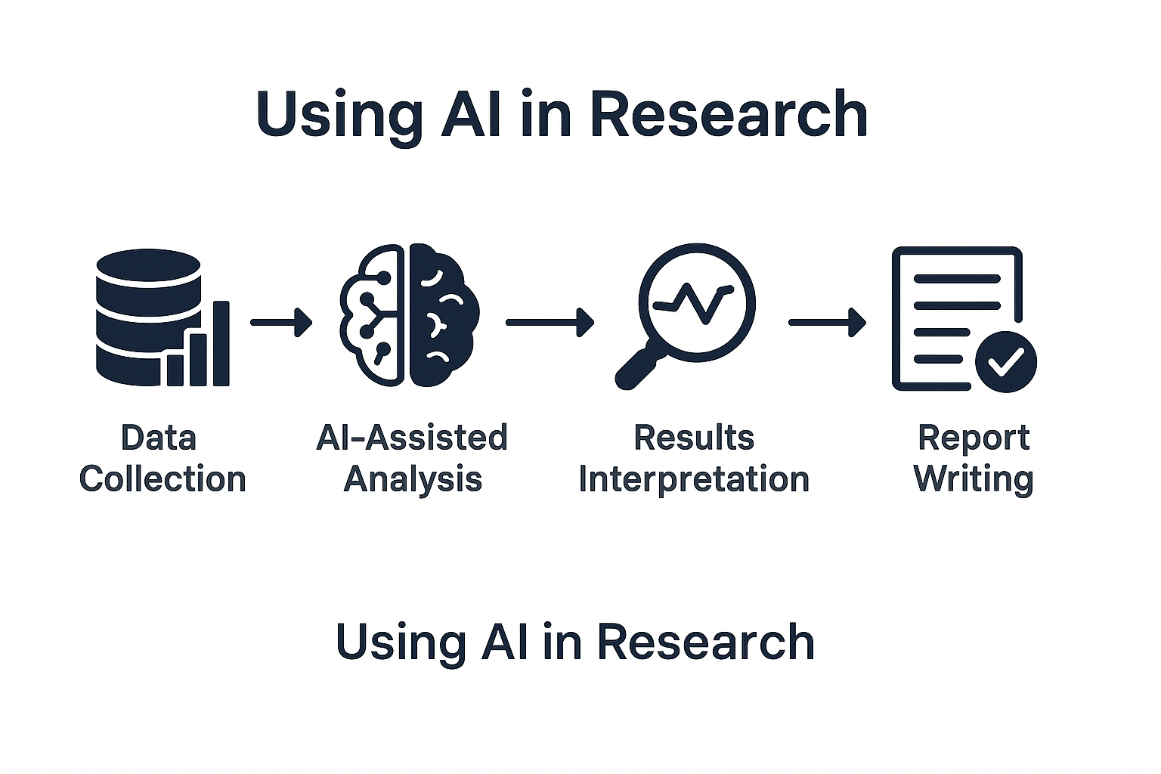
4b. Practical AI Workshops – Next Steps
🚀 Next Steps:
Translate IBM-based material into practice
Teach “data-to-reality” translation
Establish recurring feedback-driven workshops
🆘 Help Needed:
Integration & network engineers
Student testers
AI meetup facilitators
Co-builders for use case development
Using A.I

Slide 11
5a. AI-Supported Student Projects
🎯 Goal: Support student-led projects by giving them AI tools that just work — not expecting them to build infrastructure.
💡 Why: As Maxime noted: most students can’t build their own AI pipelines. Instead, we:
Provide end-user-facing tools (not just chatbots)
Focus on prompting, saving, processing
Teach how to integrate internal and external tools
🌐 Examples:
VCH-Lithium
VCH-BCM
✅ Accomplished:
Built 2 full AI-driven websites
Went beyond student-only capacity
Showed AI mentorship accelerates outcomes

Slide 12
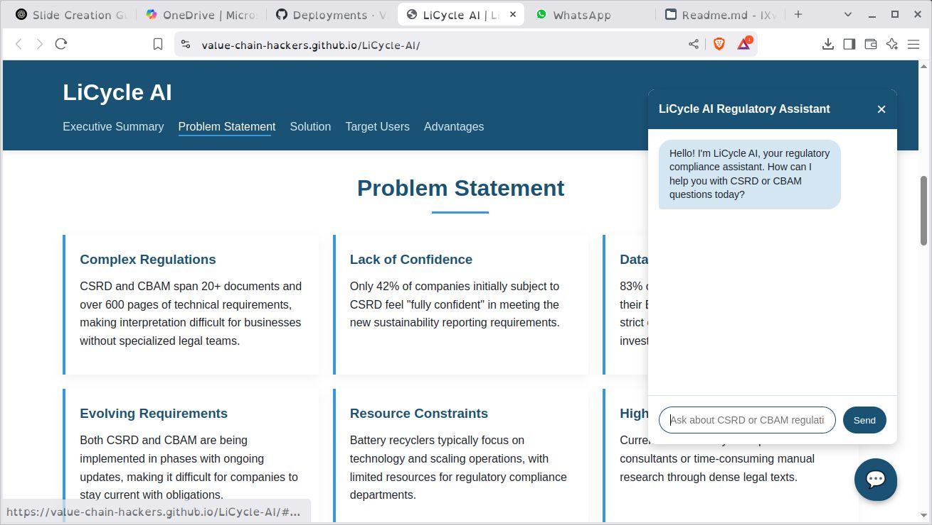
5b. AI-Supported Student Projects
🚀 Next Steps:
Showcase student outcomes
Build an AI mentorship track
Identify and guide new use cases
🆘 Help Needed:
Allow expert-student collaboration
Fund tokens for large models
Stop comparing local to OpenAI
Let trusted externals connect (e.g. Discord)
Formalize Value Chain Hackers: KvK, domain, mandate
Build a student team around AI dev
Licycle, a generated website for the students with CLINE

Slide 13

6. SupplyLens (formerly Knopenkoning)
🎯 Goal: Map complex supply chains using AI, ESG data, and graph tech.
📌 Why:
CSRD/CSDDD compliance
Risk mapping & traceability
Real insight into supply chain complexity
⏳ Why Now:
Lessons learned (Sebastien)
New, realistic architecture
Community and AI support
🚀 Next:
Approval to start
Time for focused dev
Scrum team permission
🆘 Needed:
OK to involve external contributors
Spin-off status (KvK, domain)
Small budget (< €5K)
Space to test with externals
Workflow

Slide 14
7. Experimental Tool Testing
🔬 Goal: Explore cutting-edge AI tools for scientific workflows — like multi-step reasoning and automated research tasks.
🌐 Why:
Keep Windesheim on the frontier of AI
Explore tools that can:
Simulate cyber attacks
Generate PhD-level outputs
Automate reasoning chains These tools could reshape how research is done.
🚀 Next Steps:
Test 3 tools for research potential
Document barriers & integration paths
🆘 Help Needed:
Budget for tokens to evaluate properly
Time to explore experimental edge cases
Space to collaborate with research teams
✅ Accomplished:
Reviewed AI Scientist & Far.AI
Identified promising capabilities
Repo bookmarked:
GitHub – AI Scientist (aci)

Slide 15
8. Project Proposal – ClearRoots
🎯 Goal: Support smallholders and importers in complying with EU laws (CSRD, CSDDD, EUDR).
⚙️ How:
Mobile app collects local field data
Data stored via AgUnity blockchain
Auto-generates EU-compliant documents
Importers get ready-to-submit dossiers
🌍 Why:
Smallholders lack tools
Importers lack clarity
Solves both without greenwashing
🆘 Needed:
Funding or co-dev support
Help writing grant proposal
Grant writer or funding partner
Notes:
ClearRoots fills a legal-tech gap with real partners and real field logic. It’s ready to move — with the right support.

Slide 16
9. Project Proposal – ClearPaper
📄 Goal: Create standardized templates to help actors comply with EU laws (CSRD, CSDDD, EUDR).
🌍 Why:
No shared definition of “compliance”
Importers face uncertainty
Smallholders are excluded ClearPaper bridges that gap.
🛠️ How:
Link templates to EU clauses
Formats: Word, LaTeX, JSON
Adaptable to national/language needs
Optional AgUnity integration
🆘 Needed:
Feedback to shape grant proposal
Help making it fundable
We need a grant writer

Slide 17
Automated Survey Reporting
🎯 Purpose: Streamline survey workflows by automating response collection, analysis, and personalized report generation using open-source tools on self-hosted infrastructure.
🛠️ How It Works:
Participants complete a multi-step survey.
Responses are securely stored in a local database.
Automated workflows generate customized reports (PDF/HTML).
Reports are emailed to participants.
Data is prepared for structured analysis via dashboards or custom analytics.
💡 Why It Matters:
Eliminates manual data processing and report generation.
Ensures data privacy by avoiding external cloud services.
Enhances efficiency in research and educational settings.
🔗 Repository:
GitHub – Bi-Ronald
Notes:
Bi-Ronald offers a scalable solution for automating survey processes, providing immediate, personalized feedback to participants while maintaining data control and privacy.

Slide 18
11. Key Collaborations
Thomas Dik – AI tooling and cloud architecture
Ronald de Boer – Business Intelligence, Power BI integration
Luka Westgeest – SCF, ClearRoots & ClearPaper
Stefan Barrett (AG-Unity CTO) – Document processing logic
Iivo Salmi & Raul Raus – Trusted EU infrastructure research - Finland.

