Slide 1
Byte Rights
Team Rick J19 Zeta 7
Daniel Valverde

Slide 2
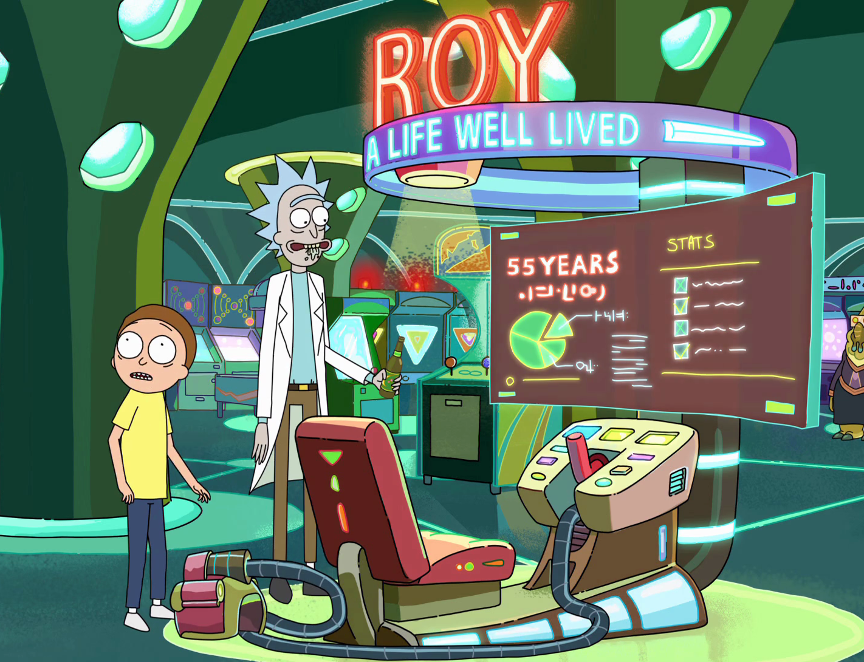
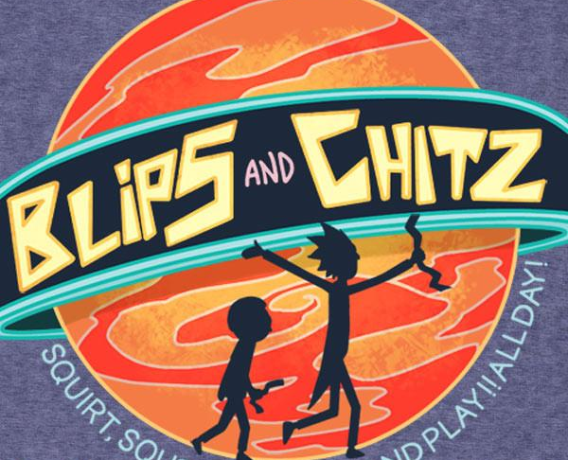
User story
Rick Sanchez is a mad scientist, inter – dimensional traveler, and loyal customer of Blips and Chitz
Blips and Chitz arcade themed establishment, located somewhere in space, seeking to expand their social media presence.

Slide 3
Closing the Gap
A digital licensing platform that encourages collaboration between creators.
Building an easy way for creators to share and re-use digital content online legally.
Our goal is to for creators to be able to use each others content and be properly compensated.

Slide 4
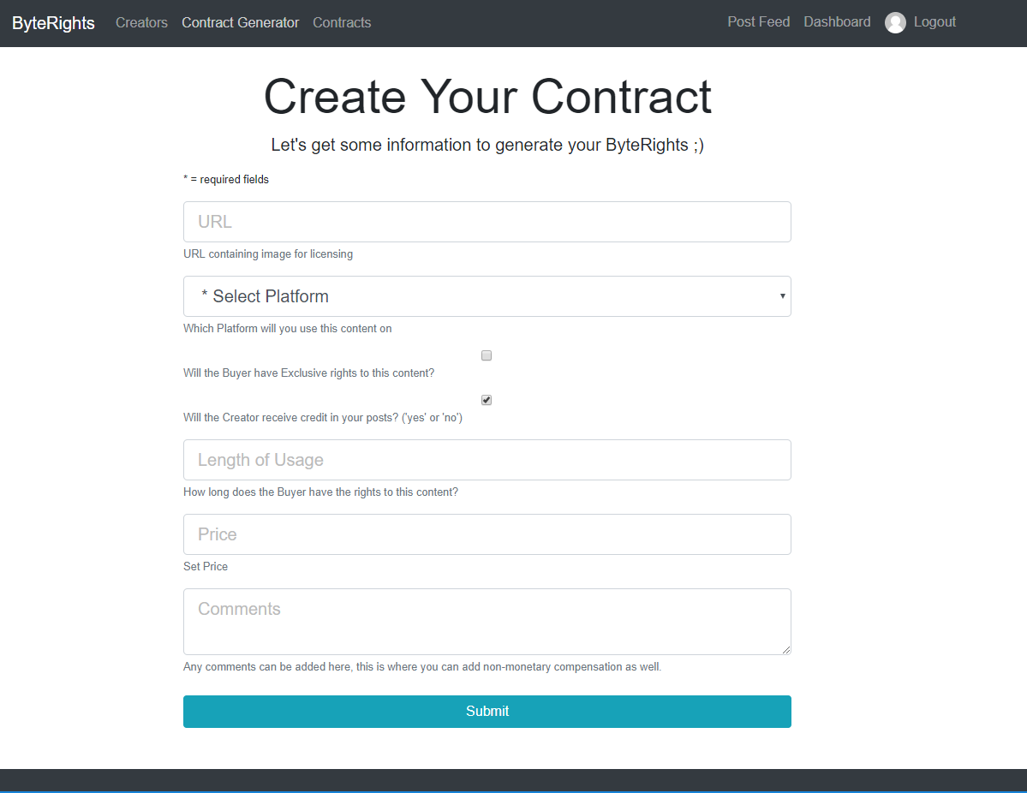
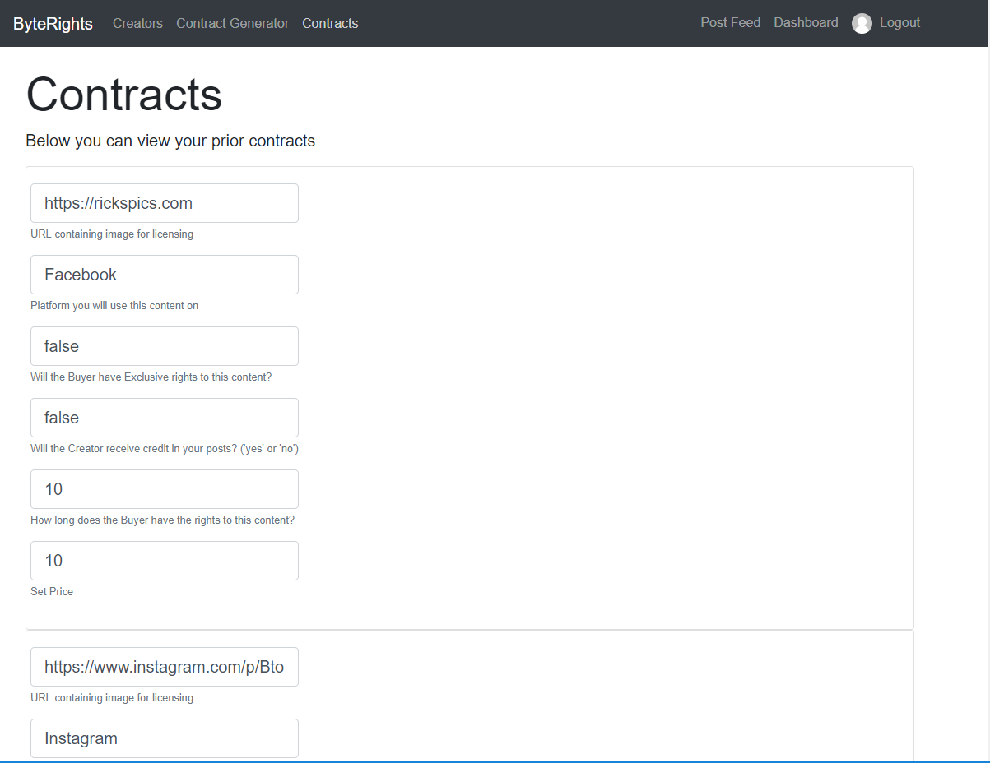
Get and Post Routes

Slide 5
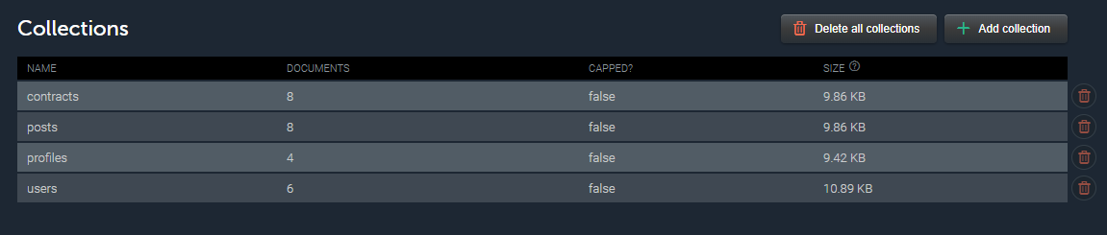
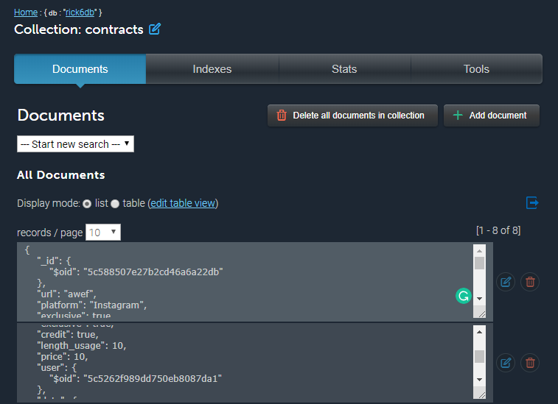
MongoDb Mlab

Slide 6
Libraries and packages or technologies
Passport-jwt : is a passport strategy for authenticating users with a JSON web token. This authentication strategy lets you authenticate endpoints using the JSON web token instead of using sessions.
Bcryptjs – is package that adds a salt to an adaptive function that is used to hash passwords and makes your user’s login-information protected from a number attacks
Redux - is a predictable state container for JavaScript apps. It helps you write applications that behave consistently, run in different environments and are easy to test.

Slide 7
DEMO TIME!
https://arcane-wildwood-54985.herokuapp.com/

