Slide 1

Predicting Ethereum Prices
Applications of XGBoost and Linear Regression Models
Daniel Valverde

Slide 2
The Purpose and Significance
The purpose of my project is to determine to what extent can I predict prices of Ethereum with XGBoost or Linear Regression using different models and feature sets.
The ability to predict price movement could be very lucrative and it seemed like a fun problem to try and solve. There are an endless number of different approaches that can be used to try and solve this problem. This is something that I will be spending more time on when I am done with this program so I might as well start now.

Slide 3
Data
Description: Ethereum is the second largest cryptocurrency and the price is quite volatile. From the coingecko aggregates the price of most cryptocurrencies from most exchanges and makes it possible to see the prices available at each exchange through an API.
Data Source: API from coingecko.com
Date, Price, Total Volume (On a per day basis)
Quantity: 5 years worth of price data

Slide 4
Data Prep for Calculated Features Set
Manually Calculated Features (commonly used trading indicators):
RSI (relative Strength Index)
EWM (Exponential Weighted Moving Average) – 14 day
Difference – change in price from yesterday
Macd (Moving Average Convergence Divergence)– difference between the 12 and 26 day moving average
Macd_s – the 9-day Moving average of the macd for the trigger line
Macd_h – the difference between macd and macd_s
Other Features
Volume
Target Variable
Ethereum – price of Ethereum at a specific time on that day
Cleaning
When creating some of these moving average features this created Nan’s for the beginning rows of data so after making the calculations I dropped all Nan’s

Slide 5
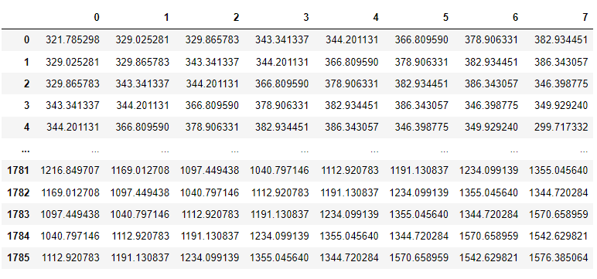
Data Prep For Sliding Window 7 days
Column 0 is target variable
Columns 1-7 are the features containing the price 1-7 days prior

Slide 6
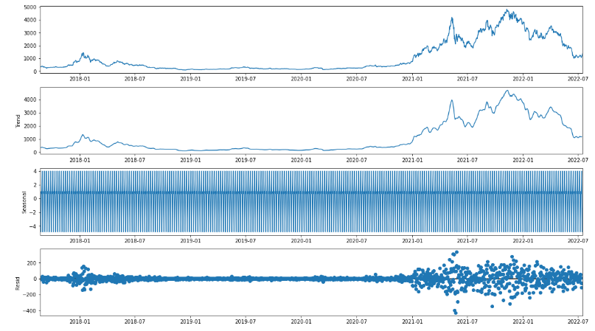
Exploratory Data Analysis and Visualization

Slide 7
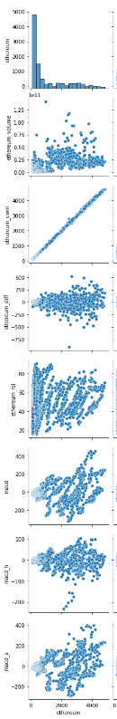
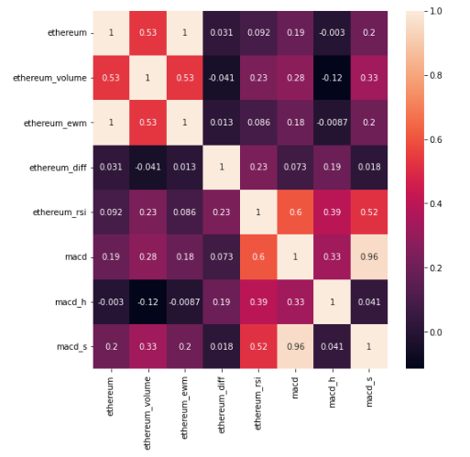
Correlation heatmap and Pair Plot

Slide 8
Data Splitting and Scaling on Calculated Features Set
Used a standard scaler on the features
Shifted the feature data by 1 day so that we are making predictions using the data from the day prior
Used the most recent 60 days as the test set. And all data prior to 60 days as the test set.

Slide 9
Data Splitting and Scaling on Sliding Window of 7 days
Used a standard scaler on the features
Used the most recent 60 days as the test set. And Aal data Prior to 60 days as the test set.

Slide 10
Summary of Models Performed
Average price of Ethereum over this period was 1066
 | Xgb_calc | Xgb_calc_grid | LR_calc | Xgb_sw | Xgb_sw_grid | LR_sw
RMSE train | 717 | 53.5 | 78.25 | 587 | 82.22 | 88.84
RMSE test | 380 | 163.35 | 84.23 | 568 | 183.3 | 80.39
R2 train | .66 | .998 | .996 | .777 | .99 | .996
R2 test | .025 | .816 | .9523 | -1.3 | .75 | .9537
Xgb_calc: Xgboost using the calculated features
Xgb_calc_grid: Xgboost using the calculated features and grid search for hyper parameter tuning
Xgb_sw: Xgboost using the sliding window as the features
Xgb_sw_grid: Xgboost using the sliding window as the features and grid search for hyperparameter tuning
LR_calc: Linear Regression using the calculated features
LR_sw: Linear Regression using the sliding window as the features

Slide 11
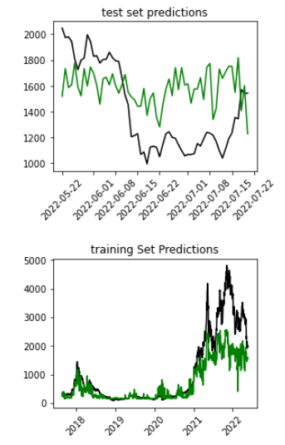
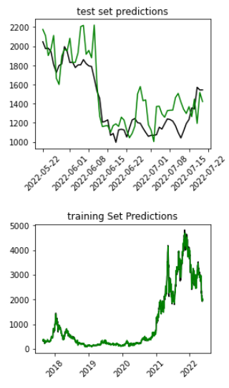
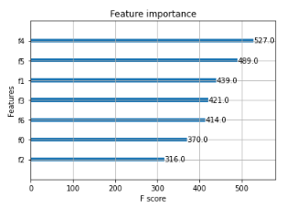
XGBoost on Calculated Features Grid Search
*Average price of Ethereum over this period was 1066
 | Xgb_calc | Xgb_calc_grid
RMSE train | 717 | 53.5
RMSE test | 380 | 163.35
R2 train | .66 | .998
R2 test | .025 | .816

Slide 12
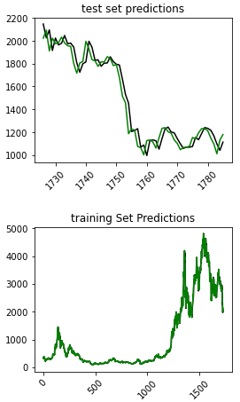
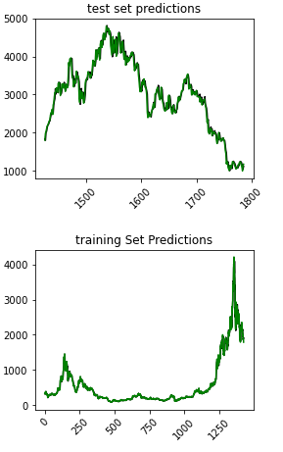
Linear Regression Sliding Window 7 days prior
*Average price of Ethereum over this period was 1066
 | LR_sw 60 day | LR_SW 360 day
RMSE train | 88.84 | 56
RMSE test | 80.39 | 132
R2 train | .996 | .99
R2 test | .9537 | .98

Slide 13
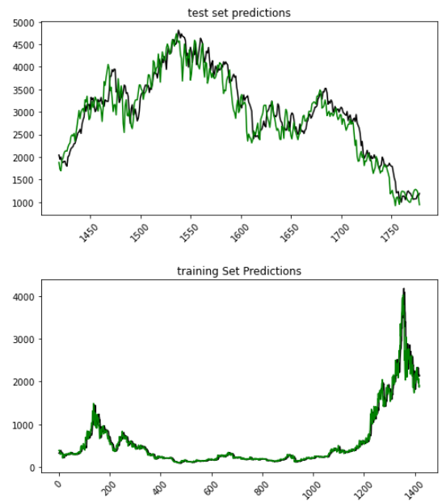
Linear Regression Sliding Window 6 days through 15 days prior
*Average price of Ethereum over this period was 1066
 | LR_sw 360 day 6day-15 days prior
RMSE train | 137
RMSE test | 327
R2 train | .959
R2 test | .866
Adj R2 test | .863

Slide 14
Conclusion
XGBoost Seemed to perform alright on the calculated features set but I would not necessarily use this model to make trades given the erratic behavior it had sometimes.
Linear Regression on the Sliding Window when I used features from 6 to 15 days prior seemed like it would be good to use for trading signals. Although it is still hard to tell just using these metrics and I would need to build a system that simulates making trades given a model and calculates profitability over time. I could possibly implement streaming with pyspark moving forward.
Time Split: Pulling Data: 5%, Creating/Researching Different Features To Test On: 50%, Running Models 45%

