Slide 1
GITC LIBRARY
Technical Preview Demo
Features & roadmap

Slide 2
TEAM MEMBERS
Team Lead
Naira Varosyan
Developers
Zorik Zaqaryan
Davit Simonyan
Khachatur Ghalmukhyan
Levon Uzunyan

Slide 3
Application Modules Structure
- common
- Rest
- Service
- Web
- doc

Slide 4
Used technologies and Infrastructure
1.Maven
2.Spring boot
3.Spring MVC
4.HIBERBATE
5.THYMELEAF
6.JUNIT
7.GIT
8.MYSql
9. Spring Data
GIT urI
https://github.com/zorikzaqaryan/gitclibrary

Slide 5
Functionality
1. Register in application with required parameters
2. See library books
3. choose the book
4. Upload book by admin
5. Edit book list by admin
6. Edit user list by admin
7. Download electronic book
8.Upload electronic book
9․MULTI LANGUAGE SUPPORT(ARM,RU,ENG)

Slide 6
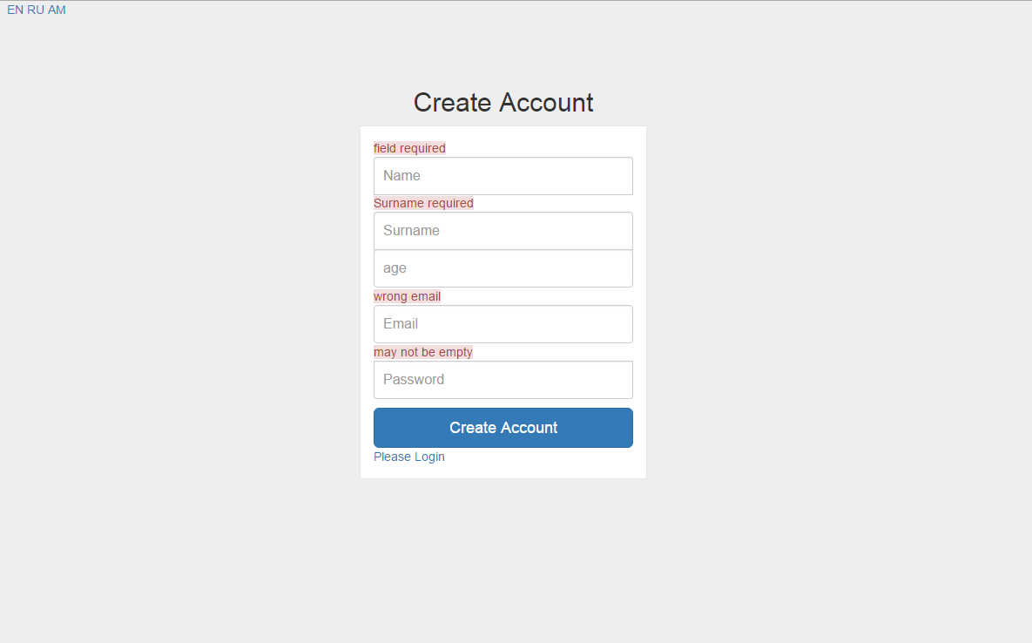

Slide 7
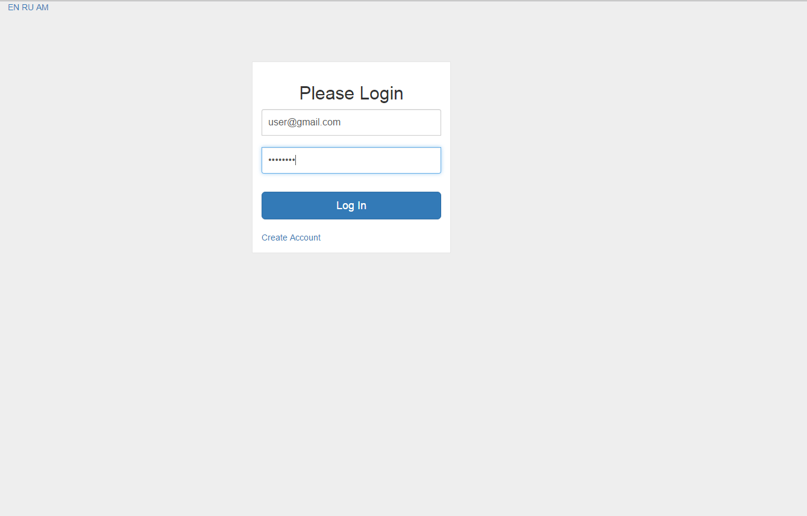
Roadmap
Book rating
Teaching video library
Chating
jenkins integration

Slide 8
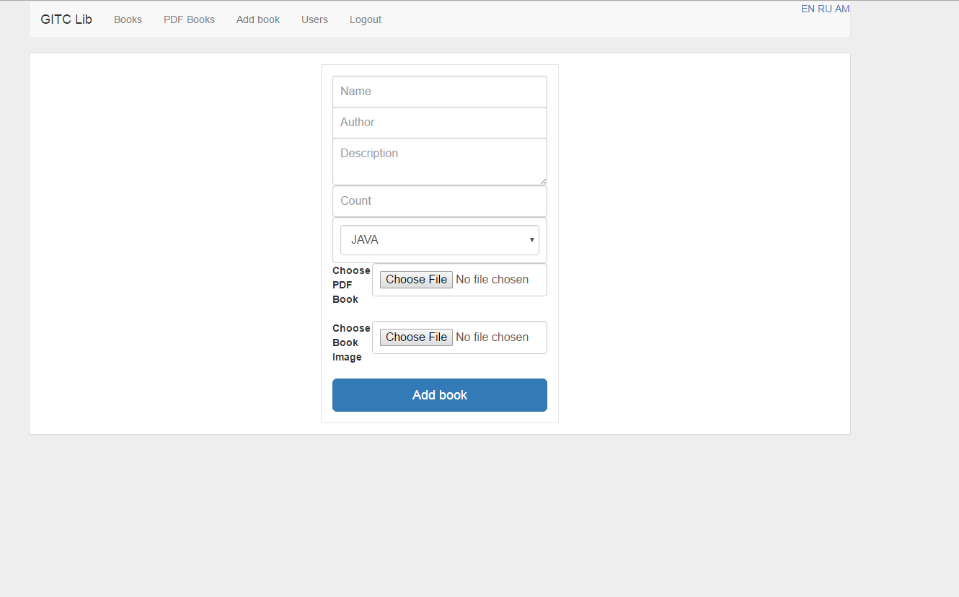
Roadmap
Book rating
Teaching video library
Chating
jenkins integration

Slide 9
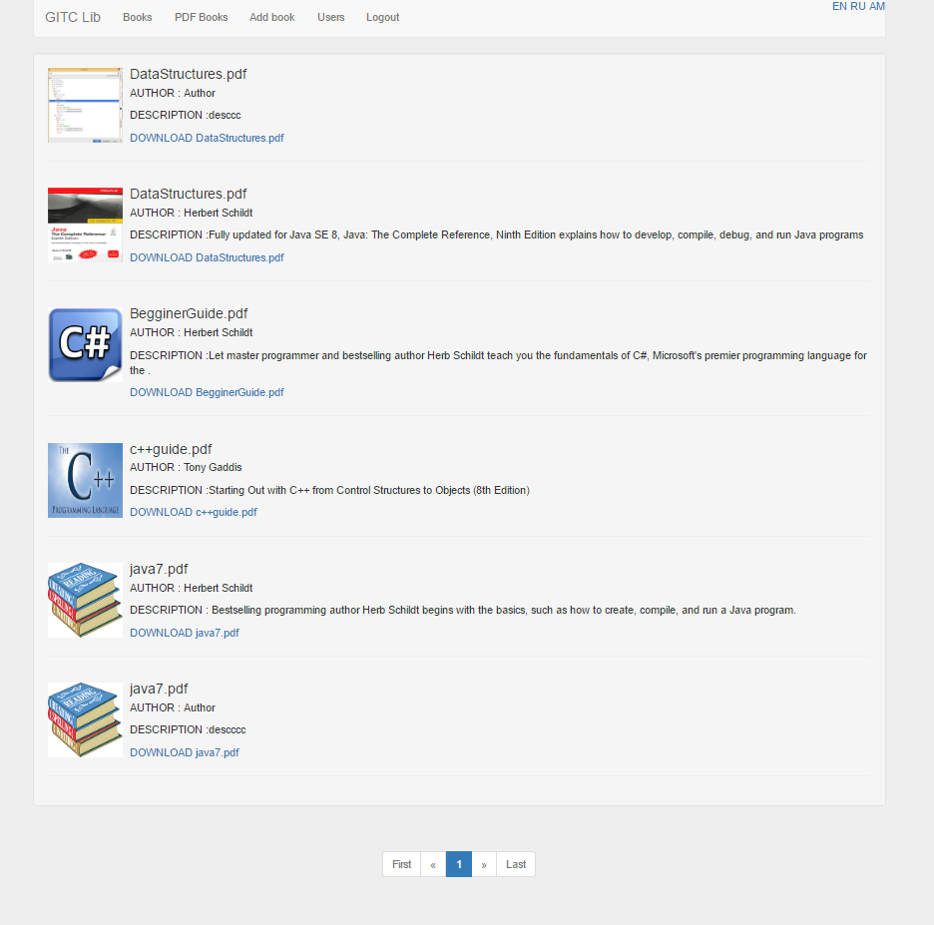

Slide 10
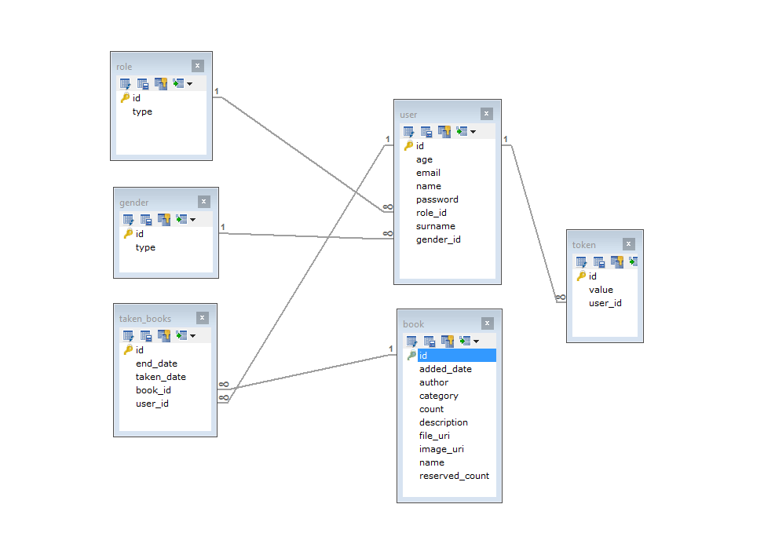

Slide 11
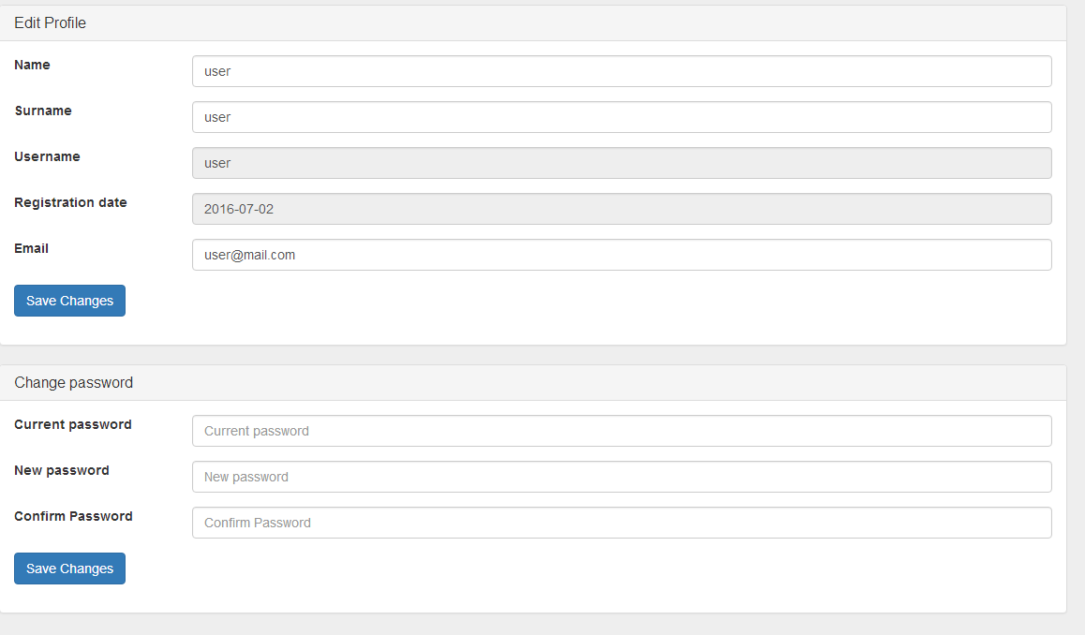

Slide 12
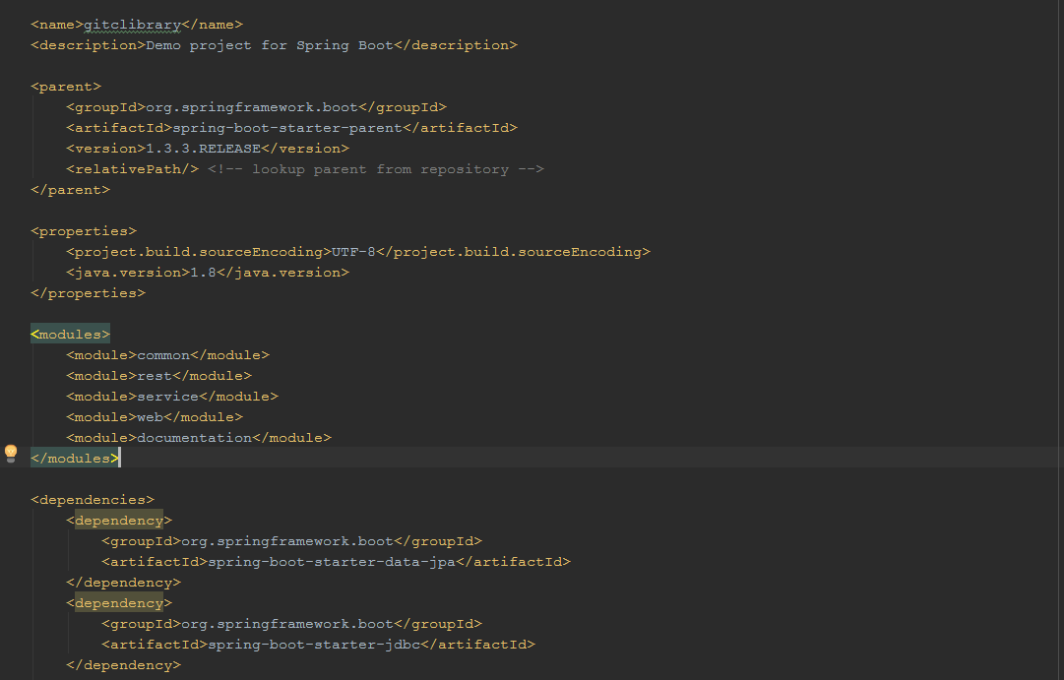

Slide 13
Roadmap
Book rating
Teaching video library
Chating
jenkins integration

Slide 14
THANK YOU

