Slide 1
J.B. HUNT
TalentIQ
01 / 08
THE PROBLEM
Long lines.
AT CHECK-IN
Lost context.
CHECK
IN
At busy career fairs, candidates wait to check in while recruiters try to remember dozens of short conversations.
A slow start creates a longer wait.
01
Lines slow the first hello.
Manual check-in creates long waits at the booth.
02
Names blur together.
AFTER THE CONVERSATION
Interviewers may forget who they spoke with.
Who was it?
What did we discuss?
What next?
03
Details disappear.
There is no clear record of what was discussed or what comes next.

Slide 2
J.B. HUNT
TalentIQ
02 / 08
THE SOLUTION
One record from check-in
to follow-up.
TalentIQ connects candidate details, resumes, and recruiter context so a conversation does not end when the fair does.
01
02
03
04
Quick
check-in
→
One
source
→
Recruiter
log
→
Voice
filtering
Candidate enters details and uploads a resume.
Supabase stores the response and resume together.
Notes and follow-up decisions stay with the profile.
Find people by the topics discussed.
LIVE TODAY
Check-in + Supabase
NEXT PHASE
Conversation logs + voice filtering

Slide 3
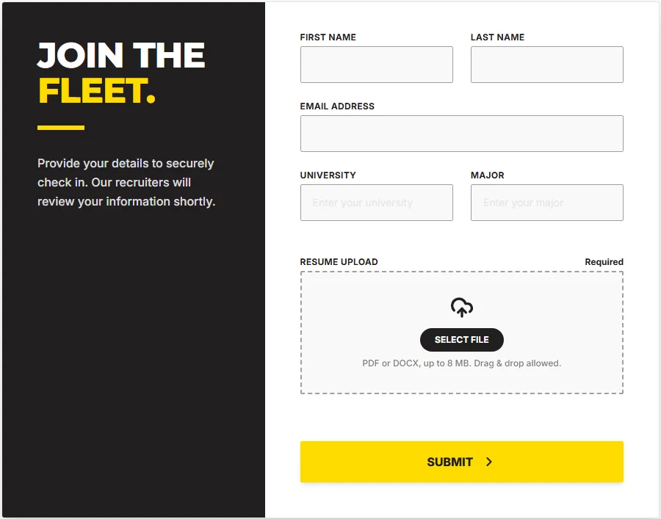
J.B. HUNT
TalentIQ
03 / 08
LIVE CHECK-IN
Check in once. Save it right.
The candidate screen captures the essentials; the server stores a validated response and resume in Supabase.
From screen to Supabase
Candidate response
responses
Name, email, university, major, and UTC check-in time.
Resume file
resumes
PDF or DOCX, up to 8 MB, saved with candidate metadata.
Required fields
Server validation
Confirmation screen

Slide 4
J.B. HUNT
TalentIQ
04 / 08
BUILT BACKEND
A clean path from submit
to saved record.
The server action checks the submission before any candidate record is committed.
01
02
03
04
Validate
details
Stamp
the visit
Store
the resume
Write
the response
Required fields, email shape, file type, signature, and 8 MB limit.
Capture the check-in instant in UTC for a consistent event record.
Upload to the Supabase resumes bucket with candidate metadata.
Insert the candidate row, then show check-in confirmation.
FAILURE HANDLING
If the database insert fails, the uploaded resume is removed so records stay in sync.

Slide 5
J.B. HUNT
TalentIQ
05 / 08
RECRUITER WORKSPACE
Every conversation has a trail.
NEXT PHASE CONCEPT
A dashboard concept that keeps candidate profiles, discussion details, and follow-up actions together.
TalentIQ / Recruiter dashboard
CONCEPT VIEW
Candidates
Candidate profile
Conversation log
Search candidates or notes
Alex Morgan
10:42 AM
Met at the booth
Alex Morgan
Checked in 10:38 AM · Resume on file
Introduced operations and analytics opportunities.
UNT · Computer Science
Python
Forecasting
Inventory
10:46 AM
Riley Santos
Discussed project work
Supply chain · Analytics
Candidate explained forecasting model and data tools.
Conversation summary
Jordan Lee
10:49 AM
Operations · Business
Discussed a Python inventory forecasting project, interest in fleet analytics, and internship availability.
Follow-up marked
Recruiter saved profile for an analytics interview.

Slide 6
J.B. HUNT
TalentIQ
06 / 08
NEXT PHASE CONCEPT
VOICE FILTERING SYSTEM
Search by
what was said.
With consent, recruiters can capture or dictate conversation notes. Transcription and topic filters make those discussions searchable later.
VOICE QUERY
“Who discussed fleet analytics?”
Alex Morgan
Voice note → Transcript → Topic filter → Candidate
Matched in conversation log: Python forecasting and interest in fleet analytics.
Recruiters review the transcript and the original candidate record before follow-up.

Slide 7
Demo

Slide 8
Thank you.

