Slide 1
Analyzing Particle Jets with Persistent Homology
Noah Green
PHY 480
Michigan State University

Slide 2
Outline
Introduction
The Standard Model
Quarks and Gluons
Particle Jets
Jet Analysis
Clustering Algorithms
Challenges for jet clustering
Persistent Homology Explaination
Persistent Homology For Jet Analysis
Monte-Carlo Generation of Events
Cleaning Events for For Persistent Homology
Persistent Homology of Jet Events
Conclusion

Slide 3
Introduction
Jets are sprays of particles that correspond with quarks and gluons produced from a high-energy particle interaction.
Right now, there are a few different algorithms that cluster these sprays of particles together to identify the original quark/gluon.
As higher energies are reached in today’s particle accelerators, it is becoming more difficult to distinguish jets from one another.
Persistent homology is a new and developing tool that is being used extensively in pattern recognition and computer vision
Question: Can persistent homology be used to improve or replace current jet clustering algorithms and analyses?

Slide 4
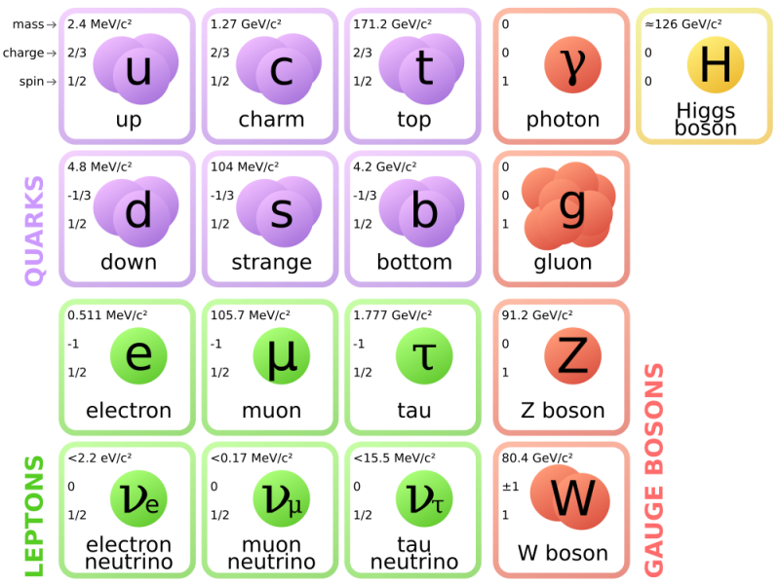
The Standard Model

Slide 5
Quarks and Gluons
In addition to fractional electric charge, quarks also carry a color charge
Color charge comes in red, blue, and green, along with anti-colors. Note that this is just a mnemonic to understand what interactions are possible.
Gluons are the carriers of the strong nuclear force, which interacts via color charge. Each gluon carries a color and an anti-color.
Unbound quarks are not seen in nature. Only color singlets can exist. These are states that have no color by combining a color and anti-color (mesons), or all three colors (baryons).

Slide 6
Particle Jets
Quarks cannot exist in unbound states due to the asymptotic freedom of the strong force.
Unlike photons, gluons have charge and can interact with each other.
When two quarks travel away from each other, the gluons that exchange interact with each other. This causes the force between the quarks to increase asymptotically.
If the quarks have enough energy, it becomes favorable for new particles to coalesce out of the vacuum to form new color singlet states.
This process is called hadronization, and it can happen many times over from the energy of the two original quarks to form two jets.

Slide 7
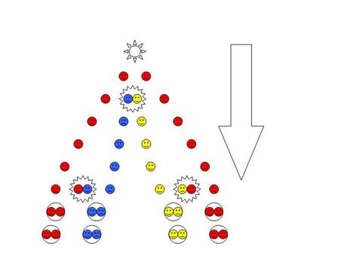
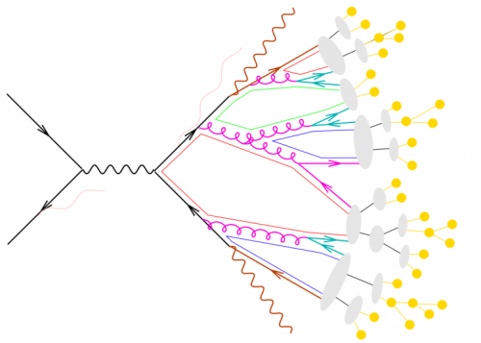
Hadronization and Jets
Concept
Simulation

Slide 8
Jet Clustering
The energy and momentum of the original quark/gluon can be determined by adding together the particles that it produced.
There are several clustering algorithms that determine which particles to add together: kt, anti-kt, and Cambridge-Aachen.
They all work similarly. They just treat momentum differently.

Slide 9

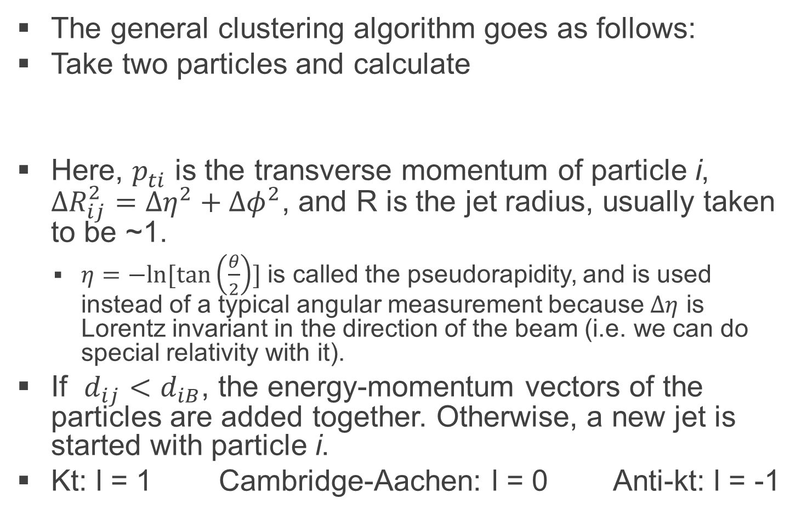

Jet Clustering
The general clustering algorithm goes as follows:
Take two particles and calculate
Here, $p_{ti}^{ }$ is the transverse momentum of particle i, $ΔR_{ij}^{2}={Δη}^{2}+{Δφ}^{2}$, and R is the jet radius, usually taken to be ~1.
$η=−ln⁡[\tan\left(\frac{θ}{2}\right)]$ is called the pseudorapidity, and is used instead of a typical angular measurement because $Δη$ is Lorentz invariant in the direction of the beam (i.e. we can do special relativity with it).
If $d_{ij}<d_{iB}$, the energy-momentum vectors of the particles are added together. Otherwise, a new jet is started with particle i.
Kt: l = 1 Cambridge-Aachen: l = 0 Anti-kt: l = -1
$$d_{ij}=\min\left(p_{ti}^{2l},p_{tj}^{2l}\right)ΔR_{ij}^{2}/R^{2}$$
$$d_{iB}=p_{ti}^{2l}$$

Slide 10
Clustering Challenges
Luminosity challenge: to discover rare events, more intense beams must be used.
Many collisions can occur simultaneously. This can cause jets from different events to overlap in a problem called pileup.
Identify pileup events and remove them.
Energy challenge: to discover new physics, it is necessary to build accelerators that can reach ever higher energies in particle collisions.
In the center-of-momentum frame, jets leave the event back-to-back. However, if a relativistic heavy particle decays, they can come out nearly side-by-side in the lab-frame.
Current methods choose a large R in the jet clustering algorithm, then work the algorithm backwards to determine how many subjets there are.

Slide 11
Persistent Homology
A mathematical tool to find the significant features in a point cloud
Does not pay attention to shape, only number of pieces and n-dimensional holes
Connects local features to global ones
Characterizes distance scales at which features live
Can characterize shape of manifold on which point live
Example: 9x9 patches of black and white images live on a Klein bottle. link

Slide 12
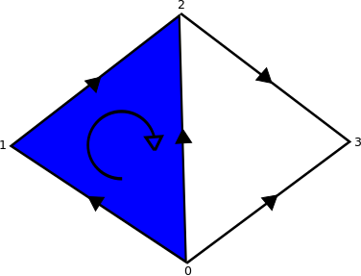

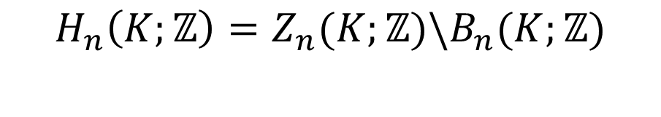
Homology
Simplex: an n-dimensional triangle
Simplicial complex: set of simplices that intersect entirely on an edge, or not at all
Boundary operator: $∂_{n}\left(σ\right)= \sum_{j=0}^{n}{{\left(−1\right)}^{j}\{u_{0},…,{\hat{u}}_{j},…,u_{n}\}}$
$σ$ is an oriented n-simplex – see figure
N-cycle: $φ∈Ker\left(∂_{n}\right)≡Z_{n}(K;ℤ)$
N-boundary: $φ∈Im\left(∂_{n+1}\right)≡B_{n}(K;ℤ)$
N^{th} homology group
Rank gives # n-dimensional holes
Simplifies to finding Smith-normal
form of 2 boundary matrices
$$H_{n}\left(K;ℤ\right)=Z_{n}(K;ℤ)\backslash B_{n}(K;ℤ)$$

Slide 13
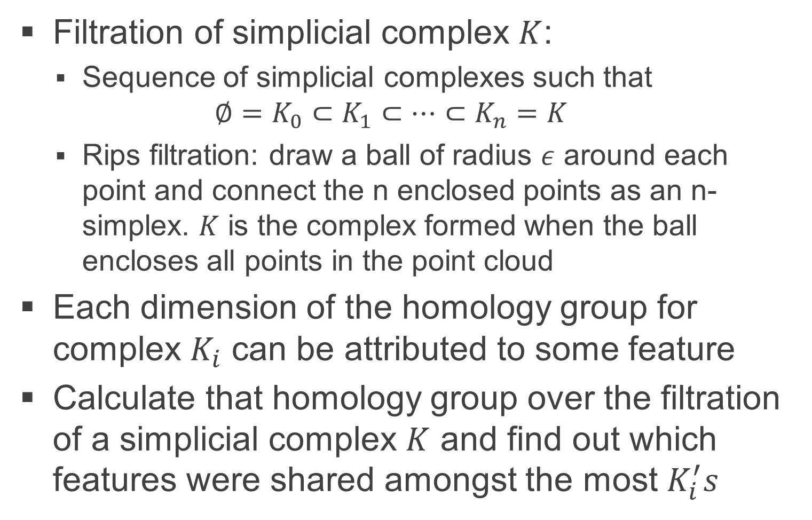
Persistence
Filtration of simplicial complex $K$:
Sequence of simplicial complexes such that
$$∅=K_{0}⊂K_{1}⊂…⊂K_{n}=K$$
Rips filtration: draw a ball of radius $ε$ around each point and connect the n enclosed points as an n-simplex. $K$ is the complex formed when the ball encloses all points in the point cloud
Each dimension of the homology group for complex $K_{i}$ can be attributed to some feature
Calculate that homology group over the filtration of a simplicial complex $K$ and find out which features were shared amongst the most $K_{i}^{′}s$

Slide 14
Can persistent homology be used to improve or replace clustering algorithms?

Slide 15
Persistent Homology?
Replace? Probably not. Clustering algorithms are very fast, while persistent homology is not. Algorithm must be used on millions of events.
Improve? Possibly. Persistent homology indicates the scale at which features in a point cloud live.
Could this be used to systematically choose a jet radius for clustering algorithms, based on energy, momentum, or position?

Slide 16
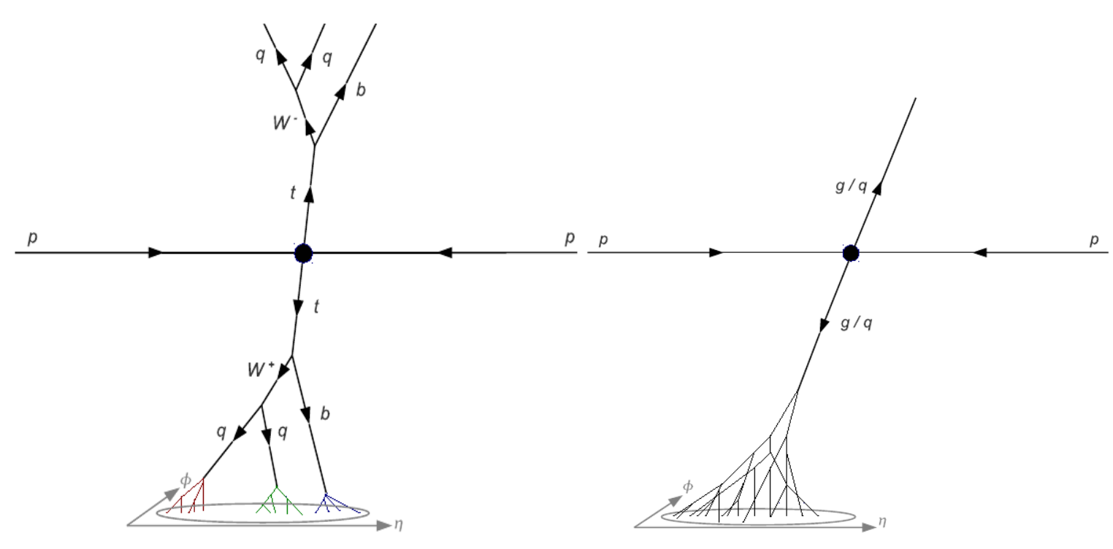
Persistent Homology for Jet Analysis
Compare persistence diagrams for events with top jets vs normal QCD jets

Slide 17
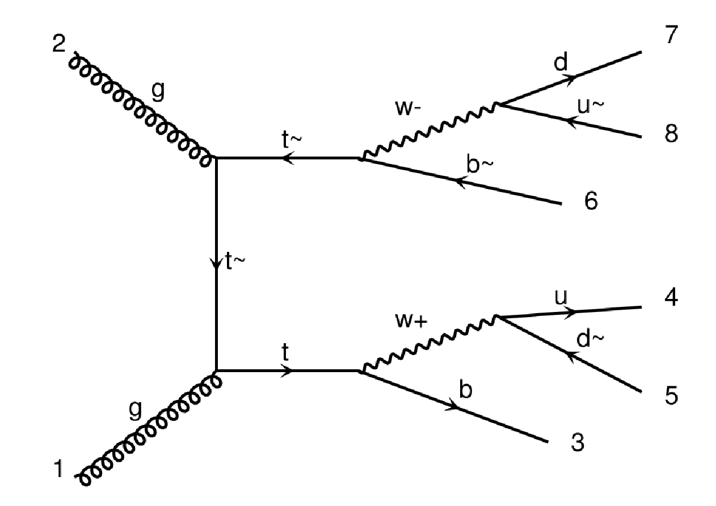
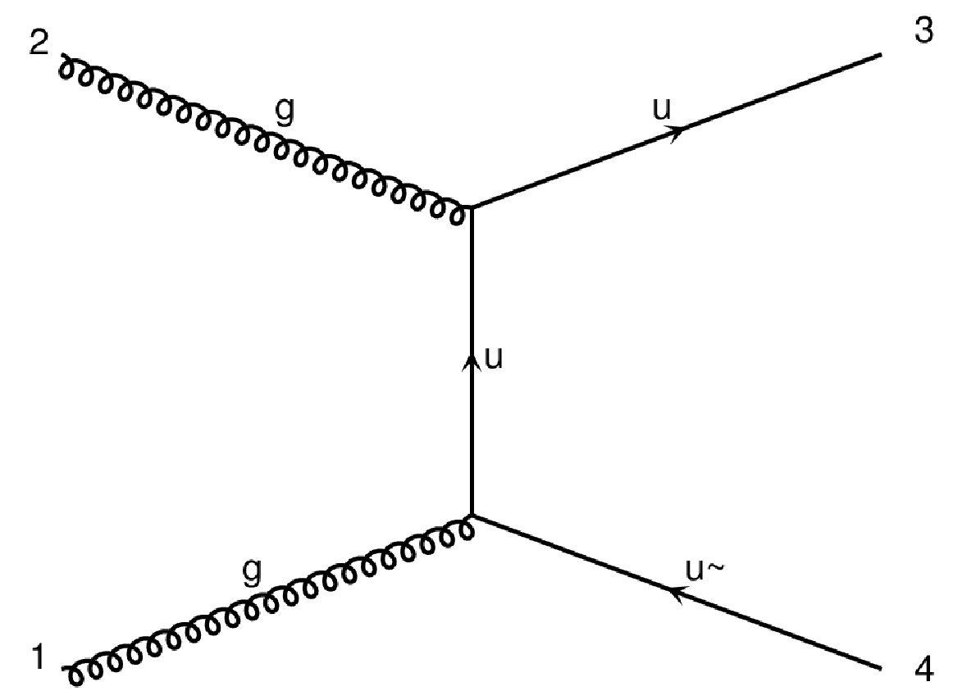
Procedure: Monte-Carlo
Use Madgraph Monte-Carlo event simulation to make events
Must simulate processes separately – regular QCD interactions 5-8 orders of magnitude more likely than top
Use Pythia to simulate hadronization to make jets

Slide 18
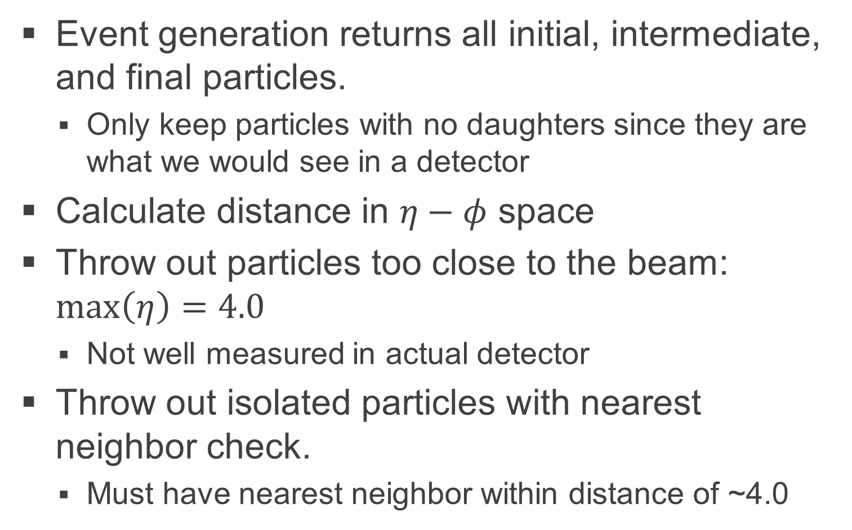
Procedure: Clean Events
Event generation returns all initial, intermediate, and final particles.
Only keep particles with no daughters since they are what we would see in a detector
Calculate distance in $η−φ$ space
Throw out particles too close to the beam: $\max\left(η\right)=4.0$
Not well measured in actual detector
Throw out isolated particles with nearest neighbor check.
Must have nearest neighbor within distance of ~4.0

Slide 19
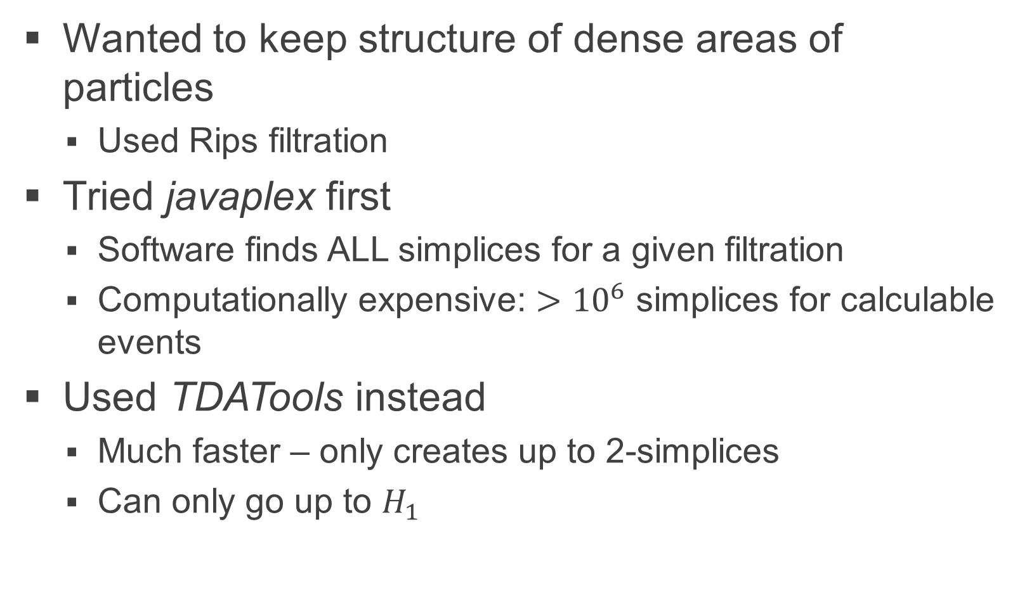
Procedure: Persistent Homology
Wanted to keep structure of dense areas of particles
Used Rips filtration
Tried javaplex first
Software finds ALL simplices for a given filtration
Computationally expensive: $>{10}^{6}$ simplices for calculable events
Used TDATools instead
Much faster – only creates up to 2-simplices
Can only go up to $H_{1}$

Slide 20
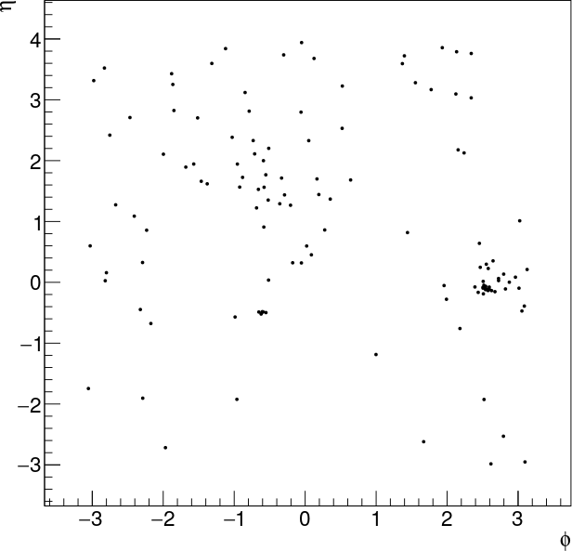
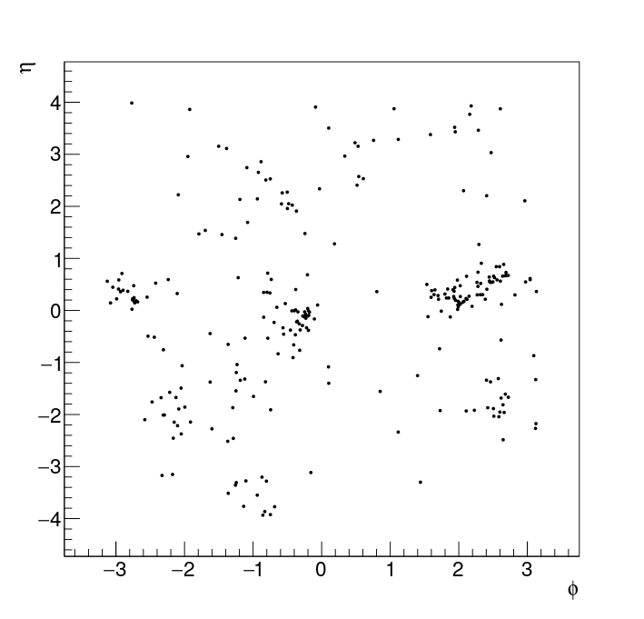
Results: Point Clouds
QCD Jets
Top Jets

Slide 21
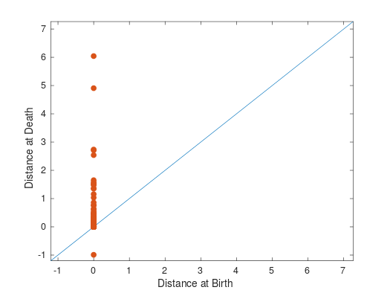
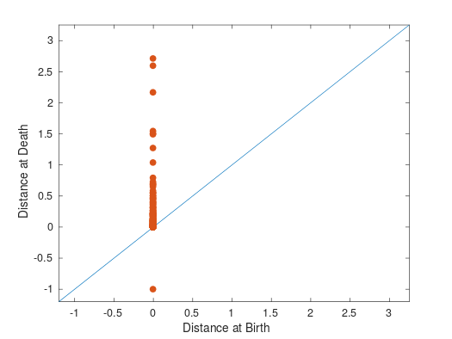

Results: $H_{0}$
QCD Jets
Top Jets
Substructure of top jets appears to be clear

Slide 22
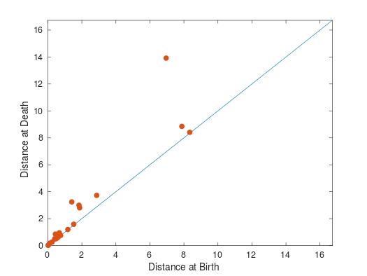
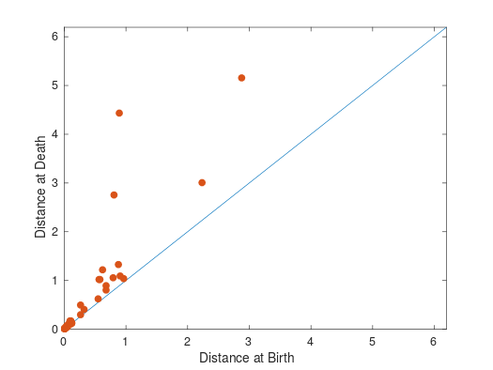

Results: $H_{1}$
QCD Jets
Top Jets
Possibly picking up the “hole” between prongs of each jet

Slide 23
Conclusion
Persistent homology seems to be able to resolve jet structure, substructure, and indicate appropriate jet radius
Calculations too slow to replace clustering algorithms
Write entirely in C++ to see if this is still the case
Small sample size for now. Need to measure distance between diagrams to verify segregation.
Future Work
Try persistent homology on jets post-clustering
Try clustering using jet radius from diagrams
Higher dimensional distance measures
N-subjettiness substructure variable separates subjets into Voronoi regions
Delauny Complex?
Other applications of persistent homology could include looking at multiple variable analyses
High dimensional spaces, but only need to be computed once

