Slide 1
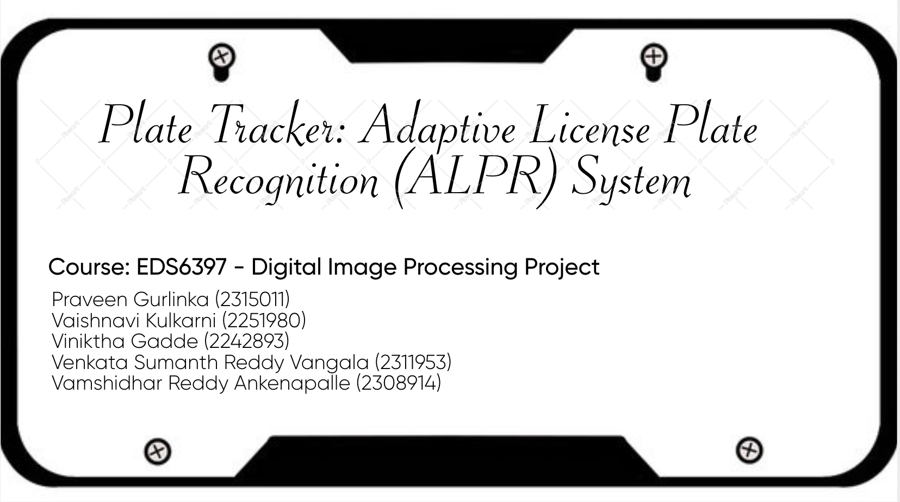

Slide 2
Abstract
The goal of this project is to increase the effectiveness of parking management by creating a foundational system for text extraction and license plate detection. The system recognizes and extracts text from photos of license plates by using digital image processing techniques. After capturing the image and preprocessing it to improve its quality, the license plate region is precisely detected. Text is then extracted from the designated Region of Interest (ROI) using optical character recognition (OCR). This project establishes the foundation for parking facility automated vehicle identification. By integrating with the current parking management infrastructure, facility managers and patrons will benefit from less manual intervention, lower operating expenses, and an enhanced user experience. This expandable solution offers a strong foundation for upcoming improvements to automated car entry and exit procedures.

Slide 3
Introduction
What is ALPR?
ALPR is an advanced computer vision and image processing system designed to automatically detect and identify vehicle license plates. It uses digital images or video recordings to capture and analyze alphanumeric characters.
Key Applications:
Traffic Monitoring and Enforcement Parking Management Automation Toll Collection Systems Security and Surveillance
Adaptability:
Fixed Systems: Mounted on infrastructure like toll booths and traffic lights. Mobile Systems: Installed on vehicles for dynamic, real-time monitoring.
Technological Advancements:
Integration with Deep Learning Algorithms enhances accuracy and adaptability. Facilitates real-time data analysis, aiding intelligent transportation systems globally.
Our Project: Plate Tracker Utilizes state-of-the-art image processing and machine learning techniques. Multi-step approach to accurately extract and process license plate data.

Slide 4
Dataset Background
Source: Kaggle’s public dataset of vehicle images, chosen for its diversity in lighting and angles.
Dataset Features:
Clear visibility of license plates.
Includes varied lighting conditions (day/night) and angles.
Contains images of cars, motorcycles, and other vehicles.
Preparation Steps:
Image normalization for uniform brightness and contrast.
Bounding box adjustments to standardize spatial relationships.
Conversion of XML annotations for easier data handling.
Purpose: A robust dataset ensures the model’s performance under real-world conditions.

Slide 5
Objectives
Primary Goal: Develop a highly accurate and adaptive ALPR system for parking management.
Specific Objectives:
Real-time license plate detection across diverse conditions (lighting, angles).
Automating entry/exit processes using access control mechanisms.
Streamlining parking fee calculation and payment processing.
Providing real-time vehicle tracking to enhance security.
Minimizing operational costs by reducing manual involvement.

Slide 6
Workflow Overview
Phase 1: Research and Planning (Weeks 1–2):
Requirement analysis to understand parking facility needs.
Identification of challenges: lighting variations, plate angles, and data security concerns.
Phase 2: Development (Week 3):
Data preprocessing: Noise reduction, contour detection, and edge enhancement using OpenCV.
Model experimentation: YOLO for object detection, custom approaches for text extraction.
Phase 3: Testing and Optimization (Week 4):
Testing system performance on real-world scenarios.
Fine-tuning preprocessing and recognition techniques.

Slide 7
Literature Review Overview
Key Technologies Used:
InceptionNetV2:
Convolutional neural network with 164 layers trained on ImageNet.
Hybrid architecture (Inception + Residual connections).Enhances training speed and prevents vanishing gradients.
Adapted for our project with pre-trained weights for accurate license plate detection.
PyTesseract OCR:
Python wrapper for Google’s Tesseract OCR engine.
Supports multiple image formats (JPEG, PNG, TIFF).
Key features:
Language detection and bounding box extraction.
Preprocessing with OpenCV for noise reduction, thresholding, and contrast enhancement.

Slide 8
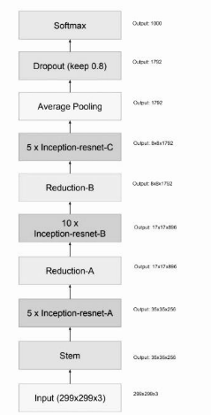
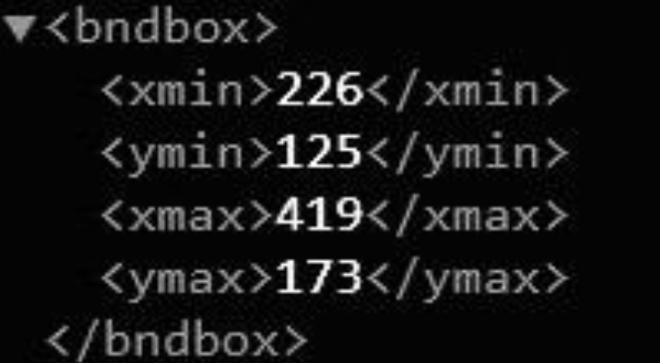
Literature Review Overview
InceptioResNetV2 Architecture
Sample XML Coordinates

Slide 9
Literature Review Overview
Supporting Tools:
TensorFlow/Keras: Model development and training.
OpenCV: Image processing and ROI detection.
Pandas/NumPy: Data handling and manipulation.
Matplotlib/Plotly: Visualization.
Key Insights:
Deep Learning Advances: CNNs and models like YOLOv8 improve real-time detection.
Preprocessing Techniques: Enhance OCR accuracy with noise reduction, thresholding, and resizing.
Integration: Combines deep learning and traditional OCR for robust ALPR solutions.

Slide 10
Development Details – Data Preprocessing
1) Preprocessing Steps:
Annotation: Extract bounding box coordinates (x_min, y_min, x_max, y_max).
2) Image Enhancement:
Thresholding: Improve contrast.
Noise Removal: Reduce image artifacts.
Grayscale to RGB: Ensure consistent color formats.
Contrast Enhancement: Enhance visibility of plate details.
Normalization: Standardize pixel values and bounding box coordinates.
3) XML Annotation Example: Label Master generates XML with bounding box.
4) Result: Structured, enhanced dataset ready for accurate license plate detection and recognition.

Slide 11
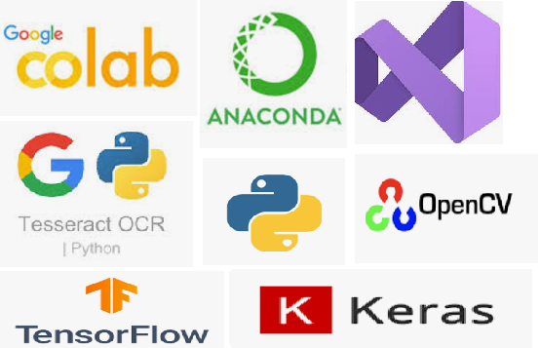
Development Details – Data Preprocessing
Tools and State of Art models used:

Slide 12
Development Details – Methodology
Data Import and Preprocessing:
Data Import: Load car images and XML annotations.
XML Parsing: Extract bounding box coordinates with xml.etree.ElementTree.
DataFrame Storage: Store coordinates and metadata in Pandas.
Image Preprocessing: Resize to 224x224 (Keras), normalize pixel values.Bounding Box Normalization: Normalize coordinates for consistency.
Data Splitting: Train-test split (80-20) using scikit-learn.
Model Architecture:
Base Model: InceptionResNetV2 with pre-trained ImageNet weights.
Custom Layers: Dense layers (500, 250 neurons, ReLU) and final output layer (4 neurons, sigmoid activation).
Compilation: Optimized with Adam; MSE loss for bounding box regression.

Slide 13
Development Details – Methodology
Model Training:
Training: TensorFlow’s fit() method; batch size 10, 100 epochs.
Monitoring: Real-time performance visualization with TensorBoard.
Model Saving: Save trained model as Plate_Tracker.keras.
Bounding Box Detection:
Inference: Load saved model, predict bounding box on test images.
Visualization: Draw bounding box using OpenCV; display with Plotly Express.
Text Extraction: ROI Preprocessing: Resizing, contrast enhancement (CLAHE), noise reduction, thresholding, morphological operations.
OCR: PyTesseract extracts text from the processed ROI.
Text Cleaning: Filter non-alphanumeric characters for accurate recognition.

Slide 14
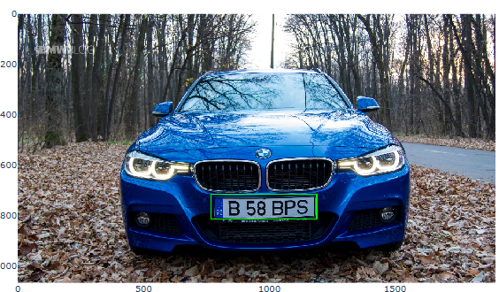
Development Details – Methodology
Bounding Box Detection:

Slide 15
Challenges & Adjustments
Low-light Performance:
Preprocessing pipeline enhanced with contrast and brightness adjustments.
Speed Optimization:
Batch processing to reduce inference times.
Simplified model complexity for faster real-time responses.
Other Challenges:
Dealing with partially obscured license plates.
Recognizing plates on vehicles moving at high speeds.

Slide 16
Results
Recognition Performance:
High accuracy achieved at 10m, 30m, and 50m distances.
Successfully recognized license plates under varying lighting conditions.
Data Management:
License plate data stored in a structured database for tracking and reporting.
Use Case Validation:
Effective application in parking lots, traffic monitoring, and vehicle tracking.

Slide 17
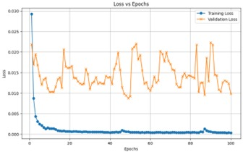
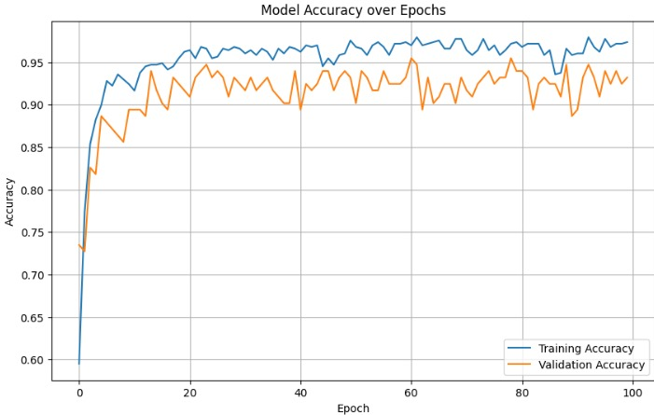
Results
Loss Vs Epchos ModelAccuracy Vs Epchos

Slide 18
Future Scope
Preprocessing Enhancements:
Incorporate bilateral filtering and tilt correction for better accuracy.
Machine Learning Improvements:
Adaptive models tailored for country-specific plates and regional variations.
Advanced OCR Features:
Integrate dynamic text recognition for better accuracy under diverse conditions.
Broader Applications: Expand use cases to toll booths, security checkpoints, and city-wide traffic systems.

Slide 19
Conclusion
The Plate Tracker project effectively created an automated system for recognizing license plates that combines deep learning and sophisticated image processing techniques. Through the use of transfer learning and the InceptionResNetV2 architecture, we were able to detect and locate license plates with strong performance under a variety of circumstances. A carefully selected dataset was used to train the model, and XML annotations were used to provide exact bounding box coordinates.
The system's capabilities were further improved by the use of PyTesseract for text extraction, which made it possible to accurately recognize alphanumeric characters from detected license plates. We proved the efficacy of fusing cutting-edge deep learning models with conventional OCR methods using a methodical approach that comprised data preprocessing, model training, and evaluation.
The findings show that our system is capable of accurately detecting and extracting license plate information, which qualifies it for use in automated vehicle identification, traffic management, and security surveillance applications. Future research could examine additional ways to improve model performance, like integrating more sophisticated architectures or adding more preprocessing methods to deal with difficult

Slide 20
REFERENCES
[1] Luo X., Ma D., Jin S., Gong Y., Wang D. Queue length estimation for signalized intersections using license plate recognition data. IEEE Intell. Transp. Syst. Mag. 2019;11:209–220. doi: 10.1109/MITS.2019.2919541
[2] Tsakanikas, V.; Dagiuklas, T. Video surveillance systems-current status and future trends. Comput. Electr. Eng. 2018, 70, 736–753.
[3] Shan Du; Ibrahim, M.; Shehata, M.; Badawy, W., "Automatic License Plate Recognition (ALPR): A State-of-the-Art Review," Circuits and Systems for Video Technology, IEEE Transactions on , vol.23, no.2, pp.311,325, Feb. 2013
[4] B. Well and N. Ronald, Two-Dimensional Imaging, Englewood Cliffs, NJ, Prentice Hall, 1995, pp. 505-537.
[5] M. Fang, C. Liang, and X. Zhao, "A method based on rough set and SOFM neural network for the car's plate character recognition, " in Intelligent Control and Automation, WCICA 2004, Fifth World Congress on, 5, 2004, 4037-4040. IEEE.
[6] E. R. Lee, P. K. Kim, and H. J. Kim, "Automatic recognition of a car license plate using color image Processing, " in Image Processing, ICIP-94., IEEE International Conference, 2, 1994, 301-305

