Slide 1
Project Presentation of CO-OP Project at Industry (Module-2) (22CS421)
On
Integrating AI for Demand Forecasting in Online Marketplaces and ERP Systems
Vamika (2210992495) & Akriti Patial (2210991221)
Supervised By
Dr. Ajay Kumar
Department of Computer Science and Engineering,
Chitkara University, Punjab

Slide 2
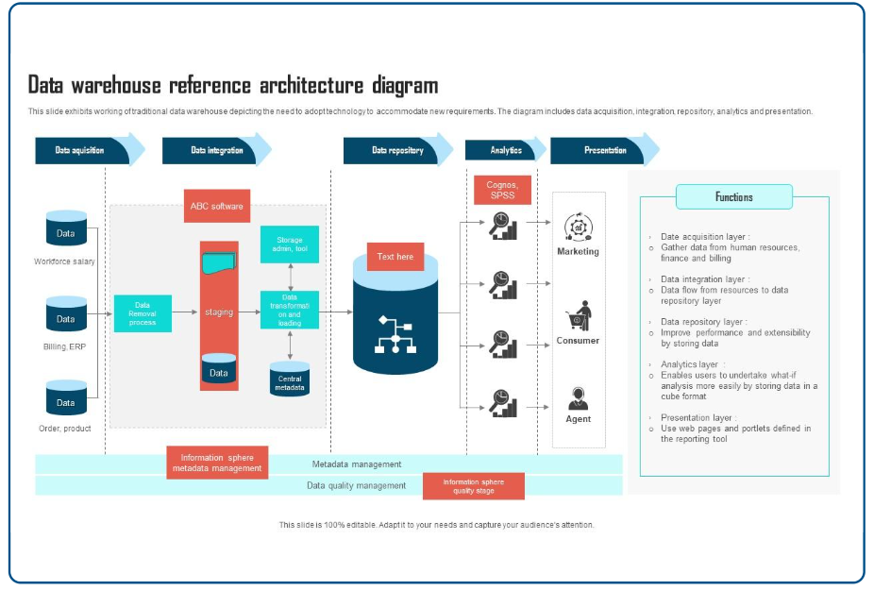
Introduction: ERP & Operations
The Operational Backbone
Core Integration: ERP systems unify purchasing, manufacturing, sales, and HR.
The Goal: Maintain minimal inventory while achieving 99% order fulfillment.
The Gap: Legacy systems rely on fixed rules that fail in dynamic digital markets.

Slide 3
Problem Statement & Objectives
Result: Excess inventory (dead stock) or missed revenue (stockouts).
Proposed Solution
A Hybrid Integration Framework designed to bridge the Internal ERP SQL database with External Marketplace APIs.
Goal: Move from reactive "lagging" statistics to proactive "leading" AI predictions.
Traditional Limitations
Customary ERP implementations use Univariate analysis (SMA/WMA) which assumes the future is a simple linear projection of the past.
Result: Excess inventory (dead stock) or missed revenue (stockouts).

Slide 4




Literature Review & Research Gaps
Phase 1: Time Series
Phase 2: ML Rise
Phase 3: Hybrid
ARIMA & Exponential Smoothing (Gardner, 2006). Effective but struggle with retail volatility and seasonality.
Carbonneau et al. (2008) used SVMs to tackle the "Bullwhip Effect". Demonstrated ML beats classical models.
Sentiment analysis (Thiebaut, 2023) improves predictions by 12%. This work adds Competitor Pricing as a variable.
Gap Identified: Lack of practical ETL documentation for combining SQL and JSON data for B.Tech frameworks.

Slide 5
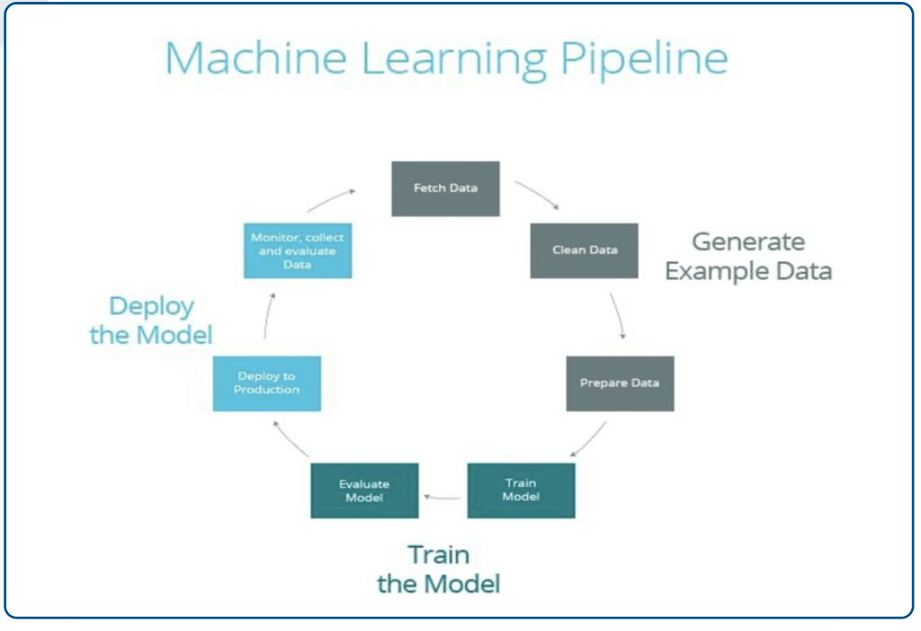
Research Methodology & Data
Dual Data Strategy
Internal (ERP): 4 years of transactional SKU-level sales, price, and quantity.
External (Market): API extracted market prices and "Consumer Trend Scores."
Preprocessing: IQR outlier detection and Min-Max scaling for normalization.

Slide 6
Feature Engineering Innovation
The Feature Fusion Layer combines internal and external signals for higher precision:
Price Elasticity Index
Seasonality Lag
7-Day Rolling Mean
Ratio of internal SKU price vs. the average market competitor price. Identifies competitive advantage.
Captures 12-month historical sales patterns to account for annual recurring peaks and troughs.
A moving average of the last 7 days to smooth out weekend noise and identify immediate trends.

Slide 7
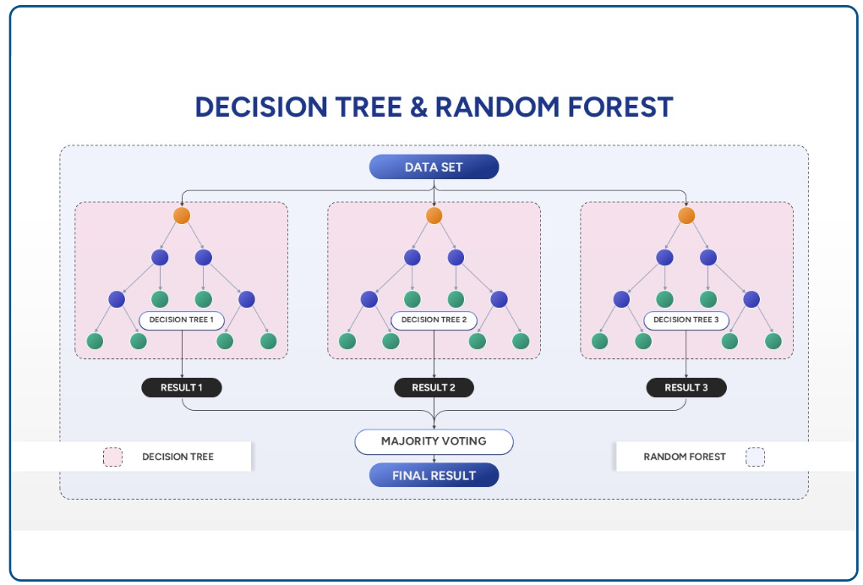
Machine Learning Model Selection
Baseline: Simple Moving Average (SMA) for comparison.
Linear Regression: Establishing the base relationship between price and demand.
Random Forest (RFR): The chosen ensemble model.
Interpretability: RFR was selected specifically for its ability to rank Feature Importance, solving the "Black Box" problem.

Slide 8




System Design & Implementation
Data Tier
Integration Tier
PostgreSQL (Internal) + Web Scraper (Marketplace Signals).
Python-based ETL pipeline for data harmonization.
Analytics Tier
Presentation
Scikit-learn for model training & hyperparameter tuning.
Streamlit dashboard for real-time inventory decisions.

Slide 9
Experimental Results & Analysis
Model Name | MAE (Units) | MAPE (%) | RMSE
Moving Average (Traditional) | 542 | 26.4% | 610
Linear Regression (Base AI) | 385 | 19.1% | 402
Random Forest (Proposed) | 122 | 7.8% | 145
Key Insight: Random Forest achieved an 18.6% gain in accuracy over traditional methods, correctly predicting "Holiday Surges" where others failed.

Slide 10
Strategic Discussion & Impact
Mitigating the Bullwhip Effect
18.6%
AI integration provides a "synchronized demand signal" predictive of market sentiment, reducing exponentially amplified upstream errors.
Reduction in Forecast
Error
Democratization for SMEs
Proves that high-fidelity forecasting is feasible with open-source ML, bypassing the need for expensive "Black Box" deep learning infra.

Slide 11
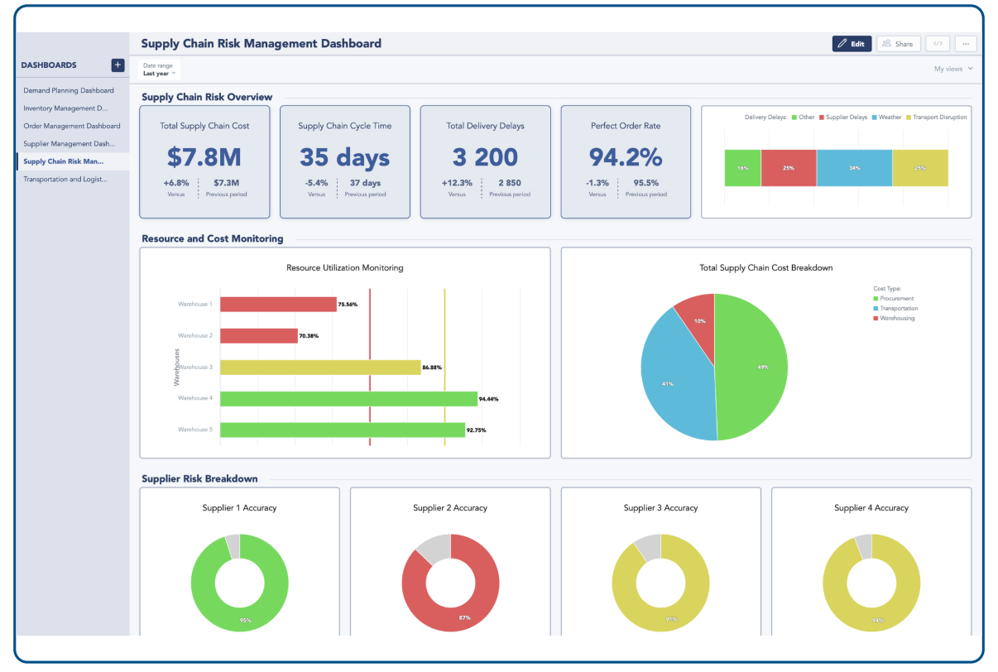
Conclusion & Synthesis
System of Intelligence: Upgrades ERP from a passive record-keeper to a strategic planner.
Feature Quality: High-quality marketplace telemetry is a stronger driver than neural network depth.
Sustainability: Reduced dead stock leads to a more sustainable production-consumption cycle.

Slide 12
Future Scope & References
Future Directions
Key References
Deep Learning (LSTM): To capture long-term seasonal trends better.
[1] Box & Jenkins, "Time Series Analysis," 1970.
Edge Computing: Real-time calibrations on warehouse scanners.
[3] Carbonneau et al., "ML for Supply Chain Forecasting," 2008.
NLP Integration: Quantifying consumer review sentiments.
[6] Zhang & Liu, "Google Trends & Competitor Pricing," 2024.

Slide 13
Thank You

