Slide 1
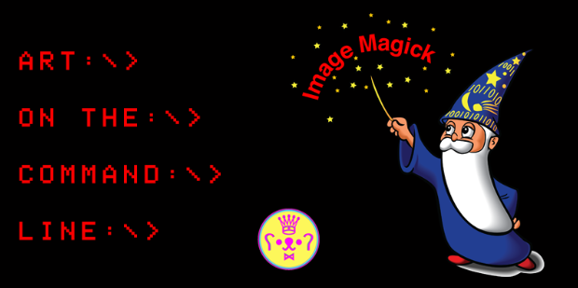

Slide 2
INTRODUCTIONS
INTRODUCTIONS
DREW: game developer
and artist working with
technology
http://vampirecomputerpeople.com
KARL: meow @ Babycastles
  http://omnikrll.github.io

Slide 3
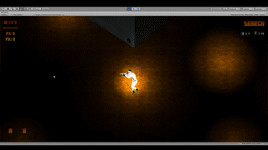
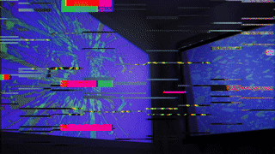
#BuiltWithImageMagick

Slide 4
What is ImageMagick?
Free and open-source (source code
is available for usage -
GraphicsMagick is popular offshoot)
Create/manipulate digital images
Command-line interface (CLI)
  A way of interacting with a
  program by entering lines
  of text

Slide 5
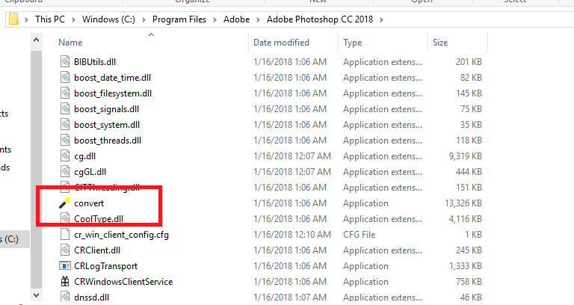
What is ImageMagick?

Slide 6
Why ImageMagick?
Fast and efficient tool
  Significantly speed up batch
  operation processes required
  in game development
Lightweight/boots up quickly
Runs on older machines
FREE and open-source

Slide 7
Why ImageMagick?
Familiar to programmatically minded
Self-documenting process for
easy implementation of aesthetic
A change of perspective
Instant Beginner's Mind for the
new user

Slide 8
Using the CLI
Check out the official docs!
'magick' in IM 7
'convert' in IM 6 and lower
First argument is input
Second argument is output

Slide 9
Using the CLI
Simple conversion
Conversion with wildcards
      Asterisk is wildcard
      '%02d' will number output files with double zero padding
  Resize
  Resize with distortion (glitch art potential)

Slide 10
Using the CLI
Montage - create a sprite sheet from images
  Montage allows you to combine
multiple images
  For IM 6 and lower, just use
  'montage' instead of
  'magick montage'
Split the sheet back into
separate images
Try executing your own command!
Take a look at the IM docs for ideas

Slide 11
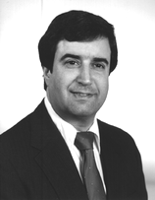
Using the CLI
Advanced Usage:
  Fred's ImageMagick Scripts:
Fred
Weinhaus
    Former physicist who, in his retirement, now answers questions on ImageMagick forums and makes complex IM batch scripts
http://www.fmwconcepts.com/imagemagick/index.php

Slide 12
Advanced usage
can be unwieldy
image.png `
-scale 4% -scale 150% `
-modulate 100,133,100 `
-brightness-contrast 0x29 `
-background none `
-gravity center `
-extent 200x200 `
-roll -2+0 `
output.png
Easy to forget a line
Some lines never change (why type it every time?)
Hard to remember

Slide 13
Enter the Custom CLI:
Try using '-help' command on
scripts/sprite_sheet.py
No chance of misuse, forgotten lines - output gives clear
feedback on any user issues
Try building your own custom
tool - tailor the code
to your specific workflow

Slide 14

Simple IM binding (glue code) for Python
Pythonic/Modern interface
Good documentation
Less Magicky, more like
application code
Object-oriented potential

Slide 15
MEME MACHINE
Try modifying values via
the values.yml file
Try modifying the script itself

Slide 16
Rorschach
Try modifying values via
the values.yml file
Try modifying the script itself
Leveraging
https://github.com/baptistemanteau/colorharmonies
  You could make a random color and derive its complements, run the script 100 times and choose your favorite output
  What are some ideas you have?

Slide 17
Resources
Fred's ImageMagick scripts - http://www.fmwconcepts.com/imagemagick/index.php
ImageMagick forum - https://imagemagick.org/discourse-server/
Google your questions and choose a promising result from https://stackoverflow.com

Slide 18

Alternatives
GraphicsMagick
  Fork of ImageMagick that supposedly has better multi-threaded performance
Flickr is (was?) a user
  Etsy made the case for it in 2010
    https://codeascraft.com/2010/07/09/batch-processing-millions-of-images/

Slide 19
Alternatives
Pillow (fork of the Python Imaging Library)
  Very popular library
  More for image manipulation than creation, but creating images supported
  Heavily used in business/enterprise applications
  Might have some interesting artistic applications
  No need to install any additional binaries, just a simple pip install

