Slide 1
Java

Slide 2
Java Install – Set Path
set path=C:\Program Files\Java\jdk1.8.0_121\bin
Control Panel -> System & Security -> System -> Advanced System Settings -> Environment variables Set PATH as local path to JDK bin

Slide 3
Compile and Run From CMD
Javac myfile.class – Java compile
Java myfile - Run

Slide 4
Eclipse Create Project
Creating Sample Project

Slide 5
Basic Syntax – Coding Standards
Classes – Noun Starting with Upper Case, Next words if any too Upper case
Methods – Name starts with lower case any other following word upper case
Program file name (.java file name) should match the class name
Variables – starts with small case, if next word the upper case
Identifiers – Any name to identify a class name, method name or variable names – Should begin with (A-Z or a-z) ; $ ; _
Once started can use any combination of letters numbers
Java is Case Sensitive
Don’t Use any other special characters except $ and _ and pre-defined keywords

Slide 6
Object & Classes
Write a class
Constructors – No Arguments Constructor, Parameterized Constructor.. Ex., Car();
Create Object – Declaration, Instantiation, Initialization
Car c = new Car();
And call it’s methods, variables

Slide 7
Basic Datatypes
Primitive, Object/Reference Data Types
Primitive
Byte: -128 to 127. Default 0
Short:- -32,768 to 32,767. Default 0
Int:- - 2,147,483,648 to 2,147,483,647. Default 0.
Long:- -9,223,372,036,854,775,808 to 9,223,372,036,854,775,807. Default 0.
Float:- Single precision
Double:- Double precision
Example why to prefer double over float with some num with 6+ decimals

Slide 8
Variable Types
Local Variables
Instance Variables
Class/Static Variables

Slide 9
Packages

Slide 10
Access Modifiers
Java provides a number of access modifiers to set access levels for classes, variables, methods and constructors. The four access levels are −
Visible to the package, the (default). No modifiers are needed.
Visible to the class only (private).
Visible to the world (public).
Visible to the package and all subclasses (protected).

Slide 11
Operators
Arithmetic Operators (+, -, *, /, %, ++, --)
Relational Operators (==, !=, >, <, >=, <=)
Bitwise Operators (&, |, ^, ~)
Logical Operators (&&, ||, !)
Assignment Operators (=, +=, -=, *=, /=, %=)
Conditional Operator/Ternary Operator (a==b ? SOP(Yes) : SOP(NO))
InstanceOf Operator (“Cigna” instanceof String) => true

Slide 12
Methods/Functions

Slide 13
Loops
To execute a block of code several times
For loop – for(initialization; BooleanExpression; Updation)
While loop – While(BooleanExpression)
Do-While:- Similar to while but Do-While executes atleast once – do{} while(BooleanExpression)

Slide 14
Arrays
Array is fixed size sequential collection of variables of same type
Declaration:
double myArray[] = new double[10]; //Works but not preferred
double[] myArray = new double[10]; //Preferred
Processing Arrays:
Array.Length – Using for loop
For-Each or Extended For – for(double element : myArr)
Passing Arrays to methods – void printArray(double[] myArr)
Returning Array from methods – double[] getArray()
Equal(), Sort(), binarySearch()

Slide 15
Loop Control Statements
Break
Continue

Slide 16
Decision Making
If – if(BooleanExpression)
If-else – if(BooleanExpression)-else
Nested If – If(BooleanExpression1){ if(BooleanExpression2)}}
Switch – Switch(Expression){case value: break; default: break;}
Variables used in switch can only be integers, or converatble integers (byte, short, char), STrings
Value for case must be of same data type as variable in switch
Once executed corresponding case, it will execute until it finds a break

Slide 17
STrings
String class

Slide 18
Exceptions
Checked Exception: is an exception that is checked at compile time. – FileNotFoundException, IOException
Un-checked Exception:- Occurs at time of execution. Also called run-time exceptions. Ex., ArrayIndexOutOfBoundsException
Try-catch-finally
Try-catch-catch-catch – ArrayIndexOutOfBounds, Arithmetic
Throws- for methods, Throw- new exception

Slide 19
Files I/O
Java handles files by using streams concept to make I/O faster
Stream is a Sequence of data. It’s called stream coz its like stram of water that continuous to flow
3 Streams which already were created for us which communicate with the Console. System.out; System.in; Sysetem .err
To read in from console -> int I = System.in.read(); (char)I;
OutputStream – To write data to file => FileoutputStream
InputStream – To read data from file => FileInputSTream
FileReader, FileWriter
File.mkdir; File.mkdirs

Slide 20
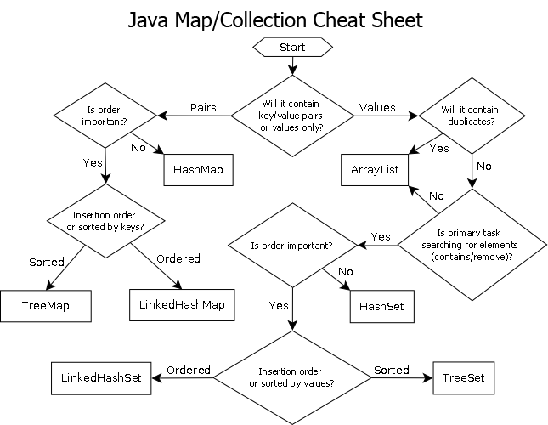
Collections

