Slide 1
AIDS (Artificial Intelligence for Data Science)
Color Detector

Slide 2
Team Members
Roll Number | Name
2110030001 | B L Narasimham
2110030109 | D Harshavardhan
2110030150 | B V V L N Bhargav
2110030153 | Jaina Vamshi
2110030229 | K Harshith

Slide 3
Objective
The objective of a color detector is to accurately determine the color of an object. This is typically done through the use of sensors or cameras that can detect the specific wavelengths of light that are reflected by an object. The detected information can then be used to identify and classify the color of the object according to a color model, such as RGB (red-green-blue), HSL (hue-saturation-lightness), or CMYK (cyan-magenta-yellow-black).

Slide 4
What is Color Detector?
A color detector is a device or Application that can identify and measure the color of an object or surface. Color detectors work by sensing the amount of light reflected off an object at different wavelengths or frequencies.
There are several types of color detectors available, ranging from simple color sensors to sophisticated colorimeters and spectrophotometers. Simple color sensors typically detect the intensity of light at three different wavelengths corresponding to the red, green, and blue color channels, and use this information to calculate the object's color based on a color model like RGB or HSL.

Slide 5
Data Set Collection
CIFAR-10 is a popular image classification dataset used in machine learning research. The dataset contains 60,000 32x32 color images in 10 classes, with 6,000 images per class. The 10 classes are: airplane, automobile, bird, cat, deer, dog, frog, horse, ship, and truck. The images were collected and labeled by Alex Krizhevsky, Vinod Nair, and Geoffrey Hinton.

Slide 6
Tools Setup
1. Python(language commands).
2. PyGUI (which provides a frame to access).
3. CIFAR-10(For Training the AI and also for testing the bot)

Slide 7
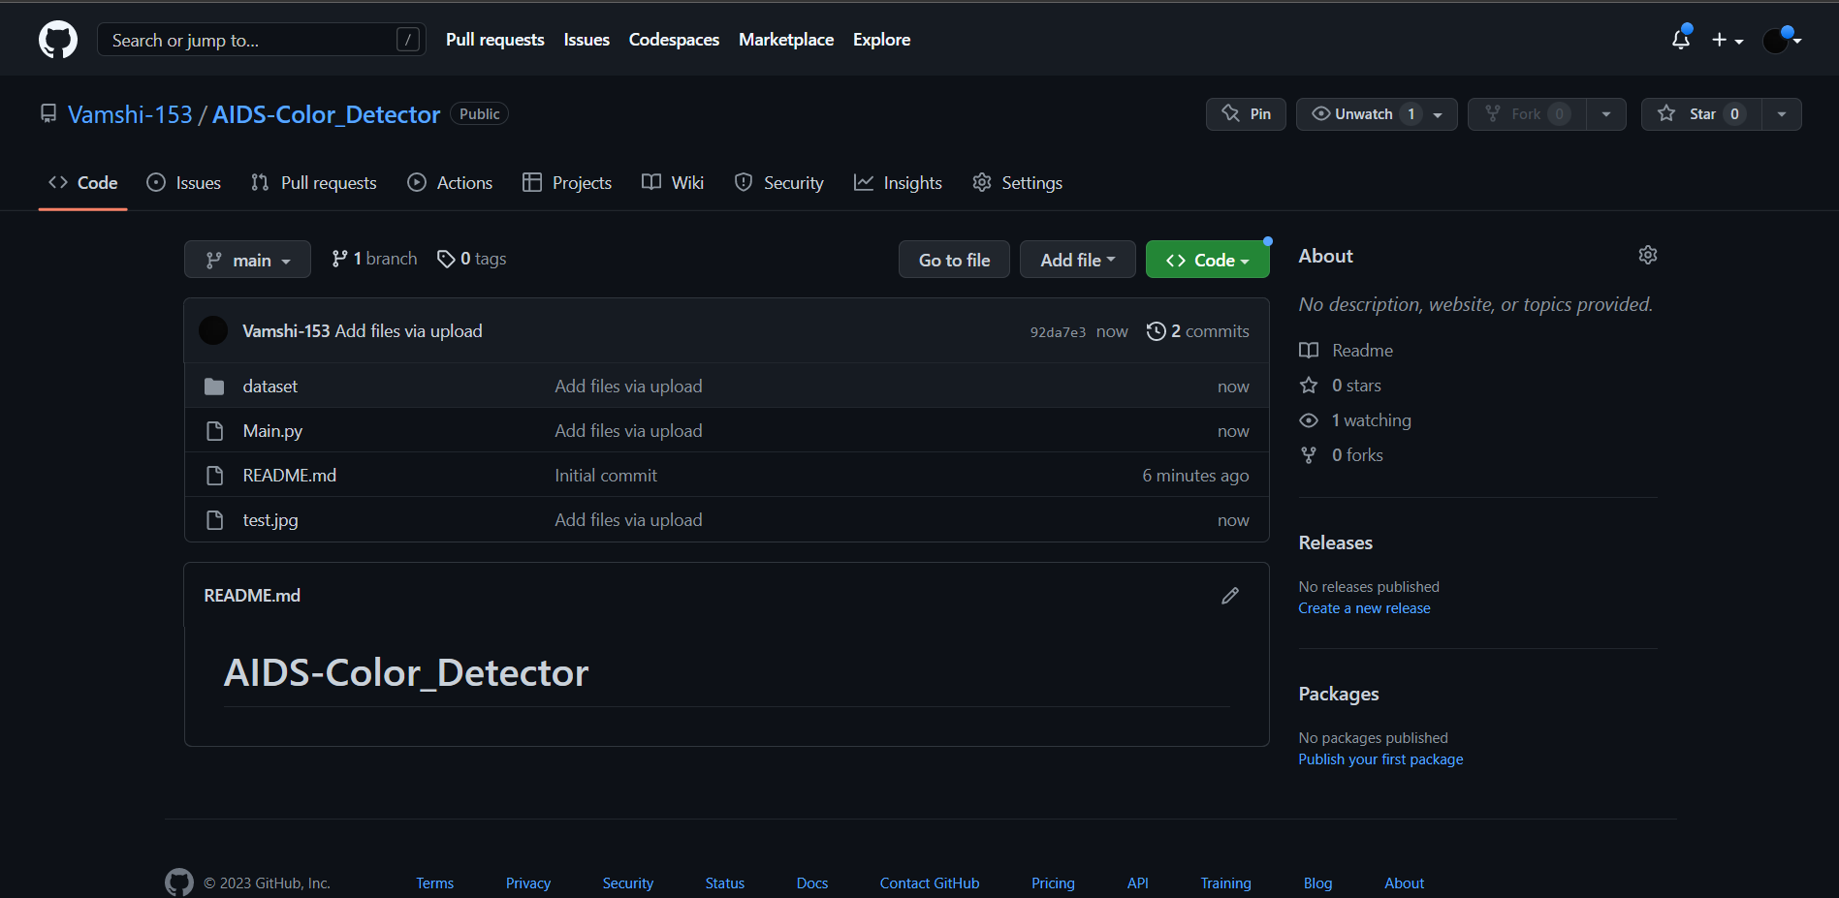
Git-Hub Commits

Slide 8
THANKS

