Slide 1
MERN (Mongo DB,Express,Reat,Node JS)
Social media app for local handicrafts

Slide 2
Team Members
Name | Roll Number
B L Narasimham | 2110030001
D Harshavardhan Reddy | 2110030109
B V V L N Bhargav | 2110030150
Jaina Vamshi | 2110030153
K Harshith | 2110030229

Slide 3
Objective
Native crafts date back thousands of years. Anything that endures for so long has to adapt with the times to survive. But adapting is hard when tradition is your main selling point. Luckily, traditional arts and crafts forms from around the world are enduring thanks to one of the planet’s most revolutionary technologies: the internet.

Slide 4
What is social media app for local handicrafts?
The internet, and social media in particular, is crucial to traditional crafts’ current day survival, whether it is down to those making, selling or appreciating the artworks. Here’s how.
Any social media platform with an image-based element is likely to be populated by various pictures of homemade crafts. Instagram, for instance, is full of DIY-based accounts such as All Things Thrifty, Studio DIY and The DIY Junkie that showcase various homemade creations, usually from simple materials like paper and cardboard, that get thousands of likes for every post.

Slide 5
Tools setup
Vs code
React Js
Node Js
MongoDB
Express Api

Slide 6
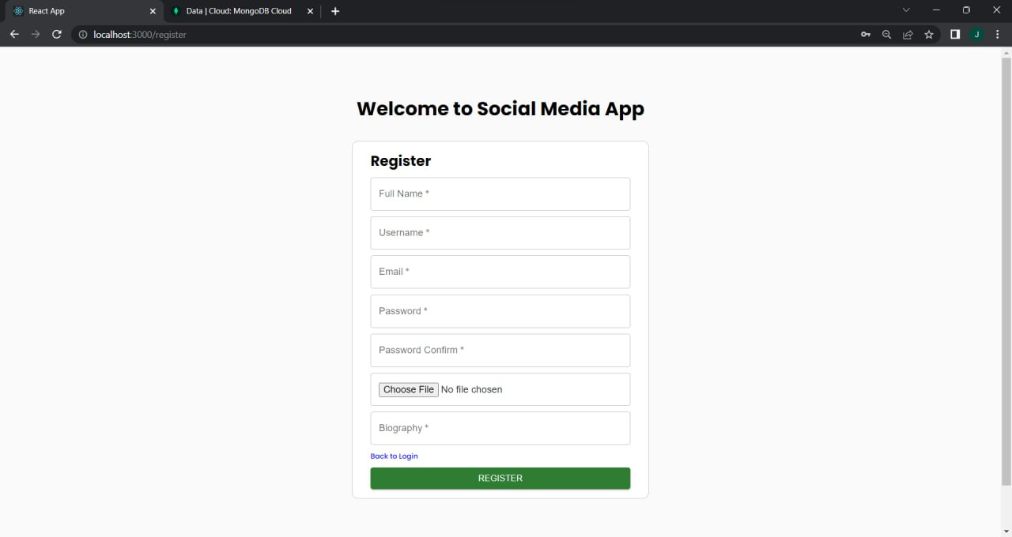
Sign up page

Slide 7
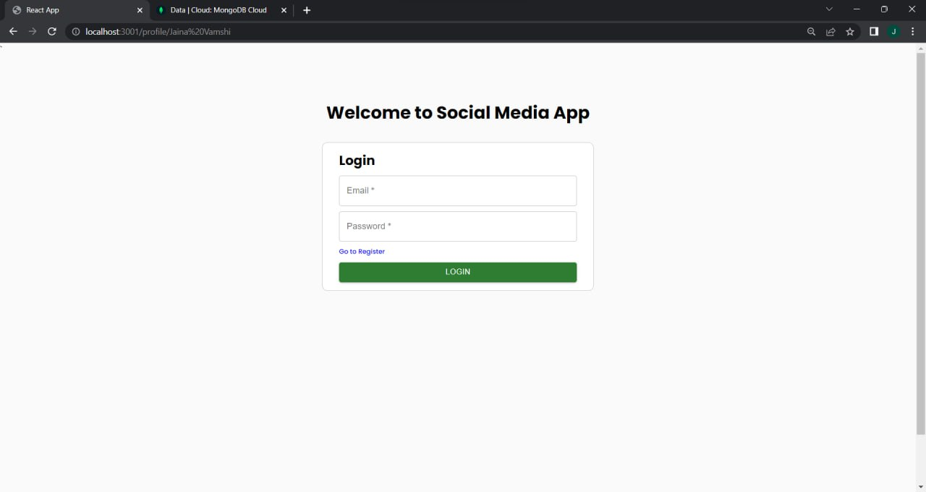
Login page

Slide 8
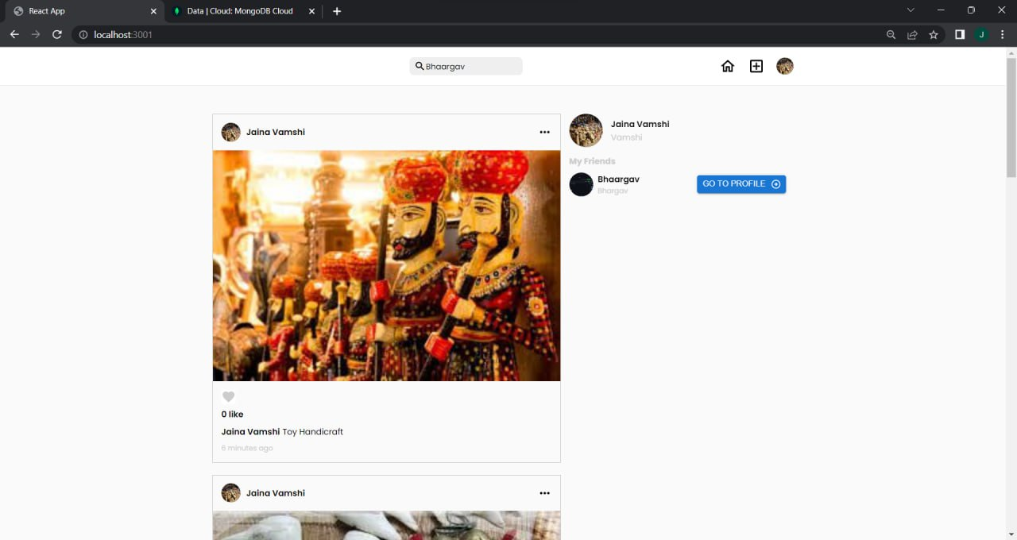
home page

Slide 9
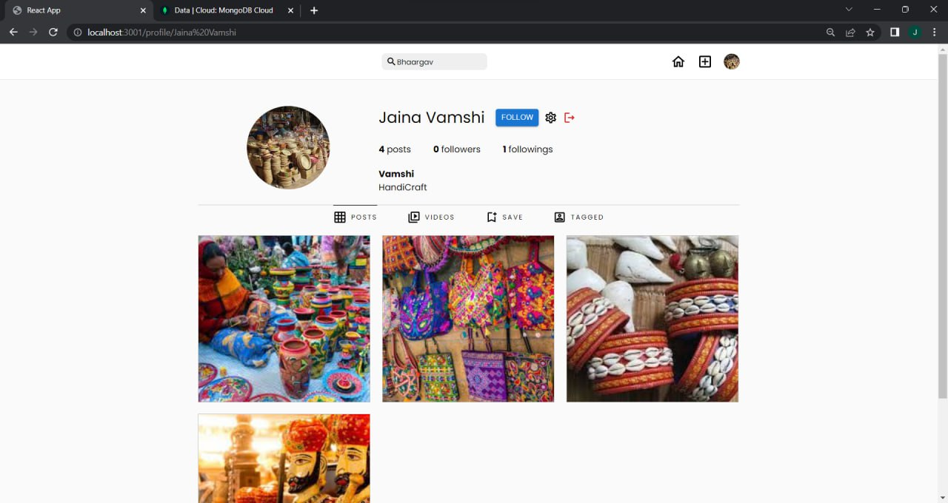
Profile page

Slide 10
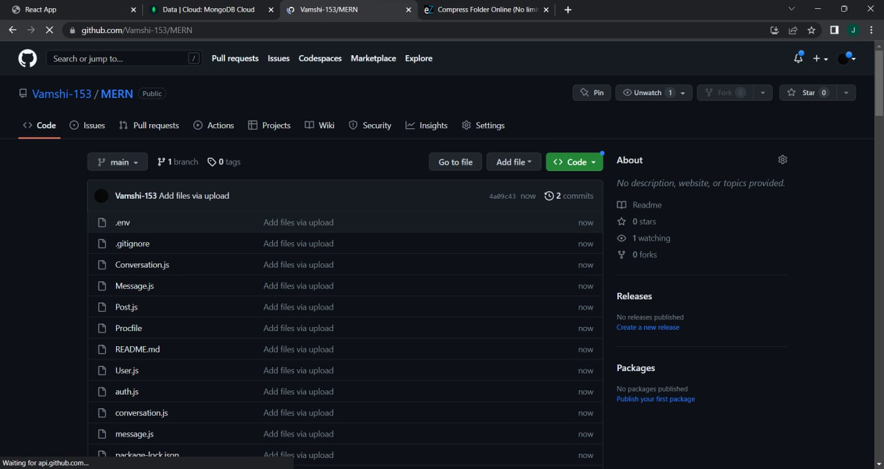
Github commits

Slide 11
Thank you

