Slide 1

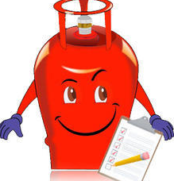
Gas MANagement system PYTHON FULL STACK DEVELOPMENT
By
B V V L N BHARGAV (2110030150 )
JAINA VAMSHI (2110030153)
JATIN MISHRA (2110030212)
U SAI SUBRAHMANYAM(2110030293)
Under the guidance of
Madhu priya

Slide 2
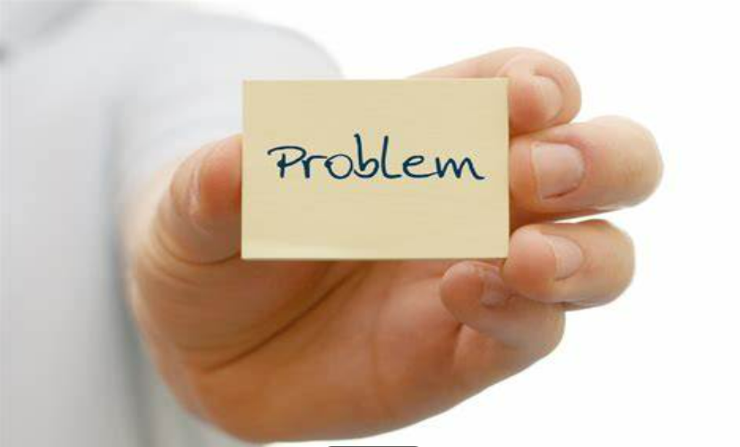
Problem statement :-
Problem Statement Most of the LPG stations in Rural areas often experience long queue of people spending several hours waiting to buy gas. This problem of time wastage at the stations has persisted for several years

Slide 3
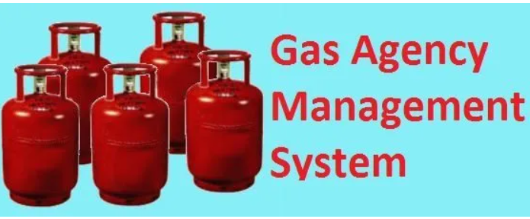
Existing solutions:-
Existing Solution1:-
Talking about the current system which presently used in the institutes is basically manually working or even if it is computerized restricted to a place or building thus all work of maintenance is also done in the same building. So, we can say that the Existing system of Gas Booking System works computerized in a building or manually with pen-paper.
ProjectSolution1:-
Through our project we can access the database from anywhere without any restrictions.
Existing Solution2:-
we can know the actual work of the ‘Bharat gas agency’ . The current work is not computerized system.
https://www.lovelycoding.org/online-gas-booking-system/ (Research Link)
ProjectSolution2:-
by this project, the process of ordering, billing, and stock maintenance for a gas agency can be processed easily (Computerized).

Slide 4

Proposed Algorithm Design Technique
What is the technique?
The objective of this project is to create a system where the customer can easily book their LPG gas cylinder through an online system and the agency can track the record of its customer and the delivery of the cylinder.
How is it suitable for your application?
Consumer Record is maintained.
Edit, update, and deletion of the record.
Online booking of the gas through internet from any point.
Check consumer is valid to book a gas.
Valid booking followed by the payments process.
Booking records should be maintaining.

Slide 5
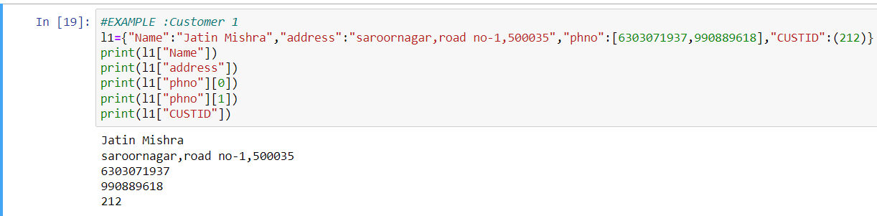
DATA SET COLLECTION:-
We will use SET, DICTATIONARY, LIST and LIST WITH DICTATIONARY and SET.
EG:-

Slide 6




TOOLS SETUP:-
We are going to use
1. Python(language commands).
2. Django Framework(which provides a frame to access).
3.PSQL[DBMS(for records management)].
4.Visual Studio Code(for “HTML and JAVASCRIPT” designing of website).
5.Terra_er and STARUML(to get workflow diagrams).

Slide 7
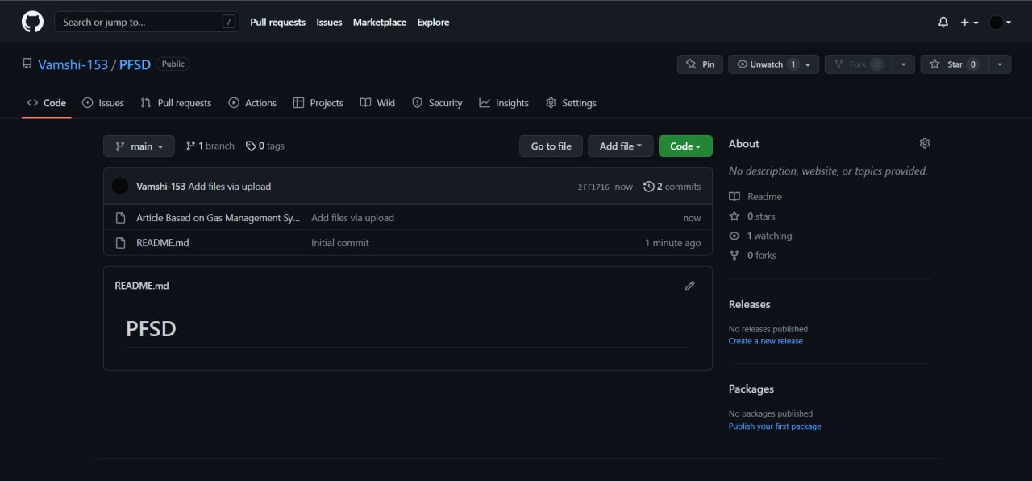
Github setup

Slide 8
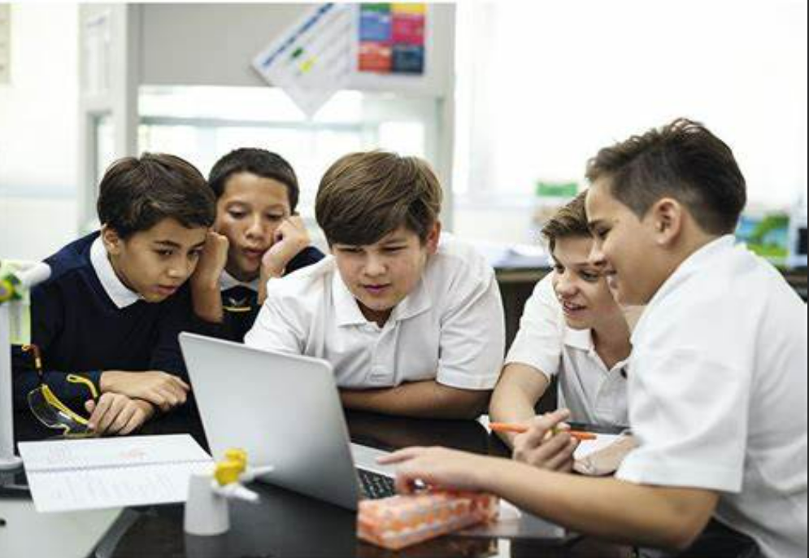
Division of work among the group members:-
PPT AND EER:- JATIN(2110030212).
REPORT WRITING:-B V V L N BHARGAV (2110030150 ).
INFORMATION GATHERING AND HTML WEB DESIGN: -U SAI SUBRAHMANYAM(2110030293).
DJANGO FRAMWORK:-VAMSHI(2110030153).
PYTHON CODE AND PRESENTATION:- Bhargav(2110030150),Vamshi(2110030153),Jatin(2110030212), Subrahmanyam(2110030293).

