Slide 1

Mini Project Speech Emotion Recognition Using Librosa Mentor : Dr M. Sunitha
By
A Hanuman Vamshi Krishna
(18B81A05R4)
S Jashwanth (18B81A05R8)
K Sri Charan (18B81A05V2)

Slide 2
ABSTRACT
Speech emotion recognition, the best example of it can be seen at call centers. If you ever noticed, call centers employees never talk in the same manner, their way of pitching/talking to the customers changes with customers. Now, this does happen with common people too, but how is this relevant to call centers? Here is your answer, the employees recognize customers’ emotions from speech, so they can improve their service and convert more people. In this way, they are using speech emotion recognition.

Slide 3
Literature Summary
A CASE STUDY OF SPEECH EMOTION RECOGNITION.
(Research article in IJAR)
Summary : In this paper speech emotion recognition system has been reviewed. Also features and classifier for recognition of speech has been discussed.
IMPROVING EMOTION CLASSIFICATION THROUGH VARIATIONAL INFERENCE OF LATENT VARIABLES.
(Paper by University of Texas at Dallas)
Summary : In this study they hypothesize that speech signal depends on multiple latent variables including the emotional state, age, gender, and speech content.

Slide 4
Literature Summary
Multimodal and Multi-view Models for Emotion Recognition (Paper by University of Houston)
Summary : In this paper, they studied the emotion recognition problem from the speech and language perspectives. They formally looked into acoustic and lexical modalities with the aim of improving models that only use acoustic information.

Slide 5
REQUIREMENTS
Functional Requirements
The model will take audio/speech as input and give the most dominant emotion of the speech as output.
The model should be independent of language.
The input should be complete so that the model doesn’t fail to give an accurate output.

Slide 6
REQUIREMENTS
Non - Functional Requirements
The model gives an accurate output factoring in differences like age, gender, etc…
The model gives an accurate output notwithstanding the disturbance in the input.
The accuracy should be high i.e. the classification should be as accurate as possible.

Slide 7
Tools and Technologies
Tools
Jupyter notebook
Technologies
Python
Librosa
Scikitlearn
Pandas
Numpy
Keras

Slide 8
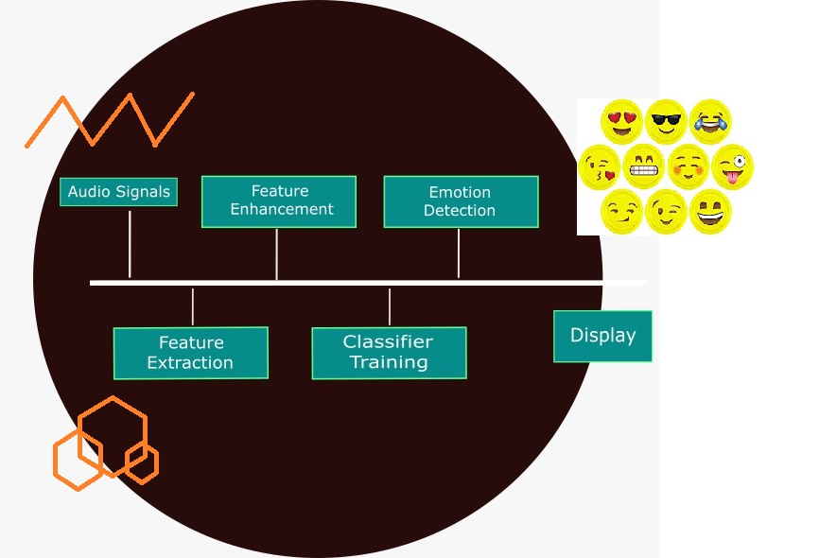
Modular Structure

Slide 9
Thank You

