Slide 1
Concrete Compressive Strength Prediction

Slide 2
Problem Statement:
The objective is to predict the concrete compressive strength of concrete block.
Prediction results tells the optimal way to get the maximum compressive strength for a unit block of concrete using the ingredients.

Slide 3
Data:
Dataset is taken from UCI Machine Learning Repository.
It’s a Supervised – Regression problem.
Shape of the data (rows, columns): (1030, 9)
8 Quantitative input variable, and 1 Quantitative output variable
Input Features: Cement, Furnace Slag, Fly Ash, Water, Superplasticizer, Coarse Aggregate, Fine Aggregate, and Age.
Target Feature: Concrete Compressive Strength.

Slide 4
Process:
In Jupyter Notebook
Explored the data.
Tried and tested all the methods.
Streamlined the process and used the results in modular coding.
Modular Coding
Complete End to End Project is made with all the Exception and Logging included.
Also Streamlit app is created for prediction and deployed it.

Slide 5
Project Flow:
EDA
Drop Duplicates
Outlier Detection
Variable Transformation
Model Evaluation
Hyperparameter Tuning
Model Building
Scaling

Slide 6
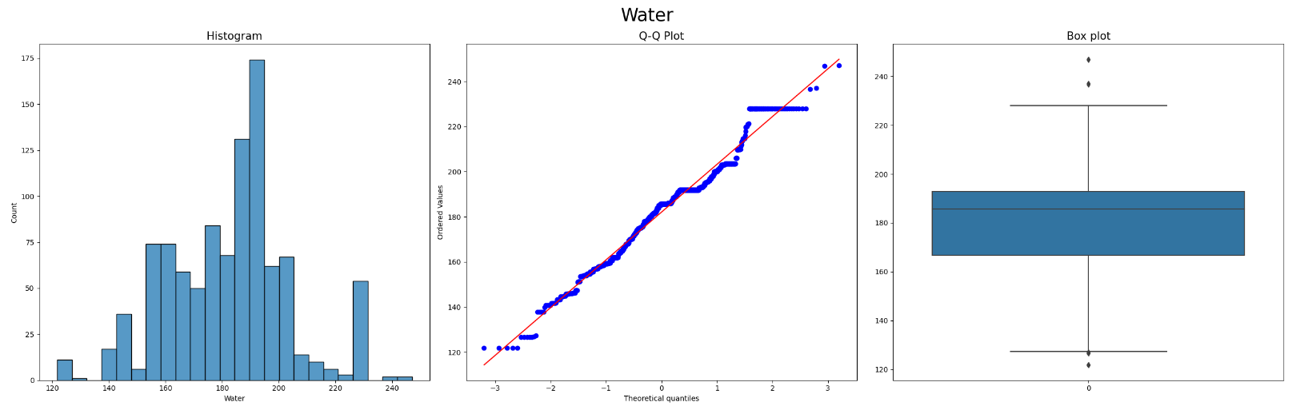
Outlier Detection:
First, we check the distribution, Q-Q plot and Box plot for every feature. depending on the distribution, we proceed further.

Slide 7
Three methods to cap the outliers.
- Gaussian (Z-Score)
- IQR
- Percentile (Winsorization)
Depending on the distribution for every feature, we perform capping and check the results.
For detailed analysis, check the Jupyter notebook here.

Slide 8
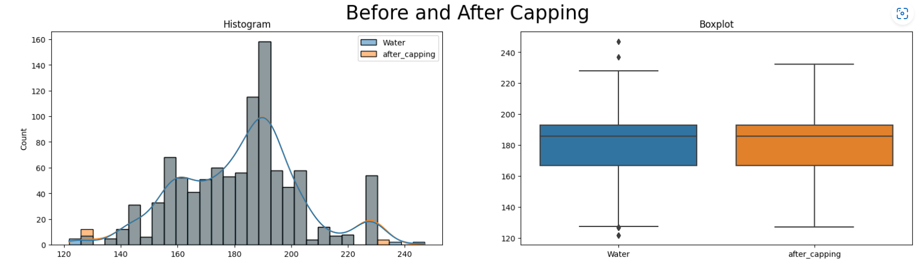
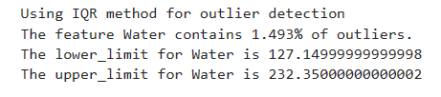
Results:

Slide 9
Variable Transformation:
Almost all the features are skewed, as some ML models assume normality, we need to transform the distribution.
Some popular transformation techniques are:
Logarithmic Transformation
Logarithmic Transformation plus constant
Exponential
Reciprocal
Box-Cox
Yeo-Johnson

Slide 10
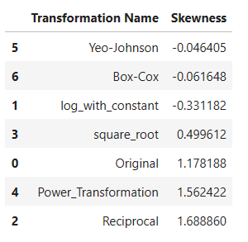
Performed all the transformation techniques on every feature and check the skewness of the distribution.
Skewness ranges from (-inf to +inf), but for all practical purposes it ranges from (-3 to +3).
For Age:

Slide 11
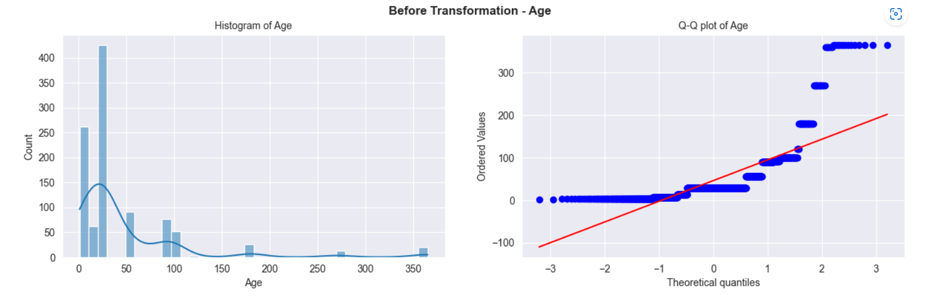
Age:

Slide 12
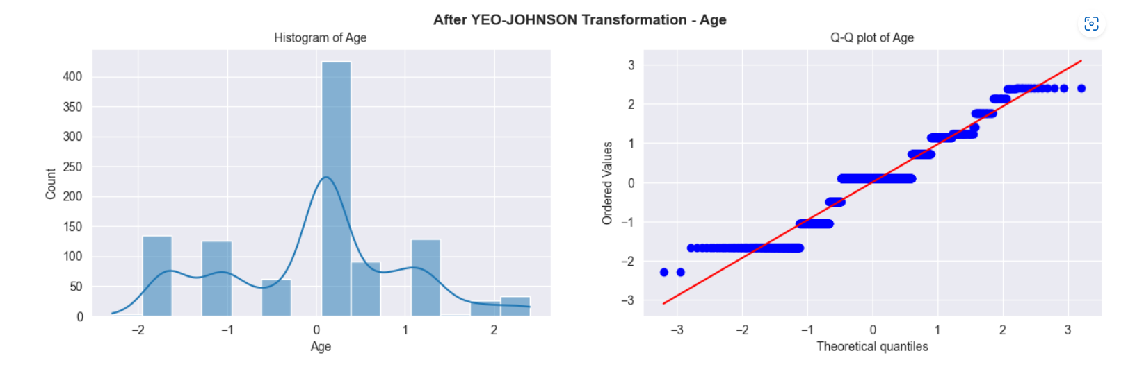
After Applying Yeo-Johnson:

Slide 13
Scaling:
As some ML models are sensitive towards scale of the variable, scaling the features to same scale is must.
There are many scaling methods:
MinMaxScaler
StandardScaler
AbsMaxScaler

Slide 14
Model Building:
Performed 7 Machine learning algorithms on the data.
Linear Regression
Lasso Regression
Ridge Regression
Support Vector Regressor (SVR)
Decision Tree Regressor
Random Forest Regressor
XGBoost Regressor

Slide 15
Model Evaluation Metrics:
R2 Score
No units, as it’s ratio
Ranges from 0 to 1
1 – Perfect Fit
0 – Not a fit
Closer to 1, better is the model at prediction.
Root Mean Squared Error
Closer to zero, better is the model.
Units are same as target feature unit.

Slide 16
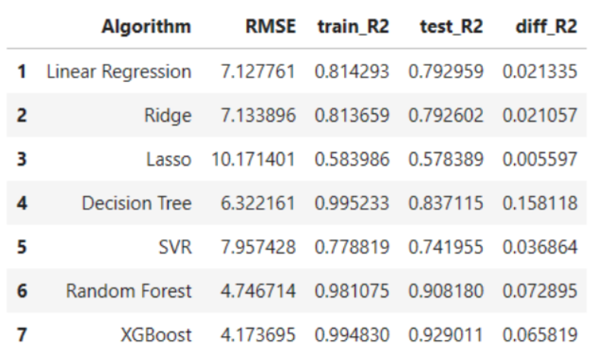
Results for all the 7 ML Models:

Slide 17
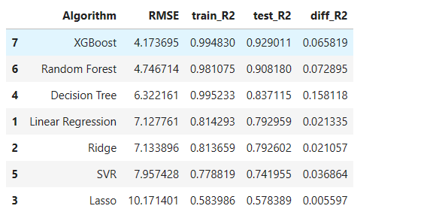
Clearly, XGBoost and Random Forest performs better of all.
Decision Tree is overfitting.

Slide 18
Hyperparameter Tuning:
Hyperparameter tuning is performed on XGBoost and Random Forest.

Slide 19
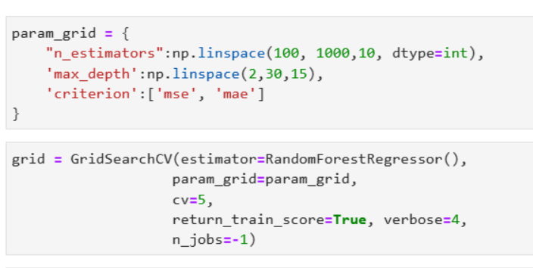
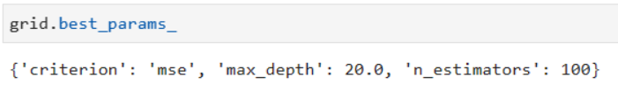
Random Forest:
Best Parameters:

Slide 20
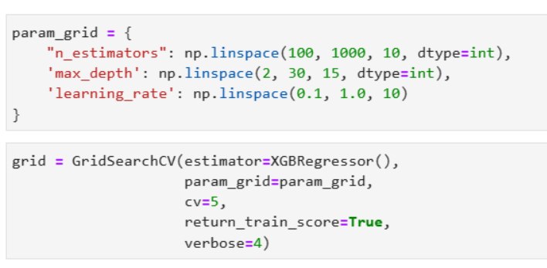
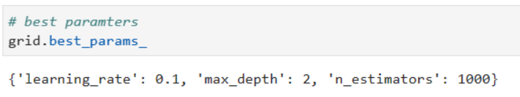
XGBoost:
Best Parameters:

Slide 21
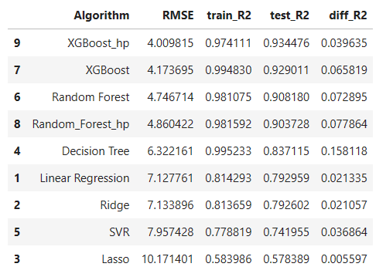
Results:

Slide 22
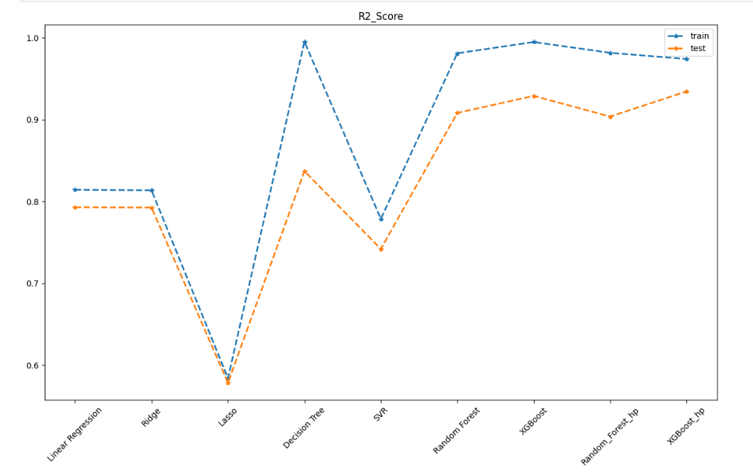
R Squared Score:

Slide 23
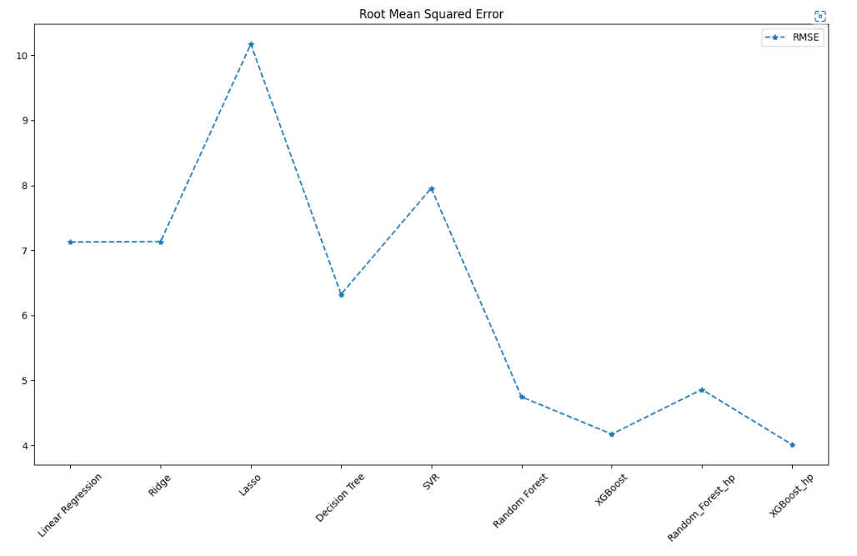
RMSE:

Slide 24
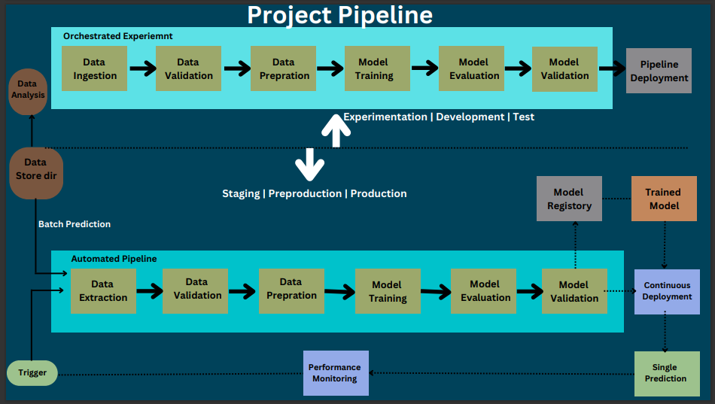
Modular Coding:

Slide 25
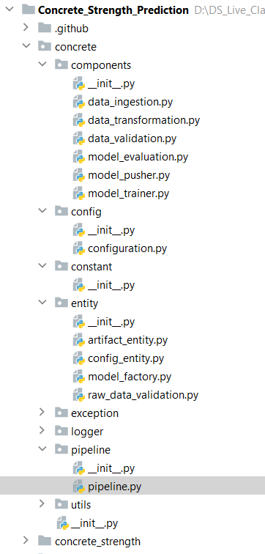
Project File Structure:

Slide 26
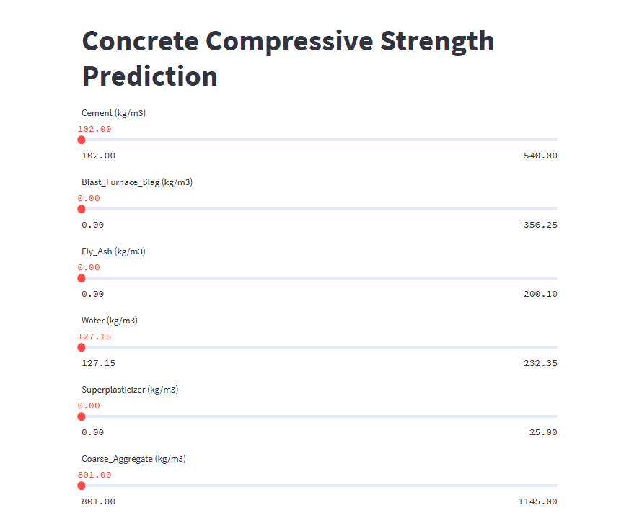
Streamlit App:

Slide 27
Further Improvements:
Only MinMaxScaler is applied, we can apply other scaling methods and check whether is there any significant change.
Only Single Prediction Pipeline is created, Batch Prediction can be added and also, retraining the model can be added.
Feature Selection can be performed, retrain the model and check the results.

Slide 28
