Slide 1

ANALYZING CUSTOMER JOURNEY WHILE USING FLIPKART …

Slide 2

ABOUT THE COMPANY
Flipkart is an Indian e-commerce company founded in 2007 by Sachin Bansal and Binny Bansal . It started as an online bookstore and later expanded into various categories such as electronics, fashion, and more. Flipkart operates a marketplace model, where it connects sellers with consumers through its platform

Slide 3
DATA COLLECTION
SOURCES :
CRM SYSTEM : Costumer Information And Purchase History
WEB ANALYTICS TOOLS : User Behaviour And Engagement Metrics
CUSTOMER SUPPORT : Customer Feeedback

Slide 4

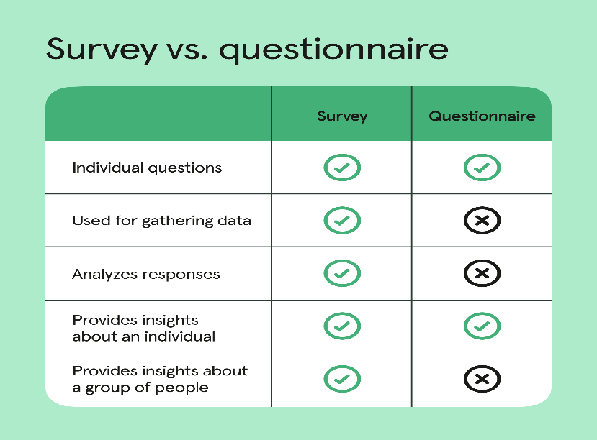
TYPES OF DATA COLLECTED
User Feedback and Reviews:
Checking the app's reviews on app stores (like Google Play Store or Apple App Store) and read user comments. Look for common complaints or issues that users are experiencing.
Surveys and Questionnaires:
Organized surveys and questionnaires targeted at current and former users of the app. Ask questions about their experience, why they stopped using the app, and what improvements they would like to see.

Slide 5
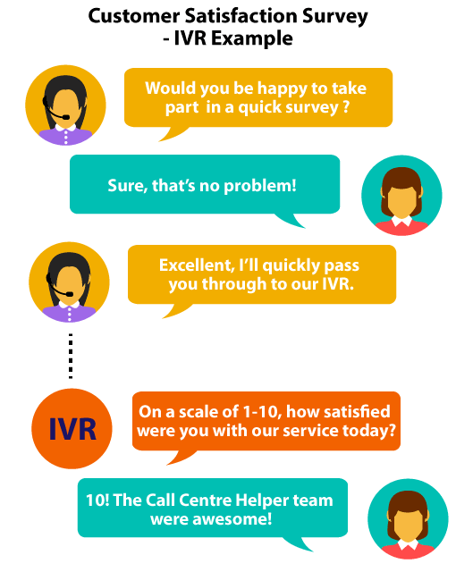

Customer Support Feedback:
Reviewing customer support inquiries to see if there are recurring issues or concerns that users are reporting.
Social Media Monitoring:
Monitoring social media platforms, forums, and online communities related to the app . Users often discuss their experiences and issues they encounter, which can provide us valuable insights.
Internal Feedback:
Talking to the development and customer support teams within the organization. They may have valuable insights based on direct interactions with users or knowledge of technical issue

Slide 6
JOURNEY OF A COUSTMER WHILE USING THE APP
Discovery and Browsing:
The customer opens the Flipkart app, which usually displays personalized recommendations, deals of the day, or popular categories based on previous interactions.
Product Search:
Search: Customers use the search bar to find specific products or browse through category listings.
Filters and Sorting: They apply filters (price range, brand, ratings, etc.) and sorting options (price low to high,relevance, etc.) to refine their search results.
Checkout Process:
Customers review items in their cart and proceed to checkout.
Payment Options: They choose a payment method (credit/debit card, net banking, UPI, COD, etc.) and enter relevant details.
Order Confirmation:
After completing the checkout process, customers receive an order confirmation with details such as estimated delivery date, order number, and summary
Post-Purchase Experience:
Order Tracking: Customers can track their order status within the app, including shipment updates and delivery notifications.
Customer Support: They can contact Flipkart's customer support through the app for any queries or issues related to their order.

Slide 7
CORE VALUES
Improving Consumer Satisfaction
Costumer Retention
Communication
Providing A Delightful And Memorable Journey To The Customer

Slide 8
PAIN POINTS OF THE FLIPKART WHY ITS LOOSING ITS COUSTMERS
Customer Service Issues:
Slow or ineffective customer support responses can frustrate users, especially when dealing with order problems or refunds.
Technical Glitches:
App crashes, slow loading times, or navigation difficulties can deter users from completing purchases.
Security Concerns:
Issues related to data security or privacy breaches may erode trust and prompt customers to seek more secure alternatives

Slide 9

Flipkart have reported losses in recent years. For Instance, despite being one of the early pioneers in the Indian e-commerce space, Flipkart has consistently reported losses since its inception. In the fiscal year 2021, Flipkart's losses widened to Rs 4,362 crore ($588.9 million), primarily due to its technical issues and its decreased in customers reviews and satisfaction The loss is continuously growing as even in FY23, the company reported loss and struggled to manage to break even irrespective of high turnover and Flipkart recorded a loss of Rs 4,890.6 crore ($621.1 million) in FY 2022-23.

Slide 10
COSTUMER RETENTION STARTERGY
Enhance User Experience (UX):
Intuitive Interface: Simplify navigation and ensure a user-friendly interface with clear categories, filters, and search functionalities.
Fast Loading Times: Optimize the app for speed to reduce loading times for product pages and search results.
Smooth Checkout Process: Streamline the checkout process with fewer steps and clear guidance, minimizing errors and drop-offs.
Improve Customer Support:
Responsive Service: Ensure prompt and helpful responses to customer queries and issues through multiple support channels (chat, phone, email).
Empowerment Tools: Provide self-service options such as order tracking, easy returns initiation, and FAQs to empower customers.

Slide 11
Secure and Transparent Transactions:
Safe Payment Options: Ensure a variety of secure payment methods and encryption protocols to protect customer data.
Transparent Policies: Clearly communicate shipping costs, return policies, and warranty information to build trust and manage expectations
Personalization and Recommendations:
Customized Experience: Use data analytics to personalize product recommendations based on browsing history and purchase behavior.
Tailored Offers: Send personalized offers and notifications to engage customers effectively without overwhelming them.
Feedback and Continuous Improvement:
Customer Feedback: Encourage customers to leave reviews and ratings, and use this feedback to identify areas for improvement.
Iterative Development: Continuously update and enhance the app based on user feedback and technological advancements.

Slide 12
Thank You .....

