Slide 1
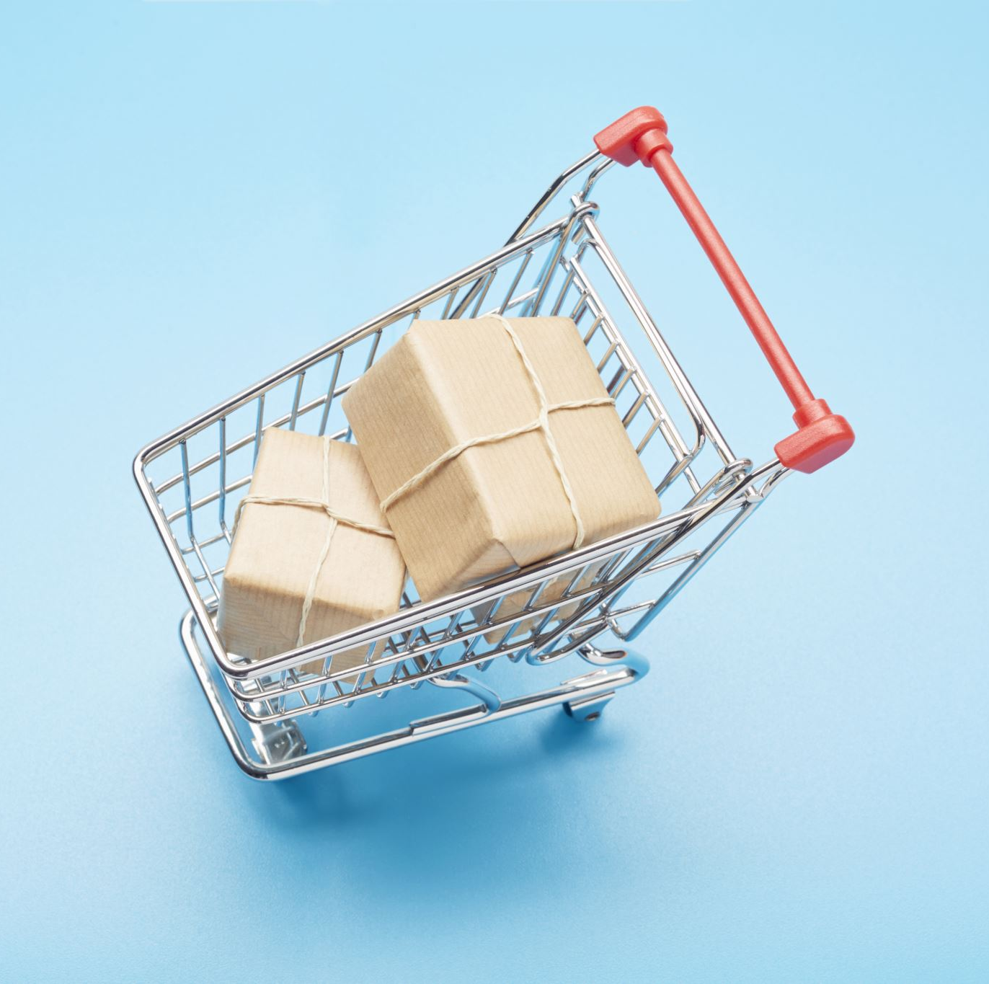
Analysis of Online Shopping Behavior Using Clickstream Data for Online Shopping
Presented by Group 10
Praneetha Raju Buddharaju
Vamshi Krishna Madhavan
Precious Oguonu
Dongari Sai Sree
Pravallika Kilari

Slide 2

Problem Statement
How do people shop online, and have can we modify the process so that they buy more items or so we can make sure the items they buy are always available?

Slide 3


Goal
To study and examine transactional data and user preferences, noting differences between Polish customers and those from other European countries by using data from an e-shop selling women's clothing.
To create a machine learning model that predicts the amount a user is willing to spend on an item.

Slide 4


Where Do we Begin?
We start by understanding the problem statement
Then we gather the data.
The data was gathered by a researcher
After that we the data to draw a conclusion.

Slide 5

Steps
Data Acquisition
Data Cleaning
Data Preprocessing
Data Modeling using KNN and Logistic Regression Machine Learning Models
Data Storage using Database

Slide 6
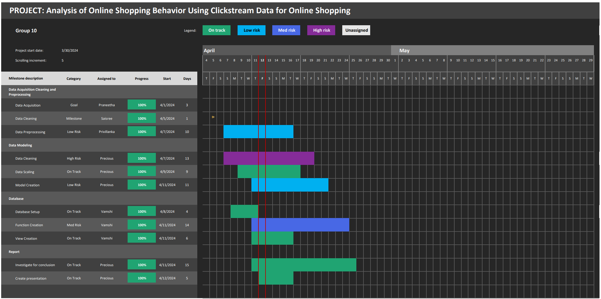
Ghant Chart

Slide 7
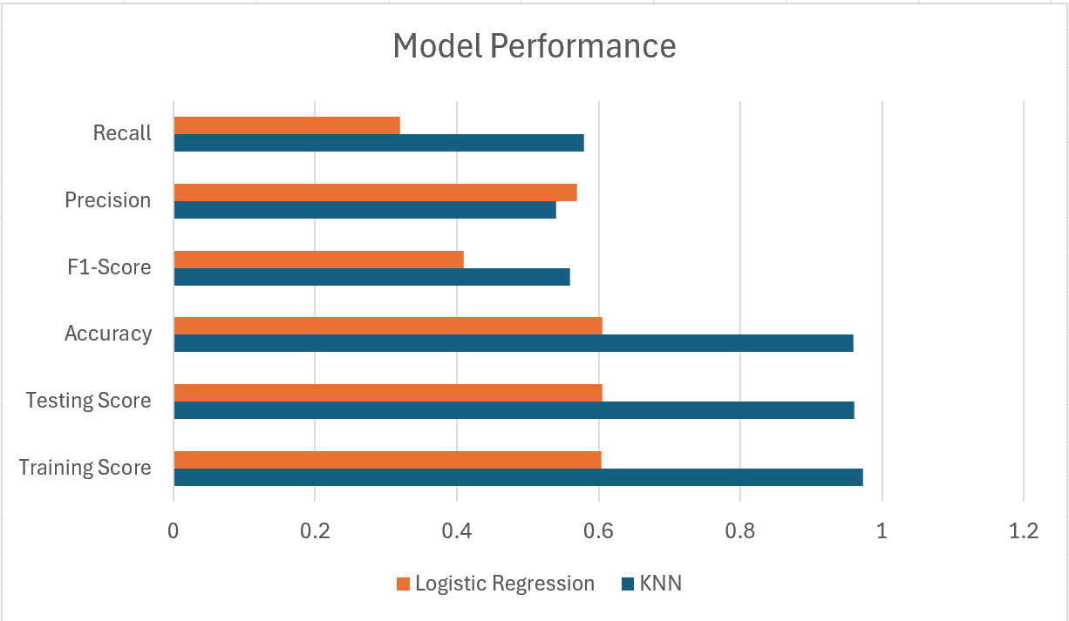

Slide 8
Additional Models Created
Random Forest
ELM Regression
Support Vector Machine
Ensemble

Slide 9

Information on New Models
The new models did not outperform the KNN and Logistic Regression models because of the nature and problem non-linearity.
Though it is important to utilize different models when trying to understand a data set. It is also important to save time of model creation by selecting the top few models best for the problem. To do this we need:
To understand the problem
Perform Data Cleaning and Preprocessing
Perform EDA
Then choose the best models.

Slide 10

Explanation of Results
Non-linearity:
KNN is a non-parametric algorithm, meaning it makes no assumption about the distribution of data. This makes it suitable for datasets where the decision boundary is highly non-linear, unlike logistic regression, which assumes a linear relationship between features and target.
No assumptions about data distribution:
Logistic regression assumes that the data is linearly separable, which might not always be the case. KNN, on the other hand, makes no such assumptions, making it more flexible and applicable to a wider range of datasets.
Local decision boundaries:
KNN makes predictions based on the majority class of its k-nearest neighbors. This allows it to capture local patterns in the data, which might be missed by logistic regression, especially if the decision boundary is complex and varies across the feature space.
Performance with imbalanced data:
KNN can perform well with imbalanced datasets because it does not rely on the class distribution of the data during training, unlike logistic regression which might struggle with imbalanced classes.
Interpretability:
While logistic regression provides coefficients that indicate the contribution of each feature to the prediction, KNN is less interpretable since it doesn't provide explicit coefficients. However, in cases where interpretability is not the primary concern and predictive performance is key, KNN can be preferred.
Overall, KNN is chosen over logistic regression when dealing with non-linear, complex datasets where no assumptions about the data distribution can be made, and local patterns need to be captured effectively for this problem statement.

Slide 11
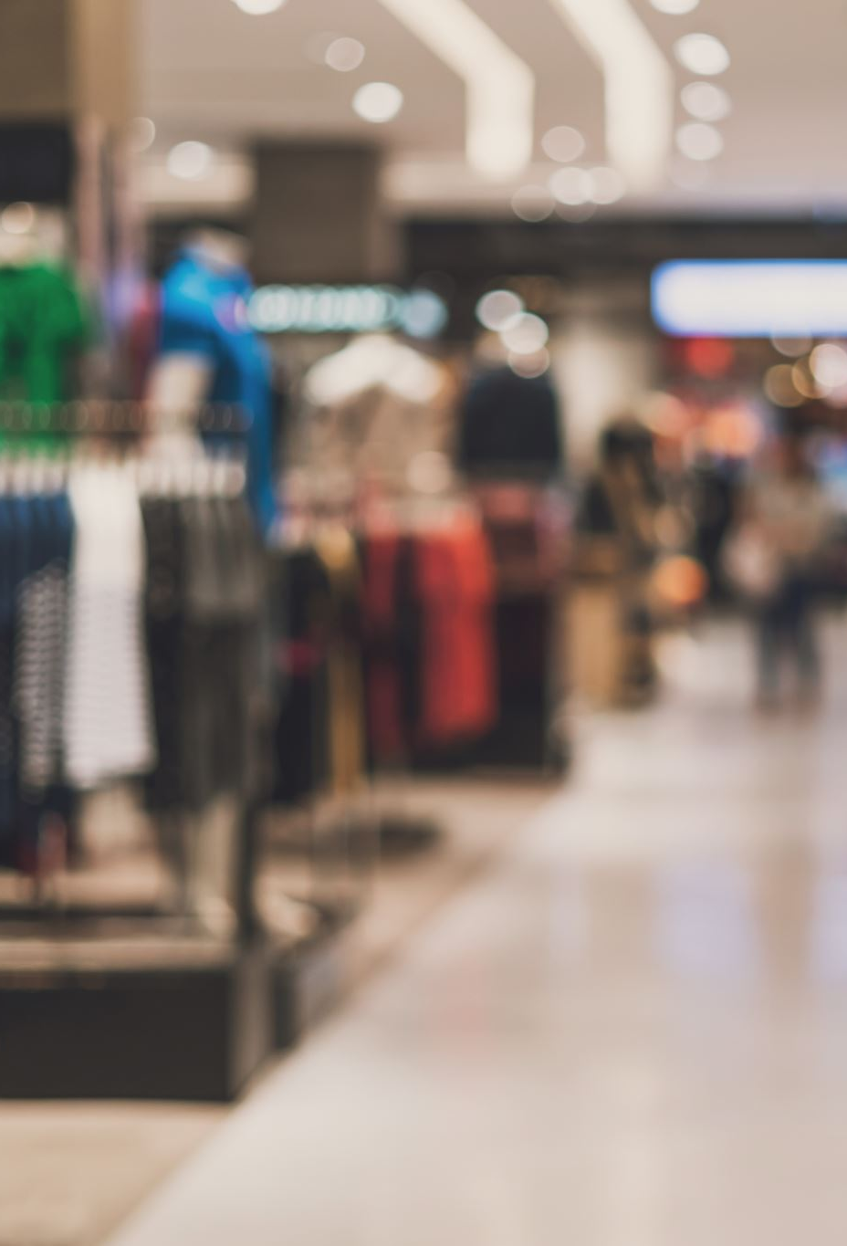
Conclusion
From the Exploratory Data Analysis (EDA) and Modeling, we can conclude that:
In our analysis of user behavior on our online store offering maternity clothing, we've uncovered key insights into customer preferences and purchasing patterns. We found significant differences between Polish customers and those from other European countries. Through descriptive statistics, we identified variations in popular clothing models and colors among different customer segments.
Our machine learning models accurately predict customer behavior, enabling us to tailor personalized marketing strategies and optimize our website for improved user experience. By leveraging web mining techniques, we can enhance website design and functionality to increase consumer satisfaction and sales volume.
Moving forward, we recommend extending our analysis to different language versions of the website and exploring advanced analytical tools like Markov chains for deeper insights. These findings will inform future strategies for website optimization and personalized marketing efforts.

Slide 12



References
Link to dataset: Clickstream Data for Online Shopping - UCI Machine Learning Repository
Python Library Used
Other resources
SKLEARN
PANDAS
NUMPY
SEABORN
Microsoft Excel

