Slide 1
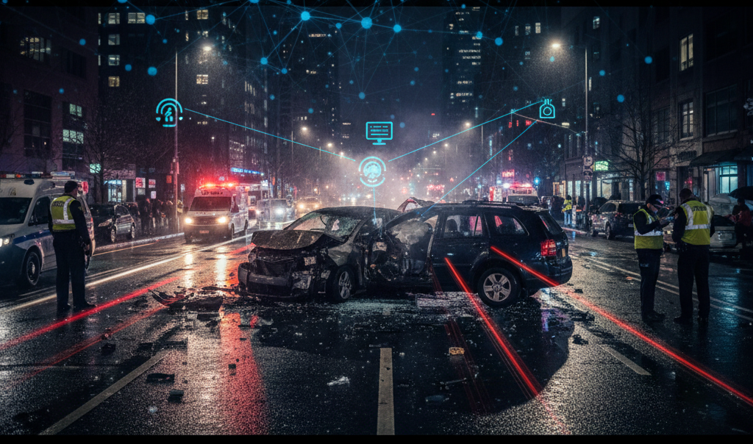
Predicting Severity of Motor Vehicle Crashes in Maryland Using Machine Learning
By:
Shashank Reddy Muthangi
Raja Vamshi Goud Amaragoni
DATA 602-Intro to Data Analysis and Machine Learning
Instructor : Devin Fensterheim
University of Maryland Baltimore County

Slide 2
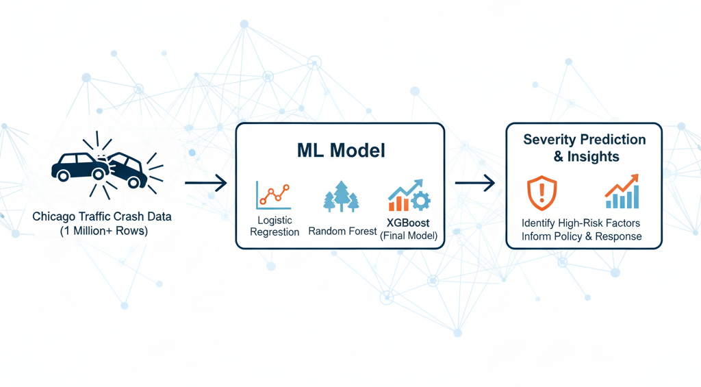
Introduction:
Project Goal
Predict the severity of road traffic crashes using machine learning
Build a model that identifies severe crashes based on environmental and road factors
Deploy a prediction system using XGBoost for real-time inference
Dataset
Chicago Traffic Crashes Dataset (1M+ records)
Includes weather, lighting, roadway conditions, traffic control, speed limit, crash type, etc.

Slide 3
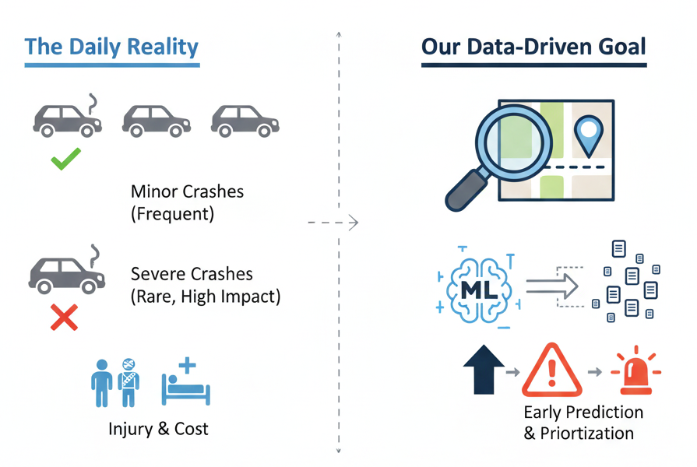
Problem Statement:
Traffic crashes are frequent, but severe crashes are rare and often unpredictable
Early severity prediction helps emergency response and public safety planning
Challenge: severe crashes account for only 1.7%, making modeling difficult
Need an ML system that balances accuracy, recall, and real-world reliability

Slide 4
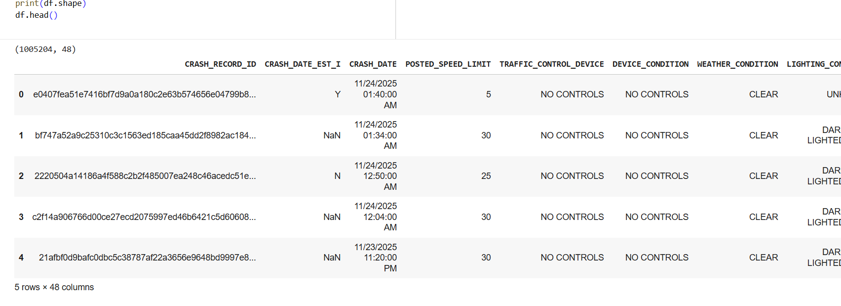
Dataset Overview :
Original Dataset Size: 1,005,204 crash records
Attributes: 48 features including
Speed limit, road surface, lighting, weather
Crash type (rear-end, sideswipe, head-on, etc.)
Traffic control devices
Injury reports
Target Variable Created:
target_severe = 1 if fatal or incapacitating injury
target_severe = 0 otherwise

Slide 5
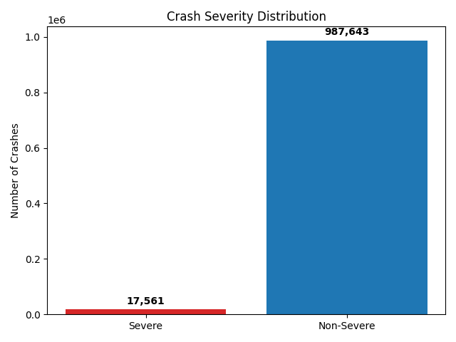
Target Variable Distribution:
Class Imbalance in Dataset:
The raw dataset exhibits extreme class imbalance:
Severe Crashes: 1.7% (17,561 records).
Non-severe Crashes: 98.3% (987,643 records).
This vast imbalance makes prediction difficult, often leading to models that simply predict the majority class (Non-severe).

Slide 6
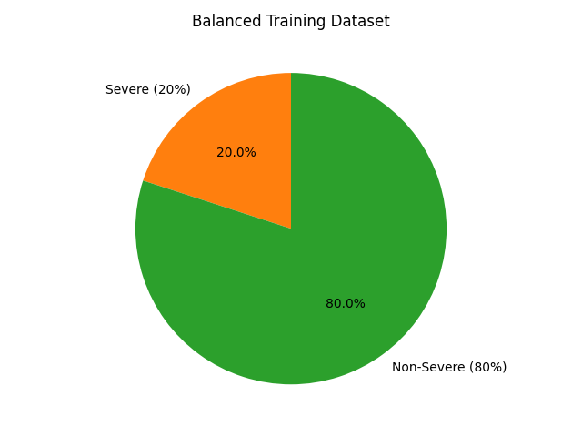
Handling Imbalance
Creating a Balanced Subset
Used all severe crashes
Sampled 4× non-severe crashes
Final training dataset: 87,805 rows
Ratio: 1 (severe) : 4 (non-severe)

Slide 7
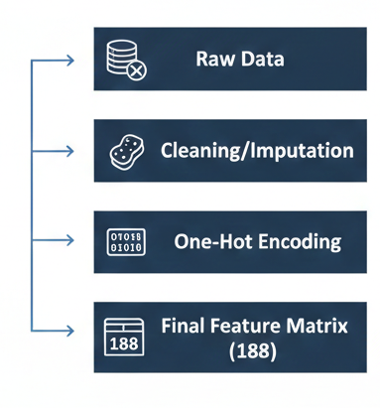
Data Preprocessing
Selected 16 meaningful predictor features
Converted LANE_CNT to numeric; filled missing values using median
Categorical missing values replaced with "UNKNOWN"
Applied One-Hot Encoding → final feature matrix: 188 columns
Removed noise by creating a balanced subset:
All severe cases (17,561)
Random sample of non-severe cases (70,244)
Final modeling dataset: 87,805 records

Slide 8
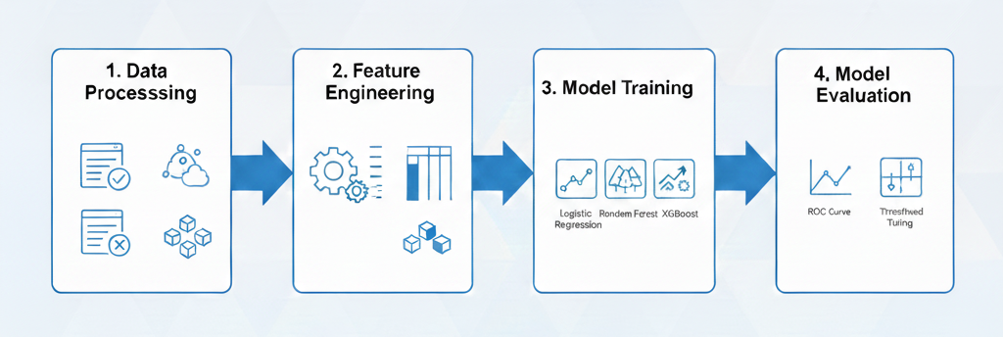
Modeling Approach
We will train and compare three machine learning models:
Logistic Regression
Random Forest Classifier
XGBoost Classifier (with threshold tuning)
Evaluation Metrics:
Severe recall
Severe F1-score
ROC–AUC
Accuracy

Slide 9
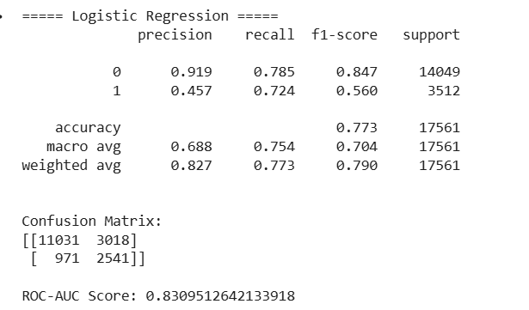
Logistic Regression
Recall (Severe): 72.4%
F1 (Severe): 0.560
ROC-AUC: 0.831
Accuracy: 77.3%
Insights:
Best at catching severe crashes (high recall)
Good balanced performance
Linear, interpretable model
Slightly lower precision → more false positives

Slide 10
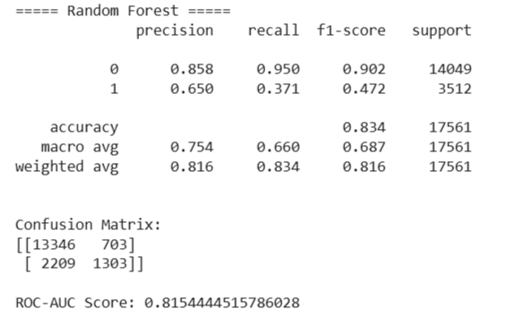
Random Forest
Recall (Severe): 37.1%
F1 (Severe): 0.472
ROC-AUC: 0.815
Accuracy: 83.4%
Insights:
High accuracy and strong at predicting non-severe cases
Weak performance on severe crashes
Tends to favor majority class
Not ideal for safety-critical prediction

Slide 11
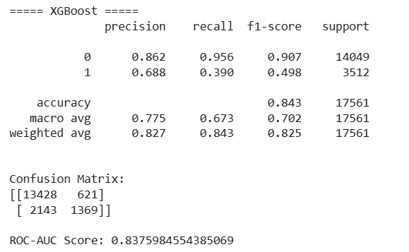
XGBoost
Recall (Severe): 39.0% (threshold 0.50)
F1 (Severe): 0.498
ROC-AUC: 0.838 (highest)
Accuracy: 84.3%
Insights:
Best AUC → strongest ranking ability
Best precision for severe crashes (68.8%)
Excellent generalization

Slide 12
Model Comparison Summary
Final Decision: Selected Model → XGBoost (threshold = 0.35) Best balance of precision, recall, and overall predictive reliability.
Model | Recall (Severe) | F1 | AUC | Accuracy
Logistic Regression | 0.724 | 0.560 | 0.831 | 0.773
Random Forest | 0.371 | 0.472 | 0.815 | 0.834
XGBoost (0.35) | 0.549 | 0.575 | 0.838 | 0.838
Final Decision: Selected Model → XGBoost (threshold = 0.35) XGBoost outperformed the other models by achieving the highest AUC score (0.838), meaning it ranked severe vs. non-severe crashes most accurately. It also maintained a strong balance between precision and recall after threshold tuning. Its ability to capture complex non-linear patterns made it the most reliable model for real-world crash severity prediction.

Slide 13
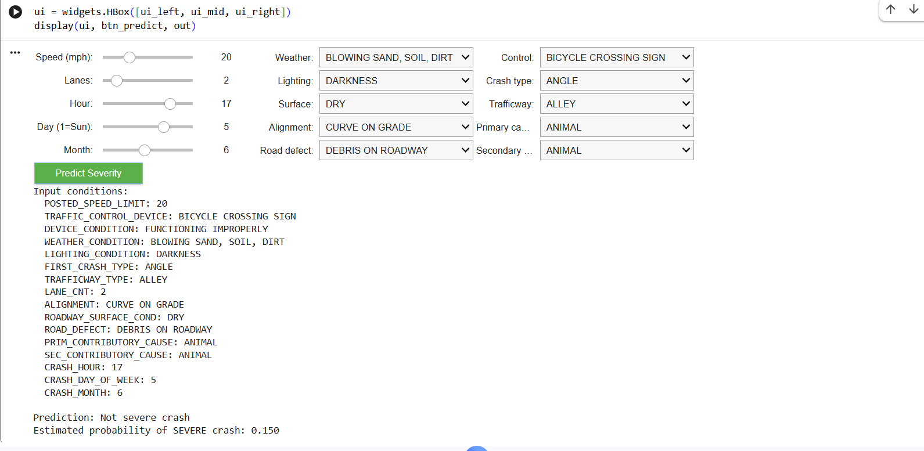
Deployment: User Prediction Interface
Built an interactive prediction interface
User inputs crash conditions such as:
Weather
Lighting
Road surface
Speed limit
Crash type
Backend:
One-Hot Encoder
Final XGBoost model
Threshold = 0.35
Output:
Predicted crash severity
Probability of being severe
Image of non - severe crash prediction

Slide 14
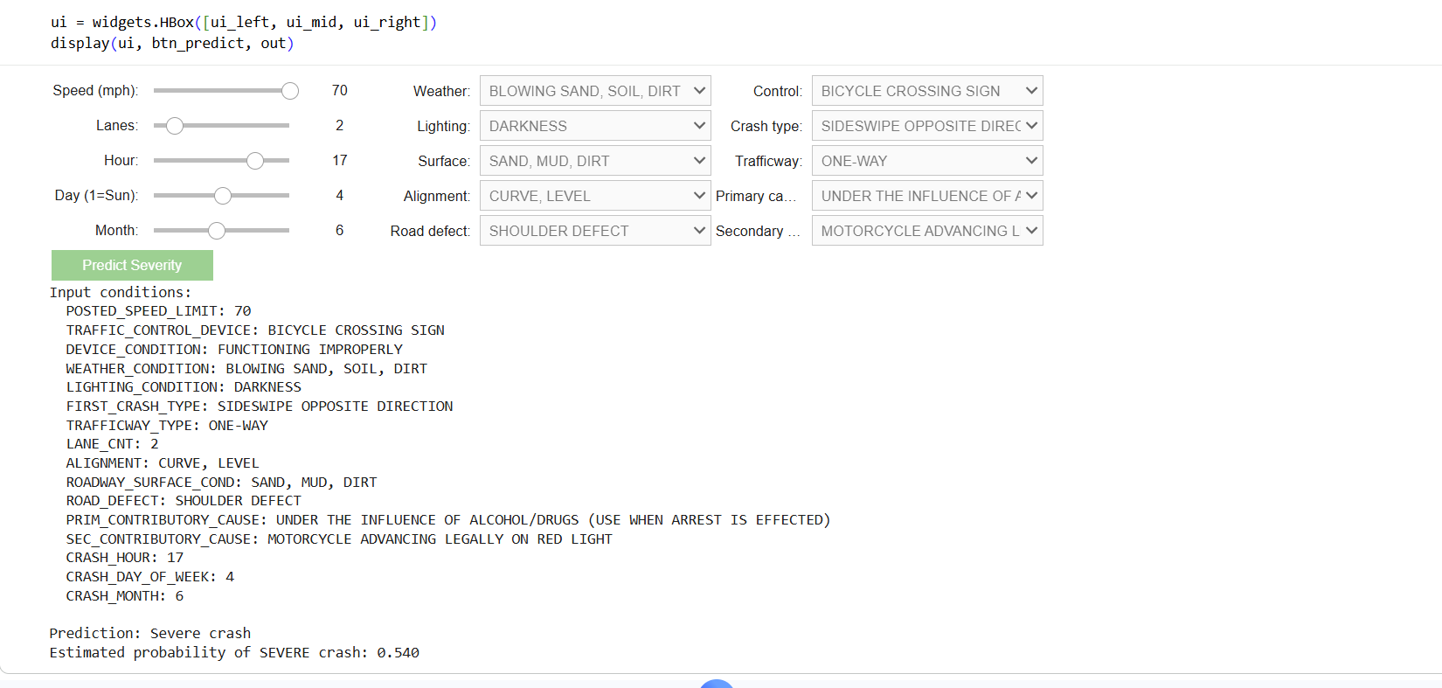
Image of severe crash prediction

Slide 15
Conclusion
Successfully developed a machine learning pipeline for crash severity prediction
XGBoost provided the best overall performance after threshold tuning
Demonstrated strong AUC and severe F1 score
Built a practical user-facing prediction application
Framework can support emergency planning, road design, and safety decision-making

Slide 16
Future Work
Incorporate more features (traffic volume, time-series patterns, GPS coordinates)
Use advanced models (LightGBM, CatBoost, deep learning)
Explore explainability tools (SHAP values)
Integrate predictions into real-time dashboards or APIs
Improve modeling using temporal crash patterns

