Slide 1
A Seminar on Effective Multitask Deep Learning for IoT Malware Detection and Identification Using Behavioral Traffic Analysis
Team Details
A. Rajavamshi(20EG105454)
K. Vinay(20EG105458)
T. Ajay(20EG105459)
Project Supervisor
B.V.V.Siva Prasad
Associate Professor

Slide 2
Introduction
The rise of new Internet of Things (IoT) devices has not only driven technological advancements but also simplified the manufacturing of these intelligent devices. However, this progress has brought about a new set of challenges, particularly in the domain of security. The 2020 IoT threat report highlights the need for heightened security measures due to the increasing number of IoT devices. Notably, cyberattacks such as the Mirai botnet's assault on Dyn have exposed vulnerabilities in IoT ecosystems, resulting in one of the most significant Distributed Denial-of-Service (DDoS) attacks on the Internet. Furthermore, the release of the Mirai source code has expedited the creation of potent malware variants like Satori, Hajime, and BrickerBot. Despite these threats, the lack of empirical data on current IoT malware and a comprehensive understanding of the behavioral aspects of infected devices raise concerns about implementing sophisticated security solutions in the IoT landscape. To address this, researchers have established IoT-specific honeypots to gather precise information about existing IoT malware.

Slide 3
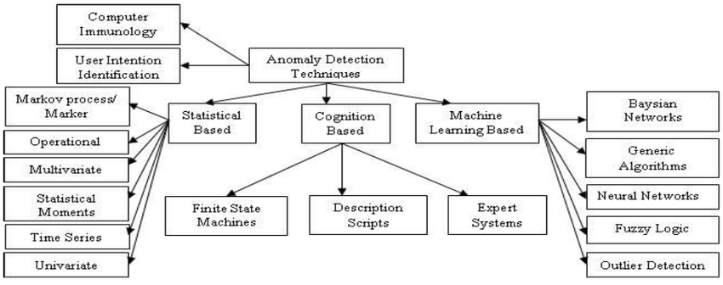
Concept Tree

Slide 4
Literature
Author(s) | Strategies | Advantages | Disadvantages
Singh et al | Statistical Methods and methods based on graph's spectral heat and wave signatures | Traditional statistical methods provide a well-established foundation for network security. Techniques like static malware analysis contribute to understanding IoT malware behavior. | Limited availability of publicly accessible botnet datasets for comparison. Absence of appropriate benchmarks for botnet identification algorithms.
Shafiq et al | supervised ML algorithms (SVM, ensemble learning,) | Supervised ML methods achieve high accuracy in attack detection. | Evaluation on limited datasets may restrict the generalization of ML models.
Lagraa et al | unsupervised ML methods | Unsupervised ML methods learn from unlabeled datasets to identify abnormalities. | Accuracy is not as expected.
Francois et al and Dib et al. | entropy measures and String-based features | Entropy measures are easily adaptable and generic in nature and String based approach offers a targeted approach for know patterns. | Entropy measures and string-based features may not capture complex patterns as effectively as ML or DL methods

Slide 5
Literature (Selected strategy):
Author(s) | Method | Advantages | Disadvantages
Gao et al | Deep Belief Networks (DBN) are employed for malware traffic monitoring and classification. | DBNs are known for their ability to capture complex hierarchical features in data. Suitable for capturing patterns in large datasets. | Training deep networks can be computationally expensive. May face challenges with interpretability of learned features.
Bendiab et al | Utilizes Recurrent Neural Networks (RNNs) to learn temporal characteristics of IoT traffic, converting them into a series of characters. | RNNs are well-suited for sequence data, capturing temporal dependencies. Effective in learning patterns in time-series data. | May face challenges with vanishing or exploding gradient problems. Training RNNs can be computationally intensive.
Shire et al | Utilizes the MobileNet architecture, a variant of Convolutional Neural Networks (CNNs), to analyze IoT malware traffic. | Utilizes the MobileNet architecture, a variant of Convolutional Neural Networks (CNNs), to analyze IoT malware traffic. | Might require substantial computational resources for training. Limited interpretability of deep CNN features.

Slide 6
Problem Statement
Developing robust intrusion detection and malware classification systems for IoT security. Current intrusion detection methods struggle due to the unique characteristics of IoT devices, which generate less traffic than traditional systems. Additionally, traditional machine learning approaches involve time-consuming feature extraction and may become ineffective against evolving IoT malware. Moreover, the data used for training the IOT based Intrusion Detection are very limited. The project addresses the limitations of existing methods by proposing deep learning-based malware classification algorithms. These aim to overcome challenges in detecting new malware families, reduce reliance on artificial feature generation, and enhance the adaptability of intrusion detection tools to the dynamic IoT security landscape.

Slide 7
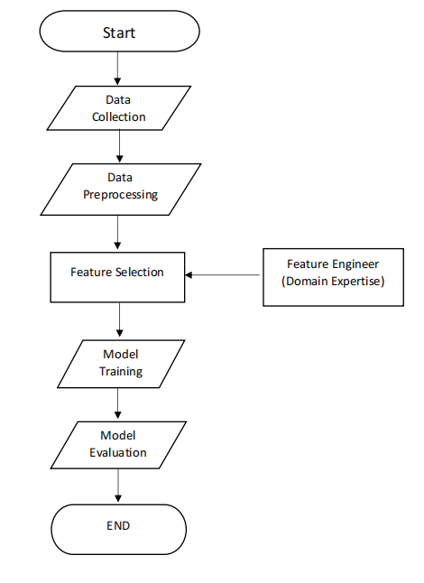
Problem Illustration

Slide 8
Proposed Method
The goal of our project is to construct an Intrusion Detection System tailored for IoT malware using advanced Deep Learning techniques. Our proposed solution entails a Multitask classification model, specifically leveraging Long Short-Term Memory (LSTM) based Deep Learning techniques. This model is designed to accurately identify and categorize diverse IoT malware types, thereby enabling targeted and effective response strategies. By relying on the efficiency of LSTM in traffic data analysis, our approach circumvents the limitations often associated with traditional machine learning methods. Notably, the LSTM-based model obviates the necessity for domain expertise and excels in autonomously performing feature selection directly from raw data, enhancing the overall efficacy of the Intrusion Detection System.

Slide 9
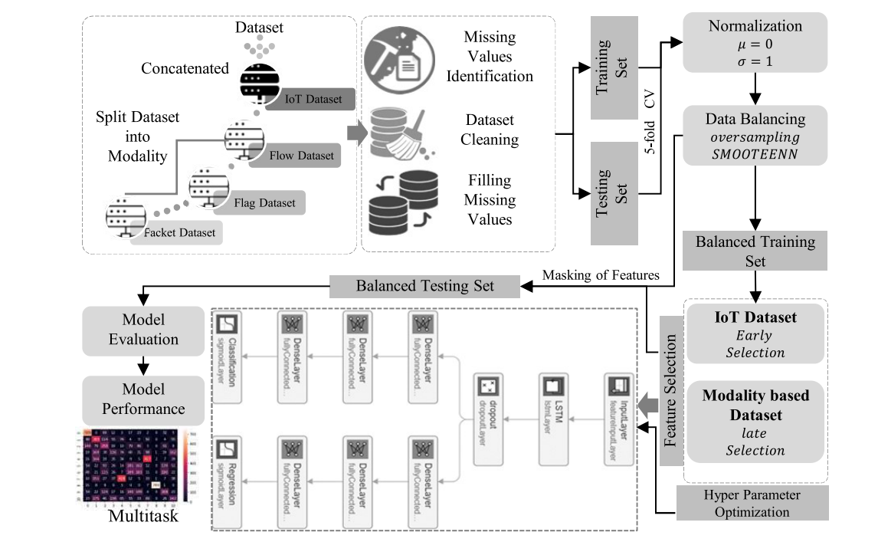
Proposed Method Illustration

Slide 10
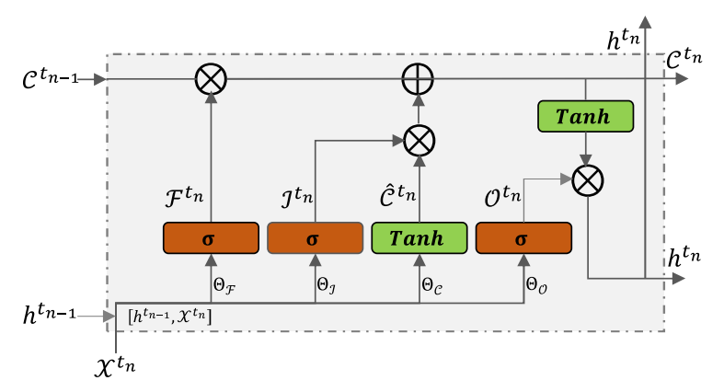
Long Short Term Memory(LSTM) Structure:

Slide 11
Parameter
Accuracy : The percentage of instances successfully classi-
fied out of the total number.
Accuracy = (T P + T N )/ (T P + T N + FP + FN)
Precision : The percentage of accurately classified positive
instances to all predicted positive instances.
Precision= T P /(T P + FP)
Recall : The percentage of accurately classified positive
instances to all instances in the actual class.
Recall = T P /(T P + FN)
F1-score = (2 × Precision × Recall)/(Precision + Recall)
where T P, T N , FP, and FN represent the true positive,
the true negative, the false positive, and the false negative,
respectively

Slide 12
Experiment Environment
Programming Language : Python 3.7.7
Libraries : Pandas, Keras, MatplotLib.
Software : Anaconda 4.8.3
Framework : Tensorflow
Code Development Environment : Jupyter notebook

Slide 13
Project status
S.No | Functionality | Status (Completed /in-progress/Not started)
1. | Data Splitting | Completed
2. | Data Preprocessing | Completed
3. | Data Rescaling and Balancing | Completed
4. | Feature Selection | In-progress
5. | Model Training | Not Started
6. | Model Evaluation | Not Started

Slide 14
References
[1] I. Ullah and Q. H. Mahmoud, “Network traffic flow based machine learning technique for IoT device identification,” in Proc. IEEE Int. Syst. Conf. (SysCon), 2021, pp. 1–8.
[2] S. El-Sappagh, T. Abuhmed, S. M. R. Islam, and K. S. Kwak, “Multimodal multitask deep learning model for alzheimer’s disease progression detection based on time series data,” Neurocomputing, vol. 412, pp. 197–215, Oct. 2020.
[3] N. Chaabouni, M. Mosbah, A. Zemmari, C. Sauvignac, and P. Faruki, “Network intrusion detection for IoT security based on learning techniques,” IEEE Commun. Surveys Tuts., vol. 21, no. 3, pp. 2671–2701,
3rd Quart., 2019.
[4] Z. Ma, H. Ge, Y. Liu, M. Zhao, and J. Ma, “A combination method for android malware detection based on control flow graphs and machine learning algorithms,” IEEE Access, vol. 7, pp. 21235–21245, 2019.
[5] M. Shafiq, Z. Tian, Y. Sun, X. Du, and M. Guizani, “Selection of effective machine learning algorithm and Bot-IoT attacks traffic identification for Internet of Things in smart city,” Future Gener. Comput. Syst., vol. 107, pp. 433–442, Jun. 2020.

Slide 15
Thank you

Slide 16
Project seminar–I Evaluation
S.No | Rubrics | Marks
1 | Concept Introduction | 4
2 | Literature and Parameter | 5
3 | Problem and Problem Illustration | 8
4 | Proposed Method and Illustration | 8
Total |  | 25

