Slide 1
Effective Multitask Deep Learning for IoT Malware Detection and Identification Using Behavioral Traffic Analysis
Team Details
A. Rajavamshi Goud(20EG105454)
K. Vinay(20EG105458)
T. Ajay(20EG105459)
Project Supervisor
Dr.B.V.V.Siva Prasad
Associate Professor

Slide 2
Introduction
The project aims to develop a multitasking intrusion detection system designed to bolster cybersecurity within the rapidly expanding Internet of Things (IoT) ecosystem. Despite the robustness of firewalls, persistent vulnerabilities provide intruders with loopholes to exploit. Our solution involves the identification and classification of malware present in data, enabling the selective disabling of affected services to prevent conflicts and protect systems. By leveraging advanced detection algorithms and seamless integration with existing infrastructure, our system aims to provide proactive security measures against evolving threats. With the proliferation of IoT devices generating vast amounts of data and the increasing sophistication of cyber threats, our project is poised to offer robust protection for modern ecosystems, safeguarding sensitive information and minimizing potential disruptions.

Slide 3
Problem Statement
The proliferation of Internet of Things (IoT) devices has brought about numerous benefits, but it has also introduced significant cybersecurity challenges. One of the primary concerns is the emergence of IoT-specific malware, which orchestrates large-scale cyberattacks through compromised IoT devices, posing a serious threat to the integrity of the Internet ecosystem. Detecting and mitigating the spread of IoT malware is crucial to maintaining the security of IoT systems and preventing potential disruptions. Additionally, there is a growing need for robust training and testing datasets to evaluate the efficacy of machine learning (ML) and deep learning (DL) approaches in cybersecurity. Therefore, there is a pressing need for innovative solutions that can effectively detect and classify IoT malware, leveraging advanced techniques like multitask deep learning models to enhance cybersecurity measures and safeguard IoT networks from malicious activities.

Slide 4
Problem Illustration:
Consider a scenario where a smart home system is equipped with various IoT devices such as smart thermostats, security cameras, and door locks, all connected to the internet for remote access and control. An attacker exploits a vulnerability in one of these devices, gaining unauthorized access to the home network. Once inside, the attacker deploys malware specifically designed to infect IoT devices and compromise their functionality. For instance, the attacker tamper with the security cameras to disable surveillance and provide cover for physical intrusion. Furthermore, the compromised IoT devices become part of a botnet controlled by the attacker, contributing to large-scale distributed denial-of-service (DDoS) attacks against internet services or other networks. These attacks can cause widespread disruptions, affecting not only the targeted services but also the overall stability of the internet ecosystem. Traditional cybersecurity measures may struggle to detect and mitigate such attacks, as IoT malware often operates stealthily and exhibits sophisticated behavior patterns. Therefore, there is an urgent need for advanced detection and classification techniques.

Slide 5
Proposed Method
The proposed method suggests using a special type deep learning model that is Long short term memory(LSTM) model to spot harmful software in the traffic of Internet-connected devices like smart home gadgets. This model focuses on two main jobs: first, figuring out if the traffic is normal or dangerous, and second, identifying what type of harmful software it is. To teach this model how to recognize bad stuff, The model is trained with a lot of data showing how both normal and harmful traffic looks like from 18 different Internet-connected devices. The model look at things like the patterns in the traffic, the types of signals it sends, and what's inside the messages it carries. LSTM networks capable of capturing dynamic temporal patterns, the model adapts to evolving malware behaviors with precision and efficiency. In tests, the model performed well, accurately identifying bad traffic and even figuring out what kind of bad software was causing it, which could help keep our devices and networks safer from cyberattacks. We not only stopped with the LSTM model, but also we implemented CNN and CNN+LSTM models and compared which model predicts the best. The proposed method include various steps like cleaning the data, Feature selection, Splitting into Training and testing data, Training the model and Testing the model.

Slide 6
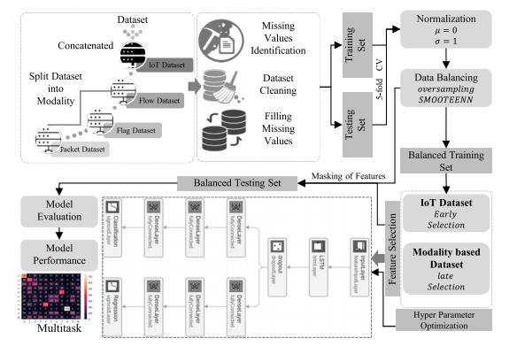
Proposed Method

Slide 7
Experiment Environment
Programming Language : Python 3.7.7
Libraries : Pandas, Keras, MatplotLib, Numpy.
Software : Anaconda 4.8.3
Framework : Tensorflow
Code Development Environment : Jupyter notebook

Slide 8
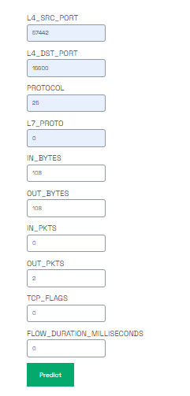
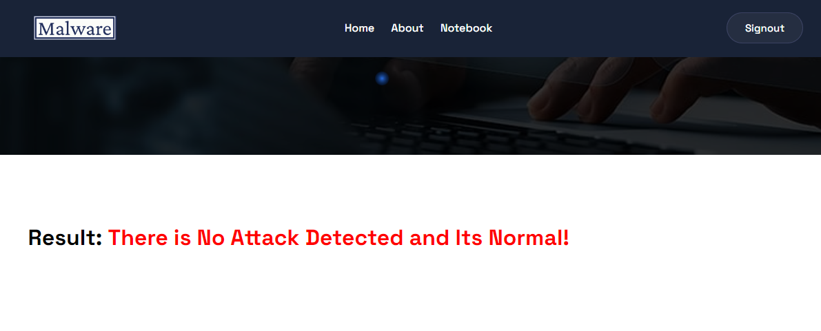
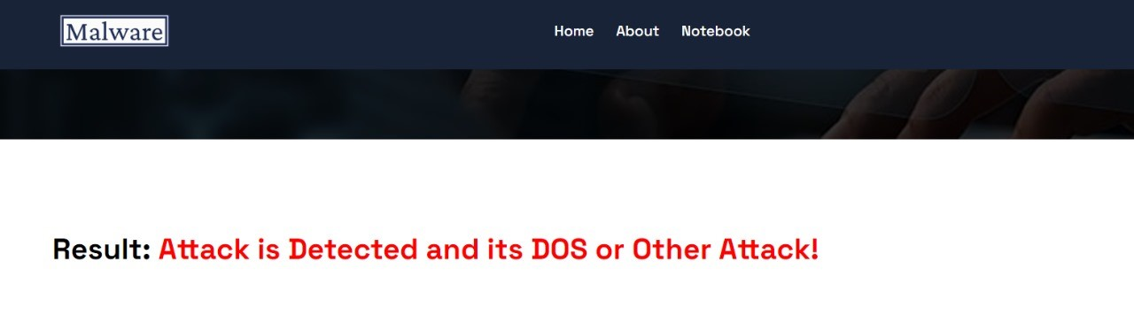
Experiment Screen shorts

Slide 9
Experiment Results
 | ML Model | Accuracy | f1_score | Recall | Precision
1 | Extension- CNN | 0.985 | 0.986 | 0.985 | 0.987
2 | Extension- CNN + LSTM | 0.981 | 0.983 | 0.981 | 0.986
3 | LSTM | 0.954 | 0.133 | 0.071 | 1.000

Slide 10
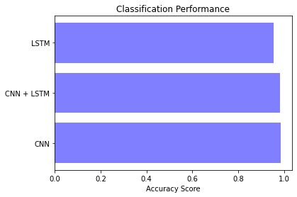
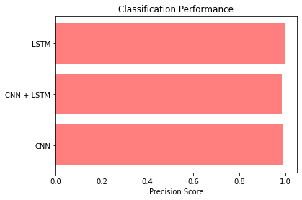
Experiment Results

Slide 11
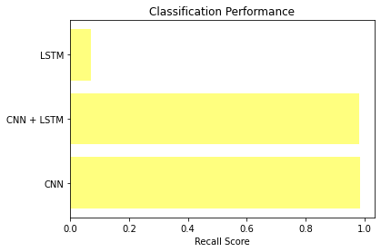
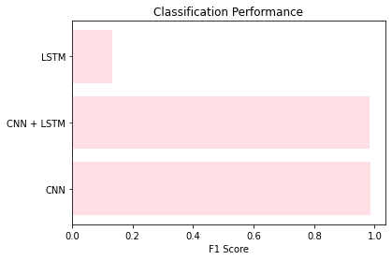
Experiment Results

Slide 12
Finding
The project showed how the computer model called multitask LSTM could find different types of harmful software in IoT devices. By using different types of data, the model was able to work well in many different situations, making it good at spotting problems in various devices and threats. It got better at understanding the patterns in the data over time. The LSTM model demonstrated impressive predictive capabilities, achieving an accuracy of over 90%, a notable improvement compared to existing malware detection models. Additionally, the extension of the project to incorporate Convolutional Neural Network (CNN) models yielded even higher accuracy, with CNN achieving an impressive accuracy of nearly 99%. This substantial increase in accuracy suggests that CNN outperforms other important deep learning models in detecting IoT malware. However, it is important to acknowledge the possibility of future advancements in deep learning models that may surpass the performance of CNN.

Slide 13
Justification
Four parameter were used in this that are accuracy, precision score, Recall score and F1 score.
Accuracy = (T P + T N )/ (T P + T N + FP + FN)
Precision= T P /(T P + FP)
Recall = T P /(T P + FN)
F1-score = (2 × Precision × Recall)/(Precision + Recall)
where T P, T N , FP, and FN represent the true positive, the true negative, the false positive, and the false negative,
respectively
The accuracy for the previous existing models is around 70% but for the proposed model the accuracy is more than 95%, where the huge datasets of IOT and proper feature selection with advanced deep learning algorithm improved this parameters.

