Slide 1


Global AI & Data Science Salary Prediction Using Machine Learning
Author : Raja Vamshi Goud Amaragoni
Professor : Dr. Chaojie Wang
Semester : Spring-2026

Slide 2

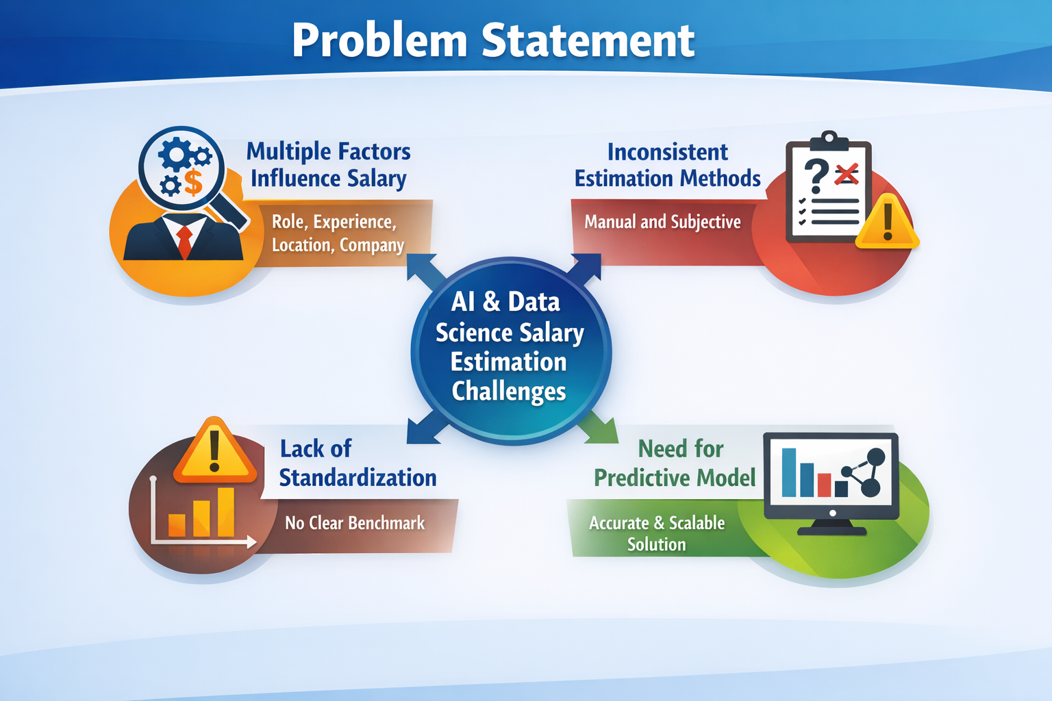
Problem Statement :
Salary estimation in AI and Data Science roles depends on multiple factors such as experience, job role, location, and company type
Traditional estimation methods are inconsistent and subjective
Lack of standardized and data-driven salary benchmarking
Need for a predictive model that provides accurate and scalable salary estimation

Slide 3
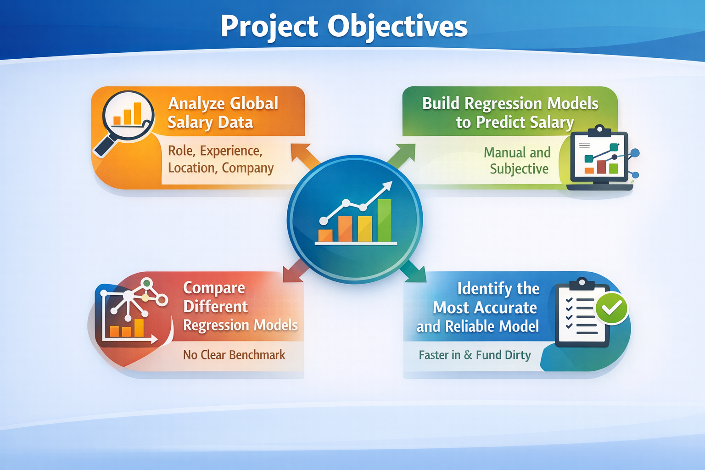
Project Objectives:
Analyze global salary data for AI and Data Science roles
Build machine learning models to predict salary
Compare different regression models
Identify the most accurate and reliable model

Slide 4
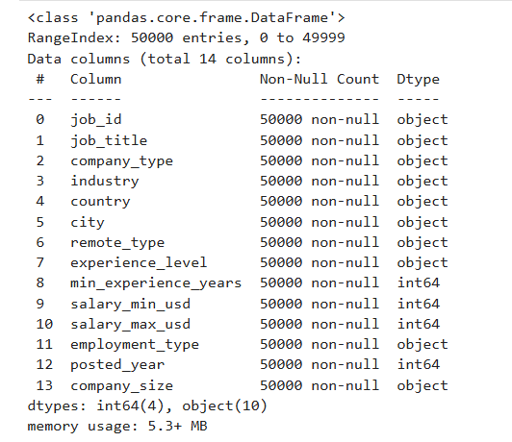
Dataset Overview :
Dataset contains 50,000 job records
Includes 14 features
Covers global AI and Data Science job roles
Key attributes:
Job title, experience level, location
Company type and work type
Salary range (min and max)

Slide 5
Data Quality & Target Variable :
No missing values found
No duplicate records detected
Dataset is clean and consistent
Target Variable:
salary_avg_usd = (salary_min_usd + salary_max_usd) / 2
Converts salary range into a single value for prediction

Slide 6
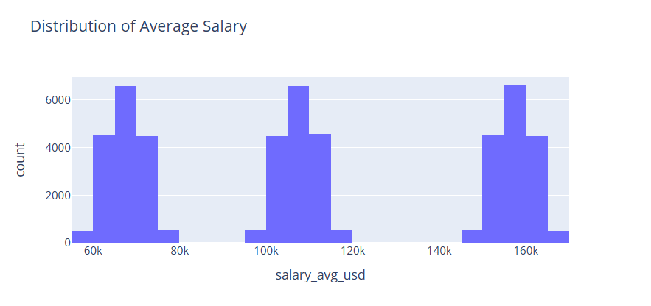
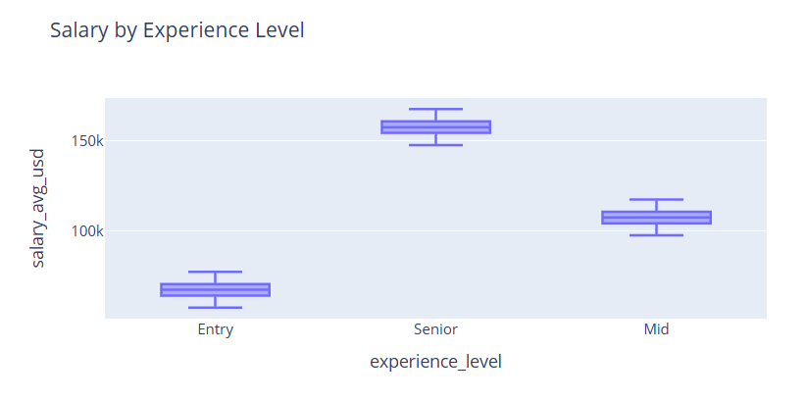
Feature Engineering & Data Preparation:
Selected relevant features for prediction
Converted categorical variables using one-hot encoding
Prepared dataset for machine learning models
Train-test split: 80% training / 20% testing
Training: 40,000 records
Testing: 10,000 records
Plotted graphs that shows the key relations between features.

Slide 7
Models Implemented :
Linear Regression
Baseline model for predicting continuous values
Assumes a linear relationship between input features and salary
Simple, fast, and easy to interpret
Random Forest Regressor
Ensemble model using multiple decision trees
Reduces overfitting by averaging predictions
Captures non-linear relationships in the data
Gradient Boosting Regressor
Sequential ensemble method that improves errors step-by-step
Each new model corrects the mistakes of the previous one
Highly effective for structured/tabular datasets

Slide 8
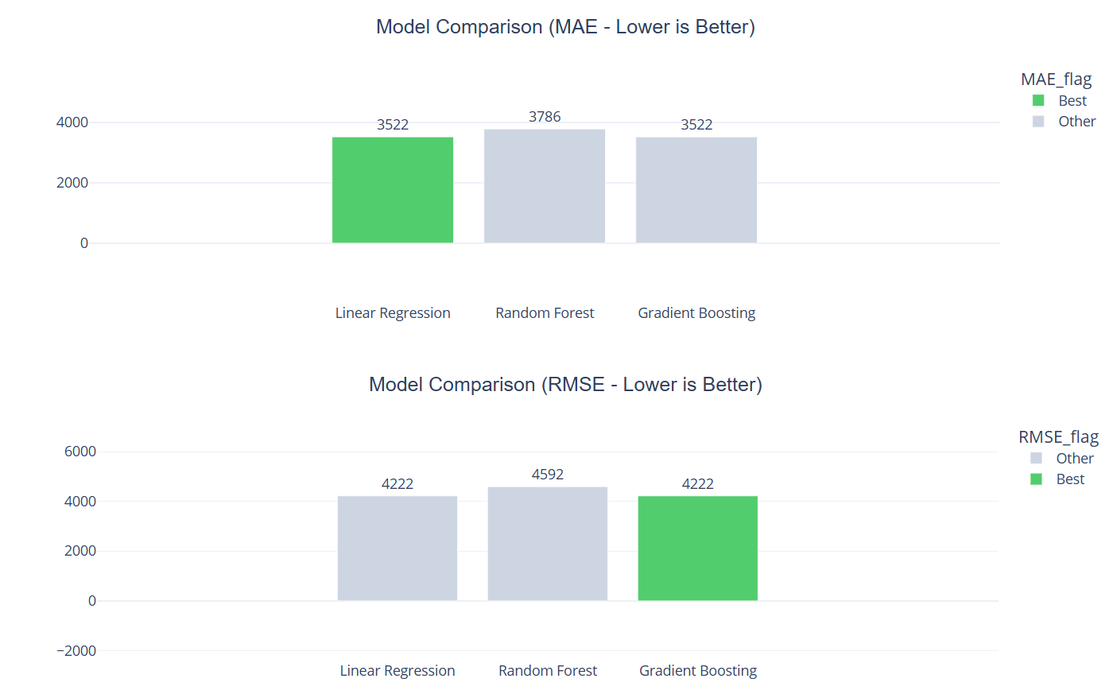
Evaluation Metrics:
Mean Absolute Error (MAE):
Measures the average difference between predicted and actual salary
Easy to interpret (in USD)
Lower MAE indicates better accuracy
Root Mean Squared Error (RMSE):
Measures the square root of average squared errors
Penalizes large prediction errors more than MAE
Useful for identifying models with large deviations
R² Score (Coefficient of Determination):
Indicates how well the model explains variance in salary
Value ranges from 0 to 1
Closer to 1 means better model performance

Slide 9
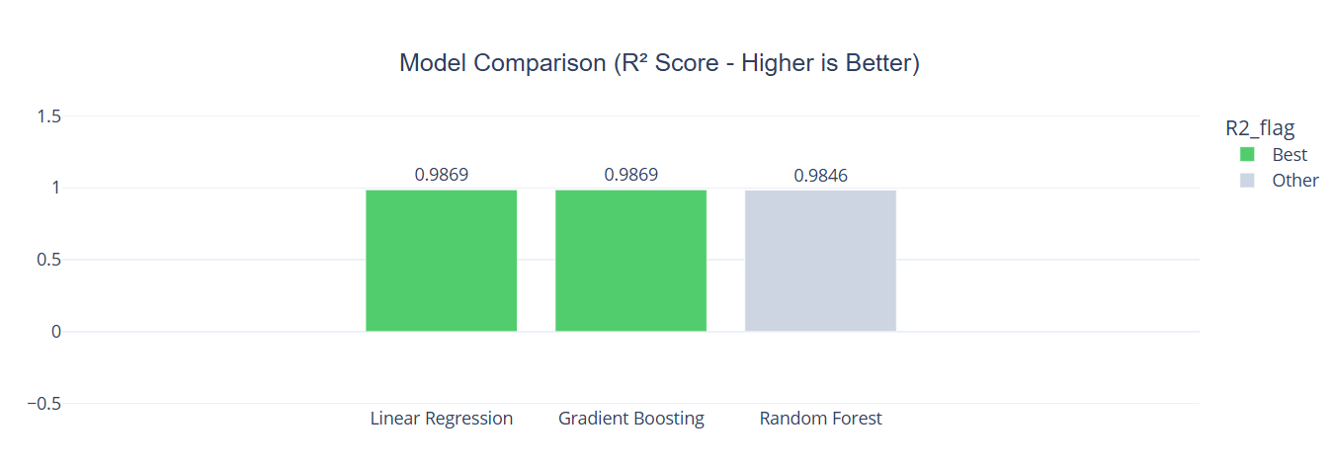
Model Performance Comparison :
Linear Regression and Gradient Boosting performed best
Random Forest showed slightly lower performance

Slide 10
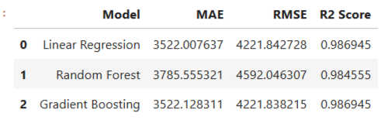
Model Selection :
Based on comparison of MAE, RMSE, and R² scores
Linear Regression and Gradient Boosting showed highest accuracy
Random Forest performed slightly lower in comparison
Gradient Boosting selected because:
Captures complex feature interactions
Handles non-linear relationships effectively
Provides stable and consistent performance
Performs well on large structured datasets
Selected model used for further optimization and testing

Slide 11
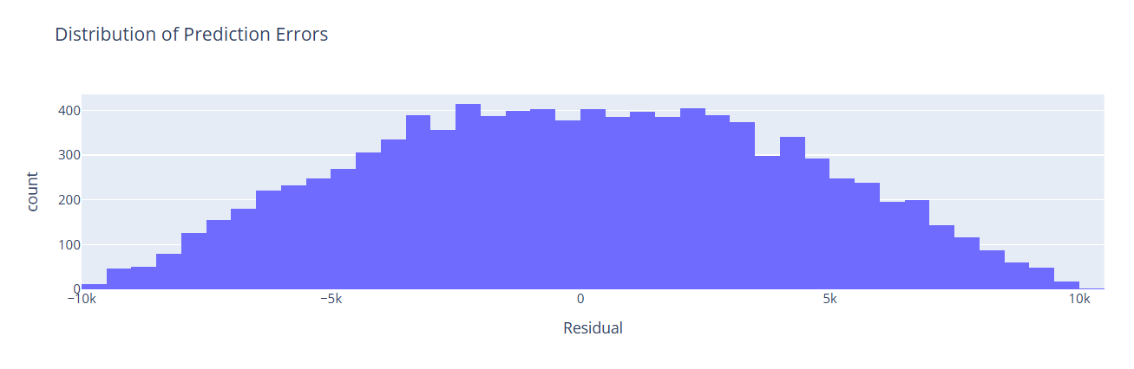
Hyperparameter Tuning & Residual Analysis:
Performed using GridSearchCV
Best parameters:
n_estimators = 200
learning_rate = 0.05
max_depth = 3
Optimized Results:
MAE: 3522
RMSE: 4222
R²: 0.9869
Minimal improvement → model already near optimal

Slide 12
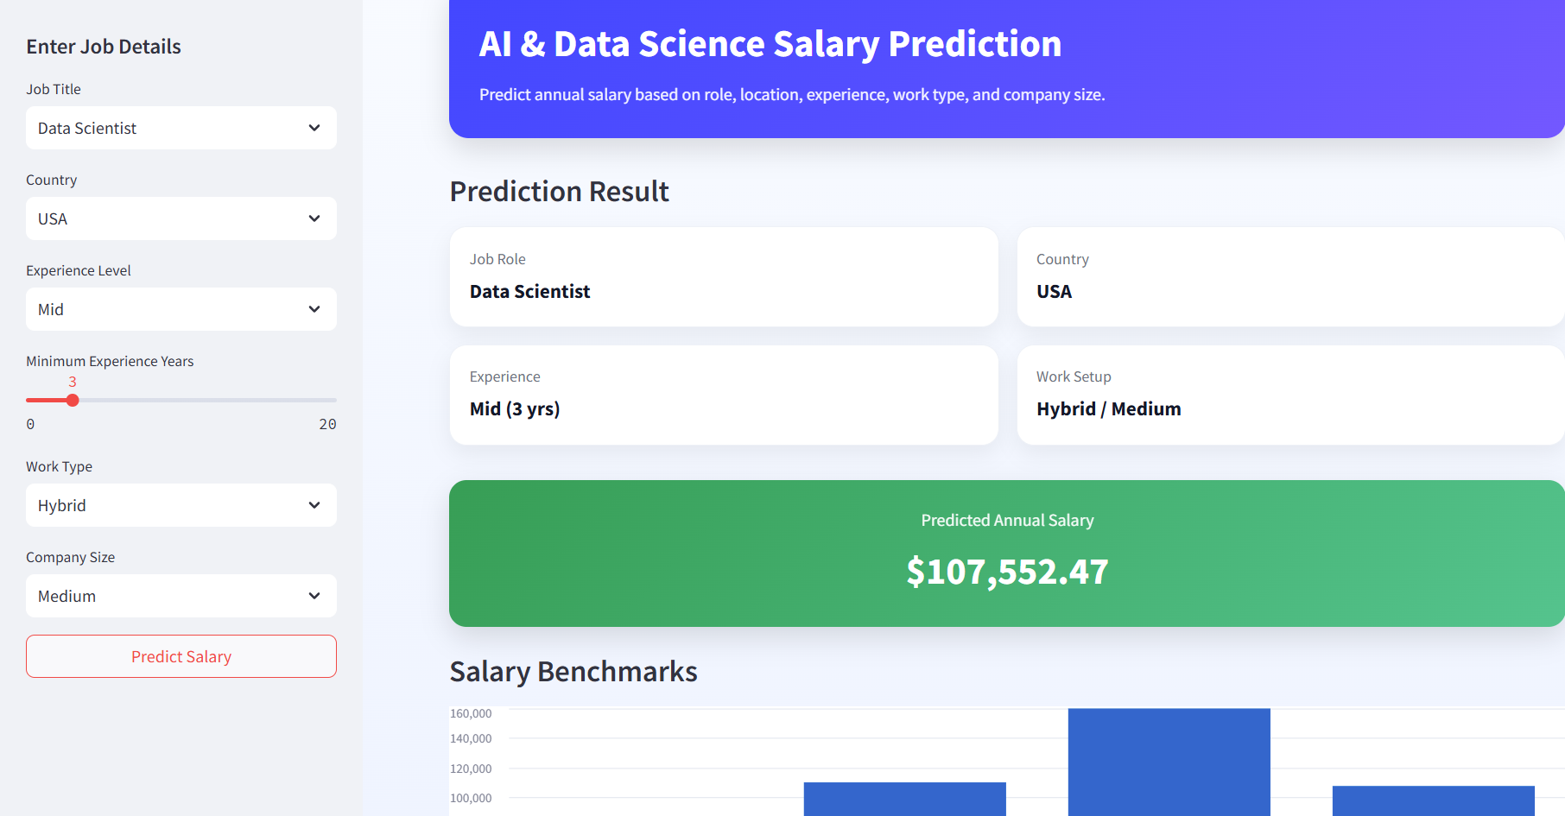
Test Case Predictions (Example 1)
Input:
Job Title: Data Scientist
Experience Level: Mid-level
Experience: 3 years
Location: USA
Remote Type: Hybrid
Company Type: Medium
Prediction Result:
Predicted Salary: ~$107,552

Slide 13
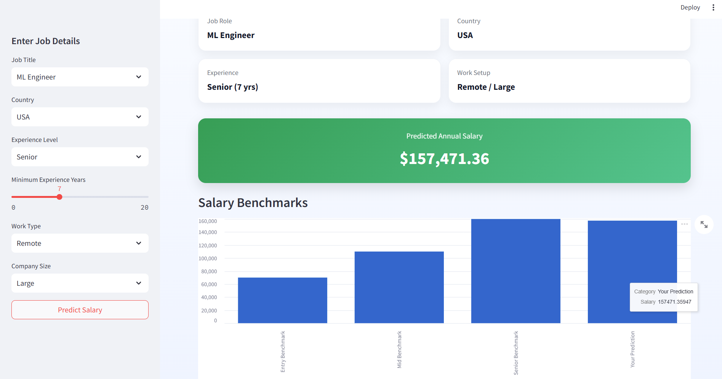
Test Case Predictions (Example 2)
Input:
Job Title: Machine Learning Engineer
Experience Level: Senior
Experience: 7 years
Location: USA
Remote Type: Remote
Company Type: Large
Prediction Result:
Predicted Salary: ~$157,471

Slide 14
Future Improvements:
Include more features such as skills and company size
Use advanced models like XGBoost or LightGBM
Apply cross-validation for better generalization
Improve feature selection and reduce redundancy
Deploy model as a real-time application

Slide 15
Conclusion :
Built a high-accuracy salary prediction model
Gradient Boosting provided the best performance
Experience is the most important factor affecting salary
Machine learning enables reliable salary estimation

Slide 16
References:
Matbouli, Y.T., & Alghamdi, S.M. (2022). Statistical machine learning regression models for salary prediction featuring economy-wide activities and occupations. Information, 13(10), 495. https://doi.org/10.3390/info13100495
Gheriyani, N.S., & Dbeea, J.I. (2024). Salary prediction: Case study. African Journal of Advanced Pure and Applied Sciences, 1–13. https://doi.org/10.65418/ajapas.vi.766
Raj, P., et al. (2025). Forecasting salary using a machine learning system. Atlantis Press. https://doi.org/10.2991/978-94-6463-XXX-X
Ayua, S.I. (2024). Salary prediction model for non-academic staff using polynomial regression technique. Advances in Intelligent Applications. https://doi.org/10.47852/bonviewAIA795
Alsheyab, A.R., Alkhasawneh, M., & Shahin, N. (2025). Job market cheat codes: Prototyping salary prediction and job grouping with synthetic job listings. arXiv. https://arxiv.org/abs/2506.15879

