Slide 1
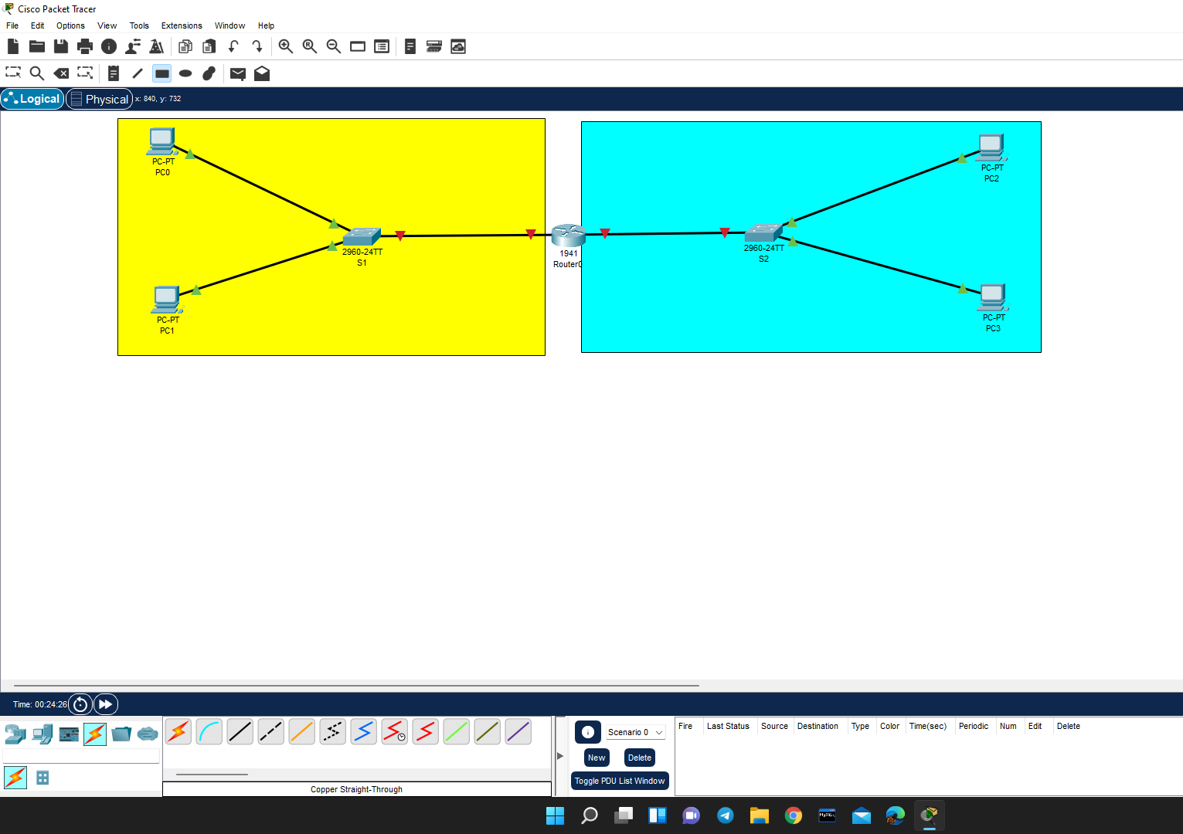
Here there are two networks, the green colored part is the first and blue colored is the second network. In first network(Yellow region) consist of two devices(PC0 & PC1) associated to the switch (S1) which is connected to router(router0),In the same way second network(blue region) consist of two devices(PC2 & PC3) associated to the switch (S2) which is connected to router(router0).
Notes:
STEP -1:
Here there are two networks, the green colored part is the first and blue colored is the second network. In first network(Yellow region) consist of two devices(PC0 & PC1) associated to the switch (S1) which is connected to router(router0),In the same way second network(blue region) consist of two devices(PC2 & PC3) associated to the switch (S2) which is connected to router(router0).

Slide 2
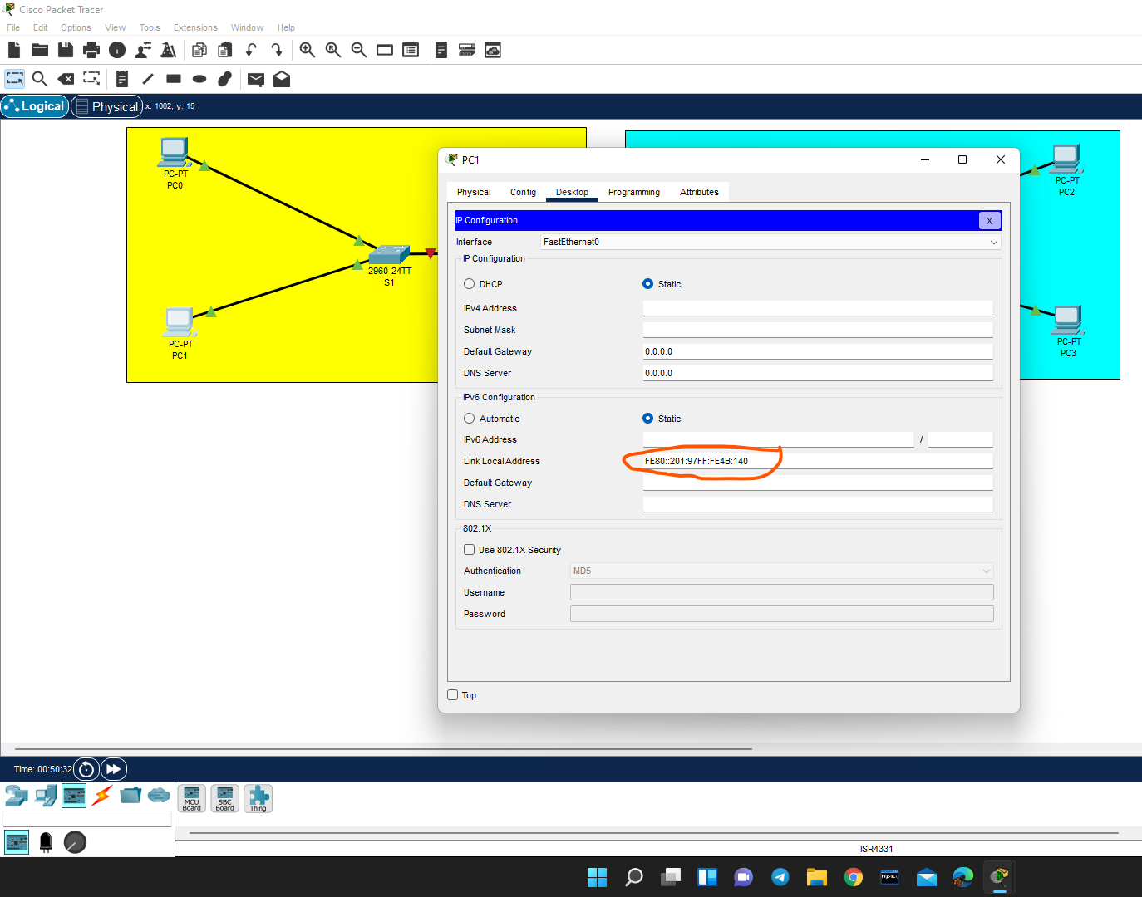
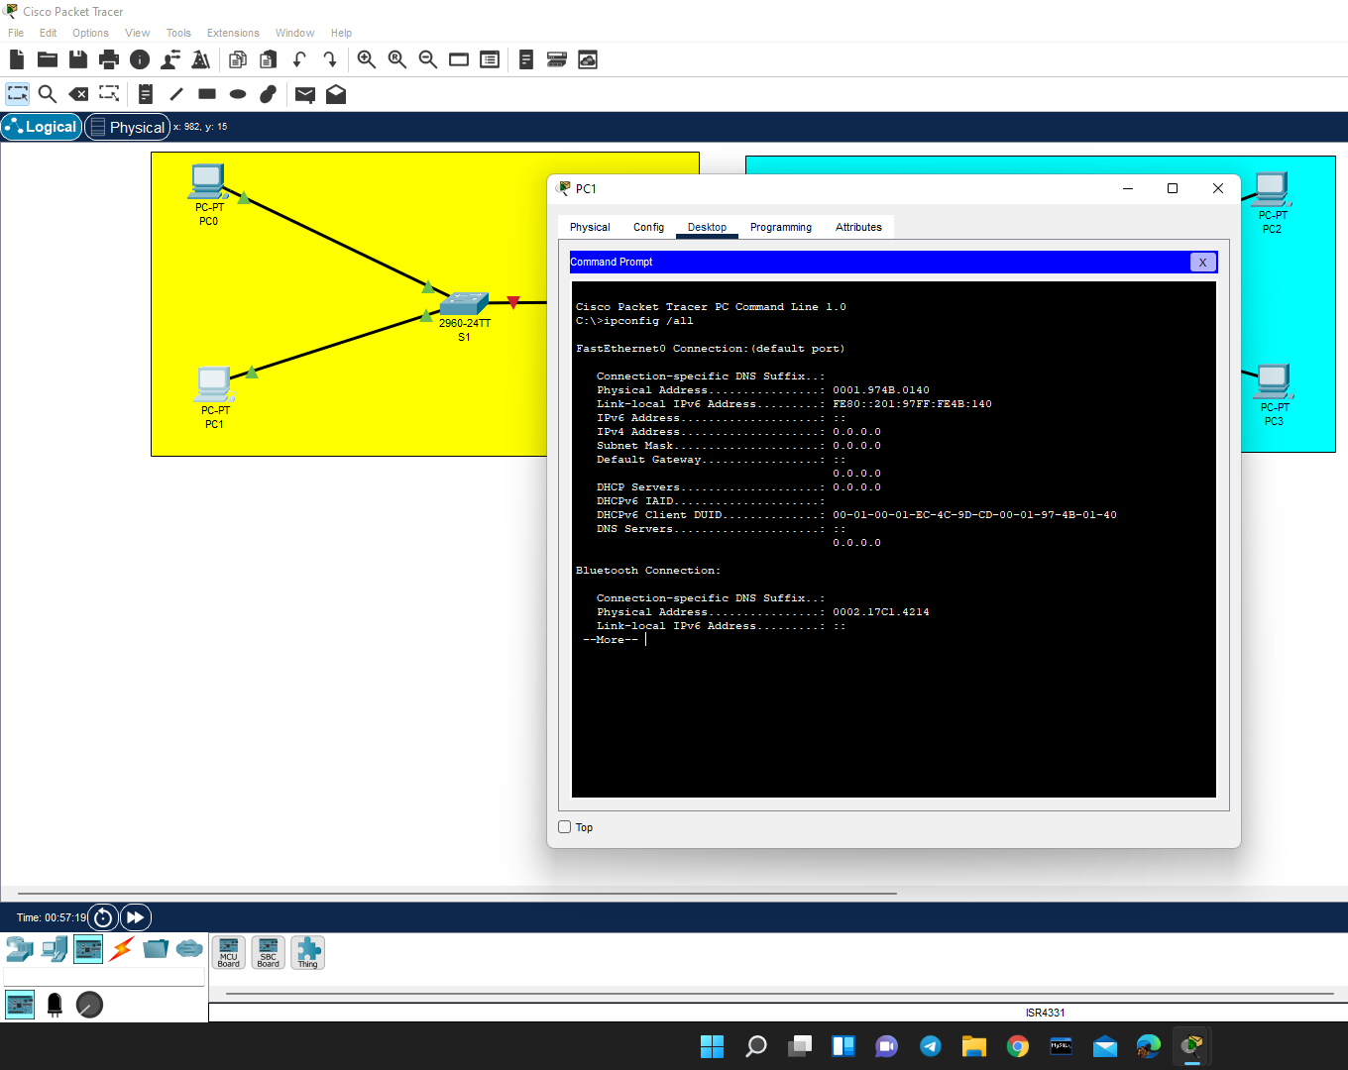
<=Local address
Basing upon the physical address the Local address is generated
Notes:
Basing upon this physical address the Local address is generated

Slide 3
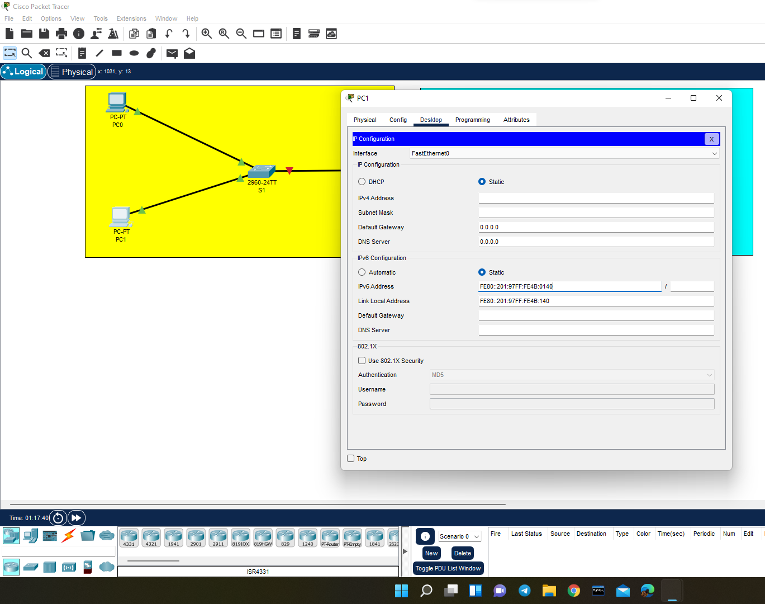
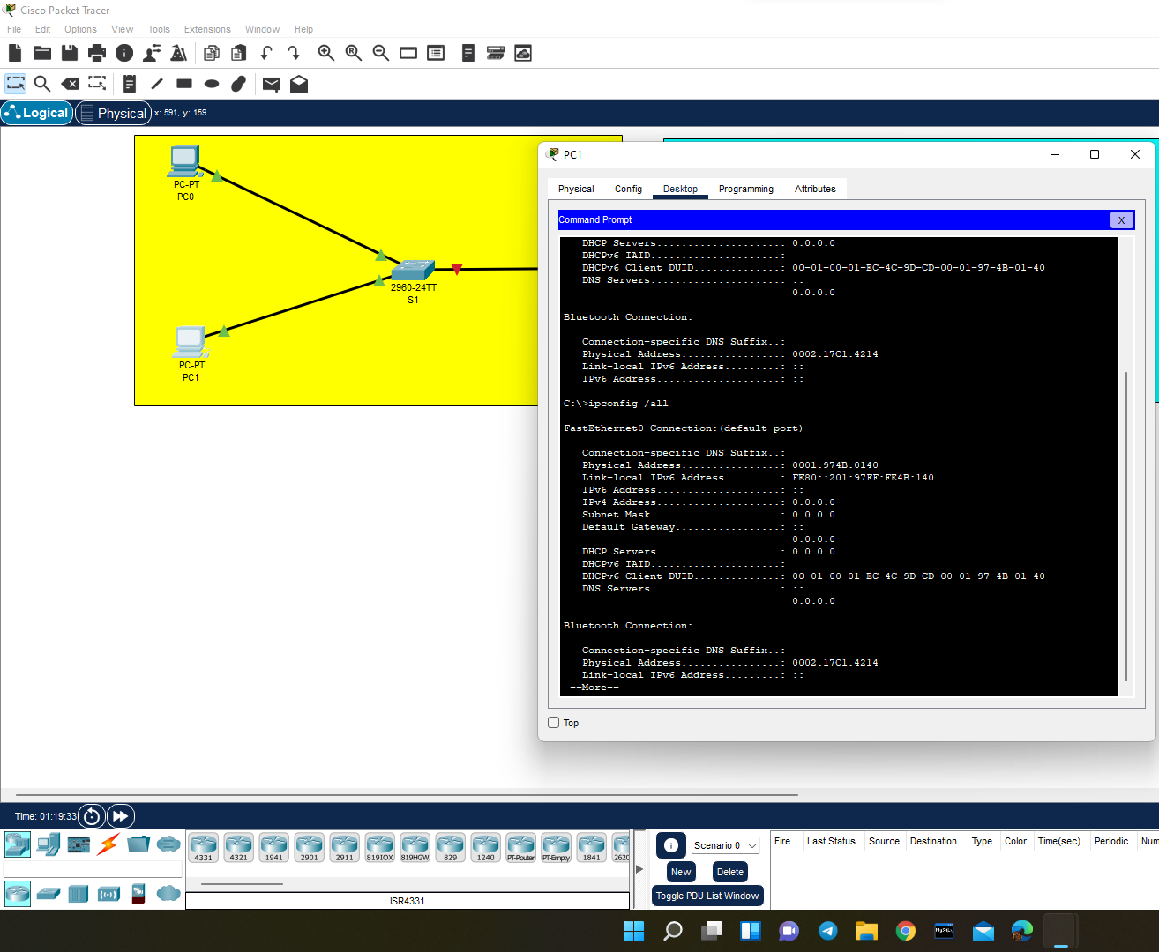
Calculating the local address and verifying them with present local address for every PC
Notes:
Calculating the local address and verifying them with present local address for every PC

Slide 4
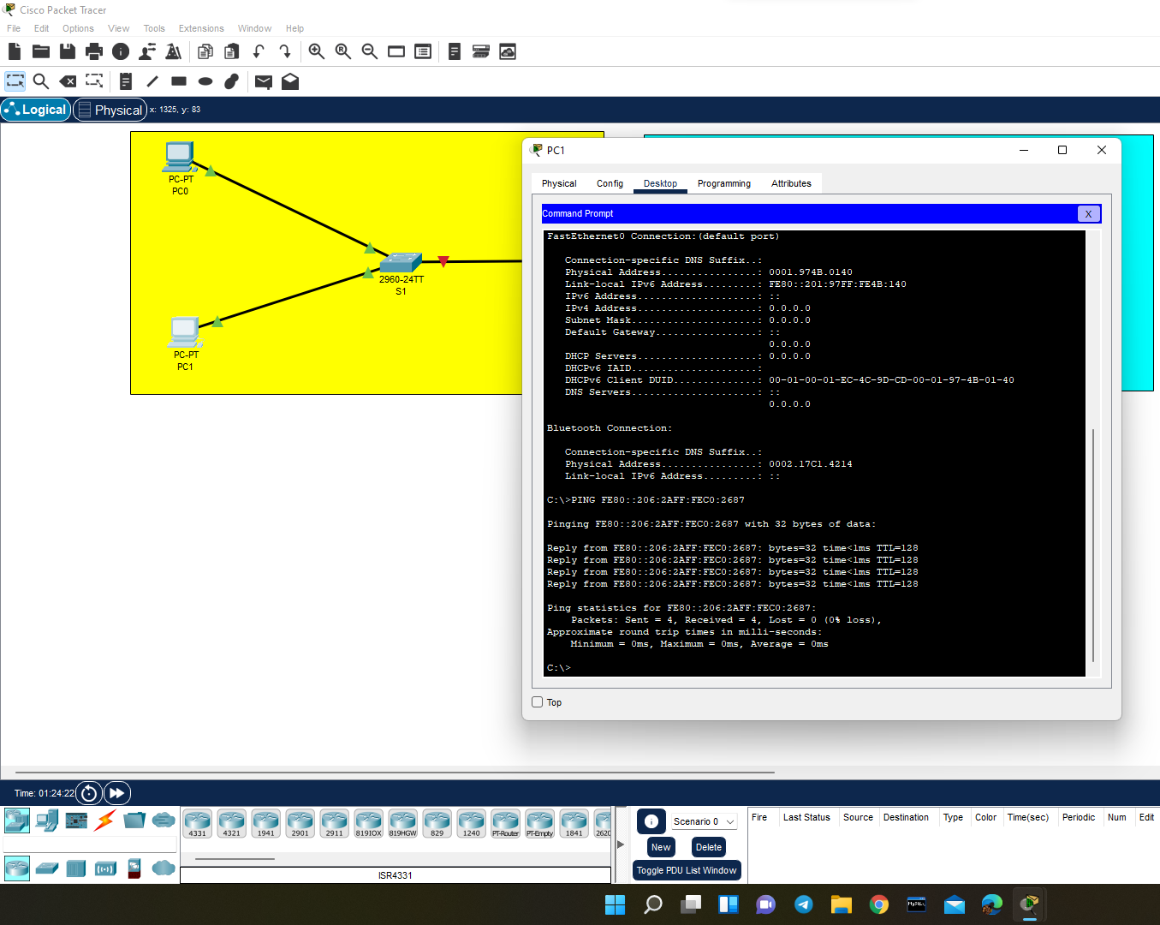
After that, we check whether we are getting the ack’s or replies for PC1 in its command prompt.
Notes:
After that, if we check for ack’s or replies in PC1 command prompt

Slide 5
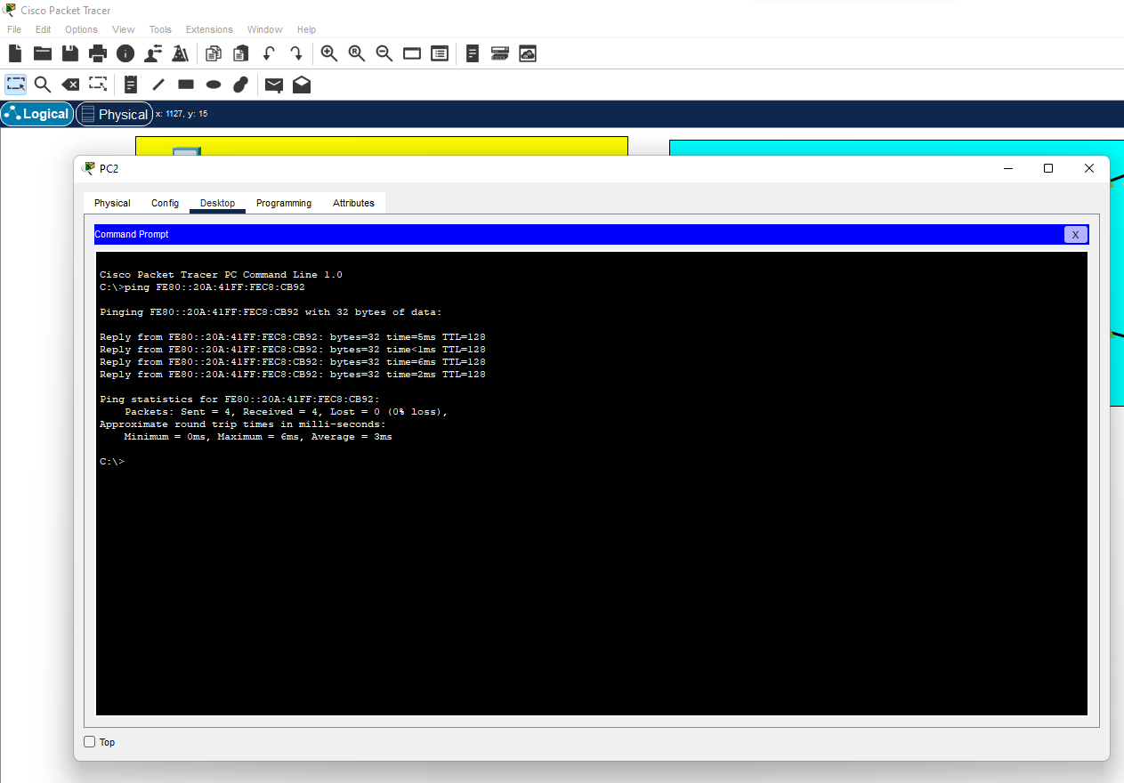
In the same way verifying the replies in second network also
Notes:
In the same way verifying the replies in second network also

Slide 6
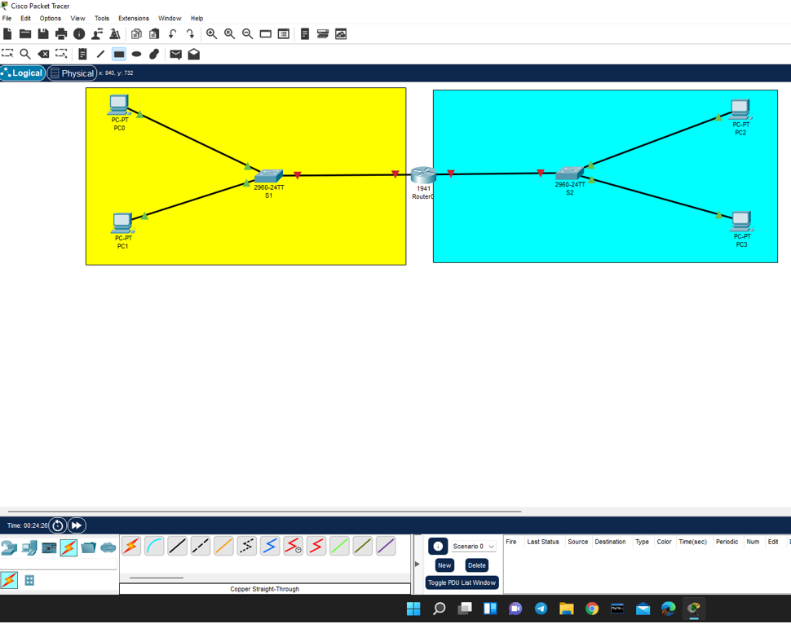
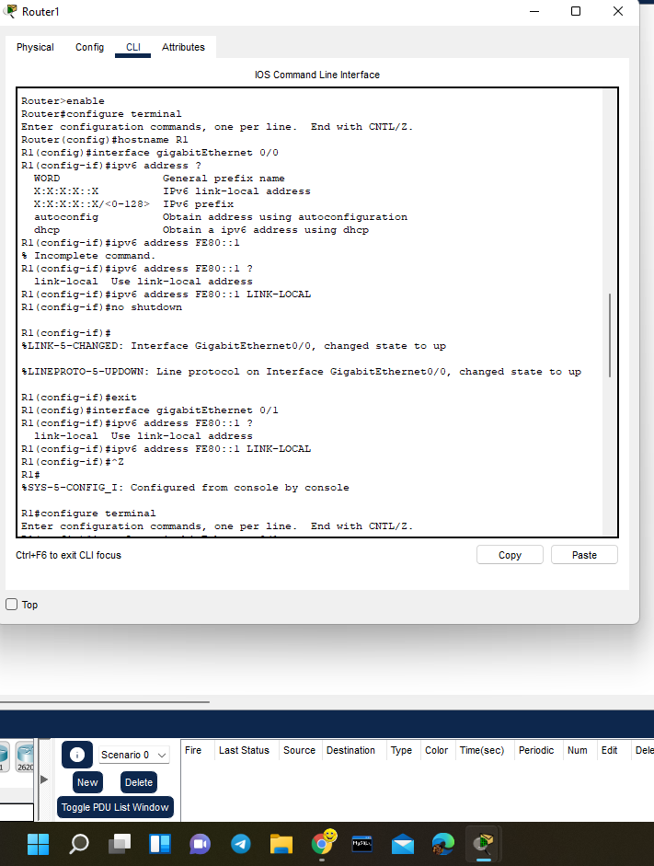
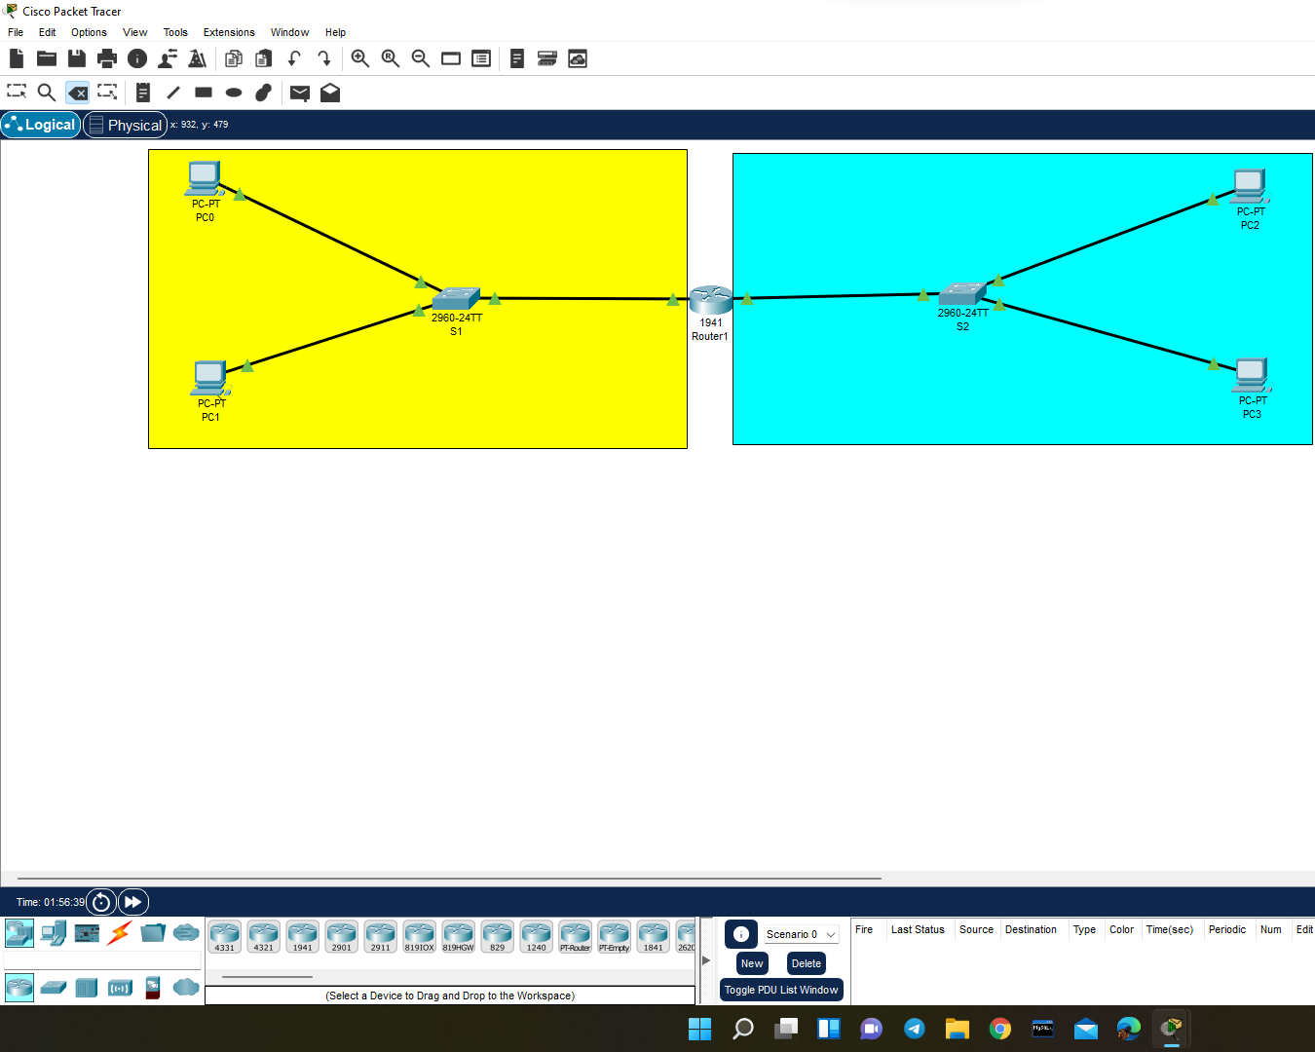
Enabling the transmission through router
Notes:
Enabling the transmission through routers

Slide 7
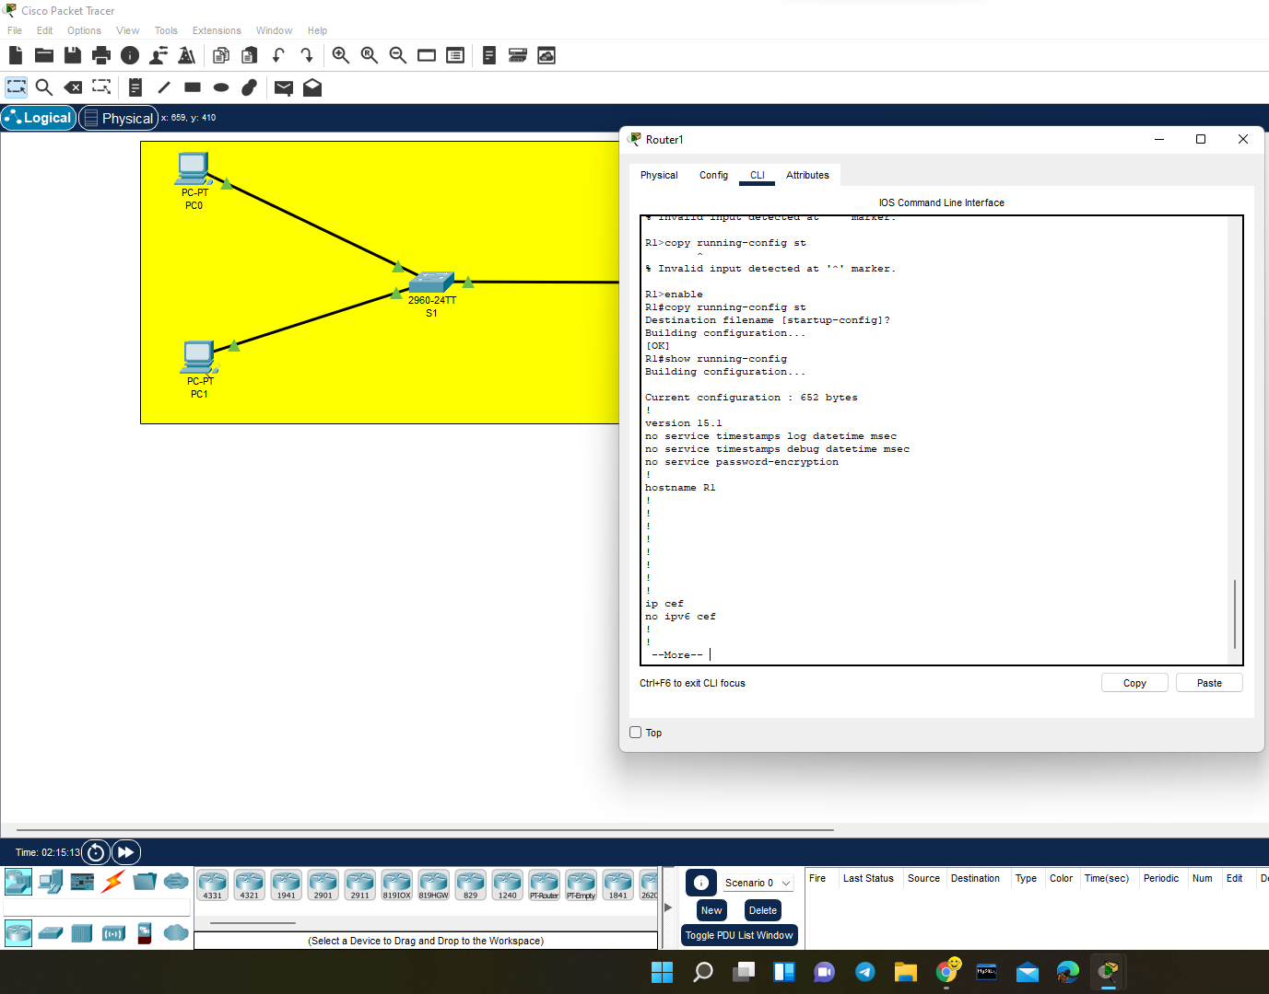
Transmission through router
Notes:
Transmission through router

Slide 8
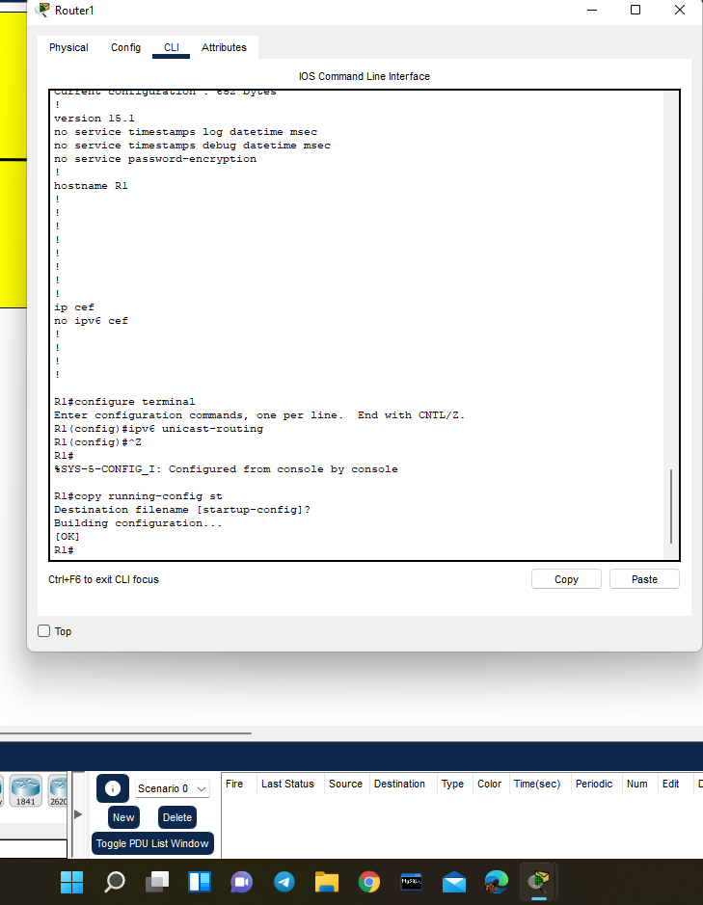
BY default ipv6 traffic for waiting is disabled so we are enabling using ipv6 space unicast-routing
Notes:
BY default ipv6 traffic for waiting is disabled so we are enabling using ipv6 unicast-routing

Slide 9
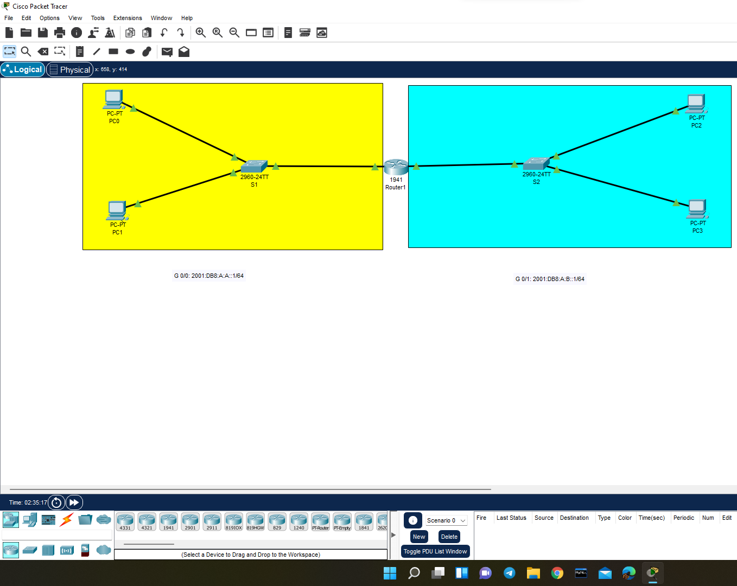
We are going to configure a global unicast address for these interfaces on this router(R1) so that these networks are going to communicate to each other. Here we assigned the ipv6 address i.e,the global unicast access for these interfaces g 0/0 and G 0/1 on this router R1

Slide 10
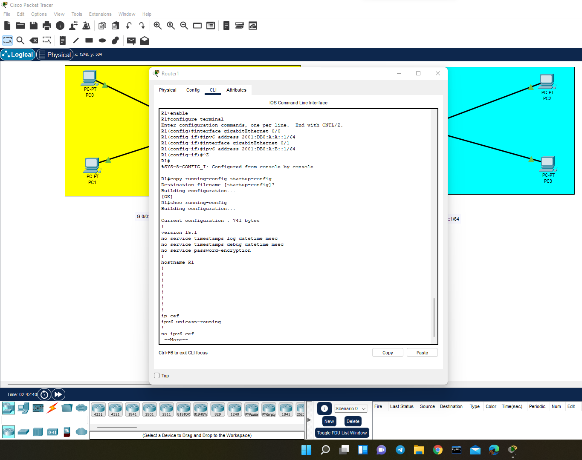

Slide 11
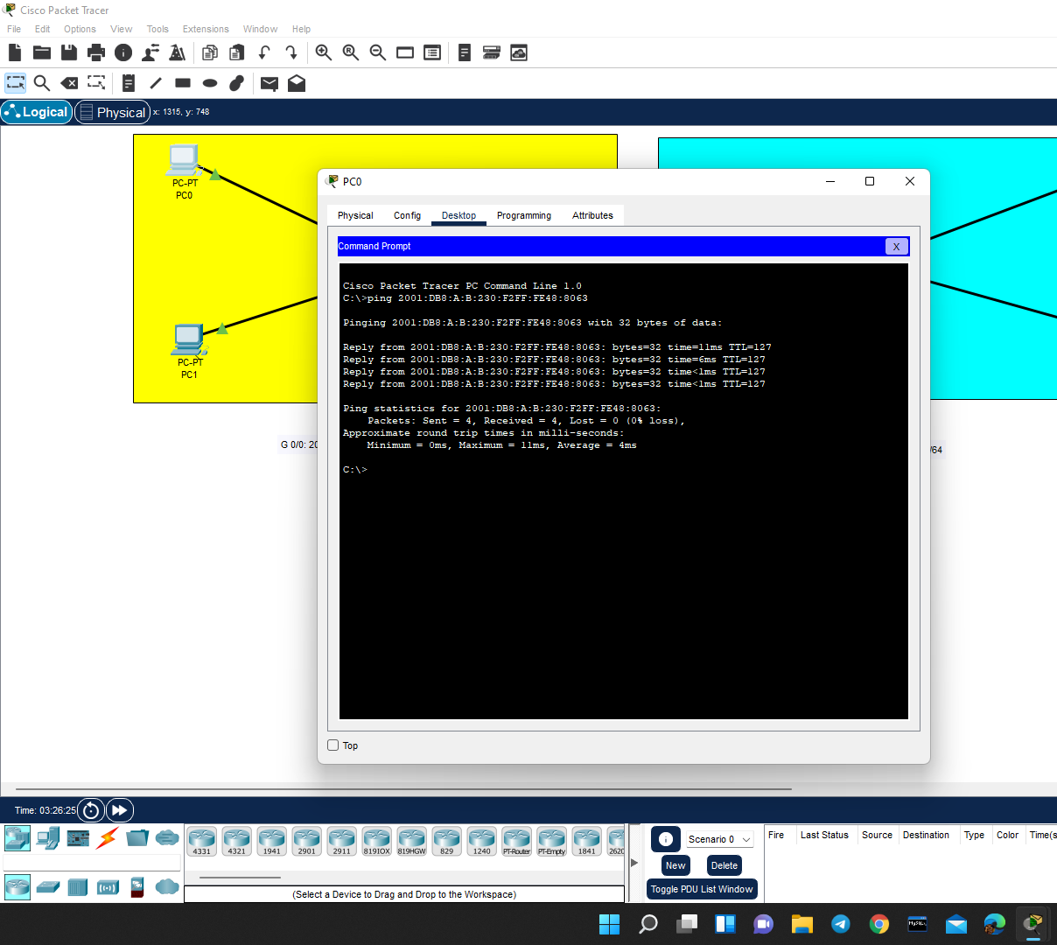
Finally, using the IP address of PC3 we check for replies from PC0.
Notes:
Finally, using the IP address of PC3 which we check for replies from PC0

