Slide 1

PROJECT MANAGEMENT TOOL
COLLABORATION TOOLS FOR PEOPLE TO WORK VIRTUALLY

Slide 2
TEAM 1 : AVENGERS ASSEMBLE
Akhila Katukuri
Claudia Dsilva
Sai Jeevan Teegala
Vamshi Krishna Shanagonda
Vikas Sanhotra

Slide 3
WHAT IS PROJECT MANAGEMENT TOOL?
Project management tool is an aid to assist an individual, team or organization to effectively organize work, projects and tasks.
This tool is made to be completely customizable so they can fit the needs of teams of different sizes and with different goals.
Projects are composed of several, interconnected projects that, when combined, achieve a larger, long-term business objective.
This means Project Management tool will need advanced features to track projects at a higher-level in order to see how each project is interacting with each other. This tool can include flexible work views, Dashboard, Reporting, Time sheets.

Slide 4
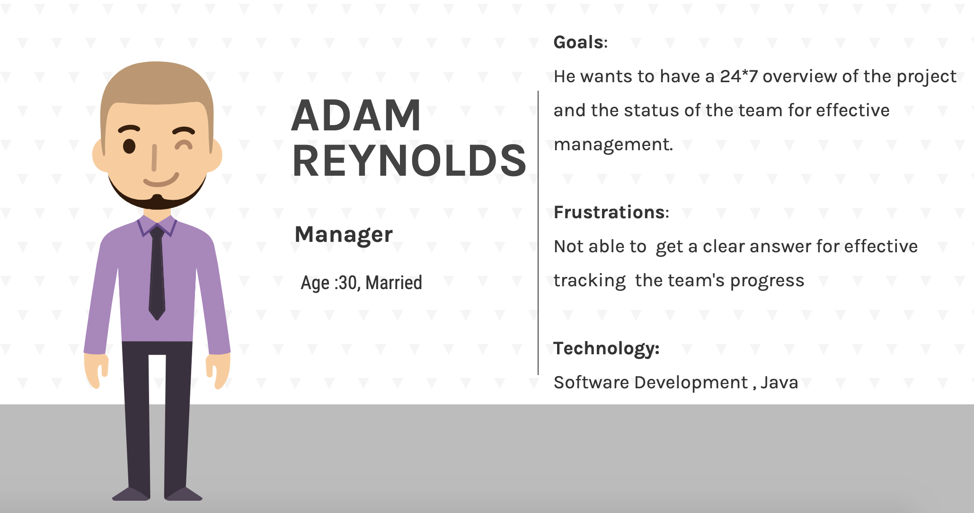
PERSONAS
MANAGER:
has ultimate control over teams and projects.
gets to create and allocate tasks to the team members.
creates custom roles and grant access levels to the team members.
gets to keep an eye on the task status of team members.
Has access to repository , chat box and other functions

Slide 5
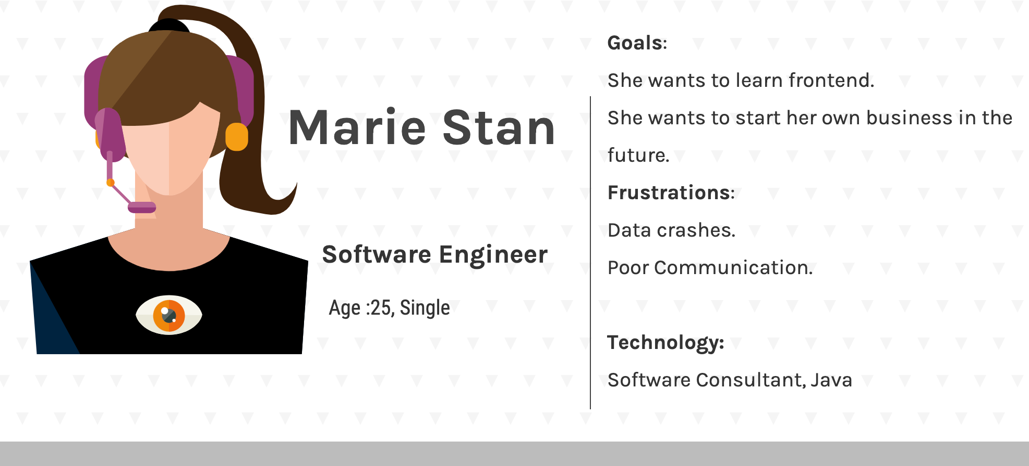
Personas
TEAM MEMBER:
can see the work allocated to them along with deadlines.
Can change the status of the task assigned on completion.
Has access to repository , chat box and other functions

Slide 6
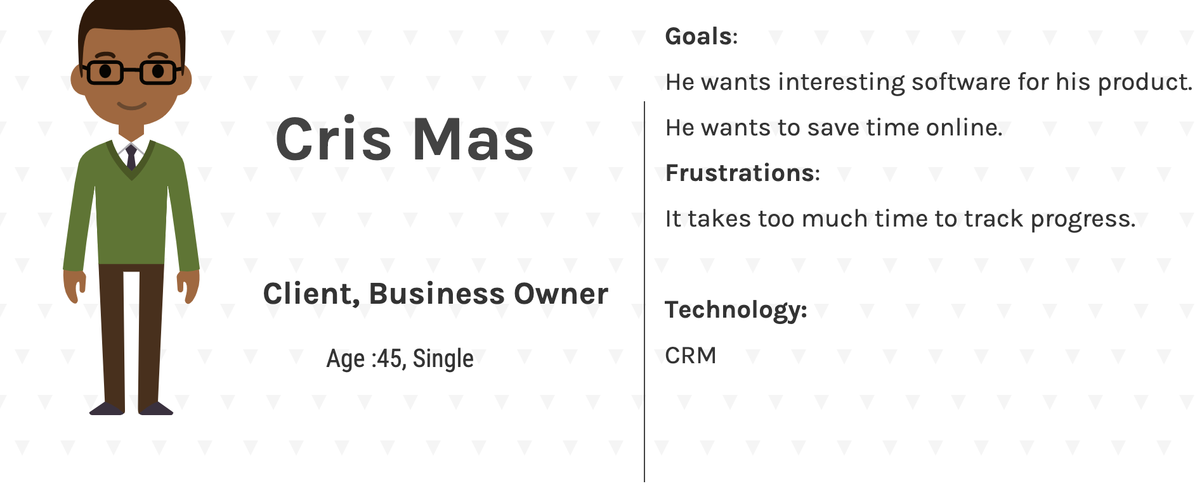
Personas
https://docs.google.com/presentation/d/1daGki1TjJgnAgYnM6ifr0UdBadEi6b_Q/edit#slide=id.p13
CLIENT:
can see the work allocated to the members along with deadlines.

Slide 7
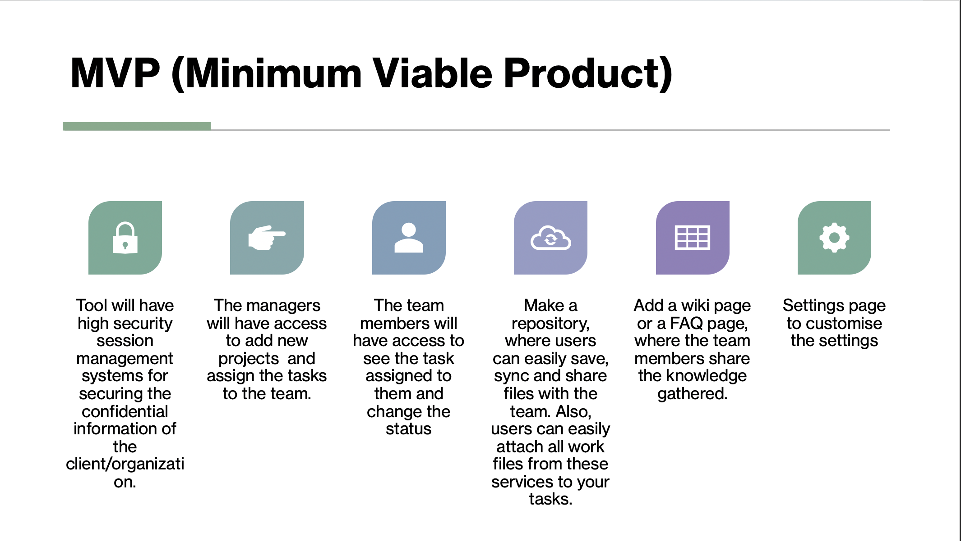

Slide 8
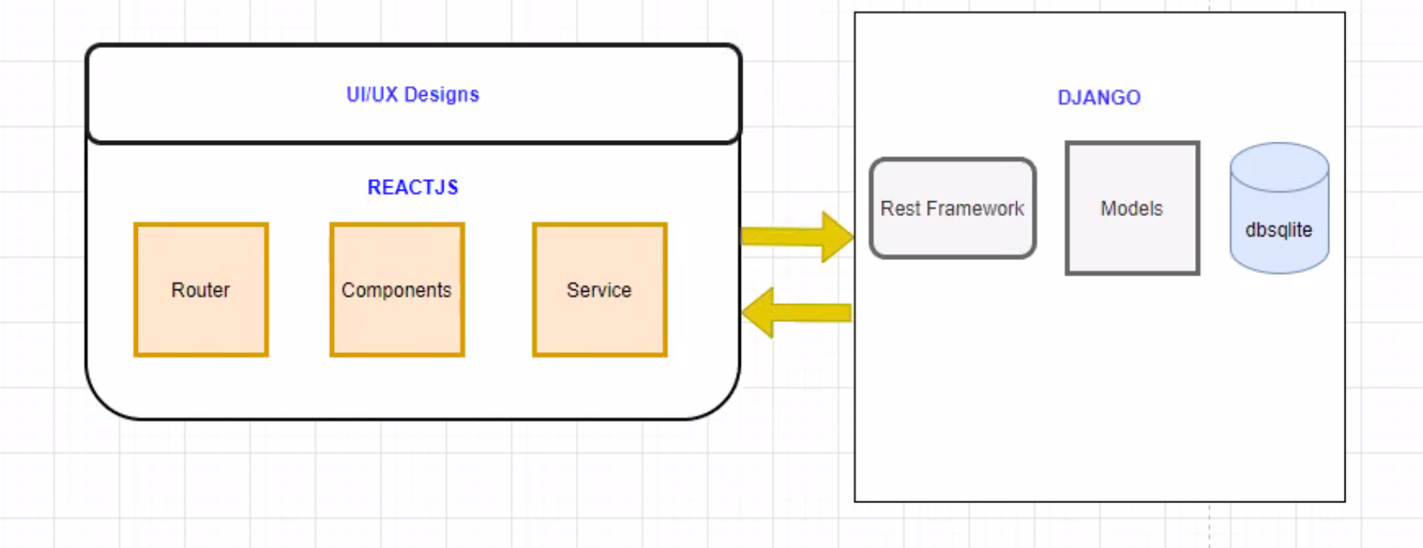



Technologies Used
Front-end
Back-end
Backend
Frontend
Python Django Framework
React Js
HTML5
BOOTSTRAP
SQLite3 Database

Slide 9
User Stories and Acceptance Criteria
User story 1 : Registration
As a manager: I should be able to sign up for the application successfully as a first time user.
As a team member: I should be able to able to sign up for the application successfully as a first time user.
As a client : I should be able to able to sign up for the application successfully as a first time user.
Acceptance Criteria: Any person who gives the mandatory required details such as first name, last name, username, password, confirm password and a valid email ID will be able to successfully register as a user to the website.
User story 2 : Login
As a manager: I should be able to login successfully as a valid user to view the homepage.
As a team member : I should be able to login successfully as a valid user to view the homepage.
As a client : I should be able to login successfully as a valid user to view the homepage.
Acceptance Criteria: Once the user registers, (s)he must encounter a login page where they have to enter a valid “username” and password for a secure login. If not the login is not successful or if the user forgets their Username or password they should be able to get their password recovery options.

Slide 10
User Stories and Acceptance Criteria
User story 3 : Tasks
As a manager: I should be able to create or delete or update tasks and assign them to team members.
As a team member: I should be able to see the tasks that are assigned to me and update it if complete.
As a client : I should be able to see all the tasks are that present along with status.
Acceptance Criteria: 1.The users should have a complete access to their accounts so that they can check their own tasks and update them when completed. The task will have a “completed” button to confirm the completion.
2.The manager should have a separate function under project where (s)he can add task to the members based on the project.
User story 4 : Chat function
As a manager: I should be able to chat with all the members of team along and also with the client.
As a team member : I should be able to chat with all the members of the team along with the manager and client.
As a client : I should be able to chat with all the members of the team along with the manager
Acceptance Criteria:All the users should have access to the chat box so that they can comment, discuss or give suggestion etc over chat to the team. This chat function works whenever a user send a particular message to other, it should reflect in the others chatroom.

Slide 11
User Stories and Acceptance Criteria
User story 5 : Update/Delete Timelines
As a manager: I should be able to add timelines to the project as team members.
Acceptance Criteria:Manager should be able to add timelines to the task.
User story 6 : Update/View Repository
As a manager: I should be able to see the documents that are present and also be able to upload new documents.
As a Team Member: I should be able to see the documents that are present and also be able to upload new documents.
Acceptance Criteria:The developer should create a repository to store all the required data. The Manager and Team Member can edit or update the repository.

Slide 12
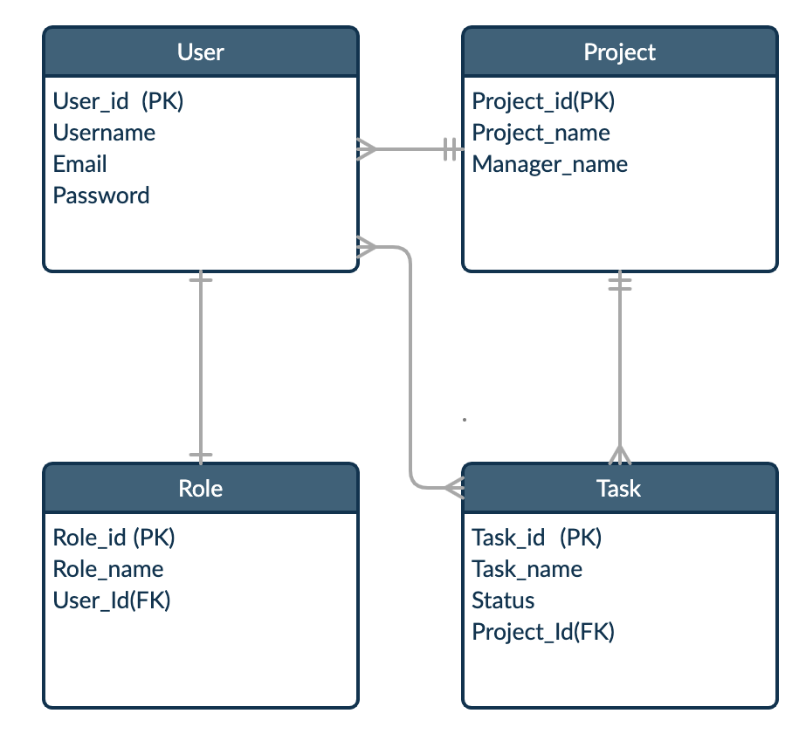
ER DIAGRAM

Slide 13
PROJECT FLOW DIAGRAM
FOR MANAGERS:
Manager
Register
Login
Access to Dashboard
Can Perform
Add Projects
Assign Tasks
Chat with Team Members
Update and view Repository
Update Profile

Slide 14
PROJECT FLOW DIAGRAM
FOR TEAM-MEMBERS:
Team Member
Register
Login
Access to Dashboard
Can Perform
Update Task Status
Chat with Team Members
Update and view Repository
Update Profile

Slide 15
PROJECT FLOW DIAGRAM
FOR CLIENTS:
Client
Register
Login
Access to Dashboard
Can Perform
View the task

Slide 16
Product Backlog
ID | For Feature | As a… | I want to be able to | So That | Priority | Sprint | Status
1 | Login Page | Manager | Register as Manager | I can get the register with details of the user and Give user role as Manager | High | 1 | Done
2 | Login Page | Manager | Fill-up login details as an Manager | I can be successfully Logged in as a Manager | High | 1 | Done
3 | Home Page | Manager | Create Project Details | I can be able to make project teams | High | 2 | Done
4 | Home Page | Manager | Define project details | I can give the name of the project along with members of the project. | High | 3 | Done
5 | Home Page | Manager | Define the task | I can assign different task of the project to team members | High | 4 | Done
6 | Login Page | Team members | Signup as a team-member | I can get the register with details of the user and Give user role as team member | High | 2 | Done
7 | Login Page | Team members | Fill-up login details as a Team Member | I can be able to login with my credentials | High | 1 | Done
8 | Home Page | Team members | View the tasks assigned by manager | I can be able to check the tasks that are assigned to me. | High | 4 | Done
9 | Login Page | Client | Sign-up as a Client | to register my self as a viewer of that Project | High | 2 | Done
10 | Login Page | Client | Login Successfully as a Client | I can view the overall Progress of the Project | High | 4 | Done
11 | Home Page | Manager | Able to see the progress | I can view the overall progress of Project, teams and team members | Moderate | TBD | To be made
12 | Repository Page | Member | Get access to the repository | I can able to upload and edit the files in the repository | High | TBD | To be made
13 | Chat Page | Manager | chat with anyone | I can chat with team members and the client | High | TBD | to be made
14 | Dashboard | Team members | Edit the progress | I can be able to show that I have completed the task assigned | High | TBD | to be made
15 | Chat Page | Team members | Chat with team member and manager | I can give information about the project with team members and discuss progress with manager | High | TBD | to be made
16 | Repository Page | Team members | Get access to the repository | I can be able to upload or view the repository uploaded by other team members | High | TBD | to be made
17 | Chat Page | Client | chat with Manager | I can know the what's progress of the project | High | TBD | to be made
18 | Settings page | User | change my Profile | I can customize my page and my account | low | TBD | to be made
19 | Dashboard | Manager | specifying the deadline | the team member can work based on the priority set | Moderate | TBD | To be made

Slide 17
Test Cases
Scenario | Test Cases | Test Data | Expected Result | PASS/FAIL
Create account | Sign up with username, email ,roles and password | username:xxxx | User should be able to sign up successfully | PASS
 | Error message if password is not as per validations |  | Proper error message should be displayed | PASS
 | emails should be correct | email: vsxxxx@pace.edu | Valid Email should be able to signup | PASS
 | Error message for invalid email | Role:Manager/ | Proper error message should be displayed for invalid emails | PASS
 | All the user details should be persisted in the user table except password | Role:Team member/ | User details email, username should be saved in the SQLite database | PASS
 |  | Role :Client | User with Role:manager ,directed dashboard wherein he can add Projects updates tasks User with Role:Team Member directed dashboard wherein he can view his tasks and update status User with Role:client, directed dashboard wherein he can view the tasks assigned | PASS
Login | Sign in with valid email id and password | User = vsxxxx@pace.edu Password: 123456m | User should be able to login with email and password without any errors | PASS
 | Reach the dashboard page |  | User should be redirected to the dashboard page after successful login | PASS
 | Error message for invalid email or password |  | User should be see proper error message for invalid email or password | PASS
Dashboard or Home | Navigate to different Pages |  | User should be able to navigate to Projects, Tasks, Repository, Calendar and FAQ's | PASS
 | Create and Assign projects and tasks |  | User Manager can be able to create, assign, view, add tasks or projects to teams and team members. | PASS
 | View and Update |  | User team member can be able to view their assigned tasks and project and also update their work status. User Client can only view the progress of the Project | PASS

Slide 18
Test Cases Continued
Scenario | Test Cases | Test Data | Expected Result | PASS/FAIL
Team Page | Update the work done |  | User team members can be able to update their tasks when completed | To be tested in next sprint
 | View the progress |  | User team members and Manager can be able to view the progress of the tasks in the project | To be tested in next sprint
 |  |  |  | To be tested in next sprint
Repository | Upload the work done |  | user team member and Manager can be able to upload the project and task work in the repository | To be tested in next sprint
 | View the Project wok |  | user team member and Manager can be able to view the project and task work of other team members | To be tested in next sprint
 | Download the files |  | User team member and Managers can be able to download files available in the repository | To be tested in next sprint
Messages | chat function |  | All User can be able to chat or message with each other | To be tested in next sprint
User Details | Update firstname |  | User should be able to update first name and it should reflect on the account page | To be tested in next sprint
 | Update last name |  | User should be able to update last name and it should reflect on the account page | To be tested in next sprint
 | Update password |  | Redirect to change password page to enter new password and then redirect to login page | To be tested in next sprint

Slide 19
Sprint 1 Backlog
Sprint Task | Module | Priority | Action Items | Status
Sprint 1 : Task 1 | Brainstorming ideas | High | Brainstorming the project ideas | Done
Sprint 1 : Task 2 | Requirement gathering | High | Requirement gathering relating to the selected Project | Done
Sprint 1: Task 3 | Deciding modules, phases and technologies | High | Deciding each modules and phases and technologies used in the project | Done

Slide 20
Sprint 2 Backlog
Sprint Task | Module | Priority | Action Items | Status
Sprint 2: Task 1 | Home Page | High | User Interface development was done and pages were developed | Done
Sprint 2: Task 2 | Linking backend API’s with the User Interface. | High | Database modeling and integrating the API’s with User Interface. | Done

Slide 21
Sprint 3 Backlog
Sprint Task | Module | Priority | Action Items | Status
Sprint -3 Task1 | UI development | High | Creating the UI for the frontend, including Dashboard and other pages | Done
Sprint -3 Task2 | Login and Session Maintenance | High | Integration of the login page with the database for maintenance of sessions | Done
Sprint -3 Task3 | Integrating Backend | High | Integration of the task table with the backend for inserting and pulling values from database | Done

Slide 22
Sprint 4 Backlog
Sprint Task | Module | Priority | Action Items | Status
Sprint 4 Task -1 | UI Styling | High | Design the style of the User Interface | Done
Sprint 4 task 2 | Data Pushing in database | High | Pushing input data from users to the backend database for storage | Done
Sprint 4 task 3 | API display | High | Displaying Data from database sent to API on the Frontend | Done
Sprint 4 task 4 | Frontend and Backend Integration | High | Integration of react and Django framework for data transfer | Done

Slide 23
PROJECT DEMO
https://www.youtube.com/watch?v=MnaSmDZXss4&feature=youtu.be

Slide 24
Future Scope
Adding the timelines along with the task, so that the priorities can be set and tracked.
Adding a repository where the documents etc. can be uploaded or viewed
Adding a chat function, so that communication with the team is possible
Adding setting page to customize the account.
Sending Email validation to confirm the user account.

Slide 25
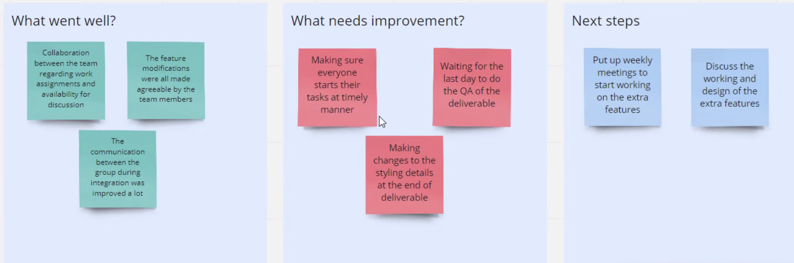
Retrospectives

Slide 26

GitHub Links
Project Link:
For Frontend: https://github.com/Vamshi399/cs691_project_management_tool/
For Backend:
https://github.com/saijeevan54/django
WiKi Page: https://github.com/Vamshi399/cs691_project_management_tool/wiki

Slide 27


