Slide 1
AI-Agent Based Intelligent Predictive Maintenance System Using Machine Sound Analysis
Batch 11 | Malla Reddy University, School of Engineering
Guide: Vinay Simha Reddy
Team Members:
Gonuguntla Vamshi Krishna
Gorre Shashikanth
Gunturu Murri

Slide 2
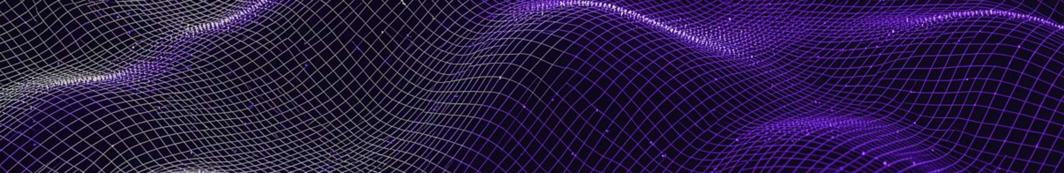
Problem Statement & Motivation
The Challenge
Traditional predictive-maintenance systems detect anomalies or predict failures, but rarely autonomously decide what maintenance action to take.
The Gap
Unplanned downtime, reactive repairs, and missed early degradation signs continue to reduce operational efficiency across industrial environments.
Our Solution
An AI-agent-based system that analyzes machine sound, detects anomalies, predicts Remaining Useful Life (RUL), and autonomously recommends maintenance actions.

Slide 3

Existing Systems & Limitations vs. Our Approach
Existing Systems & Limitations
Scheduled Maintenance
Reactive Repairs
Anomaly Detection Only
Inefficient by design — leads to systematic over-maintenance or under-maintenance, wasting resources either way.
High downtime and emergency costs; problems are addressed only after failure has already occurred.
Identifies faults but lacks autonomous decision-making and maintenance scheduling capability.
Our Approach
Integrates acoustic analysis, fault classification, RUL prediction, and agentic AI for true end-to-end autonomous maintenance.

Slide 4

Literature Survey: Research Landscape
1
Industrial Acoustic Anomaly Detection
Baseline signal-processing methods for detecting machine faults from audio.
2
Deep Learning — CNN/Spectrogram
Convolutional networks applied to spectrogram representations for improved detection accuracy.
3
Acoustic Predictive Maintenance
Real-world deployment of sound-based maintenance in industrial settings.
4
RUL Prediction via LSTM
Degradation modeling using recurrent networks to forecast remaining equipment life.
5
AI/LLM Agents for Maintenance
Decision-making frameworks using large language model agents in industrial contexts.
6
Multi-Agent Orchestration
Autonomous multi-agent systems for maintenance scheduling and coordination.
Key Finding: Most works address anomaly detection or prediction in isolation. Our contribution uniquely integrates acoustic anomaly detection, fault classification, RUL prediction, and autonomous AI-agent decision-making into one cohesive system.

Slide 5
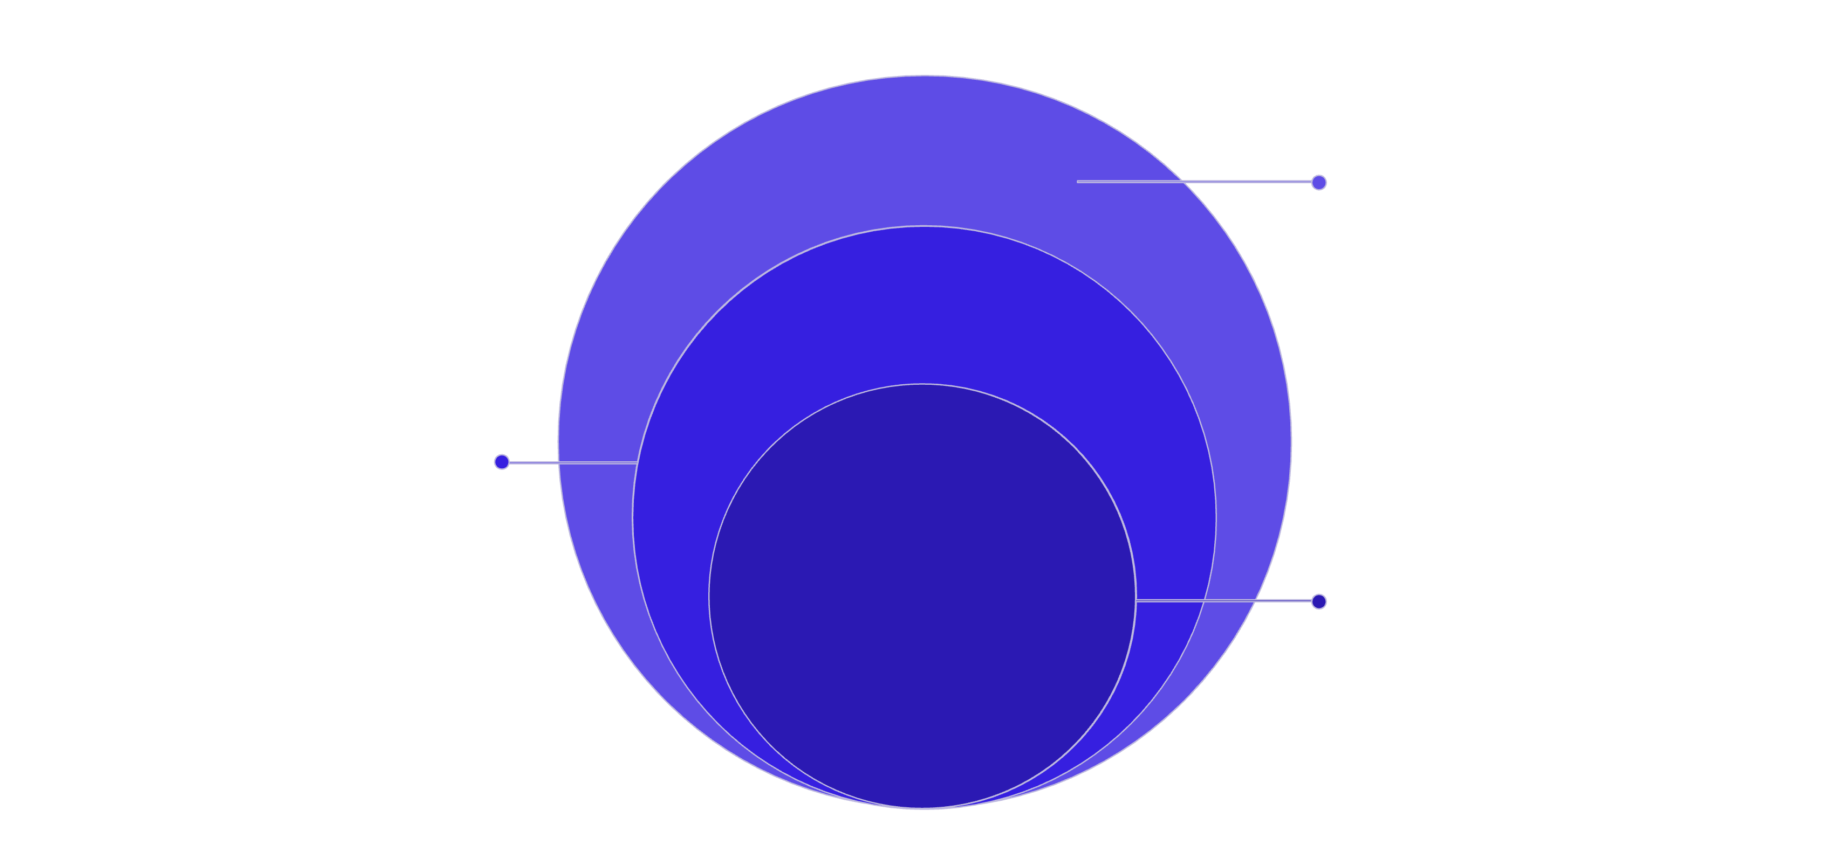
Proposed System Architecture
Agent & Interface
AI agent prioritizes maintenance; dashboard and alerts
ML Processing
CNN for anomalies; LSTM for RUL prediction
Core Audio
Mic input, preprocessing, MFCCs, spectrograms
The Agent Layer is where the system transitions from ML inference to autonomous decision-making — the defining characteristic of this agentic AI architecture.

Slide 6
Dataset, Technologies & Implementation Plan
Dataset & Stack
Phased Implementation Roadmap
MIMII Dataset — Malfunctioning Industrial Machine Investigation and Inspection. Covers fans, pumps, valves, and slide rails with labeled normal/abnormal audio recordings.
Technologies: Python · TensorFlow/PyTorch · MFCC & Mel-spectrogram · CNN · LSTM · LLM-based Agent Framework
Phase 1 — Current
1
Audio preprocessing, MFCC/spectrogram extraction, and CNN-based anomaly detection model training.
2
Phase 2 — Upcoming
LSTM-based RUL prediction, AI agent integration, and maintenance dashboard development with Telegram alert system.

