Slide 1
ELECTROWARE
By,
Ponni Dhamodharan, Ananya Ranganath,
Vamshi ganji,
Abhishek Patel.

Slide 2
About Project
Our project electroware is based on the home appliances.
It allows users to purchase their electrical appliances online.
User must create an account to buy the product.
It allows the users to filter the product and also allows the user to pay through online.

Slide 3
Requirements
Basic Flow:
• View the home page
• register/login
• Browse through the items
• Select a category
• payment

Slide 4
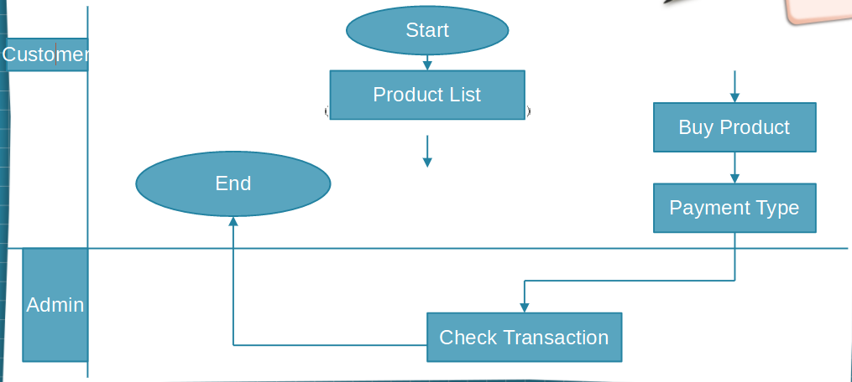
Flow Chart

Slide 5
Modules
Home
Login
Registration
Categories
All products
Products page for every appliances
Payment option
User Profile

Slide 6
Technologies used
Front end:
HTML 5
CSS 3
JavaScript
Back End:
SpringMVC
MySQL

Slide 7
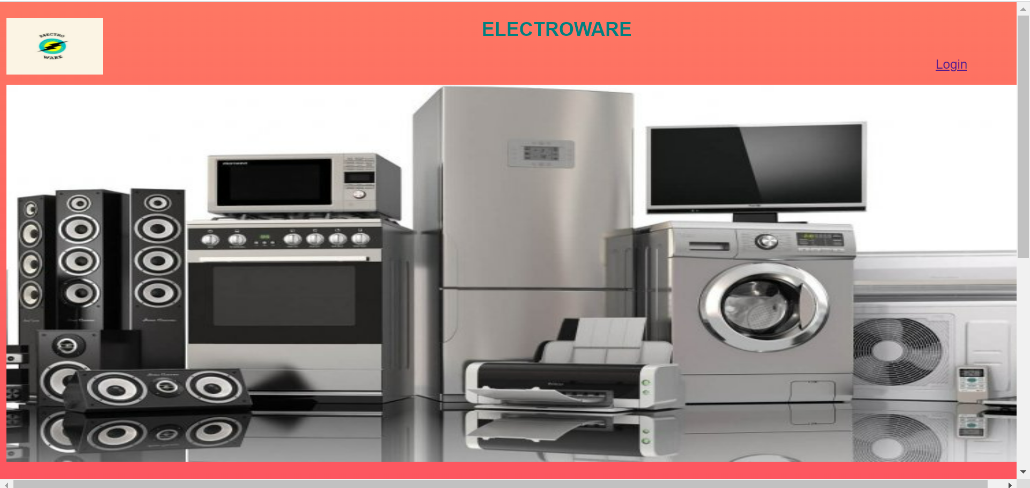
GUI(Graphical User Interface)

Slide 8
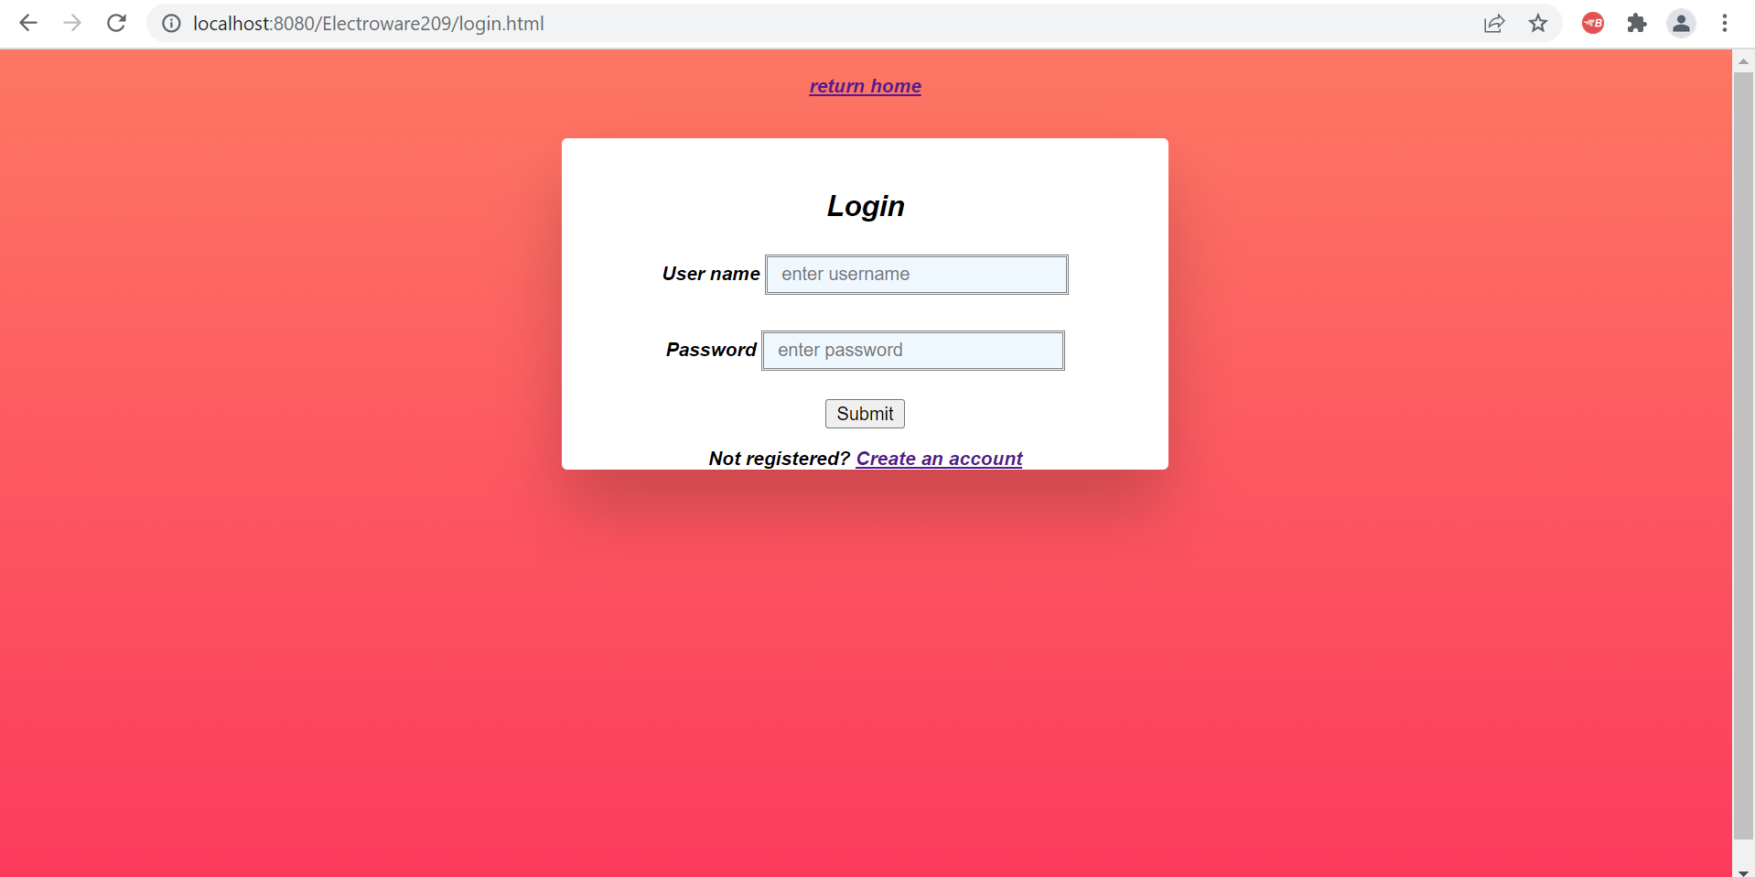
Login

Slide 9
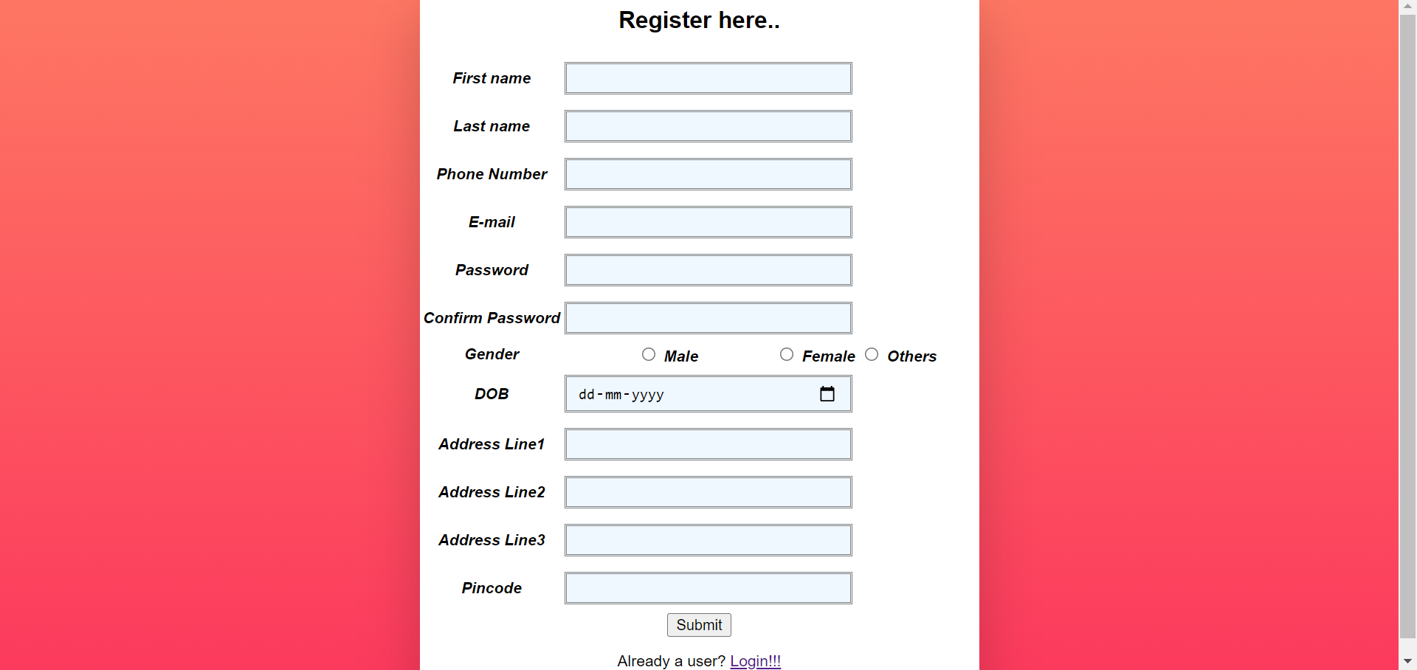
Registration

Slide 10
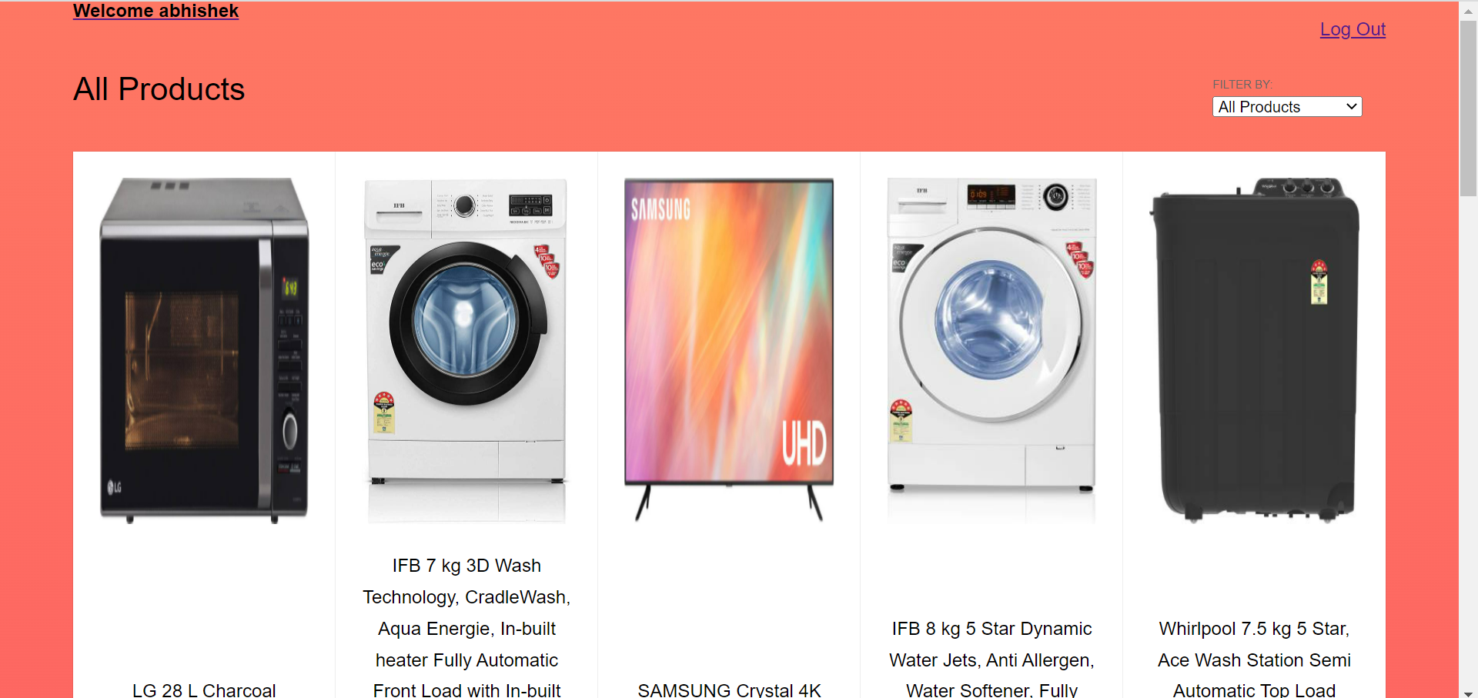
All products

Slide 11
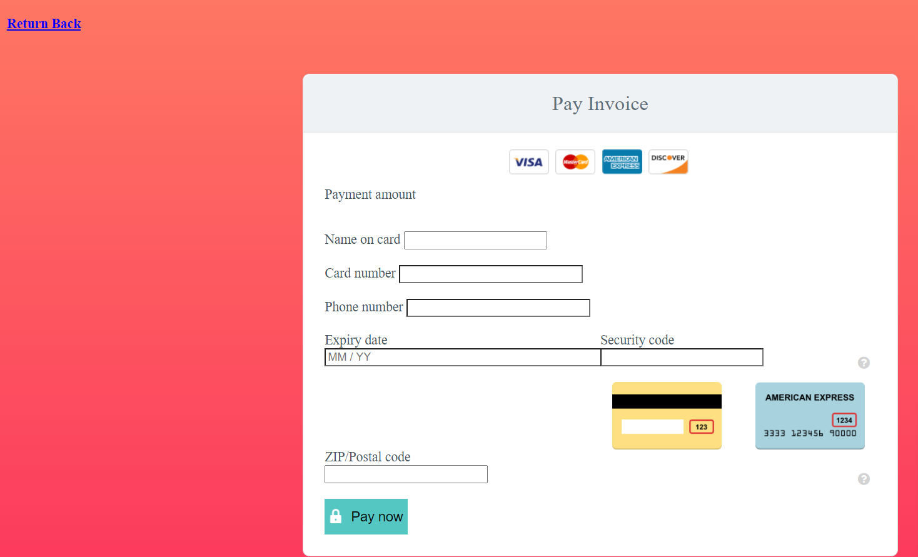
Payment gateway

Slide 12
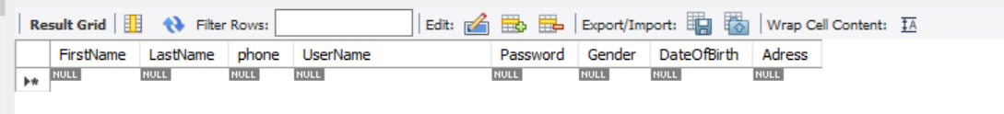
Database tables- customers

Slide 13
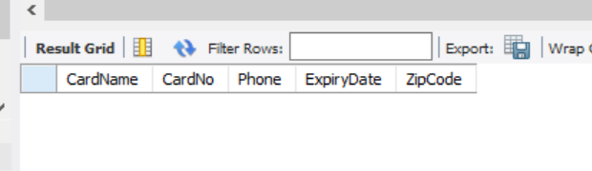
Payment table

Slide 14
Thank you

