Slide 1

Capstone Project Vamshi Kanderao
DSCI-598-01

Slide 2
Shiny in R
Shiny is an open source R package that provides an elegant and powerful web framework for building web applications using R. Shiny helps you turn your analyses into interactive web applications without requiring HTML, CSS, or JavaScript knowledge

Slide 3
A Shiny app is a web page (UI) connected to a computer running a live R session (Server) Users can manipulate the UI, which will cause the server to update the UI’s displays (by running R code)
library(shiny)
ui <- fluidPage()
server <- function(input, output) {}
shinyApp(ui = ui, server = server)

Slide 4
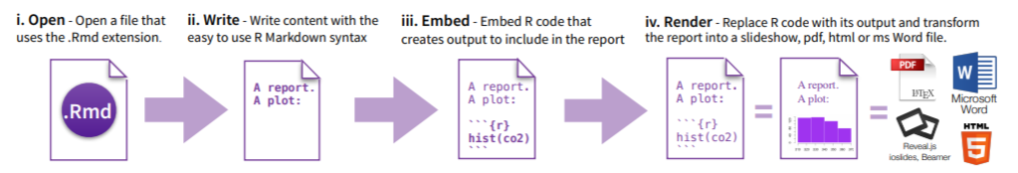
R Markdown
R Markdown is a format for writing reproducible, dynamic reports with R. Use it to embed R code and results into slideshows, pdfs, html documents, Word files and more.

Slide 5


Name : K.Vamshi Mohan Background : Graduate in Civil Engineering from Mahindra Ecole Centrale , Hyderabad (in 2018) . I’ve been learning Python for past 4 years. R programming experience : My first exposure to R programming was in spring of 2019 when I did the course Introduction to R . We were creating web pages/html documents using knit in R-Markdown .
Student Introduction

Slide 6
Packages used:
While learning Shiny ,I’ve also installed and used many available packages like
Shiny
ShinyDashboard
ShinyThemes
RSQLite
Tidyverse,DBI
DT
Dplyr,dbplyr
Ggplot2
readr

Slide 7
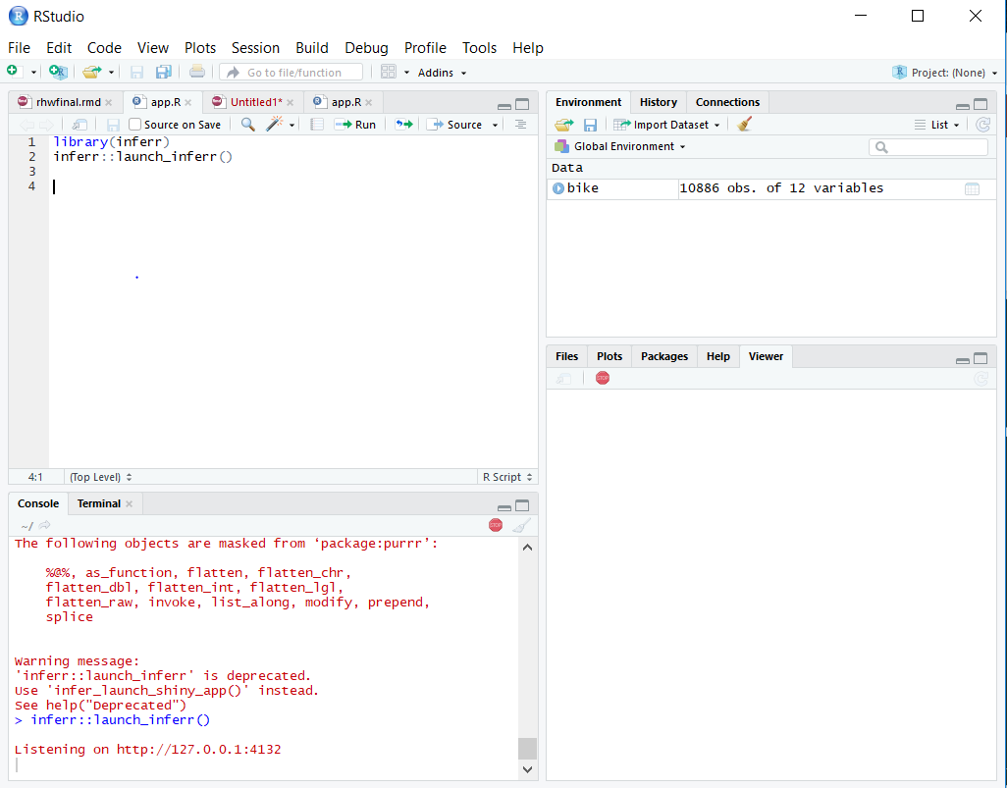
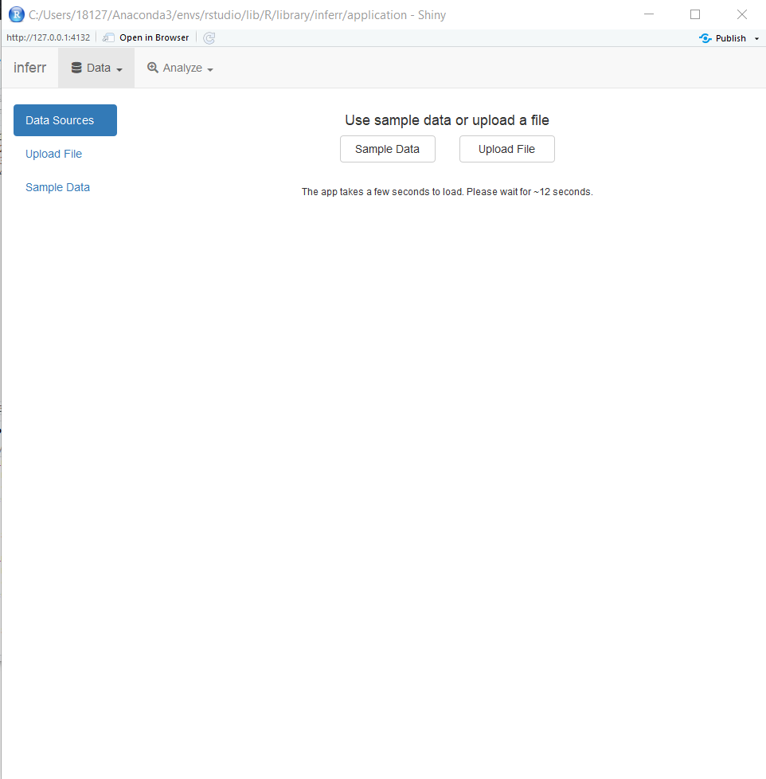
R/Shiny Demo

Slide 8
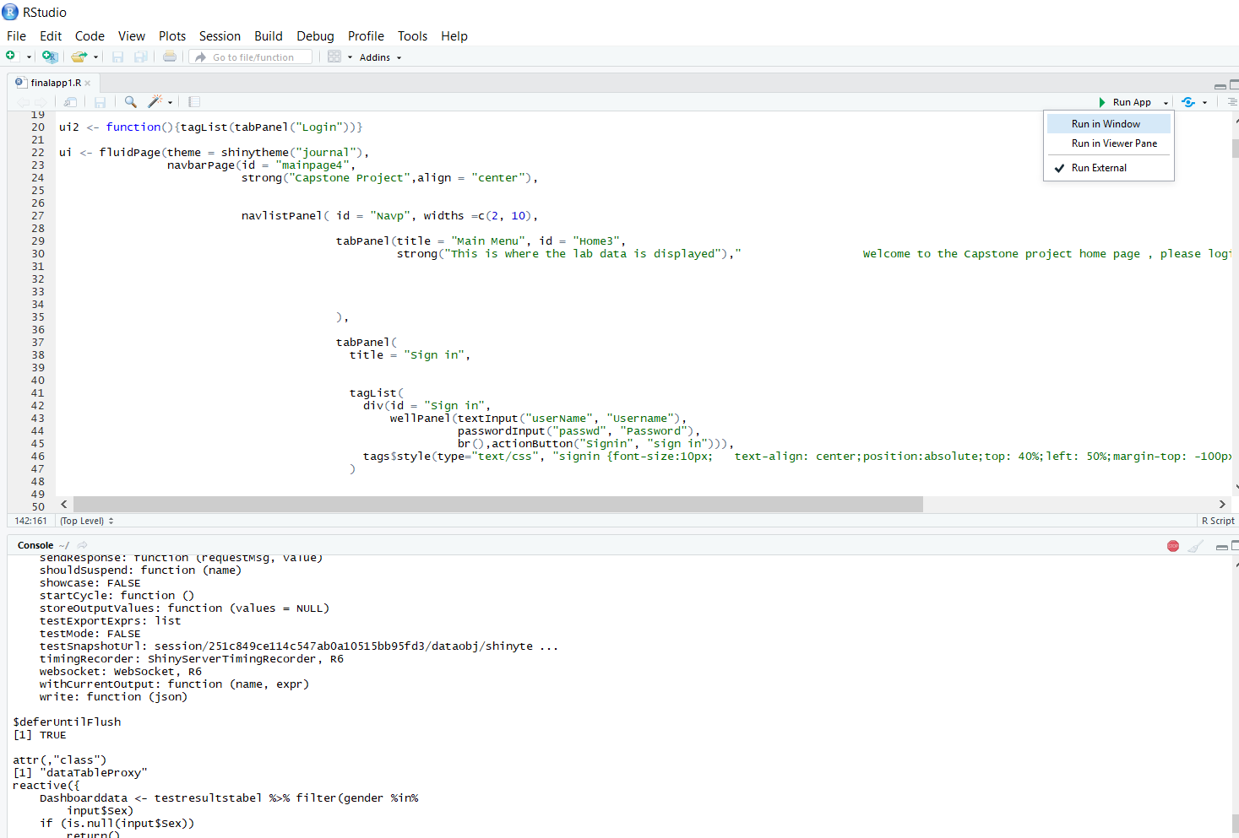

Slide 9
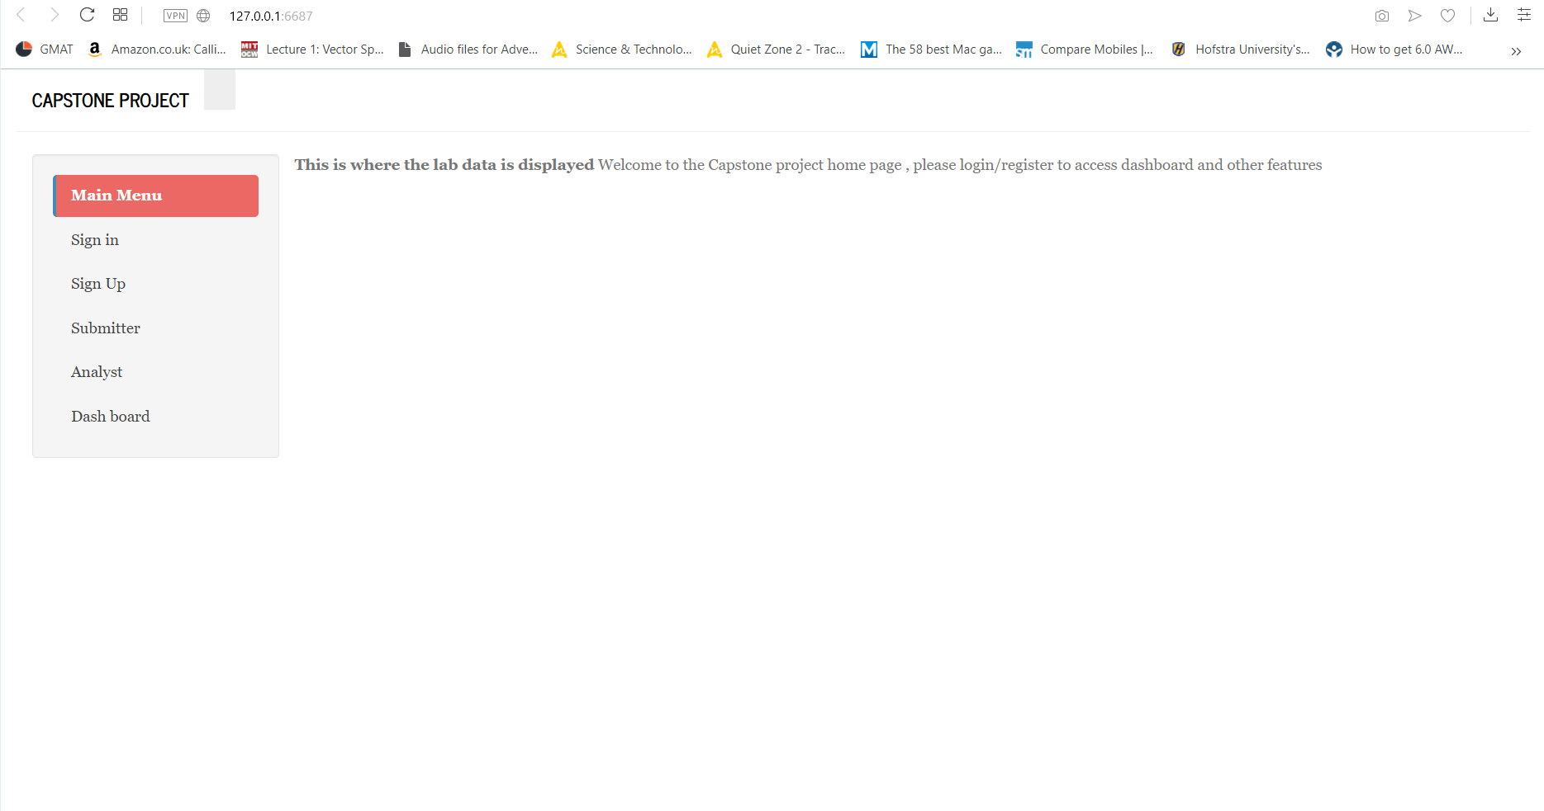

Slide 10
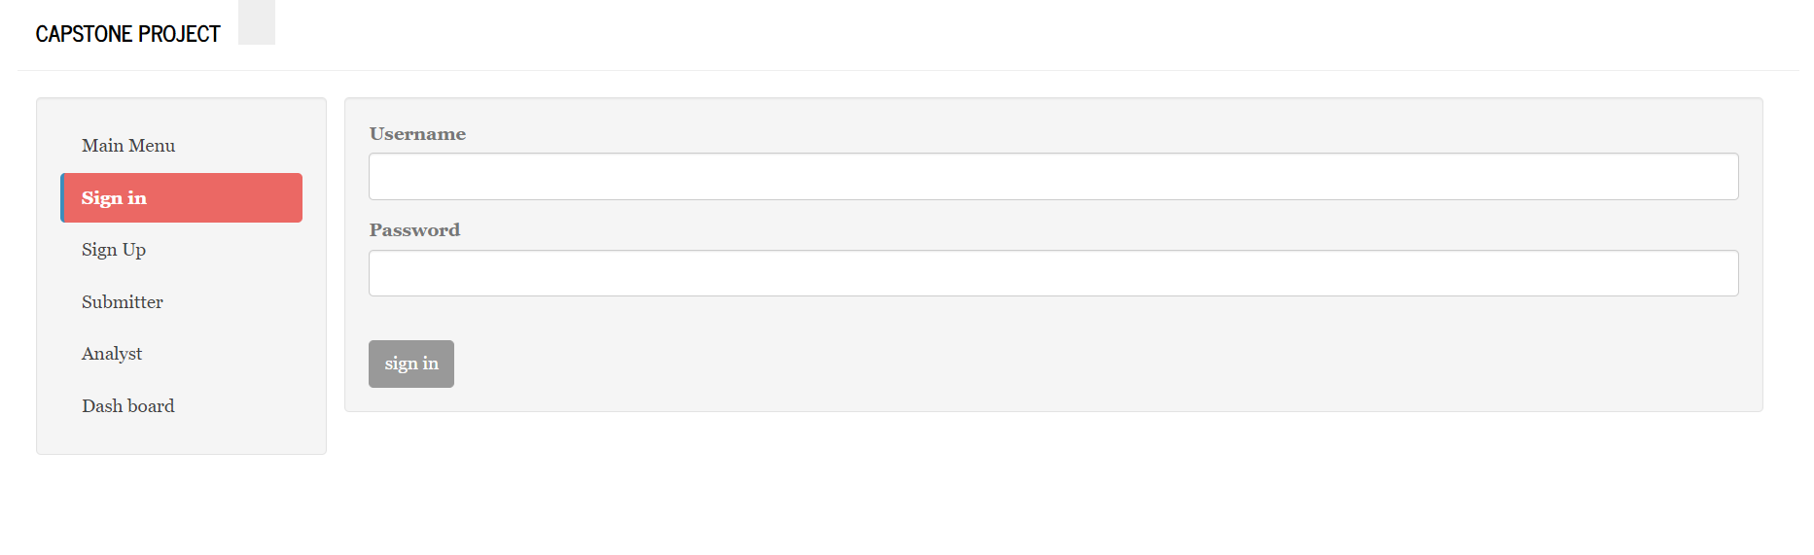

Slide 11
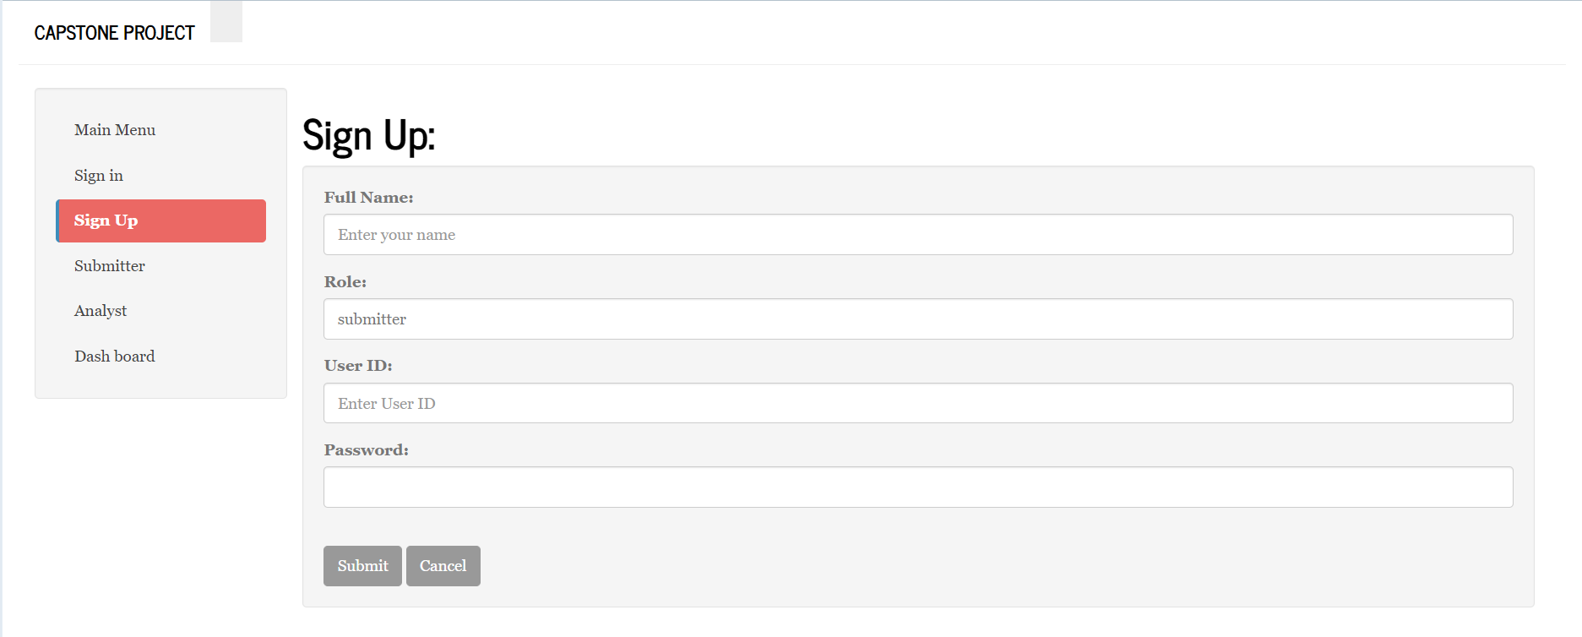

Slide 12
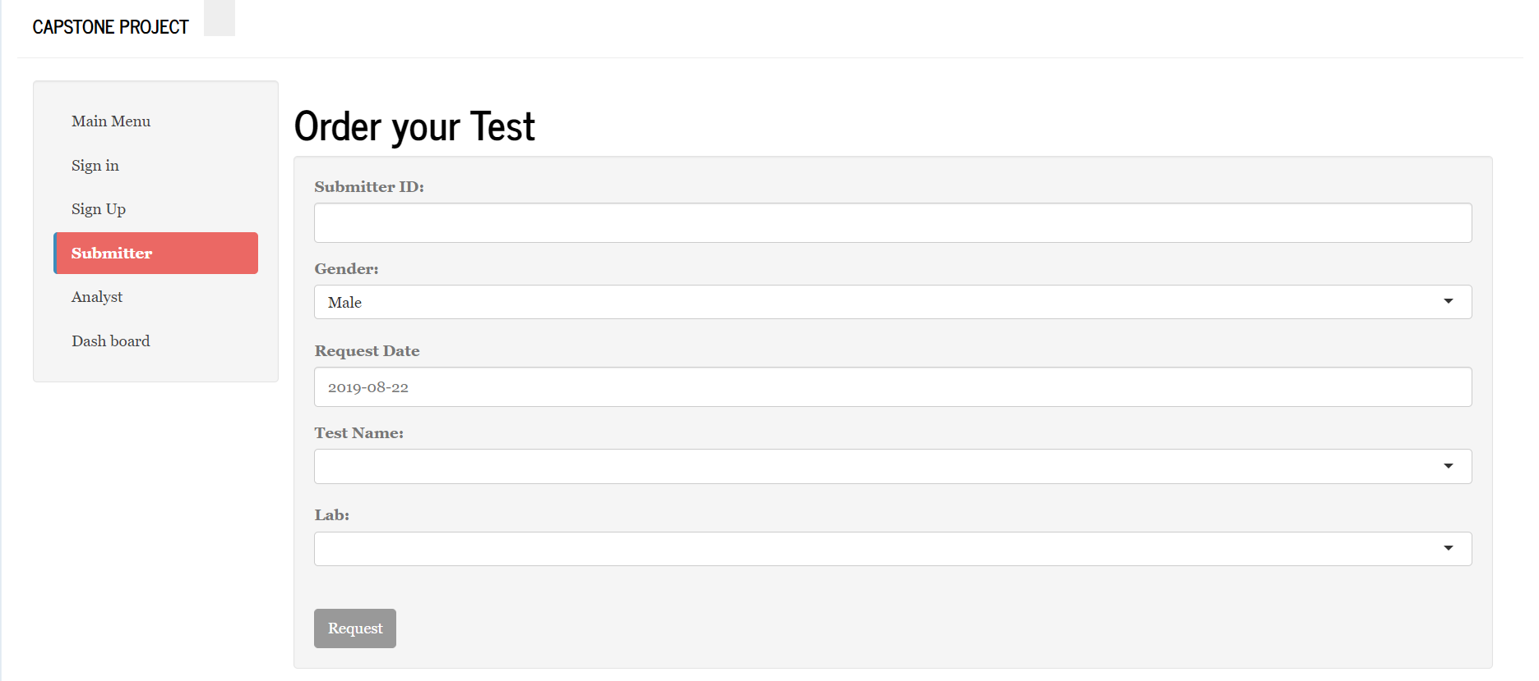

Slide 13
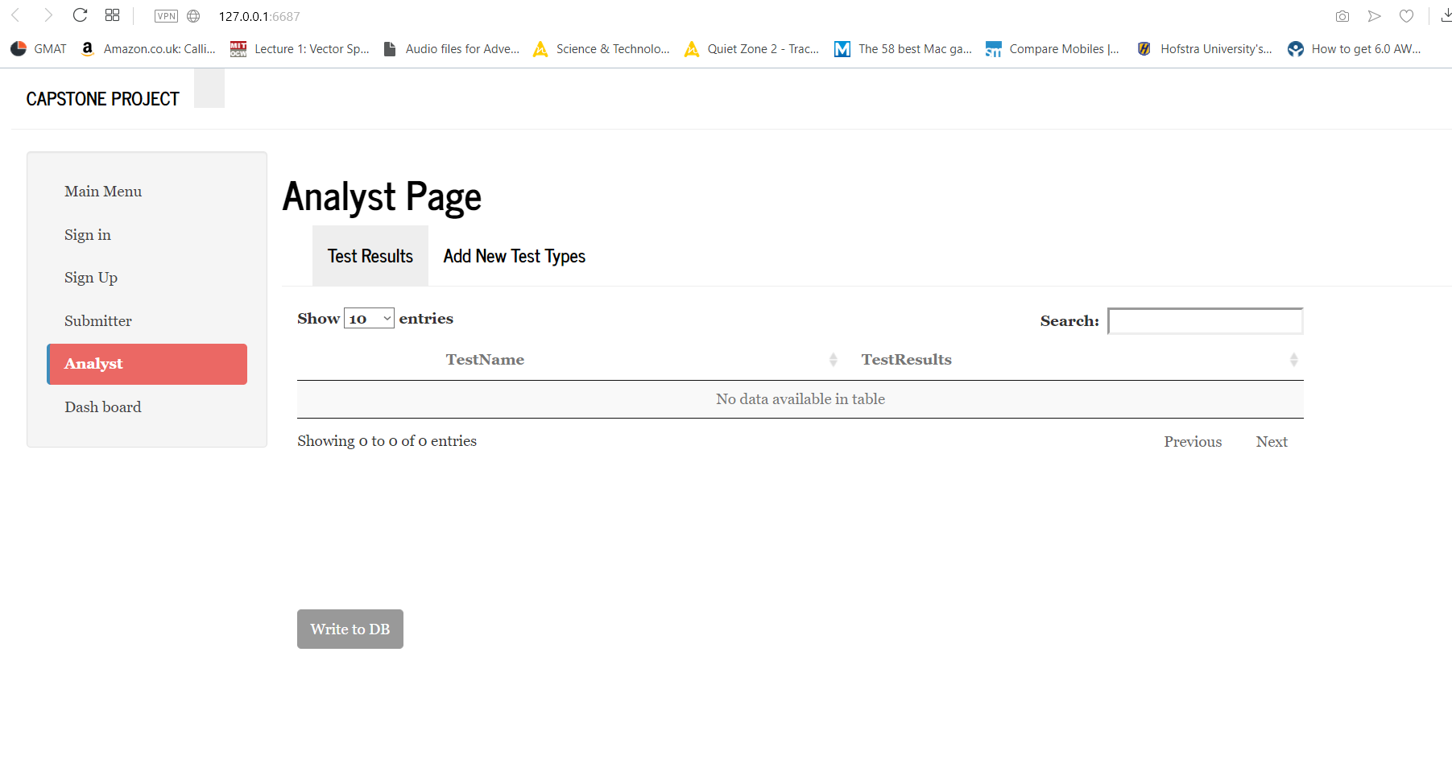

Slide 14
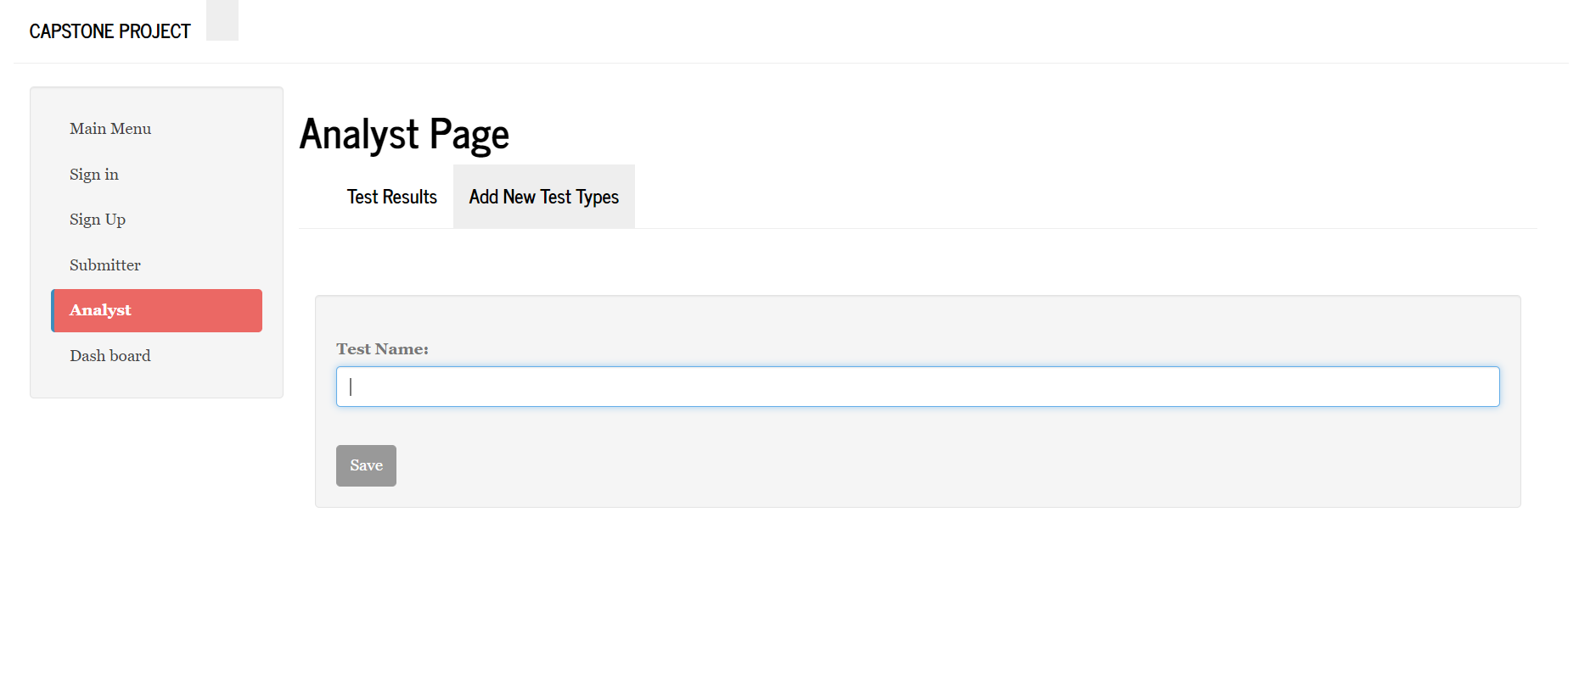

Slide 15
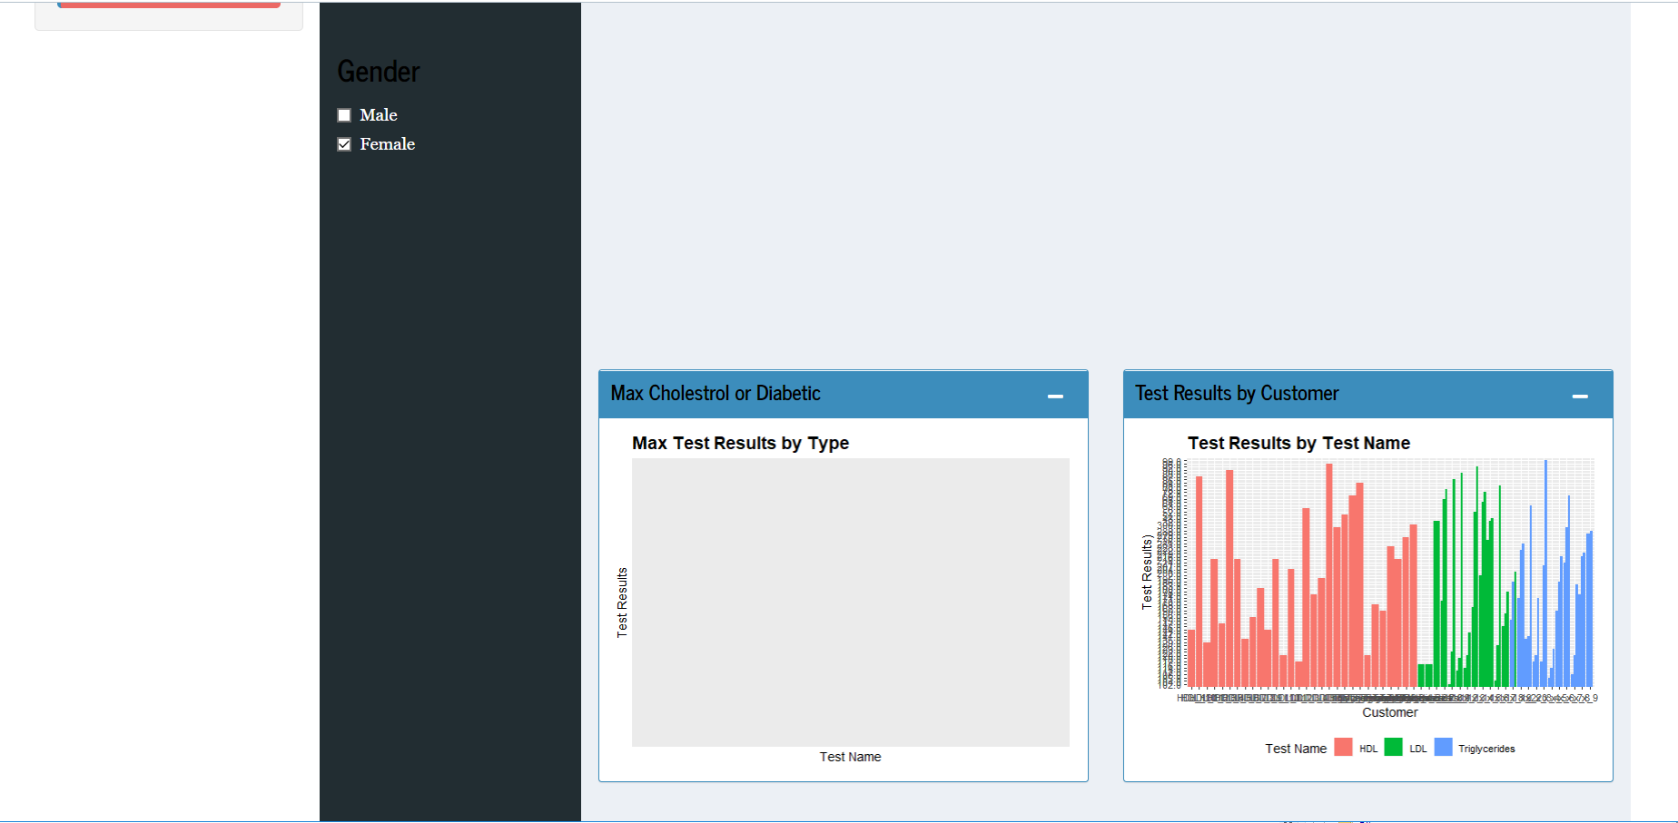
Dashboard

Slide 16
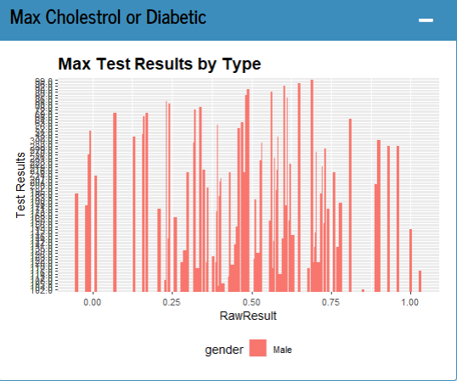
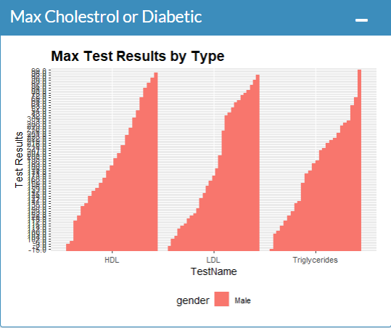
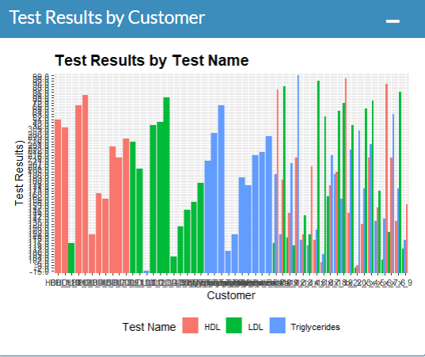

Slide 17
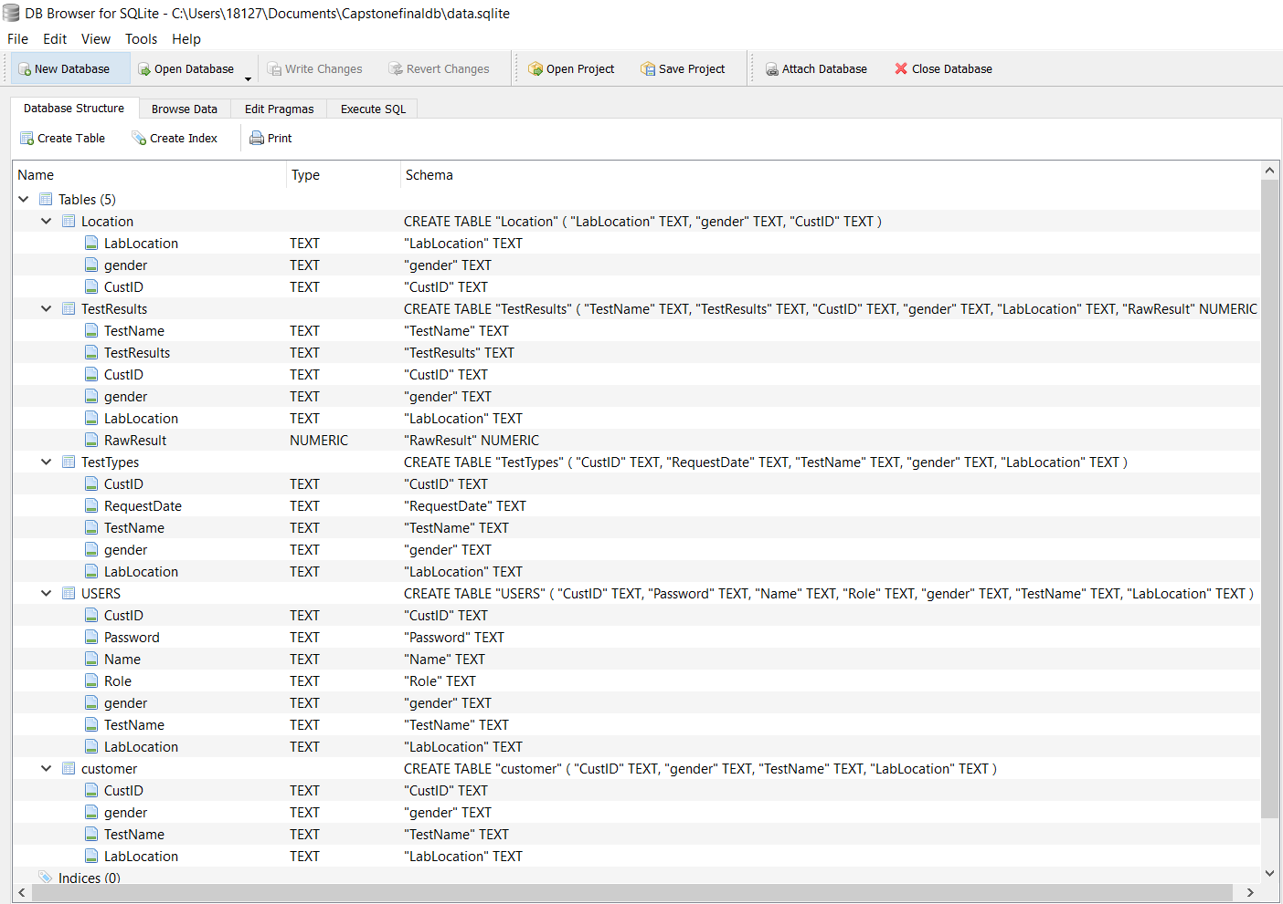

Slide 18
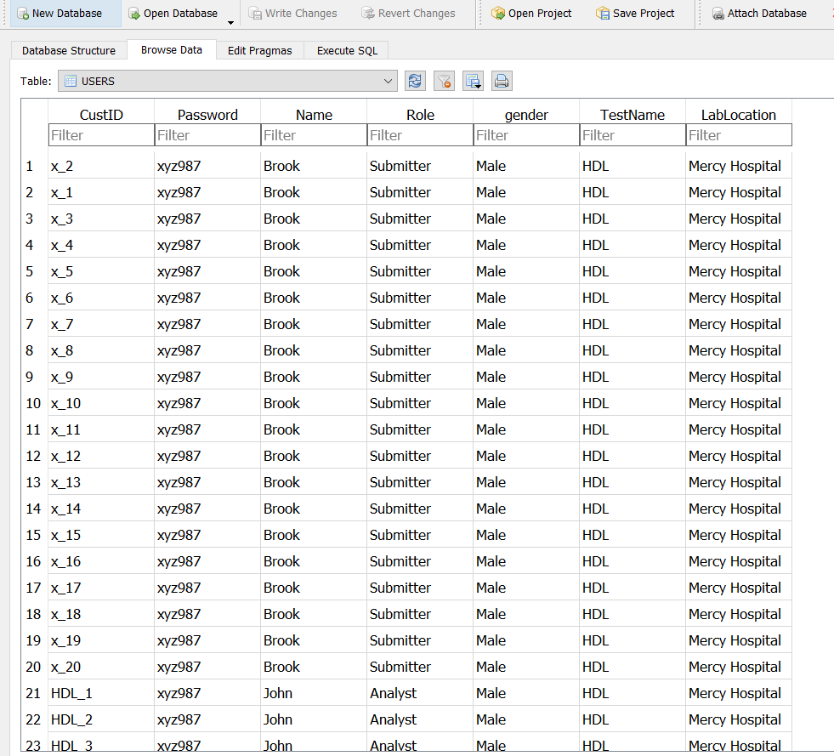

Slide 19
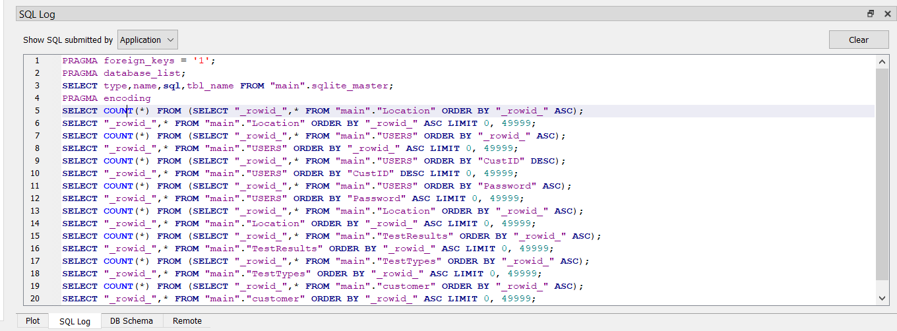

Slide 20
Project member
Project | Student
Sample Submission System
 | Vamshi Kanderao

Slide 21
Tools
MySql
DBSqlite
Rstudio
GitHub

Slide 22
References
https://rmarkdown.rstudio.com/lesson-1.html
https://machinelearningmastery.com/machine-learning-in-r-step-by-step/
YouTube , Stack overflow ,GitHub – Abhinav Agarwal
https://shiny.rstudio.com/tutorial/

Slide 23


