Slide 1

CREATE YCREATYOUR O WN EMOJI WITH University Of New Haven EMOJI’S BASED ON HUMAN REACTIONS Under the guidance of Professor:Shivanjali Khare Submitted by NaveenKrishna Akkanapally Sarath Teja Katta Devi Neeraja Kommineni

Slide 2
Table of Contents
Introduction
Objectives
Approach
Facial Emotions
Libraries Used
Deliverables
CNN, R-CNN, LSTM
ARCHITECTURE
RESULTS

Slide 3
Introduction
An "Emoji" is a small digital image or icon used to express an idea or emotion in electronic communication. Emojis have become so popular in the last year that many companies have become "FOMO," as Dr.Freberg would say. FOMO stands for "Fear of Missing Out" and it is very evident in the amount of emoji marketing recently. Even though our society is addicted to using emojis in text, the emoji phenomenon was actually introduced back in 2001, with the breakthrough of the first smartphones.

Slide 4
OBJECTIVE
To express our emotions or feelings, we now use a variety of emojis or avatars. They serve as human nonverbal cues. They play an important role in emotion recognition, online talking, brand emotion, product reviews, and a variety of other activities.
It is now possible to find out human emotions from photos because of advances in computer vision and deep learning. We will classify human facial emotions in this deep learning research in order to filter and map corresponding emojis or avatars.

Slide 5
APPROACH
Firstly, we create a deep learning model that classifies face emotions in terms of photographs. Then, using an avatar or an emoji, we'll locate the previously defined emotion.
Dataset: FER2013 is the dataset we'll be using for this project (Facial Expression Recognition 2013). It has grayscale face images that are 48*48 pixels in size.

Slide 6
FACIAL EMOTIONS
ANGRY
Sad
Surprise
Fear
Natural
Happy

Slide 7
LIBRARIES USED:
Pandas
Numpy
CV2
datetime
Tensorflow
Tkinter
OS
Seaborn
Matplotlib

Slide 8
DELIVERABLES
We will develop a convolution neural network to recognize face emotions. After that, we use the dataset into our model. Finally, we associate each facial emotion with the appropriate emojis or avatars.
Sample output images
Git hub Repository with all documentation and code
You tube link which demonstrates our work

Slide 9
CNN
CONVOLUTIONAL NEURAL NETWORKS
Convolutional Neural Networks (or convnets) are based on the following principles:
Local receptive fields
Shared weights
Pooling (or down-sampling)

Slide 10
R-CNN
R-CNN (regions with convolutional neural networks) combines rectangular region proposals with properties of convolutional neural networks.
The R-CNN algorithm is a two-stage detection method. The first stage finds a selection of image regions that could contain an object.

Slide 11
LSTM
Long short-term memory (LSTM) is an artificial neural network used in the fields of artificial intelligence and deep learning. Unlike standard feed forward neural networks, LSTM has feedback connections.
LSTM has feedback connections, i.e., it is capable of processing the entire sequence of data, apart from single data points such as images. This finds application in speech recognition, machine translation, etc. LSTM is a special kind of RNN, which shows outstanding performance on a large variety of problems

Slide 12
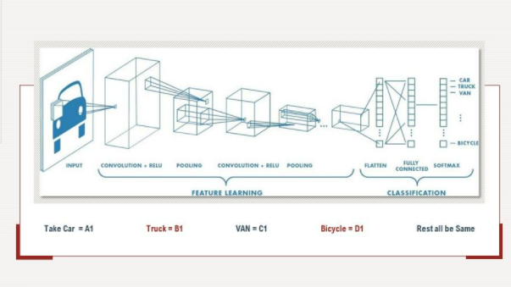
This special neural network architecture takes advantage of the spatial structure of data.
.

Slide 13
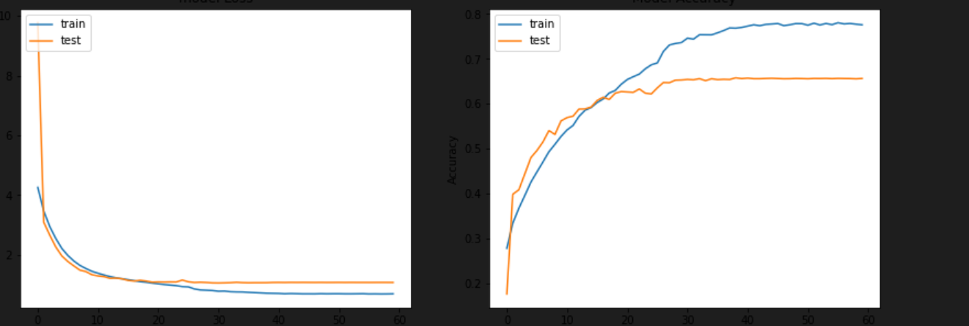
LOSS AND ACCURACY PLOT

Slide 14
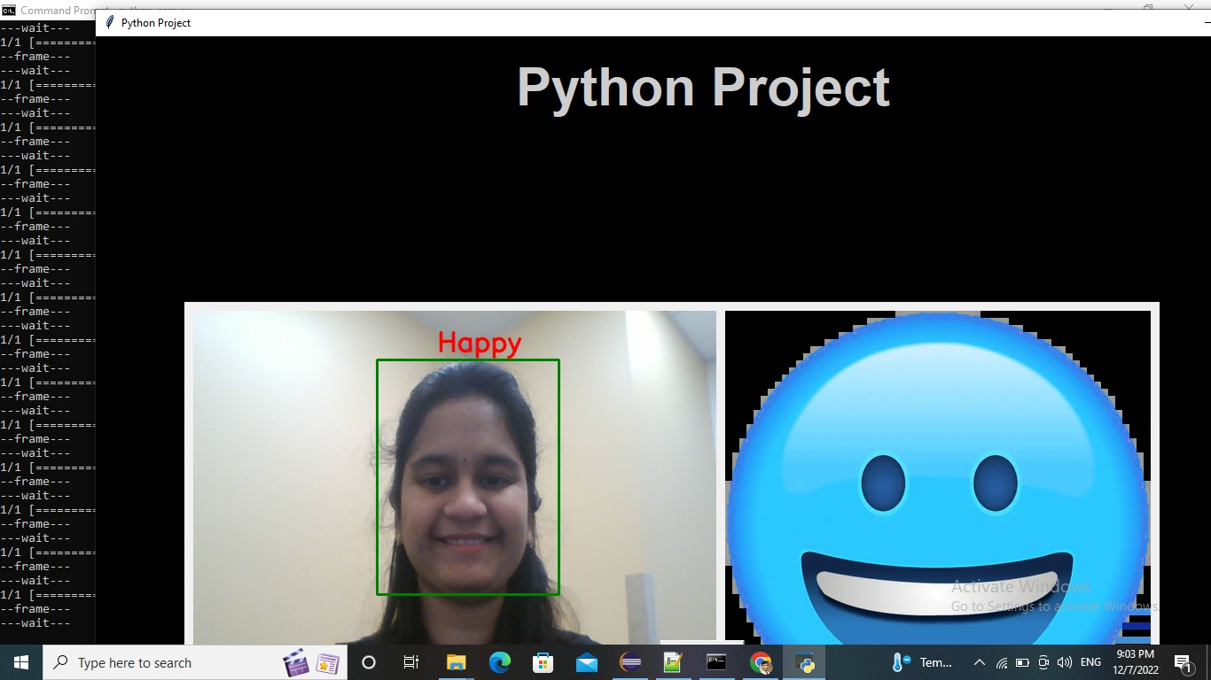
RESULTS

Slide 15

RESULTS

Slide 16
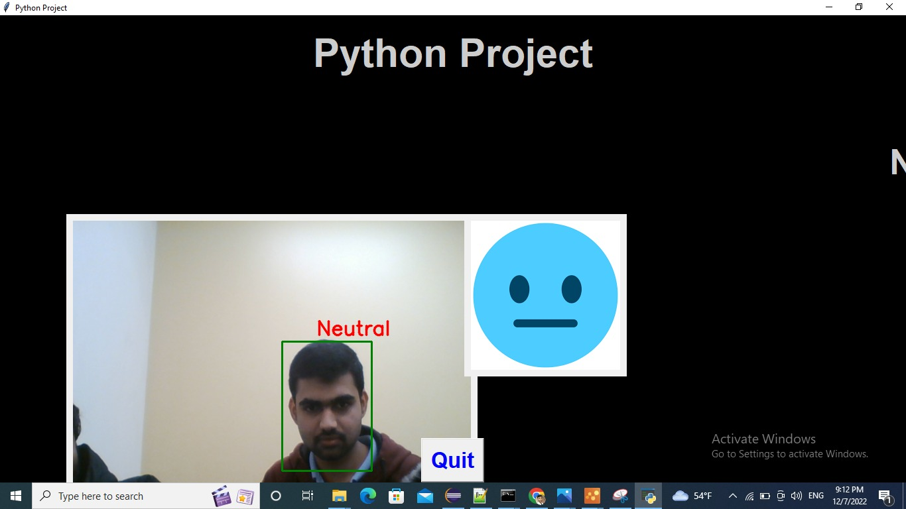
RESULTS

Slide 17

RESULTS

Slide 18
THANK YOU

