Slide 1

National Institute of Technology Patna Department of Computer Science and Engineering Title : Medical Image Segmentation Using BCDU-Net
Presented By:
Banoth Vamshi(2206284)
Naveen Kumar(2106207)
Rudra Singh Chauhan(2206201)
Under Supervision of:
Dr. Arjun Abhishek

Slide 2
TABLE OF CONTENTS
INTRODUCTION
DATA COLLECTION
DATA PREPROCESSING
TRAINING AND TESTING
RESULT
CONCLUSION
REFERENCES

Slide 3
1. INTRODUCTION

Slide 4
Medical Image Segmentation Using CNN Methods
Image segmentation is the process of labelling each pixel of an image with its corresponding class.
Medical image segmentation is a critical component of computer-aided diagnosis (CAD) systems, aiming to improve diagnostic accuracy and reduce reliance on manual interpretation.
An encoder-decoder based approach, like U-Net and its variants, is a popular strategy for solving medical image segmentation tasks.
Key Innovations:
BConvLSTM in Skip Connections → Non-linear feature fusion.
Densely Connected Convolutions → Strengthens feature propagation & reuse.
Batch Normalization (BN) → Accelerates convergence.

Slide 5
Medical Image Segmentation & BCDU-Net
Importance of Medical Image Segmentation:
Key step in Computer-Aided Diagnosis (CAD).
Reduces time, cost, and human error in diagnosis.
Deep learning outperforms traditional methods but requires large labeled Datasets
Deep Learning in Segmentation:
Fully Convolutional Networks (FCN) → First deep learning approach.
U-Net → Improved segmentation using encoding-decoding paths.
Extensions (e.g., Attention Gates, ReNet, DeepLab) refine feature processing.

Slide 6
2. DATA COLLECTION

Slide 7
Dataset
We leveraged a dataset from Kaggle, a leading platform for data sharing with the research community, to support our work.
Data Description
Dataset Contains 2D and 3D CT images along with labeled lung segmentation masks.
Each CT image is of size 512 × 512 pixels.
Dataset Size and Split:
Training Set: 70% of total data
Testing Set: 30% of total data

Slide 8
3. DATA PREPROCESSING

Slide 9
Data Loading and Identification
3D images(*.nii.gz) and corresponding segmentation makes are read using nibabel.
Axial slices are extracted from each 3D image.
These files store volumetric data — meaning they contain multiple 2D image slices stacked together to represent a 3D scan.
Mask Separation
Using a custom function return_axials(vol, seg), each axial slice yields:

Slide 10
Splitting
Data is split into:
Training set: 70% of slices.
Testing set: 30% of slices.
Saving
All arrays are saved as .npy files:
Data_train, data_test (CT images)
Mask_train, mask_test (lung masks)
Train_maska, Test_maska (aroung lung)
FOV_tr, FOV_te (field of view)

Slide 11
4. TRAINING AND TESTING

Slide 12
BCDU-Net: Encoding & Decoding Path Encoding Path(Contracting Path) 4-Step Process:
3×3 Convolutions + ReLU + 2×2 Max Pooling
Feature maps double at each step 🔹 Densely Connected Convolutions:
Prevents redundant features
Enhances feature reuse & flow
Mitigates vanishing/exploding gradients
Decoding Path (Expanding Path):
🔹 Up-Sampling & Up-Convolution:
Restores original image size 🔹 BConvLSTM in Skip Connections:
Processes feature maps non-linearly
Captures spatial & temporal dependencies

Slide 13
Batch Normalization (BN) in BCDU-Net
🔹 Purpose:
Stabilizes neural network training
Standardizes inputs by subtracting batch mean & dividing by batch standard deviation
Speeds up training by reducing internal covariate shift
Improves model performance with slight regularization effect
Enhances network stability in deep architectures
🔹 Key Benefits:

Slide 14
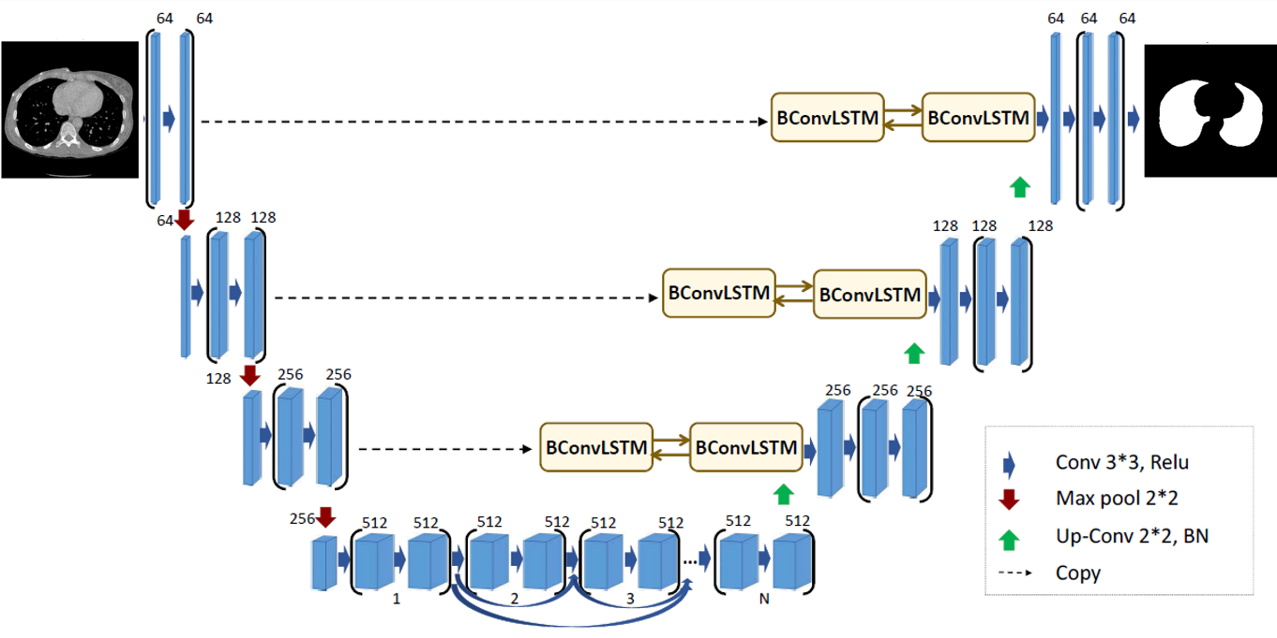
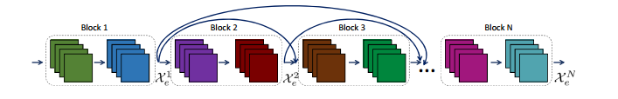
BCDU-Net with bi-directional ConvLSTM in the skip connections and densely connected convolution.
Dense layer of the BCDU-Net

Slide 15
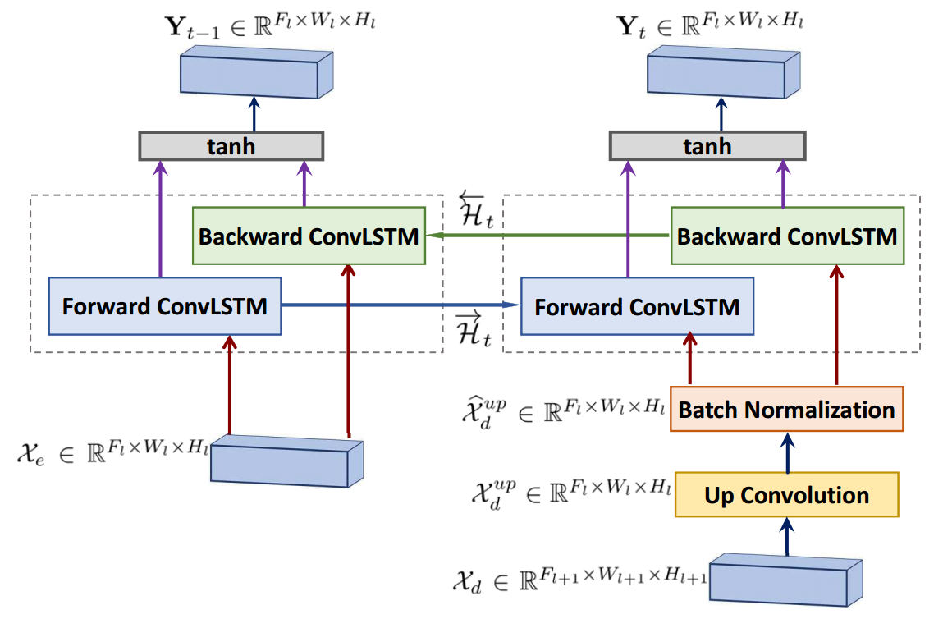
Bi-directional ConvLSTM in CUA-Net

Slide 16
5. RESULTS

Slide 17
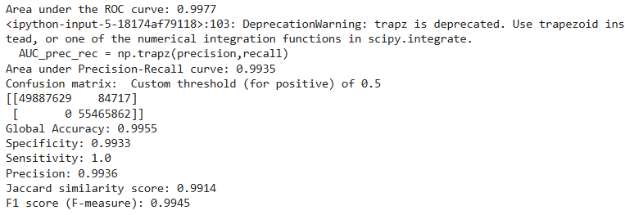
Evaluation Metrics:
evaluation metrics means and interpret the performance of your segmentation model based on the output you've shared:
AUC-ROC, AUC-PR, Accuracy, Sensitivity (Recall), Jaccard Similarity Score, F1 Score (F-measure)

Slide 18
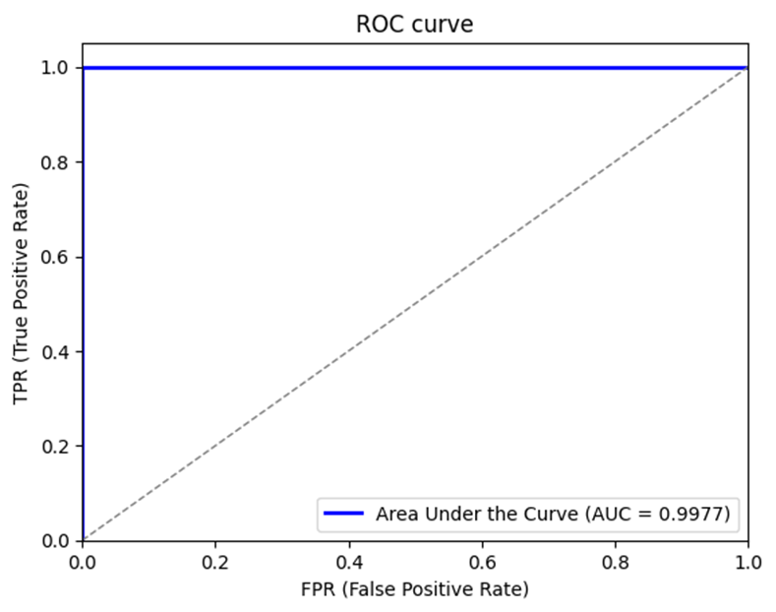
Area Under the ROC Curve (AUC-ROC): 0.9977
What it measures: How well the model distinguishes between classes across various thresholds.
Interpretation: A score of 0.9977 Indicates an excellent ability to differentiate between lung and non-lung regions, reflecting near-perfect classification performance.

Slide 19
Area Under the Precision-Recall Curve (AUC-PR):
What it measures: How precise the model is across different recall levels.
Interpretation: A score of 0.9935. Indicates excellent model performance across different recall levels, with strong ability to distinguish between classes.
Accuracy: 99.55%
Interpretation: About 99.55% of the total pixels were classified correctly, showing very high accuracy.

Slide 20
Sensitivity (Recall): 100%
Interpretation: The model catches all positive (lung) pixels. No true lung regions were missed
Jaccard Similarity Score: 99.14%
Interpretation: The predicted lung region overlaps almost completely with the actual region, indicating very high segmentation accuracy.
F1 Score (F-measure): 99.45%
Interpretation: Reflects an excellent balance between the model’s perfect recall and its high precision, resulting in a near-perfect overall performance.

Slide 21
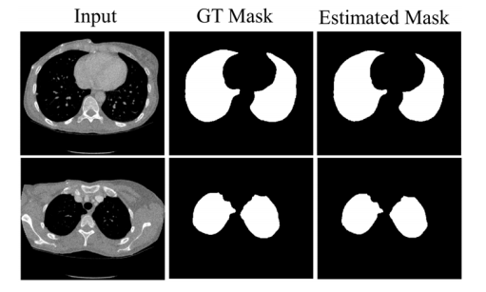
Segmentation Results:
BCDU-Net on Lung dataset.

Slide 22
6. CONCLUSION

Slide 23
In this project, we successfully implemented and evaluated the BCDU-Net architecture for the task of lung segmentation in medical CT images. BCDU-Net, an enhanced version of the popular U-Net model, integrates Bidirectional ConvLSTM units and densely connected convolutions, which helped the model better capture spatial and temporal features within the images.
Through extensive training and testing on CT image datasets, the model demonstrated strong recall (100%), meaning it accurately identified all lung regions. It also achieved high precision (99.36%), indicating very few false positives. Consequently, the F1 score (99.45%) and AUC-ROC (0.9977) confirm a highly reliable performance.

Slide 24
This project not only provided hands-on experience in deep learning-based medical image analysis but also highlighted the challenges of achieving a balance between sensitivity and specificity in real-world healthcare applications.
Key Takeaways:
BCDU-Net effectively segments lung regions with high sensitivity.
There's room to improve precision to reduce false positives.
Advanced architectures like BCDU-Net are promising for clinical support tools.

Slide 25
7. REFERENCES
P. Liskowski and K. Krawiec. Segmenting retinal blood vessels with deep neural networks. IEEE transactions on medical imaging, 35(11):2369–2380, 2016.
M. Z. Alom, M. Hasan, C. Yakopcic, T. M. Taha, and V. K. Asari. Recurrent residual convolutional neural network based on u-net (r2u-net) for medical image segmentation. arXiv preprint arXiv: 1802.06955, 2018.
J. Long, E. Shelhamer, and T. Darrell. Fully convolutional networks for semantic segmentation. In Proceedings of the IEEE conference on computer vision and pattern recognition, pages 3431–3440, 2015

Slide 26
THANK YOU

