Slide 1
Financial Inspiration
Presented by
Vamshi Rajarikam
Kranthi dodla
Sai Krishna ravilla
Venkatesh kandula

Slide 2
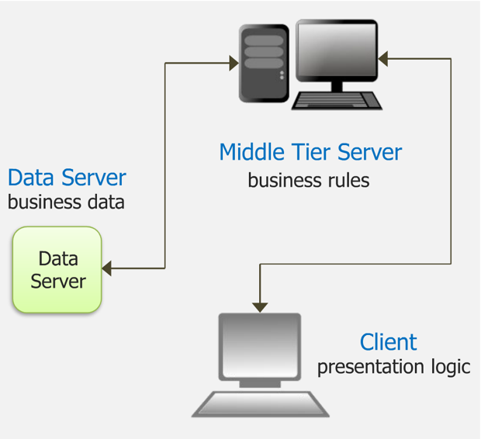
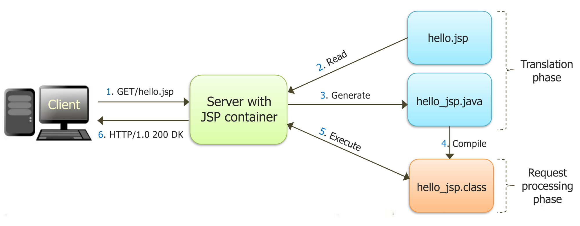
System architecture

Slide 3
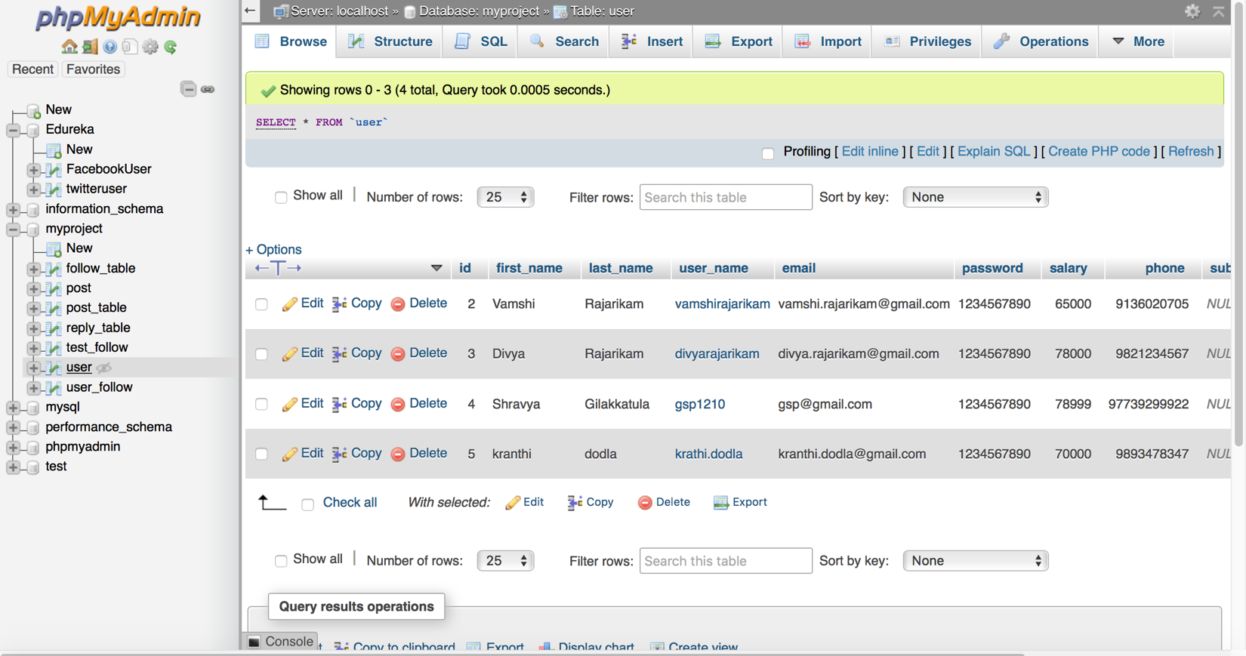
Phpmyadmin

Slide 4
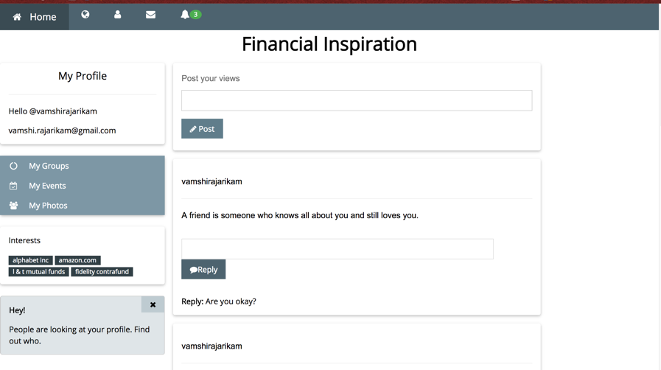
interface

Slide 5
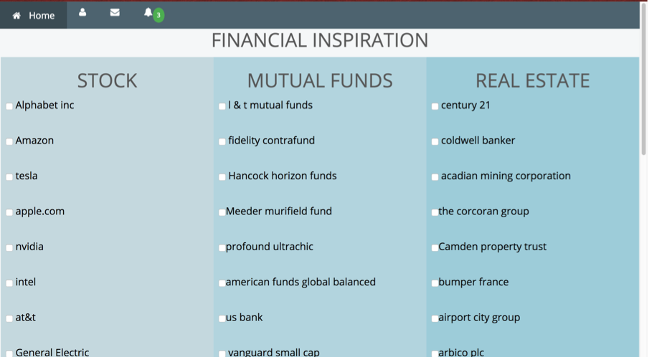
Follow page

