Slide 2

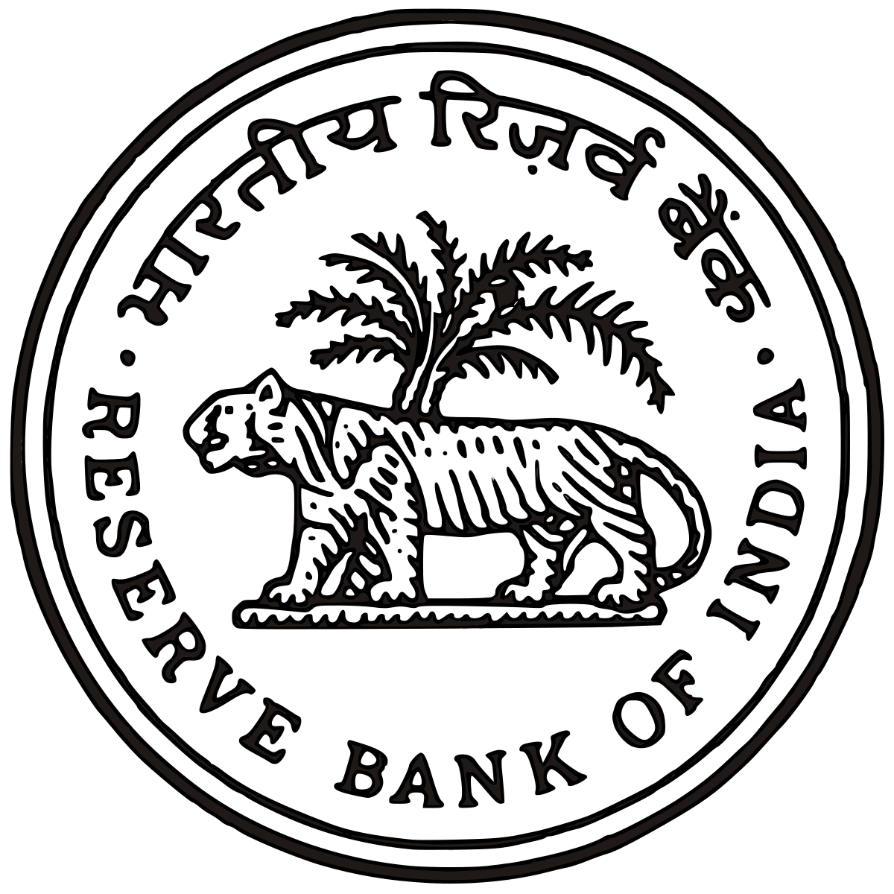
Indian payment systems

Slide 3
What is a Payment System ?
Any system used to settle financial transactions through the transfer of monetary value, and includes the institutions, instruments, people, rules, procedures, standards, and technologies that make such an exchange possible.
Payment & Settlement Systems Act 2007
https://rbidocs.rbi.org.in/rdocs/Publications/PDFs/86706.pdf

Slide 4
Payment Gateway
Transfer of information between a Payment Portal and Payment Service Provider
End to End Encryption
Merchant Service
Middleman
Examples - Razorpay, CitrusPay and CCAvenue

Slide 5
Payment Service Provider
Accepting electronic payments from multiple channels through a single window.
Technical Payment Processing.
Money collection.
Responsible for all the contracts with card acquirers and banks and for the settlement of the funds collected.
PayPal, PayU and Due are examples of PSP’s.
Can also provide Payment Gateway Services.

Slide 6
Payment Service Provider
TLS Encryption
Payment Service Provider
Payment Processing
Acquiring Bank
Card Network
Issuing Bank
Contracts
Settlements
Reconciliation
Collection
Merchant Portal
Payment Gateway

Slide 7
Payment Aggregator
A payment aggregator is a payment service provider that registers merchants, known as sub-merchants, directly under its own merchant identification number (MID) to process e-commerce and mobile payment transactions through a single master account.
A payment aggregator (a.k.a. merchant aggregator) is a service provider that aggregates and provides various payment acceptance services to merchants.
It enables merchants to accept all payment modes, without having to set up separate accounts with banks or with each payment service providers or card companies.
Aggregators function as the glue that helps entities like businesses, governments and donors easily connect with a variety of payment platforms--like mobile money services or banks—and the customers who pay via those services.
Google, Payubiz, Paytm, PayPal, Google Checkout and Amazon Payments are examples.

Slide 8
Types of Payment Methods
Cash
Cheque
Pre-Paid Cards
Credit Card
Debit Card
Mobile Wallet
Mobile Banking
Internet Banking
IVR
ATM
PoS

Slide 9
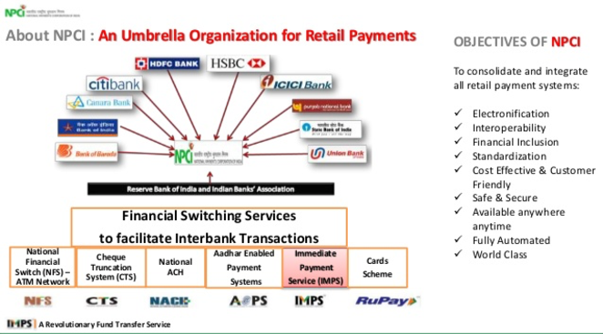

Slide 10
ISO 20022 – XML Messaging
ISO 20022 is an ISO standard for electronic data interchange between financial institutions. It describes a metadata repository containing descriptions of messages and business processes, and a maintenance process for the repository content.
The ISO 20022 Repository consists of two major parts:
The Data Dictionary
The Business Process Catalogue
The Data Dictionary will consist of the Business Concepts, Data Types and Message Concepts.
The Business Process Catalogue will consist of the description of the financial business model, financial business transactions including message definitions and the ISO20022 compliant message schemas.
The Business Domains included are Payments, Securities, Trade Services, Cards and Forex.
https://www.iso20022.org/

Slide 11
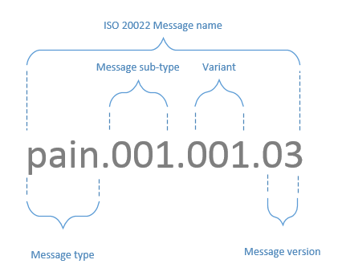
XML Structure – Payments Initiation

Slide 12
XML Structure - Payments Initiation
Unique Message ID – Unique, <=35 characters, Mapped to Client Reference Number.
Payment Information Blocks – Grouping of Payment Instructions at Account Level per block.
Payment Information ID – First Tag in each Payment Information Block and not used again.
Payment Information : Category Purpose – Requests for Special Handling.
Payment Information – Requested Execution Date - One file with two payment information blocks with different dates.
Payments – End to End ID.
Remittance Information – Rejected/Returned Payment Information Record.

Slide 13
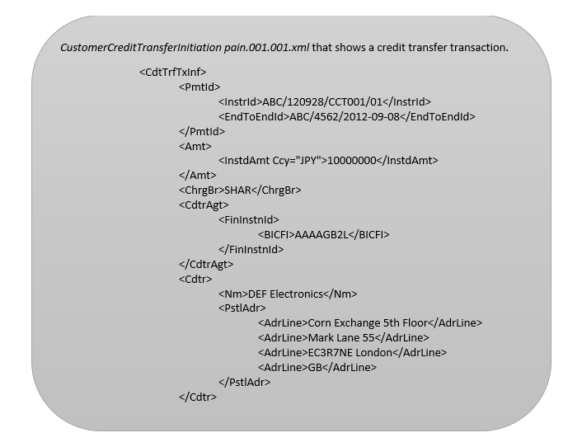
XML Message – Example

Slide 14
NFS – National Financial Switch
Largest network of shared Automated Teller Machines (ATMs) in India.
Inter-connecting the ATMs in the country and facilitating convenience banking.
Networking of ATM’s, Switching of ATM Transactions, Settlement of ATM Transactions.
Tie up with Discover Financial Service (DFS), Japan Credit Bureau (JCB) and China UnionPay International (CUPI).
https://www.npci.org.in/product-overview/national-financial-switch-product-overview

Slide 15
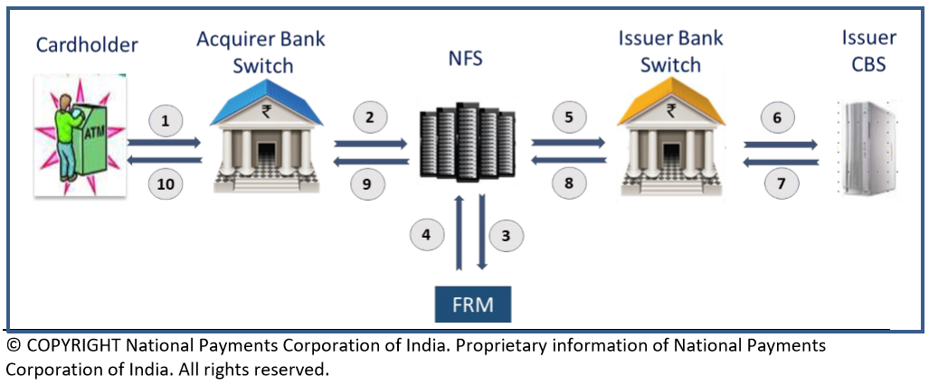

Slide 16
RuPay Card
Card Payment Scheme.
Offers a domestic, open-loop, multilateral system.
Earlier all the card transactions were routed through other payment schemes like Visa and Mastercard.
Prepaid Cards, Debit Card and Credit Cards, RuPay Global are available.
https://www.npci.org.in/product-overview/rupay-product-overview

Slide 17
RuPay Contactless
Based on NFC Technology, i.e. Near Field Communication.
Transport (Metro, Bus etc.), Toll, Shopping etc.
Low Value Payments (LVPs).
Supports online (contact & contactless) & off-line (contactless) transactions.
Supports the following PoS Transactions only. Purchase, Service Creation, Money Add, Balance Inquiry.
https://www.npci.org.in/tap-go-faqs

Slide 18
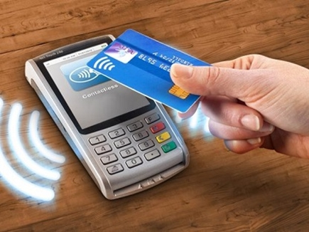
Contactless Transaction

Slide 19
UPI – Unified Payments Interface
Instant Payment System.
Powers multiple bank accounts into a single Mobile Application using Virtual Payment Address (VPA).
24*7 and 365 days.
Merchant Payments, Bill Payments & Complaints, Barcode Payments.
Single Click 2 Factor Authentication.
https://www.npci.org.in/product-overview/upi-product-overview

Slide 20
Participants in UPI
Payer PSP
Payee PSP
Remitter Bank
Beneficiary Bank
NPCI
Bank Account holders
Merchants

Slide 21
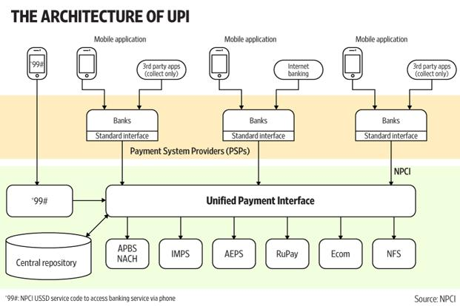
UPI Architecture

Slide 22
BHIM – Bharat Interface for Money
An app for easy and quick payment transactions using UPI.
Virtual Payment Address (UPI ID), Account number and QR Scan.
Collect Money Additionally through BHIM App.
Check your Transaction History.
Raise Complaints.
https://www.npci.org.in/product-overview/bhim-product-overview

Slide 23
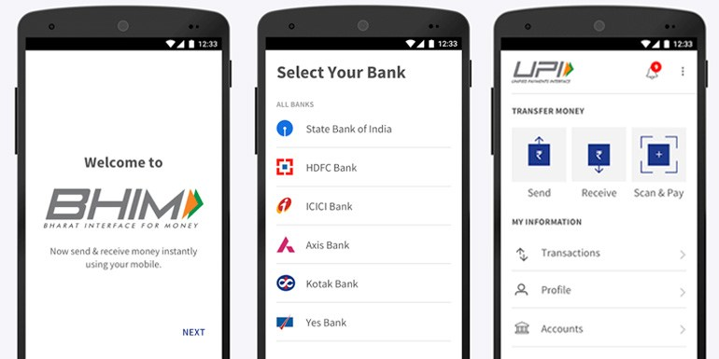
BHIM App

Slide 24
IMPS – Immediate Payment Service
Real Time Payment Service.
24X7 using Mobile, Internet, ATM, SMS, Branch and USSD(*99#).
Currently on IMPS, 243 members are live which includes banks & PPIs.
Mobile number of the beneficiary.
https://www.npci.org.in/product-overview/imps-product-overview

Slide 25
Participants of IMPS
Remitter (Sender)
Beneficiary (Receiver)
Banks
National Financial Switch - NPCI

Slide 26
Funds Transfer using IMPS
Using Mobile number & MMID (P2P)
Using Account number & IFS Code (P2A)
Using Aadhaar number (ABRS)

Slide 27
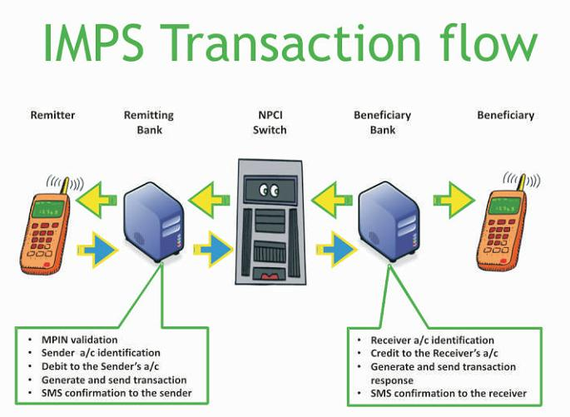
IMPS Architecture

Slide 28
NETC – National Electronic Toll Collection
Interoperable Nationwide Toll Payment Solution.
Clearing house services for Settlement and Dispute Management.
FASTag is a device that employs Radio Frequency Identification (RFID) technology for making toll payments.
FASTag (RFID Tag) is affixed on the windscreen of the vehicle.
FASTag offers the convenience of cashless payment along with benefits like - savings on fuel.
https://www.npci.org.in/netc

Slide 29
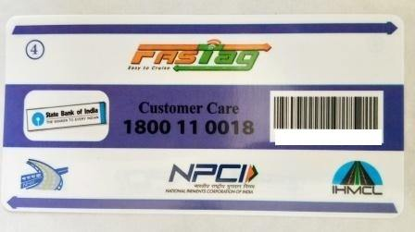
Fast Tag

Slide 30
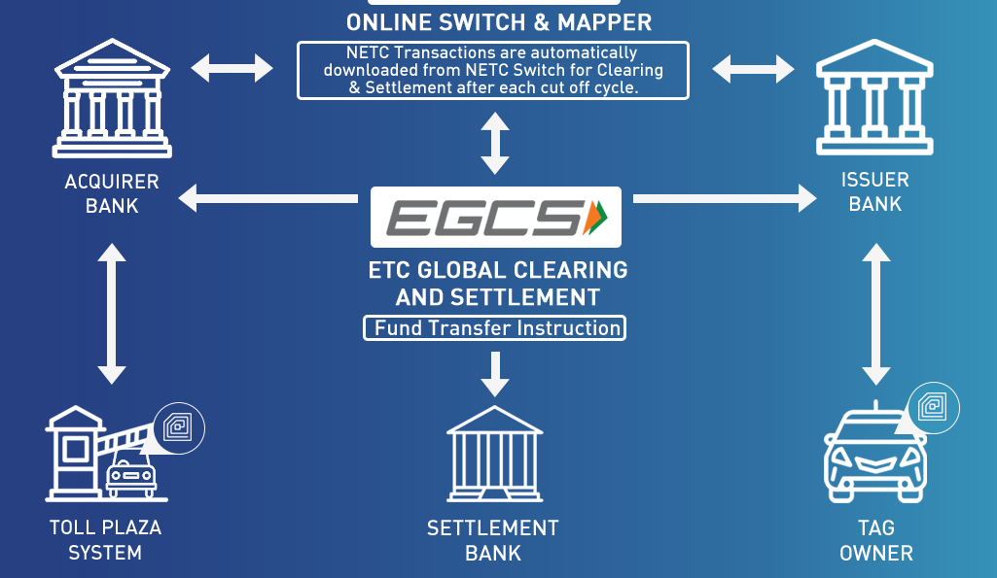
NETC Transaction Flow

Slide 31
Bharat Bill Pay
Integrated Online Platform.
Multiple modes of payment and provides instant confirmation of payment via an SMS or receipt.
Can be initiated through multiple payment channels, i.e. IB, MB, POS, ATM etc.
Facilitates bill payments, i.e. via Cards, NEFT, UPI, Wallets etc.
Bharat Bill Payment Central Unit (BBPCU).
Bharat Bill Payment Operating Unit (BBPOU).
https://www.npci.org.in/product-overview/bharat-billpay-product-overview

Slide 32
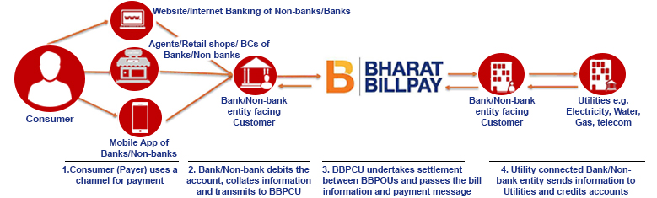
Bharat Bill Pay Transaction

Slide 33
NUUP - National Unified USSD Platform
Allows the Banks and TSPs to seamlessly integrate.
Dialing *99#, a “Common number across all Telecom Service Providers (TSPs)”.
Sending and Receiving interbank account to account funds, balance enquiry, setting / changing UPI PIN.
*99# service is currently offered by 41 leading banks & all GSM service providers.
13 different languages including Hindi & English.
https://www.npci.org.in/product-overview/99-product-overview

Slide 34
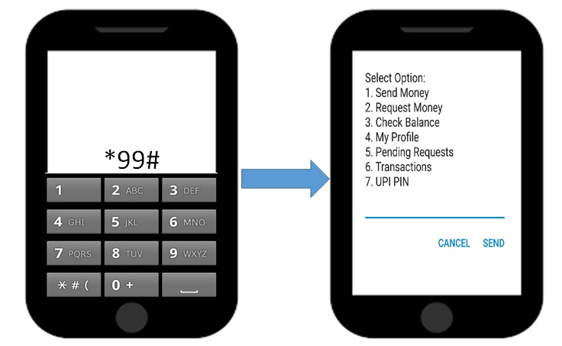
USSD Transaction

Slide 35
NACH - National Automated Clearing House
Web Based Solution for ECS.
Consolidate multiple ECS systems.
Both transaction and file based transaction processing capabilities.
Bulk transactions towards distribution of subsidies, dividends, interest, salary, pension etc.
Bulk transactions towards collection of payments pertaining to telephone, electricity, water, loans etc.
https://www.npci.org.in/product-overview/national-automated-clearing-house-product-overview

Slide 36
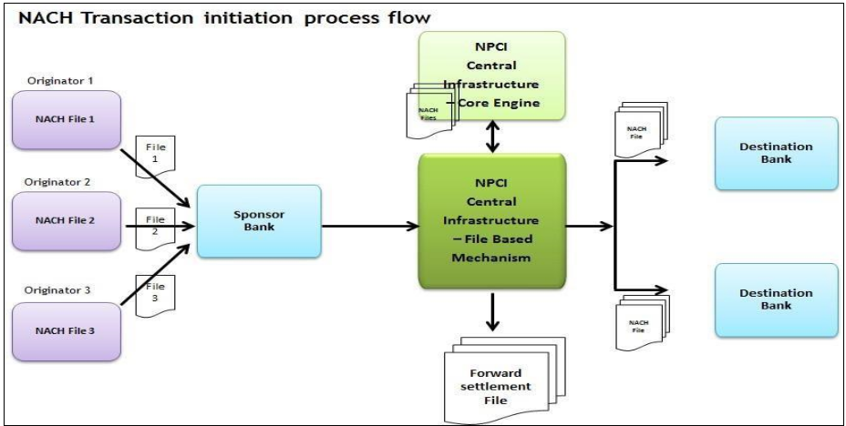

Slide 37
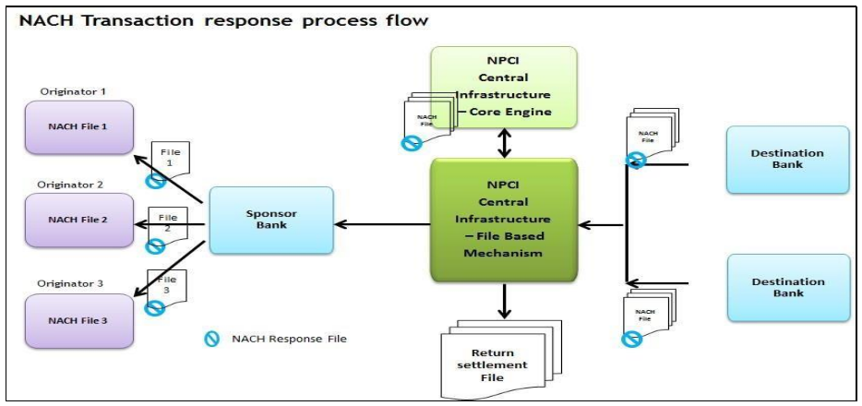

Slide 38
CTS – Cheque Truncation System
Physical instrument is truncated at presenting bank end (either at branch level or service branch level).
The images & data of collected instrument captured at presenting bank would travel electronically to drawee bank for processing same day.
The return cycle would be completed next day & settlement is completed on completion of return cycle.
The customer would get funds on completion of settlement process. Further all clearing locations are divided in 3 regional grids.
All Clearing locations are of a grid are settled together on T+1 basis.
Extended cut-off time, MICR amount encoding not required, MICR and Image data travel together, No cheques being lost/tampered/pilfered, Cost involved in paper movement eliminated and Grid implementation allowing better liquidity management for banks.
https://www.npci.org.in/product-overview/cheque-truncation-system-product-overview

Slide 39
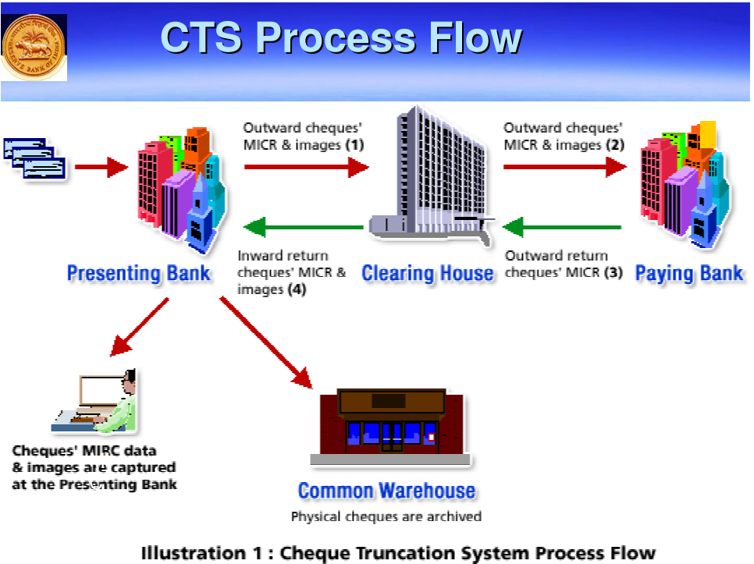
CTS Flow

Slide 40
AEPS – Aadhaar Enabled Payment System
Interoperable financial inclusion transaction at PoS (Micro ATM) through the Business correspondent.
Aadhaar Authentication Mandatory.
Allows customer to do six types of transactions.
Cash Withdrawal, Cash Deposit, Balance Enquiry, Aadhaar to Aadhaar Fund Transfer, Mini Statement, Best Finger Detection.
https://www.npci.org.in/product-overview/aeps-product-overview

Slide 41
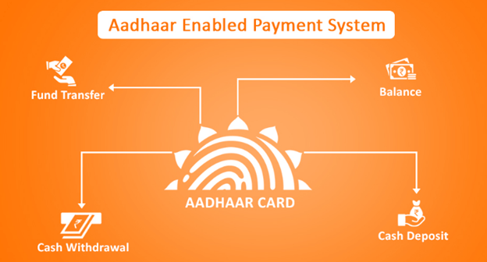
AEPS Transactions

Slide 42
Bharat QR
Person to Merchant (P2M) Mobile Payment solution.
Black squares arranged in a square grid on a white background.
Merchants need to display QR codes in their premises.
User can scan these QR using mobile phones.
https://www.npci.org.in/product-overview/bharatqr-product-overview

Slide 43
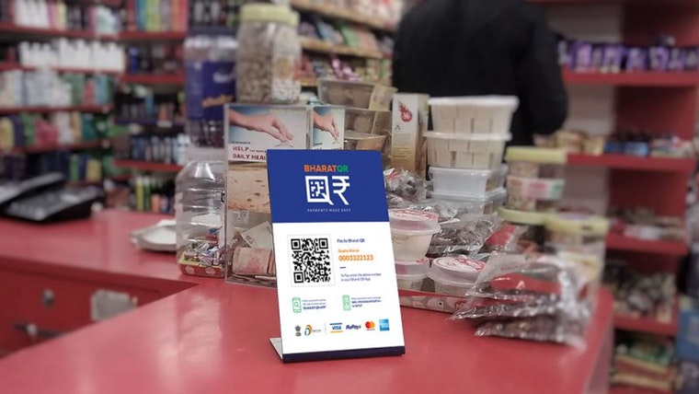
Bharat QR Grid

Slide 44
BHIM Aadhaar
Enables Merchants to receive digital payments from customers over the counter through Aadhaar Authentication.
Authenticating Customer’s Biometrics only.
Android mobile with BHIM Aadhaar app and certified biometric scanner attached with mobile phone/Kiosk/Tablet on USB Port or Micro-ATM/POS, mPOS.
Both Customer and Merchant should have their Aadhaar linked to their Bank Account.
Both Issuing and Acquiring Banks must be live on BHIM Aadhaar.
https://www.npci.org.in/product-overview/bhim-aadhaar

Slide 45
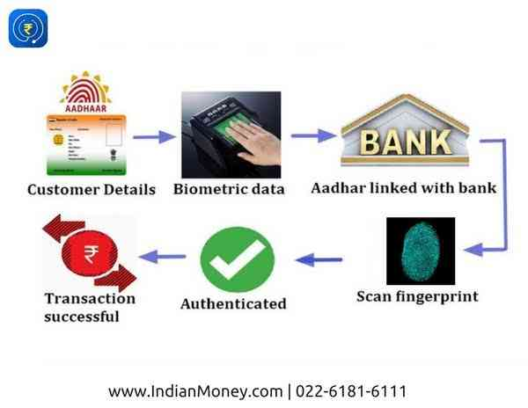
BHIM Aadhaar Flow

Slide 46
APBS – Aadhaar Payment Bridge System
Based on Aadhaar numbers issued by UIDAI & IIN (Institution Identification Number).
Transfer of Benefits and Subsidies.
Beneficiary is identified through an Aadhaar number only.
Aadhaar Mapper in which the Aadhaar number is mapped to a specific bank account.
Electronically channelizing the Government benefits and subsidies in the Aadhaar Enabled Bank Accounts (AEBA) of the intended beneficiaries.

Slide 47
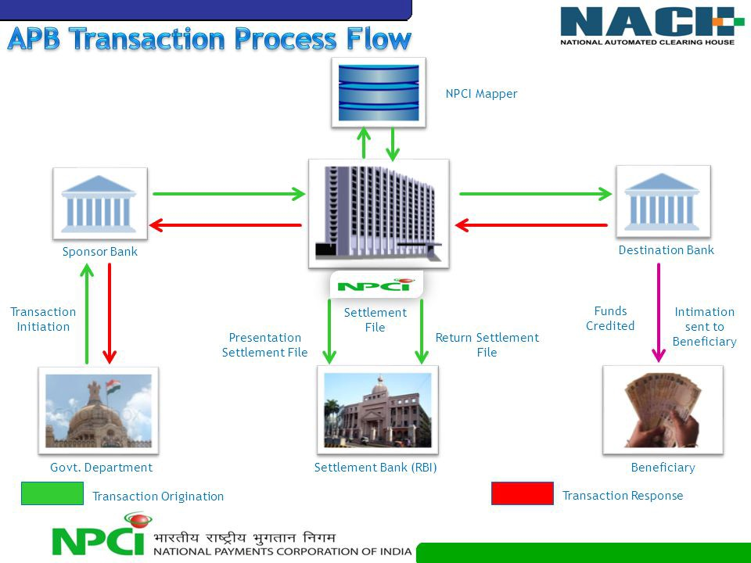
APBS Transaction Flow

Slide 48
NPCI PaySecure
Hosted by NPCI for RuPay cards for E-Commerce Transactions.
Is compliant to the RBI mandated 2-Factor authentication.
Uses dynamic One-time-Password as an additional factor of authentication for Rupay Cards.
PaySecure can be used at various internet accessible devices like Personal or Shared Computers.
Additional validation includes selecting an image and a phrase.

Slide 49
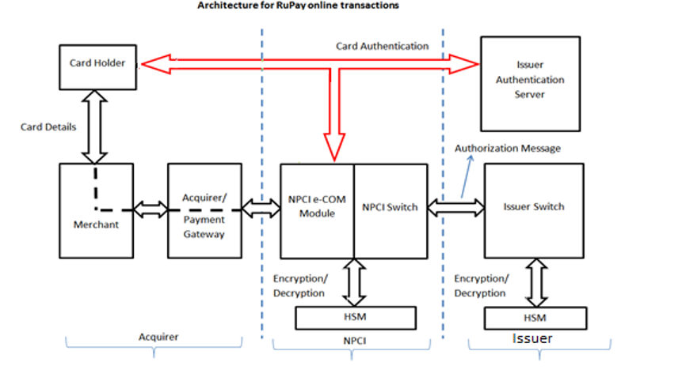
NPCI PaySecure - Architecture

Slide 50
NPCI – Blockchain Platform - Vajra
A Distributed Ledger Technology.
Promises to provide highly secure and tamper-evident transactions.
Stored in a distributed and immutable database.
Designed for automating payment clearing and settlement processes of NPCI products.
A permissioned network will be setup.
Only the parties who have been approved by the Network Administrator can be a part of the network.

Slide 51
Potential Benefits
Minimal reconciliation of transactions, higher resilience and efficiencies through automation and transparency.
Near real-time clearing and settlement.
Minimizing operations and ﬁnancial risks.
Economical, immutable, secure and easily accessible.
Provides a legitimate audit trail.
DLT is an incorruptible decentralized ledger that not only provides a transaction medium but also acts as a repository for all transactions in hashed digital packets called blocks. The availability of transaction in distributed ledger will reduce reconciliation steps and also increase transparency among participants.

Slide 52
Vajra Platform
The Vajra framework aims to derive advantage from the Blockchain framework to achieve the following goals:
Reduce manual processing, FTE for reconciliation.
Provides faster resolution for disputes.
Increase security of the payment transactions.

Slide 53
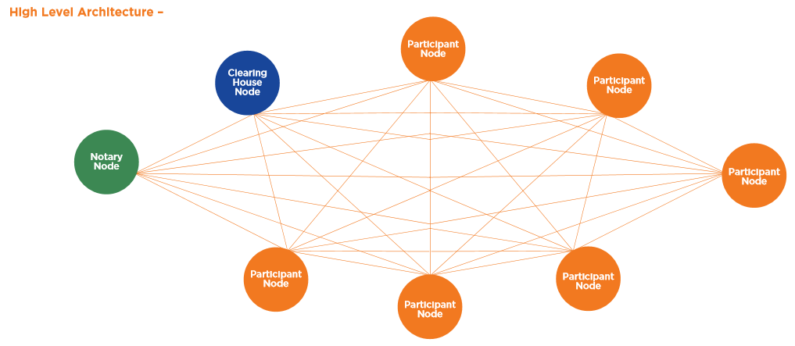
Architecture of Vajra

Slide 54
Real Time Gross Settlement
Inter-Institutional / Inter-Bank Transaction / Own Account Transfer / Customer Transaction
Multilateral Net Settlement Batch (MNSB)
Delivery versus Payment (DvP)
Return Payment Transaction
Unique Transaction Reference (UTR) / Transaction Identification Number
Message Standard – ISO 20022
Settlement

Slide 55
RTGS Events
Start of Day (SOD)
Open for Business (OFB)
Initial Cut-off (ICO)
Final Cut-off (FCO)
IDL Reversal Session
End of Day (EOD)

Slide 56
National Electronic Funds Transfer
Inter-Bank
Deferred Net Settlement
SFMS Platform – Structured Financial Messaging Solution
Batching of Payment Instructions
Multilateral Netting
NEFT Clearing Centre

Slide 57
NEFT Events
Request for NEFT by a Customer
Data Entry at the Sending Bank Branch
Processing / Data Upload at Sending NEFT Service Centre
Transmission / Submission of NEFT Message to the NEFT Clearing Centre
Processing and Transmission of NEFT Message to the Beneficiary Banks
Data Validation at the Receiving NEFT Service Centre
Payment to Beneficiary
Revocation of Payment Instruction
Acknowledgement / Positive Confirmation by the Beneficiary Bank and Return in Case of Non-Credit

Slide 58
Rahul Sridhar
Senior Business Analyst
rahul.sridhar@fisglobal.com

