Slide 1
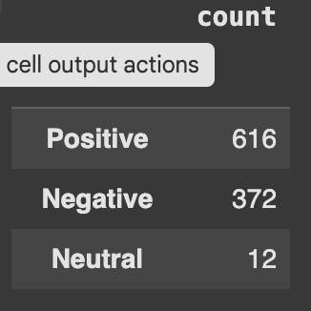
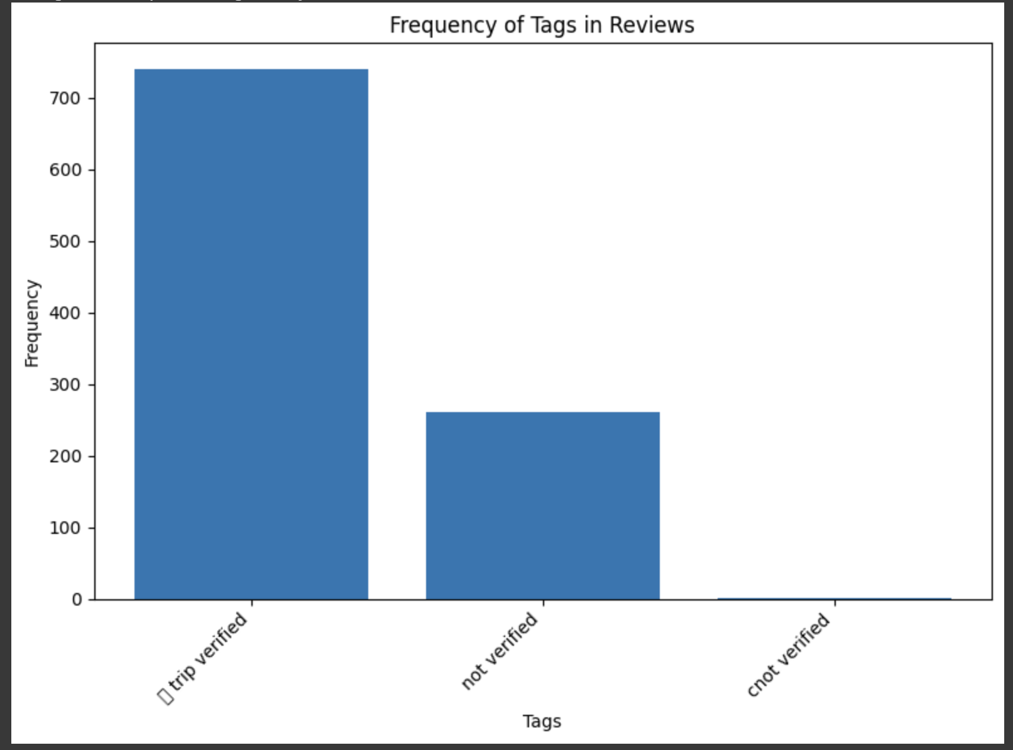
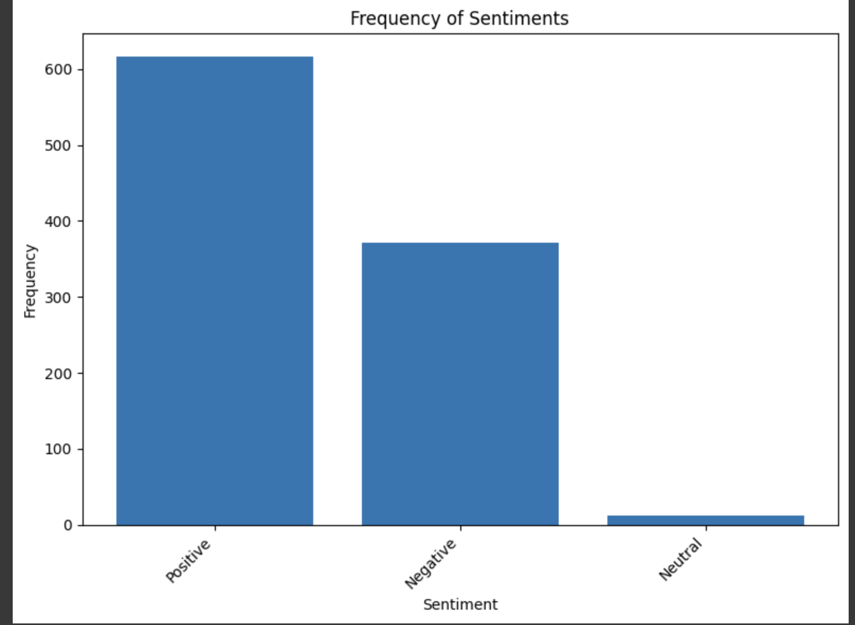
British Airways Customer Review analysis
Key Insights:
Trip Verified Reviews: More Trip Verified reviews compared to Non-Verified reviews.
Sentiment Distribution:
Positive Reviews outnumber Negative Reviews.
Neutral Reviews are significantly lower in number.

